Slide 1
Linear Regression Project-2

Slide 2
Objectives
Using simple linear regression:
Prediction of Salary hike using Years of Experience
To draw insights by performing EDA on the data
Model building and prediction
Business Impact

Slide 3
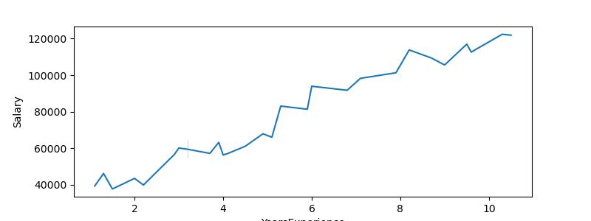
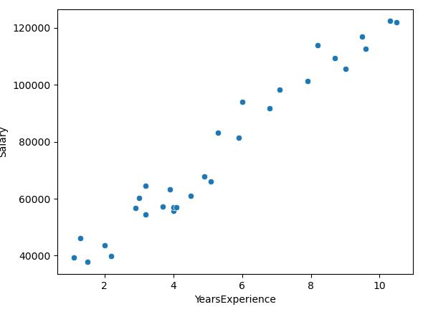
Project 2: Prediction of Salary Hike using Years of Experience
Exploratory Data Analysis on the data
(1)
(2)
YearsExperience
Figure 1 line plot between years of experience and salary hike. More is the experience more will be the salary hike.
Scatter plot in Figure 2, it can be concluded that hike in Salary does depend on the years of experience. More is the experience, more is the salary hike.
Although, It also depend on other parameters, can be the efficiency of the employee or other factors.

Slide 4
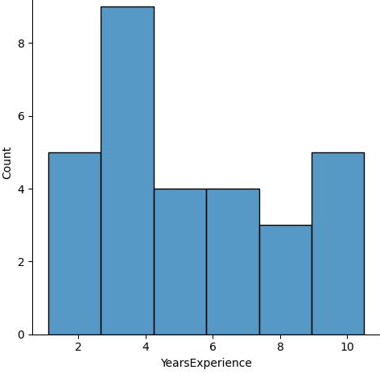
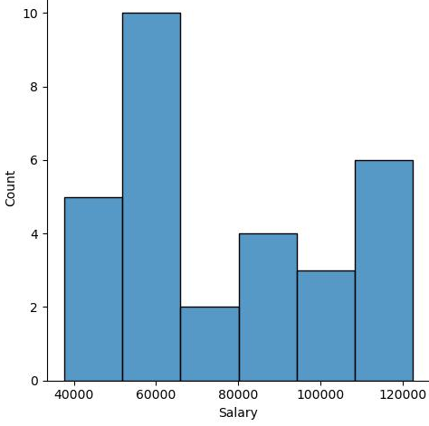
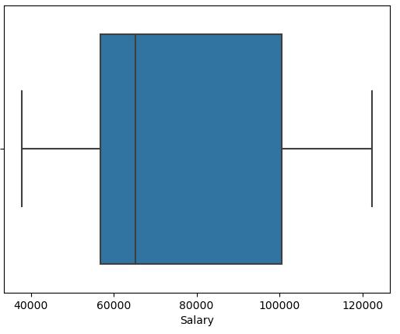
Figure 3 and 4 depicts that the distribution of years of experience and salary hike is normally distributed and the skewness lies between -1 and 1.
Skewness (Years of experience): 0.35
Skewness (Salary hike ):0.38
Box plot in Figure 5 depicts that there are no outliers present in the data.

Slide 5
Correlation
Both years of experience and salary hike are ~98% correlated, which is a strong correlation.
(correlation > 85%, is a strong correlation)
Co-efficient (m)
The co-efficient of the equation of fitted data came out to be 9299.55
Intercept (c)
The intercept of the equation of fitted data came out to be 26356.32
R square value
R_square value: 0.96
The strength of the model is strong since R square value lies between 0 and 1.
The model is strongest when approaches 1 and weakest when approaches 0.
The predicted values are very accurate and the fitted model is super strong.

Slide 6
Business Impact
Employee Retention: By providing fair and competitive salary hikes based on experience, company can improve employee satisfaction and retention. Contented employees are more likely to stay with the organization, reducing turnover costs.
Talent Attraction: Accurate salary predictions position us as an attractive employer in the job market. Potential candidates are more inclined to join an organization with transparent and data-driven compensation practices.
Employee Productivity: Satisfied employees who receive appropriate salary hikes tend to be more motivated and productive. This contributes to improved overall organizational performance.
Data-Driven HR Decisions: The success of the Linear Regression model reinforces the commitment to data-driven HR decisions. To explore additional predictive analytics and machine learning applications to improve various aspects of human resource management are encouraged.

Slide 7
Business Impact
Competitive Advantage: A fair and transparent compensation strategy gives the competitive edge in attracting and retaining top talent. It helps to stand out in the labor market.
Organizational Efficiency: With accurate salary predictions, HR teams can focus on strategic initiatives, talent development, and culture-building, rather than spending excessive time on compensation negotiations.
Employee Satisfaction and Morale: Fair and accurate compensation leads to higher employee morale and satisfaction, which positively impacts teamwork and the overall work environment.

