Slide 1
Chapter 3
Data Modeling Using the
Entity-Relationship Model
Chapter 3

Slide 2
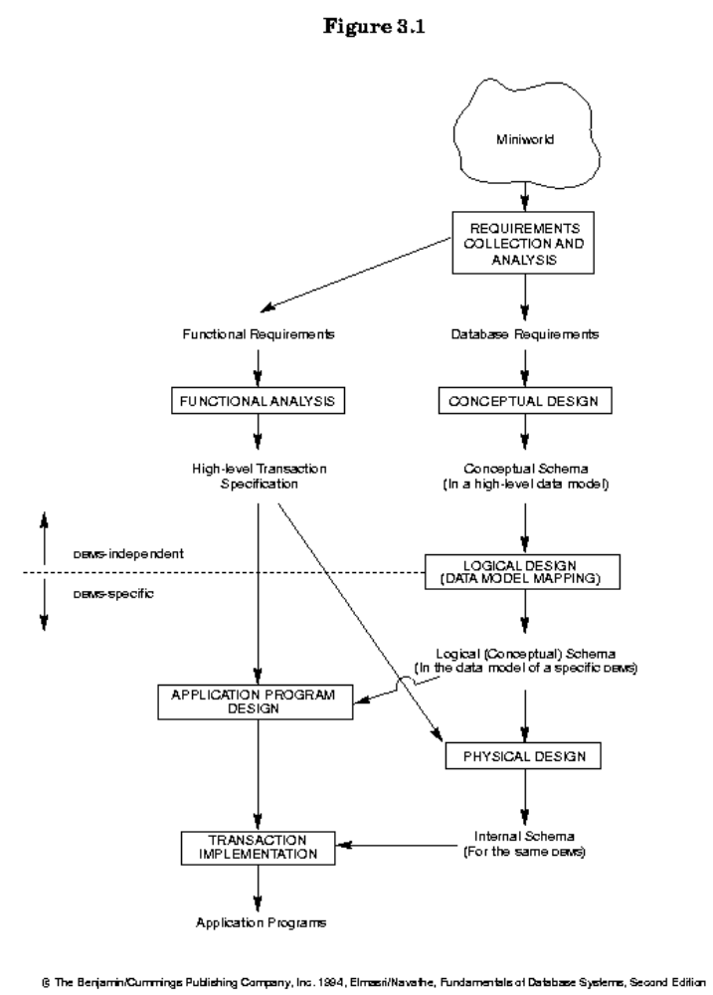
Chapter 3

Slide 3
Entity-Relationship(ER) Model
The ER model is a high-level conceptual data model. It has not been implemented in any commercial DBMS (?), but is a powerful short hand often used in database design for a first rendition of the miniworld.
The ER model was introduced by Peter Chen in 1976, and is now the most widely used conceptual data model.
Chapter 3

Slide 4
Entity-Relationship(ER) Model
(con’t)
Much work has been done on the ER model, and various extensions and enhancements have been proposed (see Ch. 21 and the text Conceptual Database Design by Batini/Ceri/Navathe, Benjamin Commings).
Chapter 3

Slide 5
Definitions
An entity is an object in the miniworld.
An attribute of an entity can have a value from a value set (domain)
Each entity belongs to some one entity type s.t. entities in one entity type have the same attributes (so each entity type is a set of similar entities).
Chapter 3

Slide 6
Definitions (con’t)
A key attribute of an entity type is one whose value uniquely identifies an entity of that type.
A combination of attributes may form a composite key.
If there is no applicable value for an attribute that attribute is set to a null value.
Chapter 3

Slide 7
Entity Type / Entity Set
Entity Type (Intension): EMPLOYEE
Attributes: Name, Age, Salary
Entity Set (Extension):
e₁ = (John Smith, 55, 80000)
e₂ = (Joe Doe, 40, 20000)
e₃ = (Jane Doe, 27, 30000)
.
.
.
Chapter 3
Notes:
Point out that each e are entity

Slide 8
Attributes
Attributes can be
  composite / simple (atomic)
  single-valued / multivalued
  stored / derived
  key / nonkey.
Chapter 3

Slide 9
Attribute Examples
Name = John Doe
Birthdate = May 10, 1989
Age = 9
Degree = null
SSN = 123456789
Name = John Doe
Birthdate = May 10
Birthyear = 1989
Age = 9
Degree = null
SSN = 123456789
Name = Jane Doe
Birthdate = July 11, 1960
Age = 38
Degree = B.S., M.S.
SSN = 987654321
Chapter 3
Notes:
Show examples of attribute types:
composite / simple (atomic)
single-valued / multivalued
stored / derived
key / nonkey.

Slide 10
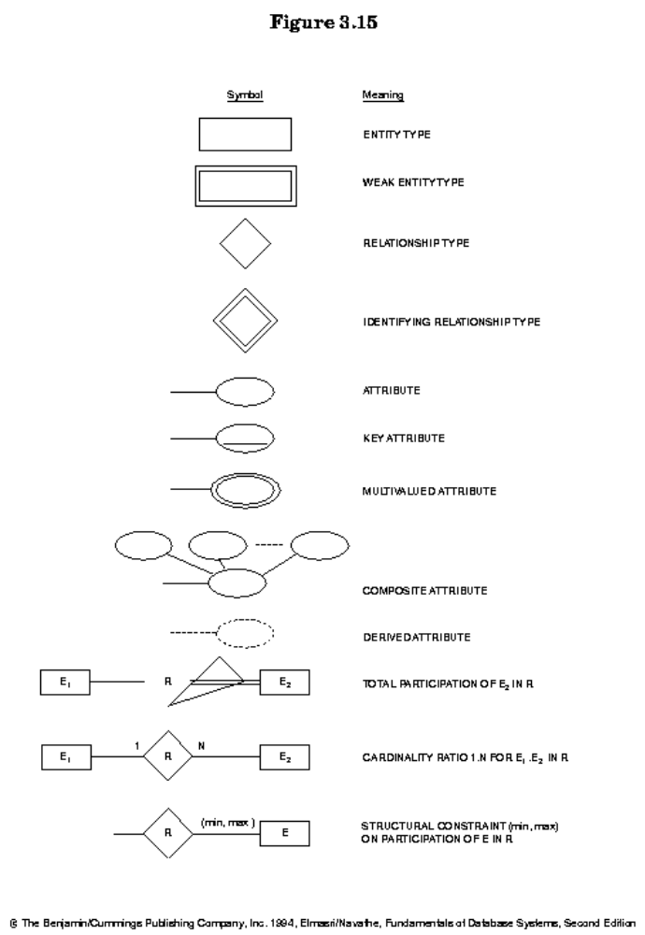
Chapter 3

Slide 11
EMPLOYEE
Name, SSN, Sex, Address, Salary, Birthdate, Department,
Supervisor, {Works on ( Project, Hours)}
WORKS_FOR
N
1
Name SSN . . .
EMPLOYEE
DEPARTMENT
Relationship instances of WORKS_FOR:
{(KV, CS), (Pan, EE), . . .}
Chapter 3

Slide 12
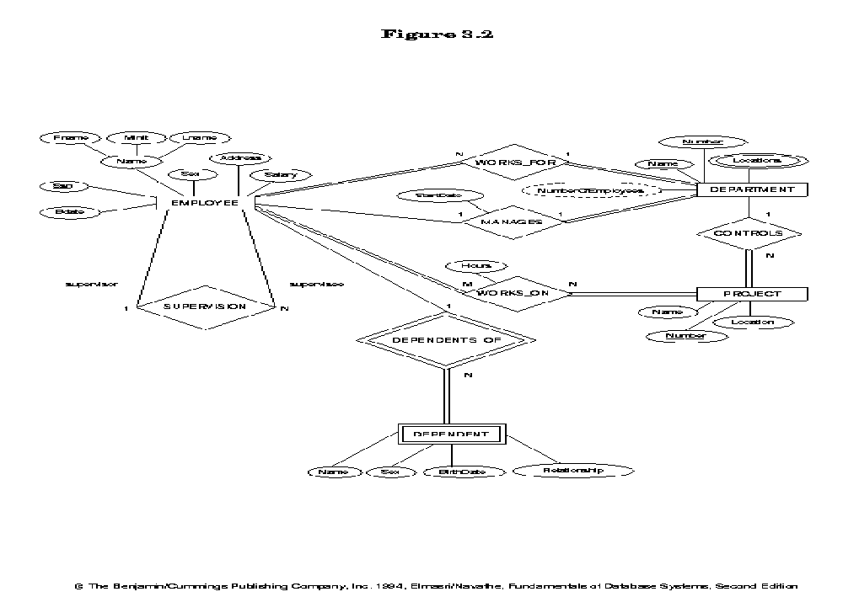
ER Diagram for COMPANY Database
Chapter 3
Notes:
Point out what each item is

Slide 13
Relationship Type
A relationship type R among n entity types E₁,…,E_{n} is a set of relationship instances r_{i}, where each r_{i} associates n entities (e₁,…,e_{n}), s.t. each e_{j} ∈ E_{j}. Informally, a relationship instance is an association of entities, with exactly one entity from each participating entity type.
Chapter 3

Slide 14
Relationship Type (con’t)
The degree n of a relationship type is the number of participating entity types.
In the ER model relationships are explicitly represented.
Chapter 3

Slide 15
Entity Roles
Each entity type in a relationship type plays a particular role that is described by a role name. Role names are especially important in recursive relationship types where the same entity participates in more than one role:
Employee
Supervisor 1
N Supervisee
Supervision
Chapter 3

Slide 16
Weak Entity Type
A weak entity type is one without any key attributes of its own. Entities belonging to a weak entity type are identified by being related to another entity type ( called identifying owner) through a relationship type ( called identifying relationship), in combination with values of a set of its own attributes (called partial key). A weak entity type has total participation constraint w.r.t. its identifying relationship.
Chapter 3

Slide 17
Relationship Attributes
Relationship types can have attributes as well. in case of 1:1 or 1:N relationships, attributes can be migrated to one of the participating entity types.
Chapter 3

Slide 18
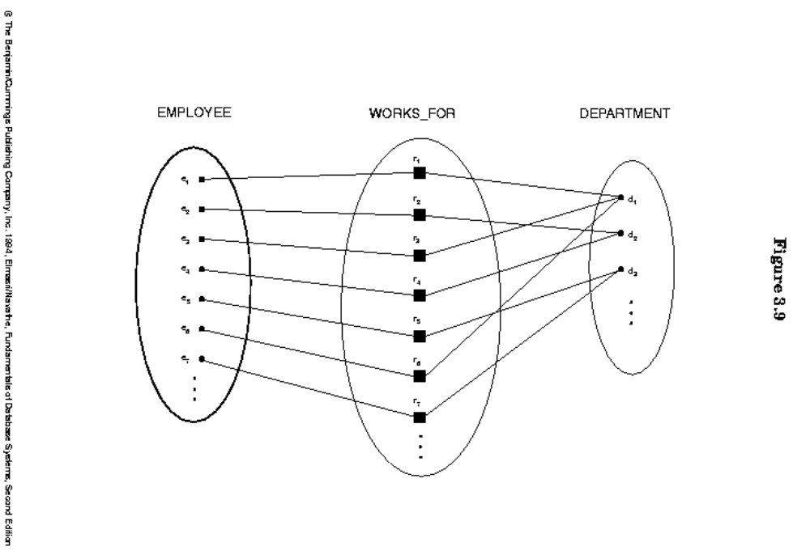
Relationship
Chapter 3

Slide 19
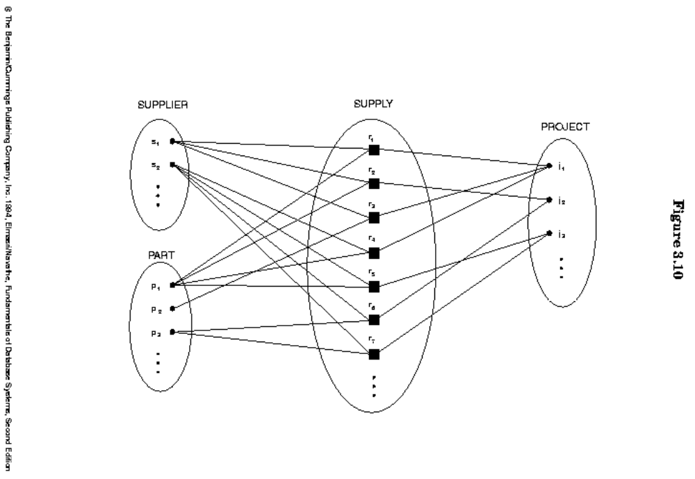
Relationship (con’t)
Chapter 3

Slide 20
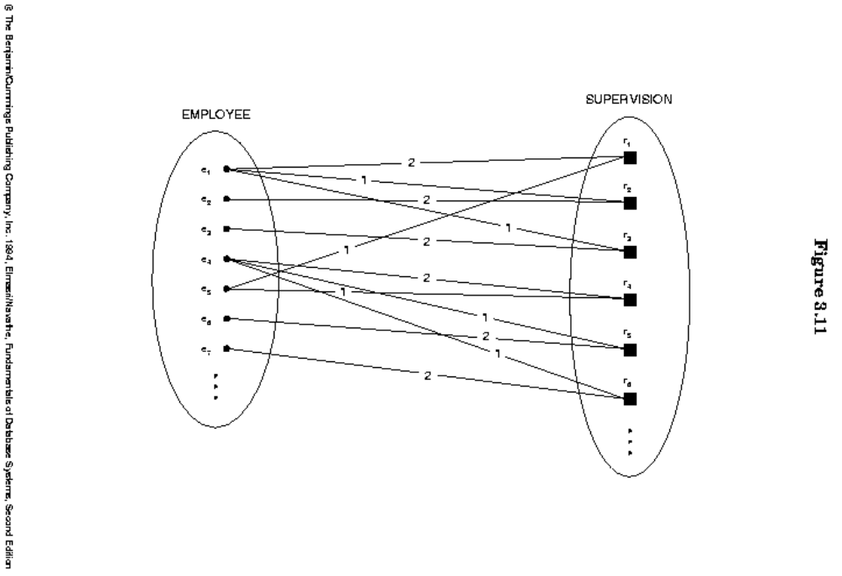
Relationship (con’t)
Chapter 3

Slide 21
Fig 3.12
Chapter 3

Slide 22
Fig 3.13
Chapter 3

Slide 23
Structural Constraints
Structural constraints of a relationship type:
  Cardinality ratio: Limits the number of relationship instances an entity can participate in, eg. 1:1, 1:N, M:N
  Participation constraint: If each entity of an entity type is required to participate in some instance of a relationship type, then that participation is total; otherwise, it is partial.
Chapter 3

Slide 24
Structural Constraint Min, Max
A more complete specification of the structural constraint on a relationship type can be given by the integer pair (min, max), which means an entity must participate in at least min and at most max relationship instances.
Chapter 3

Slide 25
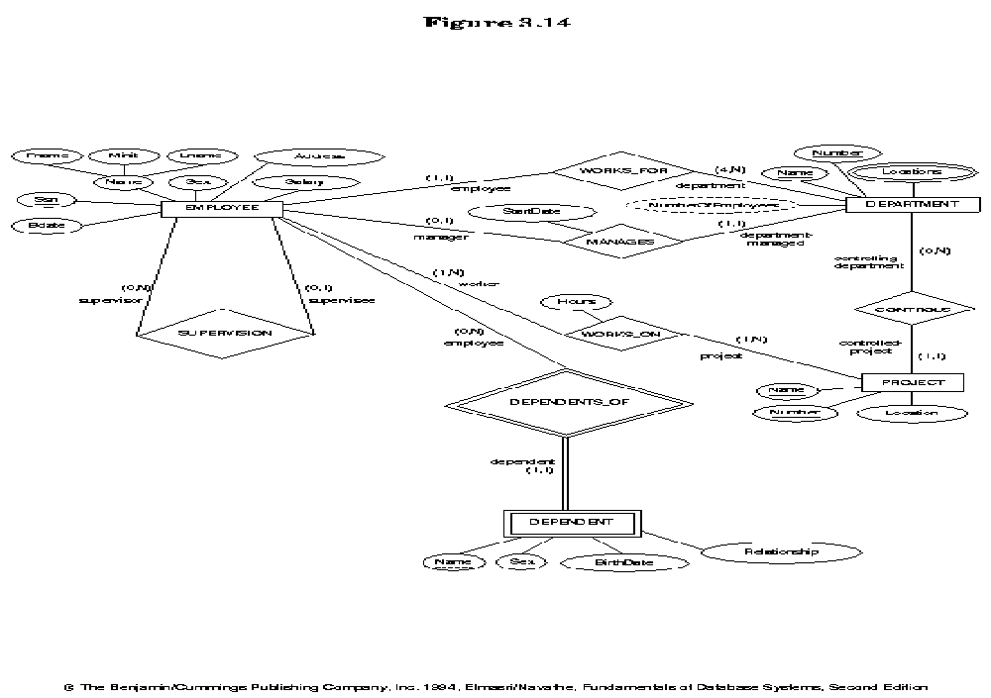
Chapter 3

Slide 26
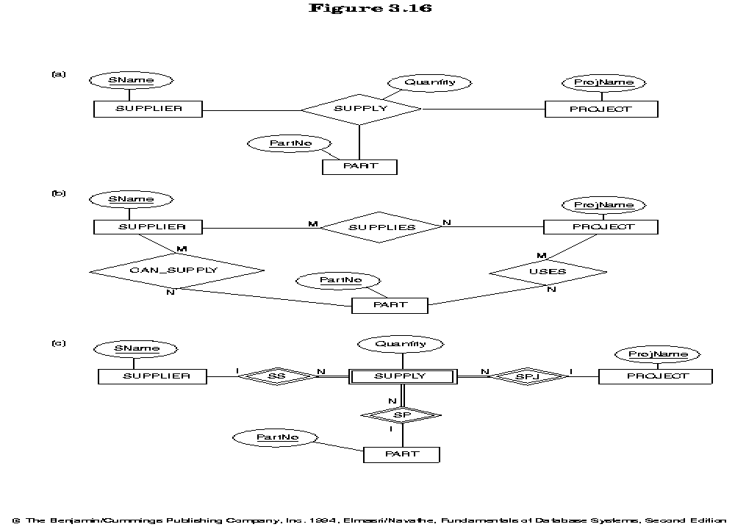
A ternary relationship generally represents more information than 3 binary relationships
Chapter 3
Notes:
Prepare a discussion

Slide 27
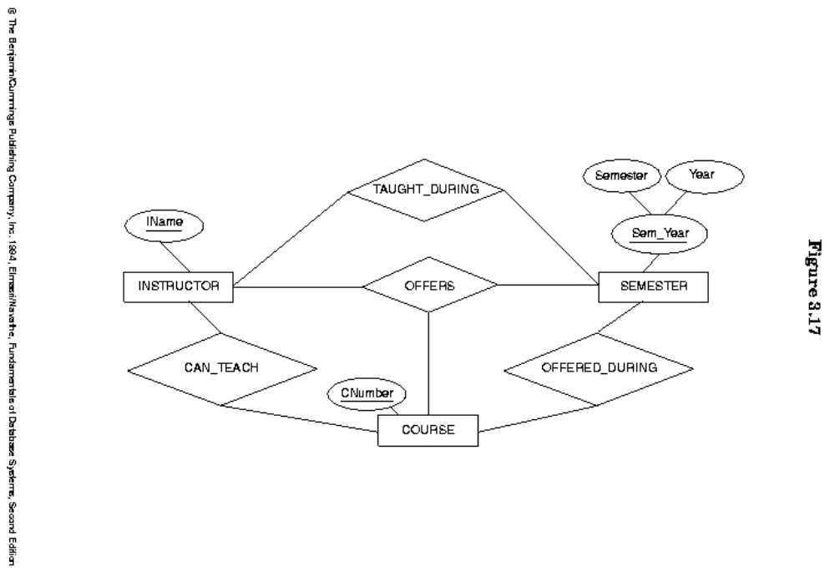
Chapter 3
Notes:
Consider is can teach 1:1

Slide 28
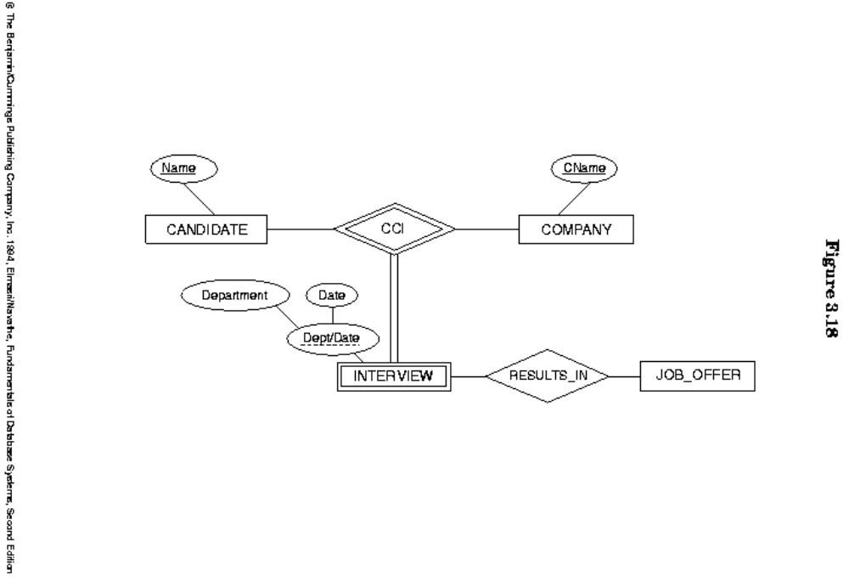
A Weak Entity with a Ternary Identifying Relationship
Chapter 3
Notes:
Compare with weak entity with multiple identifying relationships

