Slide 1
Advanced Programming
Lab 11, dynamic memory in classes
廖琪梅，王大兴，于仕琪，王薇

Slide 2
Topic
Dynamic Memory in classes of C++
Constructor, destructor, copy constructor and assignment operator
Hard copy vs Soft copy
Smart pointers
Unique pointer
Shared pointer
Dynamic Memory allocation in Python
reference counting and garbage collection
reference counting and weak reference
Exercises

Slide 3
Four important member functions
To define a class containing a pointer member, you should think more carefully about
four things: constructor, destructor, copy constructor and assignment operator.
In constructor, first, use new to allocate enough memory to hold the data where the
pointer points to. Second, initialize the storage space with proper data.
In destructor, release the memory using delete.
With copy operations(copy constructor and assignment operator), we have two choices:
one is hard copy(deep copy) and another is soft copy(shallow copy).

Slide 4
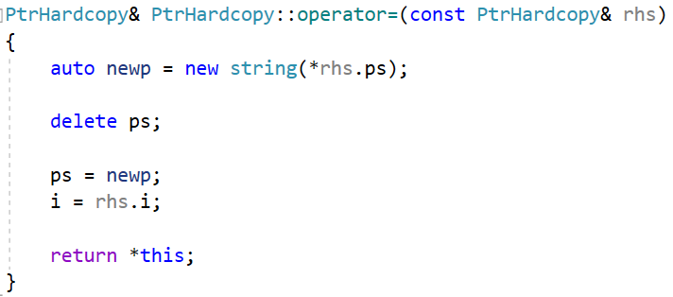
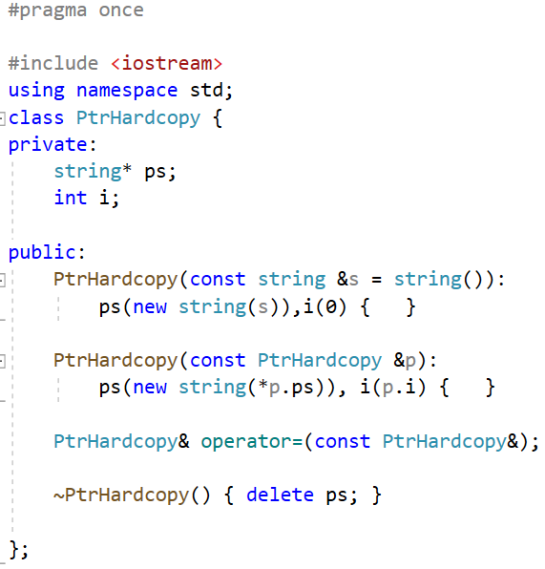
Hard copy
Assignment operators typically combine the actions of the destructor and the copy constructor. Like the destructor, assignment destroys the left-hand operand’s resources. Like the copy constructor, assignment copies data from the right-hand operand.
Self-assignment(an object is assigned to itself) must be considered.
Constructor by initialization list, it dynamically allocates its own copy of that string and stores a pointer to that string in ps.
Copy constructor by initialization list, it also allocates its own, separate copy of the string.
Destructor frees the memory allocated in its constructors by executing
delete on the pointer member, ps.

Slide 5
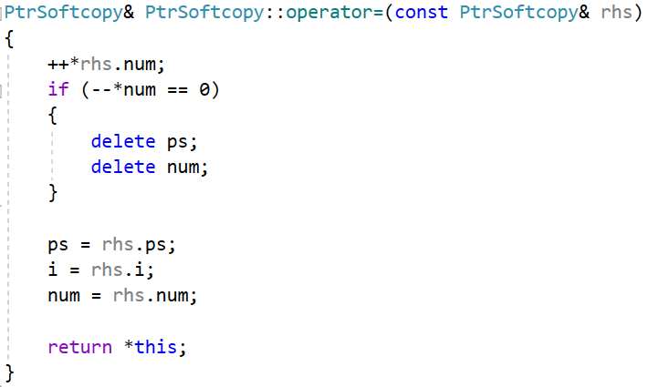
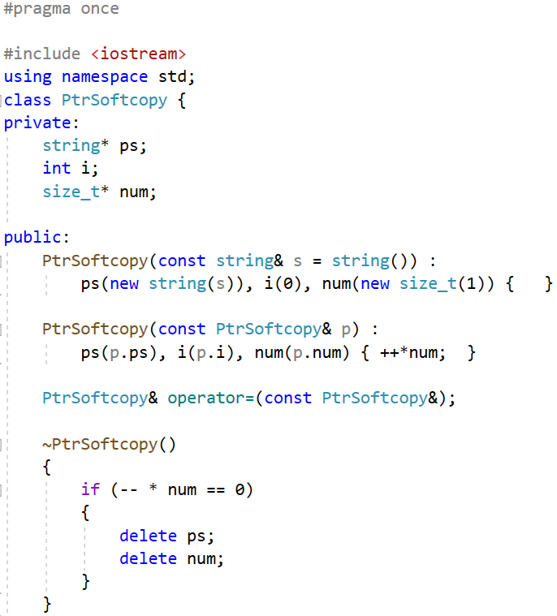

Soft copy
The assignment operator must increment the counter of the right-hand operand and decrement the counter of the left-hand operand, deleting the memory used if appropriate. Also, as usual, the operator must handle self-assignment.
add a new data member named num that will keep track of how many objects share the same string.
The constructor that takes a string allocates this counter and initializes it to 1, indicating that there is one user of this object’s string member.
The copy constructor copies all three members from its given PtrSoftcopy. This constructor also increments the num member, indicating that there is another user for the string to which ps and p.ps point.
The destructor cannot unconditionally delete ps—there might be other objects pointing to that memory. Instead, the destructor decrements the reference count, indicating that one less object shares the string. If the counter goes to zero, then the destructor frees the memory to which both ps and num point.

Slide 6
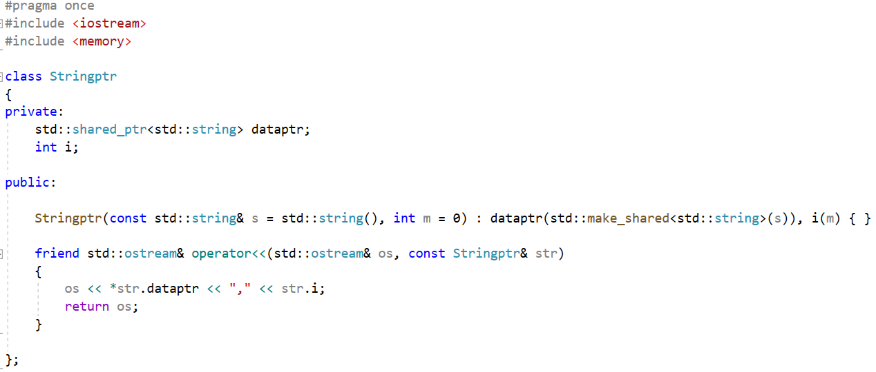
A smart pointer as a data member
Define a smart pointer as a data member
Initialization list is used. Do not use assignment statement for smart pointer in constructor.

Slide 7
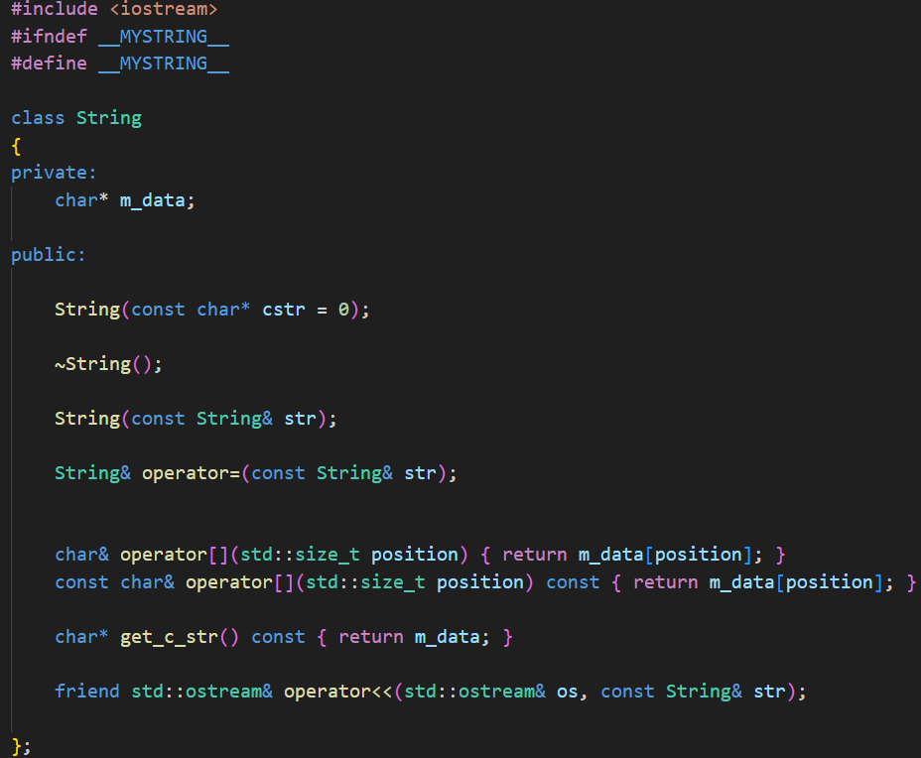
[ ] operator (array subscript operator)
User-defined classes that provide array-like access that allows both reading and writing(modifying)
typically define two overloads for operator[]: const and non-const variants.
Usually, we overload [] operator with two versions,
const version for reading(rvalue) and non-const version for writing(lvalue).

Slide 8
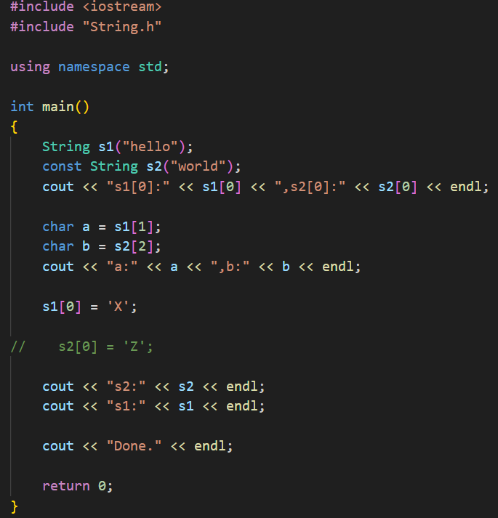
For non-const or const string, reading
its value is allowed by its corresponding
[] operator function respectively.
For non-const string, you can modify its
value by non-const [] operator function
For const string, you can not modify its
value by const [] operator function.
Note: Neither version of the [] operator function can match both non-const string and const string.

Slide 9
A copy constructor is usually called in the following situations:
1. When a class object is returned by value.
2. When an object is passed to a function as an argument and is passed by value.
3. When an object is constructed from another object of the same class.
4. When a temporary object is generated by the compiler.
The following four definitions(constructing an object from another object) invoke a copy constructor:
Complex c1 (c2);
Complex c3 = c1;
Complex c4 = Complex(c1);
Complex *pc = new Complex(c1);
This statement initializes a anonymous object to c1 and assigns the address of the new object t the pc pointer.

Slide 10
Smart pointers
To make using dynamic memory easier (and safer), the C++ new library provides two
smart pointer types(smart pointer template classes)unique_ptr and shared_ptr that
manage dynamic objects.
A smart pointer acts like a regular pointer with the important exception that it
automatically deletes the object to which it points. A smart pointer is a class template defined in the std namespace in the <memory> header file.
Each of these classes has an explicit constructor taking a pointer as an argument. Thus, there is no automatic type cast from a pointer to a smart pointer object.

Slide 11
Unique pointer
The unique_ptr<> template holds a pointer to an object and deletes this object when the unique_ptr<> is deleted.
Make sure that only exactly one copy of an object exists. Assignment operation of two unique_ptr<> is not allowed. However, it supports move semantics, where the pointer is moved from one unique_ptr<> to another.
A unique pointer can be initialized with a pointer upon creation.

Slide 12
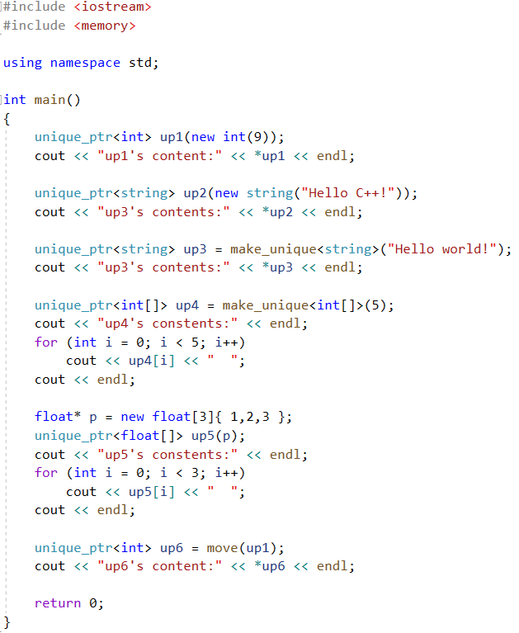
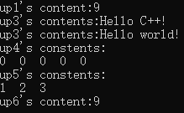
Use new operator or make_unique() function
to create unique_ptr. make_unique() is
recommended.
You can use a pointer to initialize a unique_ptr
Use the move function to transfer the ownership from up1 to up6.
Is the assignment statement unique_ptr<int> up6 = up1; OK? Why?
Is there any memory leak problem in the program?
Need we use the statement delete[] p; to free the memory
we allocated before?

Slide 13
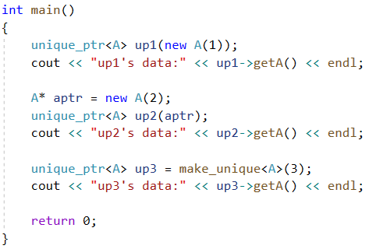
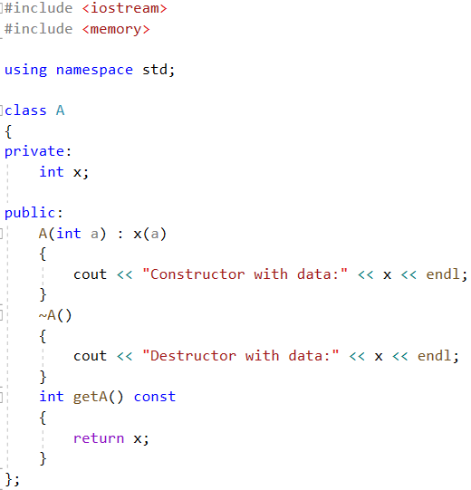
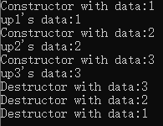
You can create unique_ptr by
user-define type.

Slide 14
Shared pointer
More than one pointer can point to one object.
After you initialize a shared_ptr<>, you can copy it, pass it by value in function arguments, and assign it to other shard_ptr<> instances.
The shared pointer maintains a Ref_count that is a reference counter.
If the last pointer is released, the dynamic memory is released.
We can know the value of Ref_count by using the use_count() function.

Slide 15
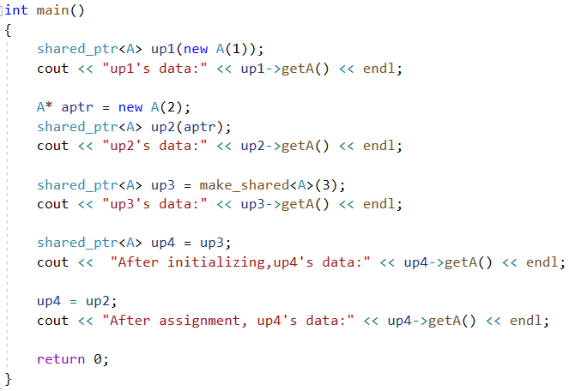
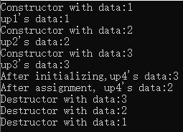
Use new operator or make_shared() function
to create shared_ptr. make_shared() is
recommended.

Slide 16
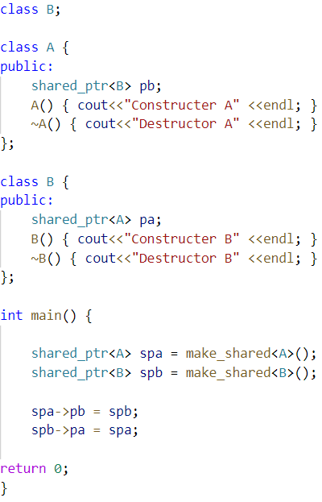

Does shared pointer always releases memory? Can we do this?
Only constructer invoked,
No Destructor invoked.

Slide 17
Dynamic Memory Allocation in Python
‌Python dynamically allocates and manages memory during program runtime, with objects (such as lists, dictionaries, strings, etc.) allocated on demand in the heap without the need for developers to explicitly request or release memory.
Implementation method:
When an object is created (such as a=[1,2]), the Python interpreter requests a memory block from the operating system and binds it to a variable reference.
Memory release is automatically triggered by reference counting and garbage collection mechanisms, without the need for manual intervention.

Slide 18

Reference Count(1)
All variables in Python are essentially references to objects. Each object has a built-in counter (ref_count) that records the current number of references. When the reference returns to zero, the memory will be released.
#demo1
import sys
class MyClass:
def __init__(self, name):
self.name=name
print(f"object {self.name} created")
a=MyClass("A")
print(a)
print(sys.getrefcount(a)-1)
del a
try:
print(a)
except NameError:
print("object is released")
Statement “del”: Its core function is to delete references to variables or objects, thereby reducing the reference count of objects.
Function “getrefcount” is in the Python standard library's sys module that returns the current reference count of a specified object, NOTEs:Return value 1 more than actual value: When calling sys. getrefcount (obj), the function parameter obj generates a temporary reference, causing the return value to be 1 more than the actual reference count.

Slide 19
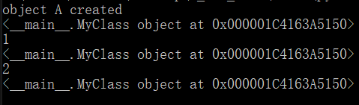
Reference Count(2)
When the reference returns to zero, the memory is immediately released, otherwise the memory is not released.
#demo2
import sys
class MyClass:
def __init__(self, name):
self.name=name
print(f"object {self.name} created")
a=MyClass("A")
print(a)
print(sys.getrefcount(a)-1)
b=a
print(b)
print(sys.getrefcount(a)-1)
del b
try:
print(a)
except NameError:
print("object is released")

Slide 20
circular references(1)
circular references：A closed-loop dependency relationship is formed between two or more objects through mutual reference. Specifically, object A references object B, which in turn directly or indirectly references object A, resulting in the entire reference chain forming a circular structure.
The harm caused by circular references: Causing memory leakage.
# NOT circular references
import sys
class Node:
def __init__(self, value):
self.value=value
self.next=None
a=Node(10)
b=Node(100)
c=Node(10.1)
d=Node(100.1)
a.next=c
b.next=d
print(sys.getrefcount(a)-1)
print(sys.getrefcount(b)-1)
# circular references
import sys
class Node:
def __init__(self, value):
self.value=value
self.next=None
a=Node(10)
b=Node(100)
a.next=b
b.next=a
print(sys.getrefcount(a)-1)
print(sys.getrefcount(b)-1)

Slide 21
circular references(2)
Solution1: Garbage Collection (GC)
Dealing with scenarios where reference counting cannot be resolved, such as circular references, by regularly scanning and releasing unreachable objects through tagging clearing algorithms and generational recycling strategies.
Solution2: Weak References (suggested)
import weakref
import sys
classNode:
def __init__(self, value):
self.value=value
self.next=None
a=Node(10)
b=Node(100)
a.next=weakref.ref(b)
b.next=weakref.ref(a)
#circular reference
#solution 1: using gc
import gc
import sys
class Node:
def __init__(self, value):
self.value=value
self.next=None
a=Node(10)
b=Node(100)
a.next=b
b.next=a
gc.collect()
Disadvantage of mandatory garbage collection:
1)The tag clear algorithm requires traversal of all objects for reachability analysis, causing program execution to pause;
2)Frequent calls will exacerbate performance degradation

Slide 22
Exercise:
#include <iostream>
#include <memory>
using namespace std;
int main()
{
double *p_reg = new double(5);
shared_ptr<double> pd;
pd = p_reg;
pd = shared_ptr<double>(p_reg);
cout << "*pd = " << *pd << endl;
shared_ptr<double> pshared = p_reg;
shared_ptr<double> pshared(p_reg);
cout << "*pshred = " << *pshared << endl;
string str("Hello World!");
shared_ptr<string> pstr(&str);
cout << "*pstr = " << *pstr << endl;
return 0;
}
1. Could the program be compiled successfully? Why? Modify the program until it passes the compilation. Then run the program. What will happen? Explain the result to the SA.

Slide 23
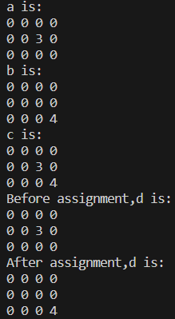
Exercise:
2. Create a class Matrix to describe a matrix. The element type is float. One member of the class is a pointer(or a smart pointer) who points to the matrix data.
The two matrices can share the same data through a copy constructor or a copy assignment.
The following code can run smoothly without memory problems.
class Matrix{...};
Matrix a(3,4);
Matrix b(3,4);
Matrix c = a + b;
Matrix d = a;
d = b;

Slide 24
Exercise:
3.Is there a solution in C++ similar with the weak reference (weakref) solution in Python, specifically designed to solve the memory leak issue caused by shared_ptr circular reference?
If the answer is YES, please try using this solution to solve the problem on Page 16.

