Slide 1
Advanced Programming
CS205
Prof. Shiqi Yu (于仕琪)
yusq@sustech.edu.cn
http://faculty.sustech.edu.cn/yusq/

Slide 2
Improve Your Source Code

Slide 3
Suggestions to your Project 3
Use size_t for mat.cols and mat.rows
Use memcpy() to copy data. Element assignment has a lower efficiency.
Use 1D array (float*) nor 2D array (float**) for matrix data.
Redundant computation in loops
Do parameter checking in functions: null pointers, dimension matching in matrix operations, etc.
Do not bind the create matrix function with file I/O.
File name: 1.c, 2.c, 3.h
Good implementation VS good homework.
matrix/

Slide 4
Derived Classes

Slide 5
Inheritance
Inherit members (attributes and functions) from one class
Base class (parent)
Derived class (child)
C++ supports multiple inheritance and multilevel inheritance
class Derived: public Base1, public Base2
{
...
};
class Base
{
public:
int a;
int b;
};
class Derived: public Base
{
public:
int c;
};

Slide 6
Constructors
To instantiate a derived class object
Allocate memory
Derived constructor is invoked
Base object is constructed by a base constructor
Member initializer list initializes members
To execute the body of the derived constructor
class Derived: public Base
{
public:
int c;
Derived(int c): Base(c - 2, c - 1), c(c)
{
...
}
};

Slide 7
Destructors
The destructor of the derived class is invoked first,
Then the destructor of the base class.
derive.cpp

Slide 8
Access Control

Slide 9
Member Access
Public members
Accessible anywhere
Private members
Only accessible to the members and friends of that class
class Person {
private:
int n; // private member
public:
// this->n is accessible
Person() : n(10) {}
// other.n is accessible
Person(const Person& other) : n(other.n) {}
// this->n is accessible
void set(int n) {this->n = n;}
// this->n and other.n are accessible
void set(const Person& other) {this->n = other.n;}
};

Slide 10
Member Access
// a non-member non-friend function
void compare(Base& b, Derived& d)
{
// b.n++; // Error
// d.n++; // Error
}
Protected members
Accessible to the members and friends of that class
Accessible to the members and friends of the derived class
class Base
{
protected:
int n;
private:
void foo1(Base& b)
{
n++; // Okay
b.n++; // Okay
}
};
class Derived : public Base
{
void foo2(Base& b, Derived& d)
{
n++; //Okay
this->n++; //Okay
//b.n++; //Error.
d.n++; //Okay
}
};

Slide 11
Public Inheritance
Public members of the base class
Still be public in the derived class
Accessible anywhere
Protected members of the base class
Still be protected in the derived class
Accessible in the derived class only
Private members of the base class
Not accessible in the derived class
class Derived : public Base
{
...
}

Slide 12
Protected Inheritance
Public members and protected members of the base class
Be protected in the derived class
Accessible in the derived class only
Private members of the base class
Not accessible in the derived class
class Derived : protect Base
{
...
}

Slide 13
Private Inheritance
Public members and protected members of the base class
Be private in the derived class
Accessible in the derived class only
Private members of the base class
Not accessible in the derived class
class Derived : private Base
{
...
}

Slide 14
Virtual Functions

Slide 15
Virtual Functions
Let’s look at the example first, what will be the output?
class Person
{
public:
void print()
{
cout << "Name: " << name << endl;
}
};
class Student: public Person
{
public:
void print()
{
cout << "Name: " << name;
cout << ". ID: " << id << endl;
}
};
Person * p = new Student();
p->print(); // call Person::print()?
virtual.cpp

Slide 16
Virtual Functions
But if we define print() function as a virtual function, the output will be different.
Static binding: the compiler decides which function to call
Dynamic binding: the called function is decided at runtime.
Keyword virtual makes the function virtual for the base and all derived classes.

Slide 17
Virtual Destructors
If a destructor is not virtual, only the destructor of the base class is executed in the follow examples.
Person * p = new Student("xue", "2020");
p->print();
...
...
delete p; //if its destructor is not virtual

Slide 18
Inheritance and Dynamic Memory Allocation

Slide 19
Question
If a base class uses dynamic memory allocation, and redefines a copy constructor and assignment operator
Case 1: If no dynamic memory allocation in the derived class, no special operations are needed
Case 2: if dynamic memory is allocated in the derived class, you should redefine a copy constructor and an assignment operator.

Slide 20
Case 2
class MyMap: pubic MyString
{
char * keyname;
public:
MyMap(const char * key, const char * value)
{
...
}
MyMap(const MyMap & mm): MyString(mm.buf_len, mm.characters)
{
//allocate memory for keyname
//and hard copy from mm to *this
}
MyMap & operator=(const MyMap &mm)
{
MyString::operator=(mm);
//allocate memory for keyname
//and hard copy from mm to *this
return *this;
}
};

Slide 21
Examples in OpenCV

Slide 22
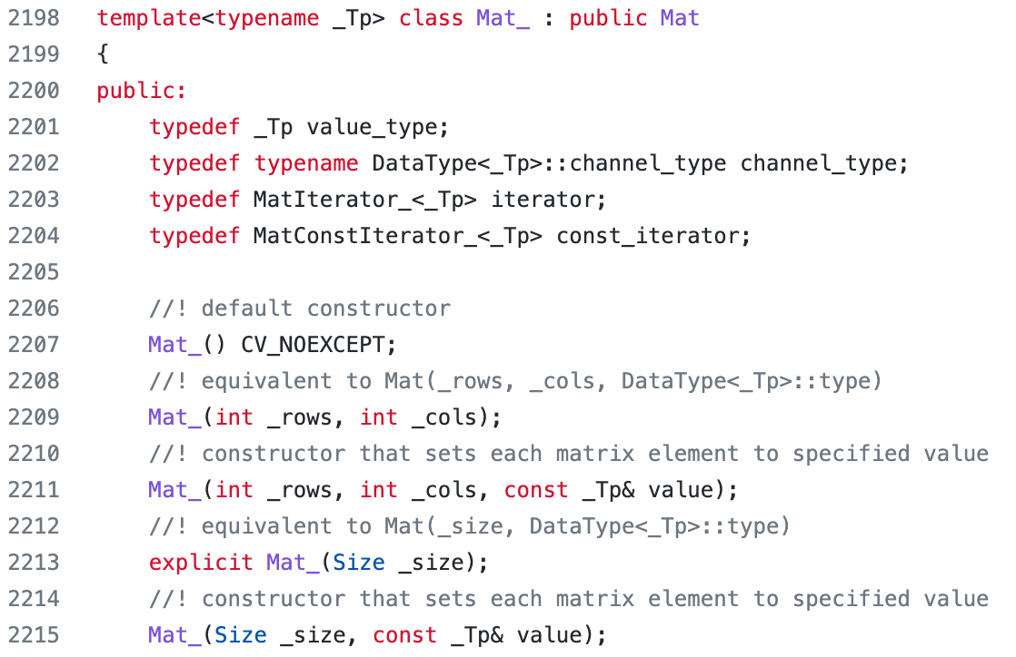
Derived cv::Mat_
Template matrix class derived from cv::Mat, a wrapper, more C++ style.
modules/core/include/opencv2/core/mat.hpp

Slide 23
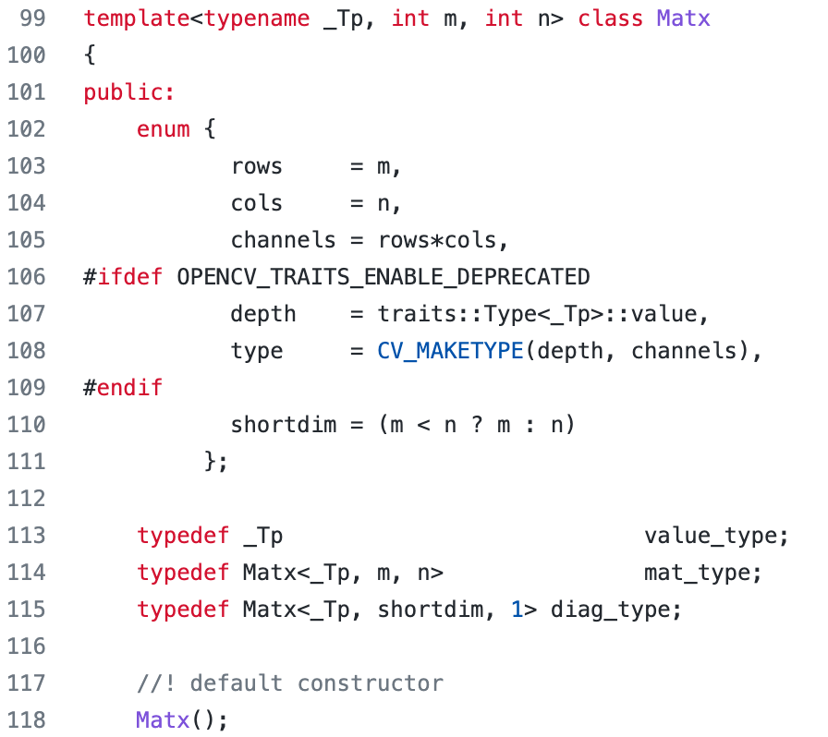
cv::Matx
A template class for small matrices whose type and size are known at compilation time.
modules/core/include/opencv2/core/matx.hpp

Slide 24
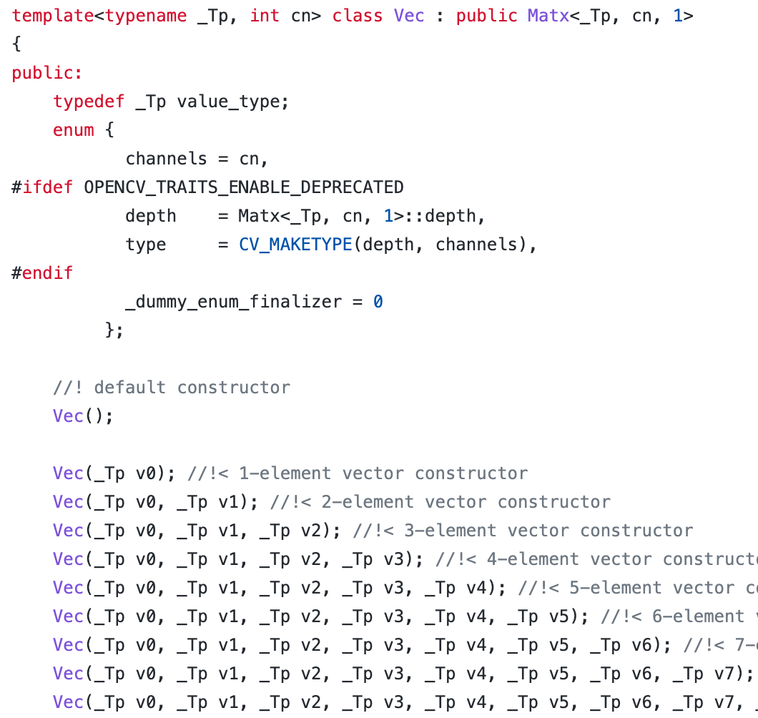
cv::Vec
modules/core/include/opencv2/core/matx.hpp
Vec<float, 3> xyz(1.2f, 2.3f, 3.4f);

Slide 25
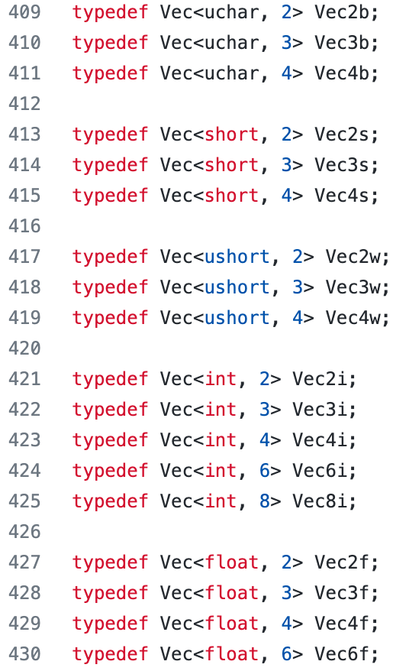
Combined with typedef
modules/core/include/opencv2/core/matx.hpp
Vec<float, 3> xyz(1.2f, 2.3f, 3.4f);
Vec3f xyz(1.2f, 2.3f, 3.4f);

Slide 26
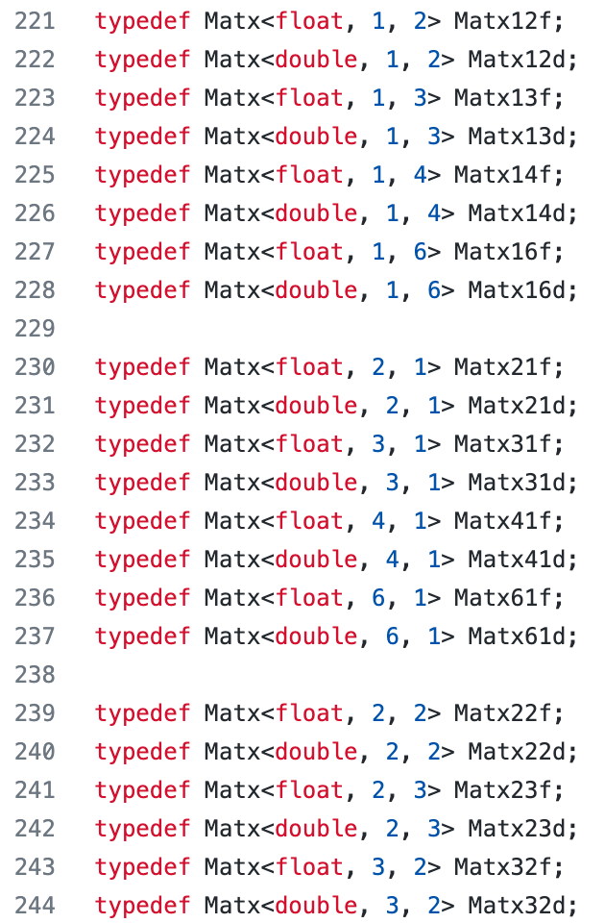
Combined with typedef
Matx33f m(1, 2, 3,
4, 5, 6,
7, 8, 9);
cout << sum(Mat(m*m.t())) << endl;

