Slide 1
Advanced Programming
Lab 2, data types and arithmetic operators in C/C++
廖琪梅，于仕琪，王大兴, 王薇

Slide 2
Topics
1. Formatting with cout
1.1 Using member functions of ios class
1.2 Using iomanip manipulators
2. Debug C/C++ by using gdb in VScode
3. Data type conversions and calculations
data storage, integer vs float
Integer promotions of Implicit conversions
4. Practices
data types and arithmetic operators

Slide 3
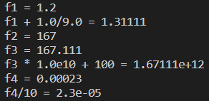
1. Formatting with cout
Floating-point types are displayed with a total of six digits, except that trailing zeros aren’t displayed. The float number is displayed in fixed-point notation or else in E notation depending on the value of the number. In particular, E notation is used if the exponent is 6 or larger or -5 or smaller.
int main()
{
double f1 = 1.200;
std::cout << "f1 = " << f1 << std::endl;
std::cout << "f1 + 1.0/9.0 = " << f1 + 1.0/9.0 << std::endl;
double f2 = 1.67E2;
std::cout << "f2 = " << f2 << std::endl;
double f3 = f2 + 1.0/9.0;
std::cout << "f3 = " << f3 << std::endl;
std::cout << "f3 * 1.0e10 + 100 = " << f3 * 1.0e10 + 100 << std::endl;
double f4 = 2.3e-4;
std::cout << "f4 = " << f4 << std::endl;
std::cout << "f4/10 = " << f4/10 << std::endl;
return 0;
}
Notes:
exponent 指数
科学计数法一般用于指数大于等于6或者小于等于-5的情况
图中示例是c++，c语言里也如此吗

Slide 4
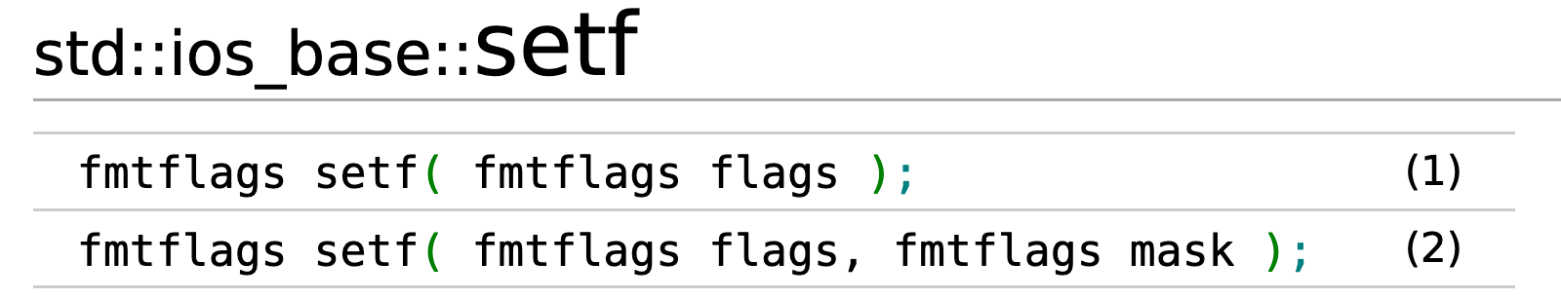
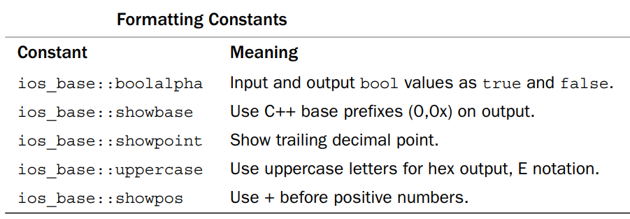
C++ provides two methods to control the output formats
1.1 Using member functions of ios class
1.2 Using iomanip manipulators
1.1 Using member functions of ios class
1.1.1 cout.setf(): The setf() function has two prototypes,the first one is:
cout.set(fmtflags);
Notes:
两种方法：
1. ios中的成员函数
cout 与ios的关系是？
1.1 setf
2. iomanip的 manipulator ？操纵符

Slide 5
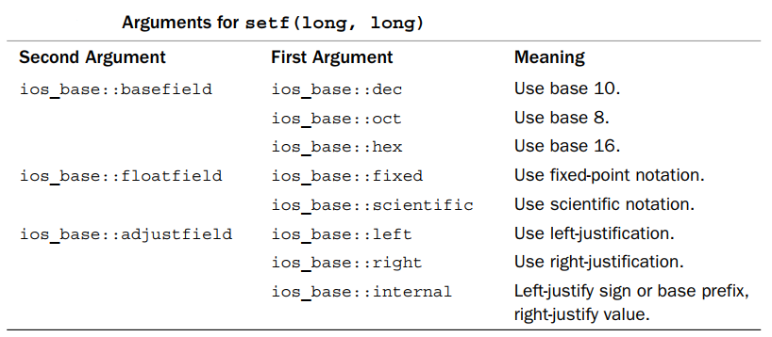
1.1 Using member functions of ios class
The second one is:
cout.set(fmtflags,fmtflags);

Slide 6


1.1 Using member functions of ios class
1.1.2. cout.width(len) //set the field width
1.1.3. cout.fill(ch) // fill character to be used with justified field
1.1.4. cout.precision(p) // set the precision of floating-point numbers
#include <iostream>
using namespace std;
int main()
{
cout << 56.8 << endl;
cout.width(12);
cout.fill('+');
cout << 456.77 << endl;
cout.precision(2);
cout << 123.356 << endl;
cout.precision(5);
cout << 3897.678485 << endl;
return 0;
}
#include <iostream>
using namespace std;
int main()
{
cout.setf(ios_base::fixed, ios_base::floatfield);
cout << 56.8 << endl;
cout.width(12);
cout.fill('+');
cout << 456.77 << endl;
cout.precision(2);
cout << 123.356 << endl;
cout.precision(5);
cout << 3897.678485 << endl;
return 0;
}
significant digits
precision of
floating number
Notes:
科学计数法默认精度是 >=6, 123.256 (1.2e2) 为什么也用科学计数法？

Slide 7

The effect of calling setf() can be undone with unsetf().
#include <iostream>
using namespace std;
int main()
{
bool flag = true;
float f = 0.20f;
cout.setf(ios::showpoint);
cout.setf(ios::boolalpha);
cout << flag << endl;
cout << f << endl;
cout.unsetf(ios::boolalpha);
cout.unsetf(ios::showpoint);
cout << flag << endl;
cout << f << endl;
return 0;
}
Notes:
究竟是 unset（原文） 还是 unsetf（代码中）

Slide 8
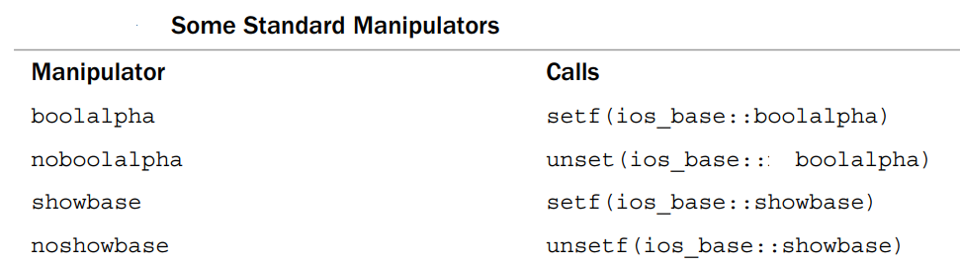
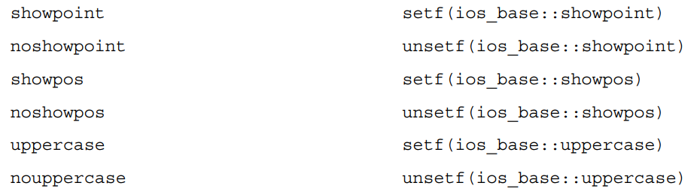
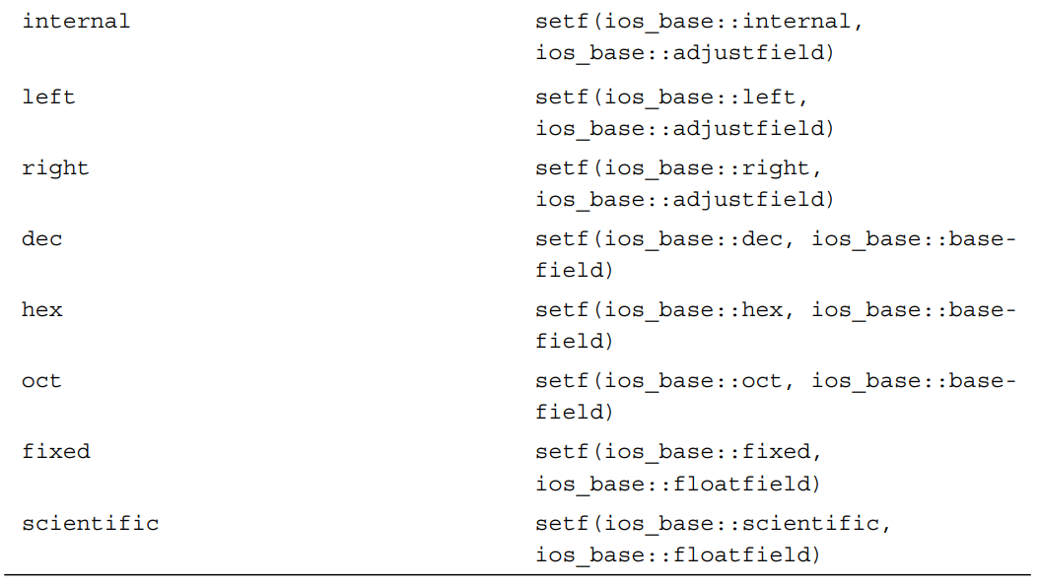
Standard Manipulators
C++ offers several manipulators to invoke setf(),automatically supplying the right arguments.

Slide 9

#include <iostream>
using namespace std;
int main()
{
bool flag = false;
double a = 2.3876;
double b = 0.46e2;
cout << boolalpha << flag << endl;
cout << fixed << a << endl;
cout << b << endl;
cout << noboolalpha << flag << endl;
cout.unsetf(ios::fixed);
cout << a << endl;
cout << b << endl;
return 0;
}
Notes:
cout<<b 是否按fixed来操作？（从代码的运行结果来看是的）

Slide 10
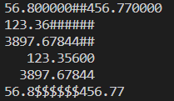
1.2 Using iomanip manipulators
#include <iomanip>
1. setw(p) 2. setfill(ch) 3. setprecision(d)
#include <iostream>
#include <iomanip>
using namespace std;
int main()
{
cout.setf(ios_base::fixed, ios_base::floatfield);
cout << 56.8 << setw(12) << setfill('#') << 456.77 << endl;
cout << left;
cout << setw(12) << setprecision(2) << 123.356 << endl;
cout << setw(12) << setprecision(5) << 3897.6784385 << endl;
cout << right;
cout << setw(12) << setfill(' ') << 123.356 << endl;
cout << setw(12) << setfill(' ') << 3897.6784385 << endl;
cout.unsetf(ios_base::fixed);
cout << 56.8 << setw(12) << setfill('$') << 456.77 << endl;
return 0;
}

Slide 11
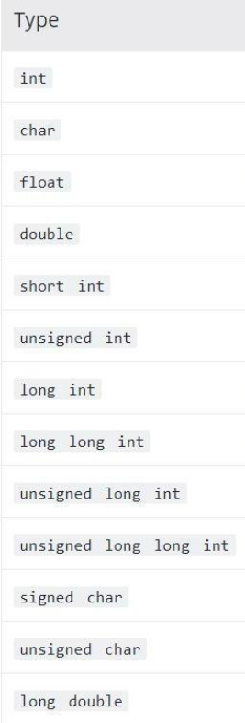
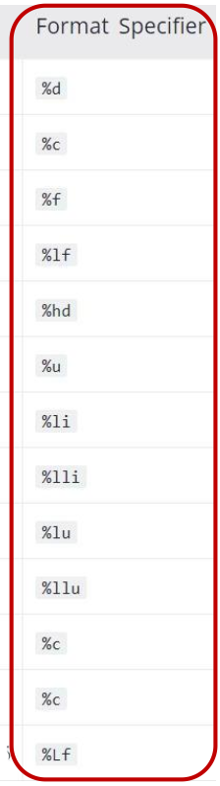
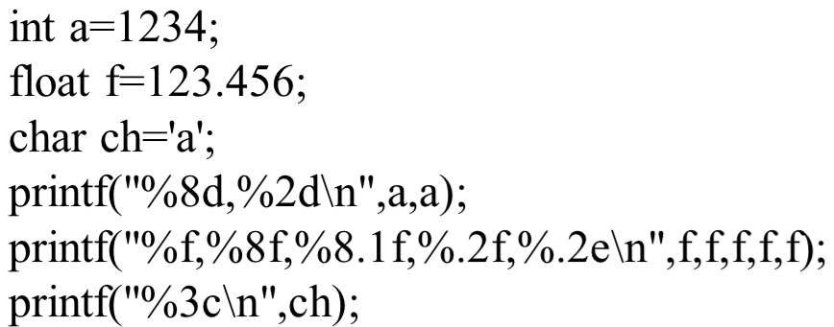
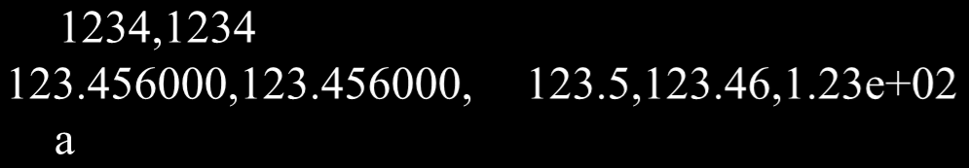
printf() vs cout
Which one do you prefer?
Example:
Sample output:
Notes:
printf vs cout， 性能，资源， 实现原理上区分

Slide 12
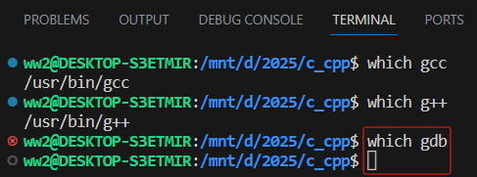

2. Debug C/C++ by using gdb in VScode
2.1 Install “gdb” (the debug tool of C/C++)
using cmd “which gdb” to check whether gdb is installed or no
if there is no info about gbd after running command “which gdb”, it means that gdb is not installed, then
1. using “sudo apt undate” to update package list
2. using “sudo apt install gdb” to install gdb
If the installation directory of gdb is displayed after running command “which gdb” is executed, it means that gdb has been successfully installed.

Slide 13
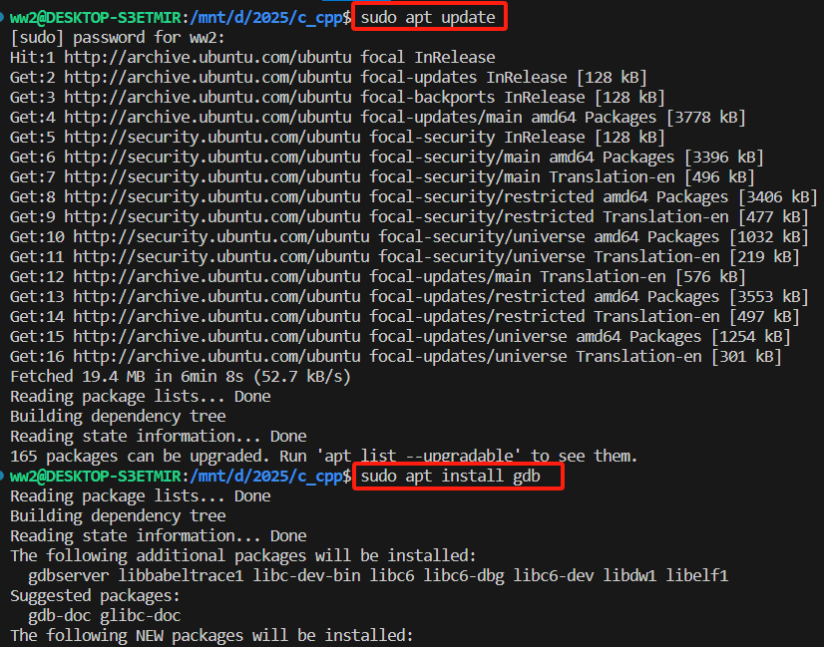
commands for install gdb

Slide 14
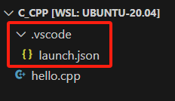
2. Debug C/C++ by using gdb in VScode
2.2 configure VSCode for using gdb to debug C/C++ code
create and edit “.vscode” folder and json files
step1. create a new folder named “.vscode” in the directory of C/C++ codes
step2. create a new json file named “launch.json” in the “.vscode” folder which is created in step1
edit “launch.json” to set gdb for debugging the execute file which is created by “g++ -g" / “gcc -g”
tips: option “-g” used with gcc/g++ is to generate information for debugging while compiling the C/C++ source code.
https://code.visualstudio.com/docs/cpp/config-linux

Slide 15
{
"version": "0.2.0",
"configurations": [
{
"name": "(gdb) Launch",
"type": "cppdbg",
"request": "launch",
"program": "${fileDirname}/${fileBasenameNoExtension}",
"args": [],
"stopAtEntry": false,
"cwd": "${workspaceFolder}",
"environment": [],
"externalConsole": false,
"MIMode": "gdb",
"setupCommands": [
{
"description": "Enable pretty-printing for gdb",
"text": "-enable-pretty-printing",
"ignoreFailures": true
},
{
"description": "Set Disassembly Flavor to Intel",
"text": "-gdb-set disassembly-flavor intel",
"ignoreFailures": true
}
]
}
]
}
<--- An example of launch.json
https://code.visualstudio.com/docs/cpp/config-linux

Slide 16

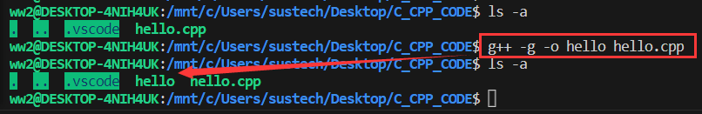
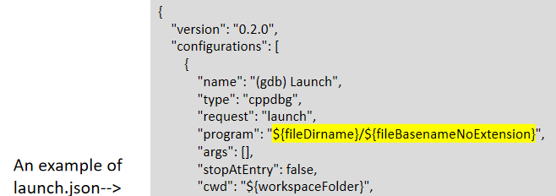
2. Debug C/C++ by using gdb in VScode
2.3 lunch gdb to debug in VS Code by “Run and Debug”
compile the souce code with “-g” option to generate information for debug and generate the executable file

Slide 17
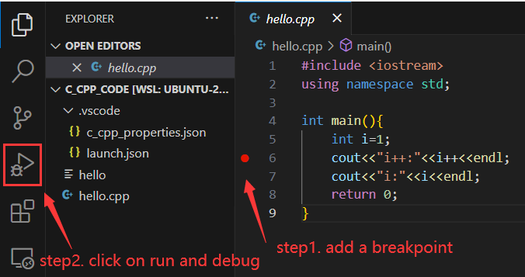
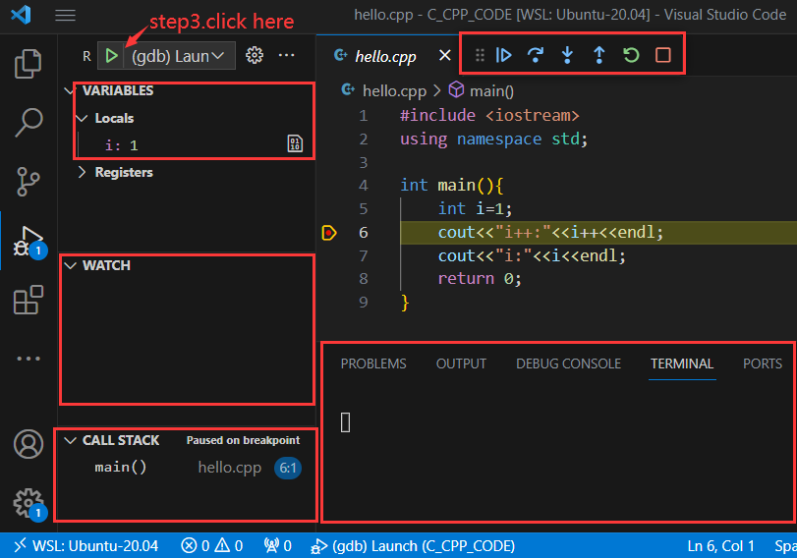
2. Debug C/C++ by using gdb in VScode
2.4 set “breakpoint” on source file, lunch gdb to run and debug
https://code.visualstudio.com/docs/cpp/config-linux

Slide 18
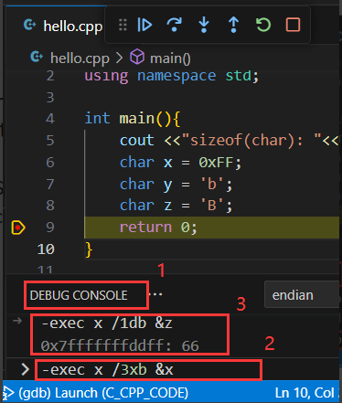
2. Debug C/C++ by using gdb in VScode
2.5 View the data stored in a variable by gdb(optional)
During debugging, you can use GDB commands to view the data stored in variable(s).
step1. choose “DEBUG CONSOLE” window.
step2. run the command in command line in the “DEBUG CONSOLE” window.
-exec [gdb command] in vscode
step3. View the results after executing the command in the “DEBUG CONSOLE” window.

Slide 19
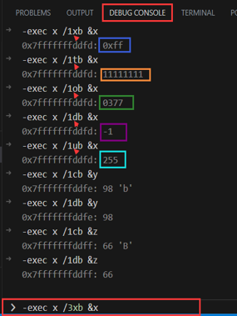
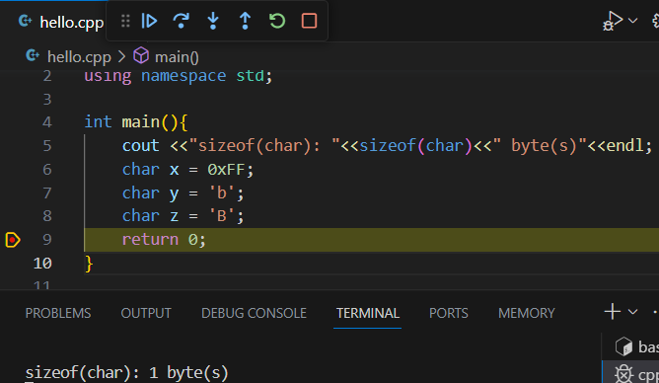
2. Debug C/C++ by using gdb in VScode
Using the command x (for “examine”) to examine memory in any of several formats, independently of your program’s data types.
x /nfu addr
n, the repeat count
f, the display format
u, the unit size
https://sourceware.org/gdb/current/onlinedocs/gdb.html/Memory.html#Memory

Slide 20
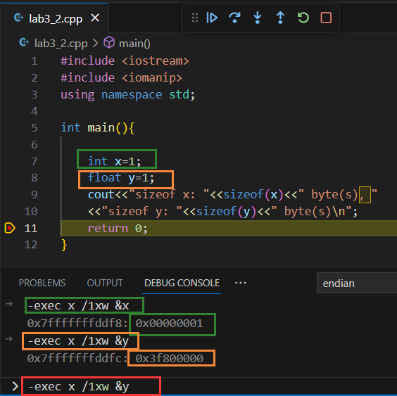
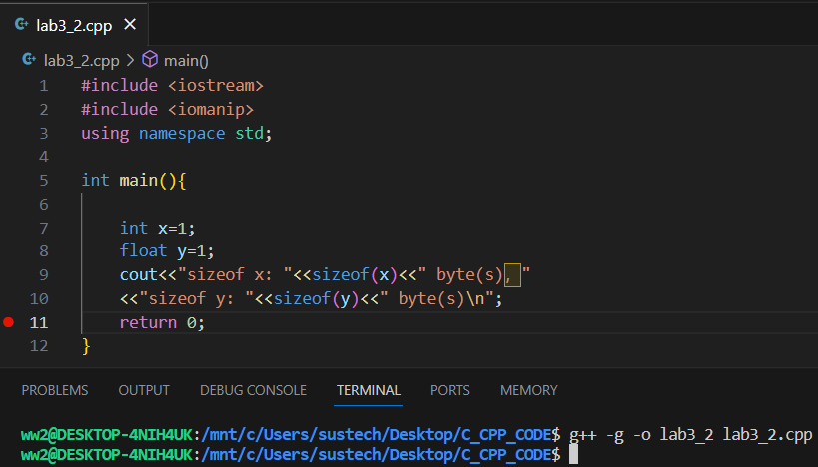
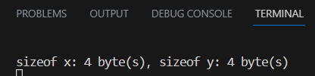
3. Data type conversions and calculations
3.1 data storage: integer vs float

Slide 21

3. Data type conversions and calculations
3.2 Signed vs Unsigned
Integer promotions of Implicit conversions
#include <stdio.h>
int main(){
char x=0xff;
unsigned char y=0xff;
printf("x: 0x%x, %d , %u\n",x,x,x);
printf("y: 0x%x, %d , %u\n",y,y,y);
printf("x>>2: 0x%x, %d , %u\n",x>>2,x>>2,x>>2);
printf("y>>2: 0x%x, %d , %u\n",y>>2,y>>2,y>>2);
return 0;
}
https://en.cppreference.com/w/c/language/conversion

Slide 22
4. Exercises
4.1.Compile and run the following program, what is the result?
You need to explain the reason to a SA to pass the test.
#include <stdio.h>
int main()
{
signed char a = 127;
unsigned char b = 0x7f;
char c = 0x7f;
a=a<<1;
b=b<<1;
c=c<<1; printf("a=%x\nb=%x\nc=%x\n",a,b,c);
printf("a=%d\nb=%d\nc=%d\n",a,b,c);
a=a>>1;
b=b>>1;
c=c>>1;
printf("a=%x\nb=%x\nc=%x\n",a,b,c);
printf("a=%d\nb=%d\nc=%d\n",a,b,c);
return 0;
}

Slide 23
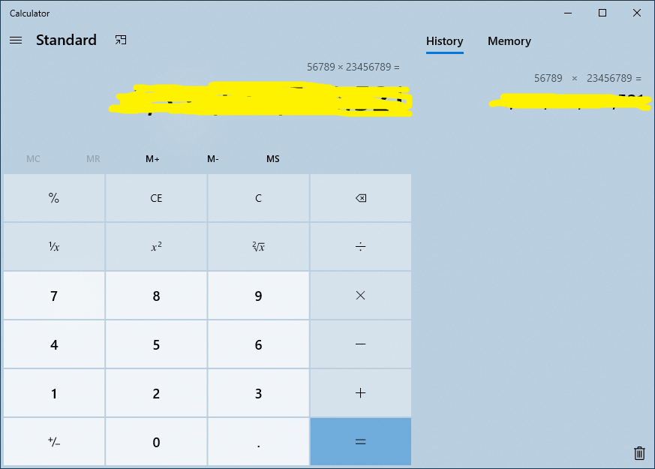
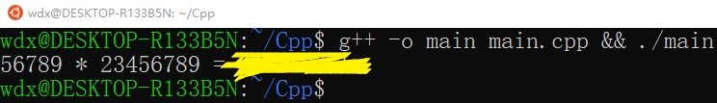
4.2. Write a program to calculate integer multiplication: 56789 * 23456789, and then print the result. Verify the result using a calculator. If the result is wrong, what could be the reason? How to get the correct result for this exercise? You need to explain the reason to a SA to pass the test.
4. Exercises
Notes:
溢出的问题
结合先加后用，先用后加的问题 （找到临界点的数字，/2 * 一个 i++
或者结合移位进行判断

Slide 24


4. Exercises
4.3. Run the following source code and explain the result.
#include <iostream> //file name: lab3_p4_3.cpp
using namespace std;
int main()
{
cout << fixed;
float f1 = 1.0f;
cout<<"f1 = "<<f1<<endl;
float a = 0.1f;
float f2 = a+a+a+a+a+a+a+a+a+a;
cout<<"f2 = "<<f2<<endl;
if(f1 == f2) //TIPS: Modify the code here
cout << "f1 == f2" << endl;
else
cout << "f1 != f2" << endl;
return 0;
}
Then using the method learnt in lecture2 to make the output of the code same as following picture .
NOTE: DO NOT use if (f1=f2) instead of if(f1==f2).
Notes:
浮点数的大小 以及 浮点数的比对
使用lecture上介绍的方法来解决

Slide 25
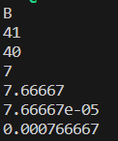
4.Exercises
#include <iostream>
using namespace std;
int main()
{
int a, b;
double c, d,f,g;
char h;
a = 19.99 + 21.99;
b = (int)19.99 + 21.99;
c = 23 / 3;
d = 23 / 3.0;
f = 23 / 3.0e4;
g = 23 / 3.0e5;
h = 'b' - 32;
//complete code here
return 0;
}
4.4. Complete the following source code to print the variables as the following picture and explain the result.
Why the value of a and b are not equal? Explain the division operation with different types.
You need to explain the reason to a SA to pass the test.
Notes:
数据类型转换：强制转换 以及 自动转换
记录c和d中的16进制数 进行展示（可以打印，也可以用debug的方式进行展示

Slide 26
4.Exercises
4.5. What is the output of the code as follows? What is the meaning of auto when defines a variable in C++?
You need to explain the reason to a SA to pass the test.
#include <iostream>
int main()
{
auto a = 10;
a = 20.5;
a += 10.5;
std::cout << a << std::endl;
auto b=10.0;
b = 20.5;
b +=a;
std::cout << b << std::endl;
return 0;
}

