Slide 1
Advanced Programming
Lab 3 Common Commands in Linux, Makefile
于仕琪，王大兴，廖琪梅, 王薇

Slide 2
topics
1. Commands in Linux
commands: directory, file .etc.
lists of commands, pipelines
2. Makefile
file: makefile/Makefile
command: make, make clean
3. Practices
commands, makefile
branch, loop

Slide 3
1. Commands in Linux
Linux is a family of open-source Unix operating systems based on the Linux Kernel.
There are some popular distributions
such as Ubuntu, Fedora, Debian, openSUSE, and Red Hat.
A Linux command is a program or utility that runs on the Command Line Interface – a console that interacts with the system via texts and processes.
Linux command’s general syntax looks like:
CommandName [option(s)] [parameter(s)]
CommandName is the rule that you want to perform.
Option or flag modifies a command’s operation. To invoke it, use hyphens (-) or double hyphens (--).
Parameter or argument specifies any necessary information for the command.

Slide 4
1. Commands in Linux
1.1 Linux directory and file commands:
Command | Meaning
pwd | Print the name of current/working directory.
cd <directory name> | Change the current directory.
ls | List of content of a directory.
mkdir <directory name> | Make a new directory under any directory.
rmdir <directory name> | Remove directories without files.
cat <file name> | Display content of the file.
rm <file name> | Remove a file.
cp <source> <dest> | Copy a file or files to another
mv<source><dest> | Move a file or files to another directory
cat/tail/head, less/more, nano/vim, file, whereis, echo
https://www.javatpoint.com/linux-commands

Slide 5
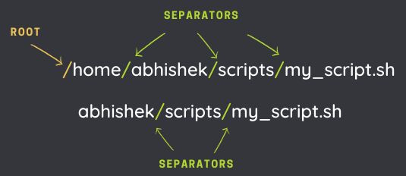
Absolute path and relative path
A path is how you refer to files and directories. It gives the location of a file or directory in the Linux directory structure. It is composed of a name and slash syntax.
If the path starts with slash "/", the first slash denotes root. The rest of the slashes in the path are just separators.
The absolute path always starts from the root directory (/).
A relative path starts from the current directory.
Two special relative paths:
. ( single dot) denotes the current directory in the path.
.. (two dots) denotes the parent directory, i.e., one level above.

Slide 6

pwd command
Use the pwd command to display the current working directory you are in.
Start Ubuntu, you will see:
$ or # is the prompt, you can type command now.
The current directory

Slide 7
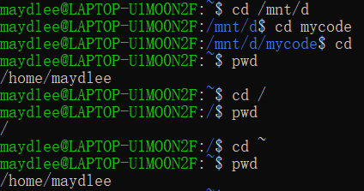
cd command
To navigate through the Linux files and directories, use the cd command.
change the directory to the root directory of d drive
change the directory to the home directory
change the directory to the root directory
change the directory to the home directory
Here are some shortcuts to help you navigate:
cd ~[username] goes to another user’s home directory.
cd .. moves one directory up.
cd - moves to your previous directory.
cd without an option will take you to the home folder.

Slide 8
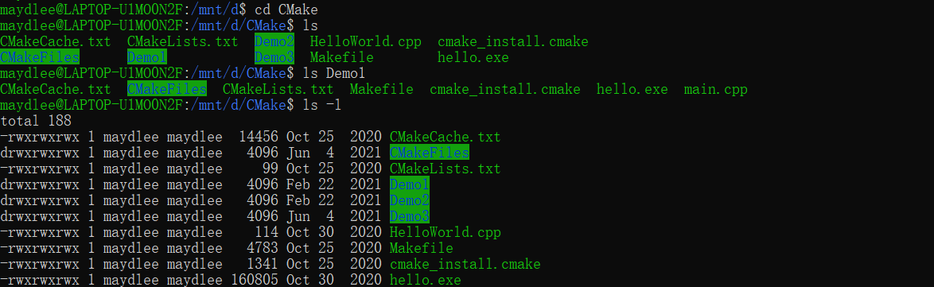
ls command
The ls command lists files and directories within a system. Running it without a flag or parameter will show the current working directory’s content.
List subdirectory and files in the current directory
List subdirectory and files in the Demo1 directory
List detail information of subdirectory and files in the current directory
Here are some options you can use with the ls command:
ls -R lists all the files in the subdirectories.
ls -a shows hidden files in addition to the visible ones.
ls -l (or ll) shows detail information of subdirectory and files

Slide 9
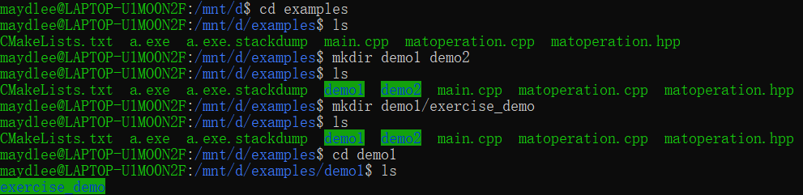
mkdir command
Use the mkdir command to create one or multiple directories at once.
Create two subdirectories in the current directory
Create a subdirectory inside the demo1 directory

Slide 10
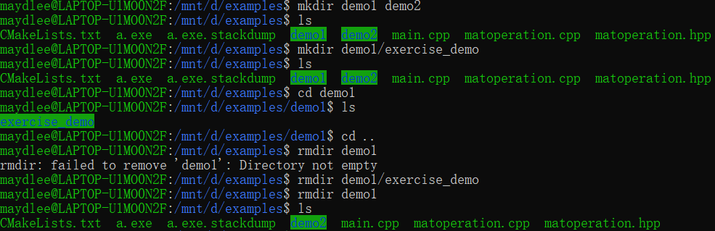
rmdir command
Use the rmdir command to permanently delete an empty directory.
Delete demo1 in the current directory
First delete the directory in demo1,
then delete demo1

Slide 11
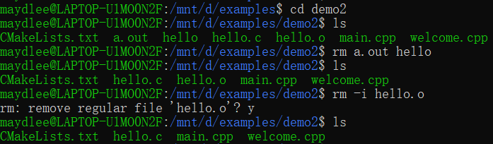

rm command
The rm command is used to delete files within a directory. Make sure that the user performing this command has write permissions.
Delete two files without confirmation
Delete a file with confirmation
Delete all the files in demo2
Here are some acceptable options you can add:
-i prompts system confirmation before deleting a file.
-f allows the system to remove without a confirmation.
-r deletes files and directories recursively.

Slide 12
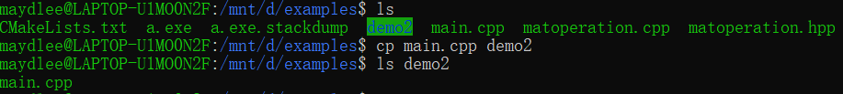
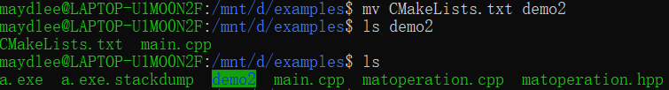
cp command and mv command
The cp command is used to copy a file or directory.
Copy a file into demo2
The mv command is used to move a file or a directory form one location to another location.
Move a file into demo2
The CMakeLists.txt is not in the examples directory because it is moved into demo2.
Use mv command to rename a file

Slide 13
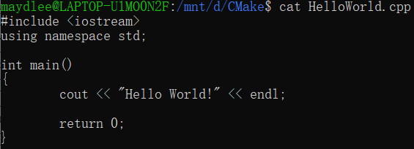
cat command
Concatenate, or cat, is one of the most frequently used Linux commands. It lists, combines, and writes file content to the standard output. To run the cat command, type cat followed by the file name and its extension.
Here are other ways to use the cat command:
cat > filename.txt creates a new file.
cat filename1.txt filename2.txt > filename3.txt merges filename1.txt and filename2.txt and stores the output in filename3.txt.
tac filename.txt displays content in reverse order.

Slide 14
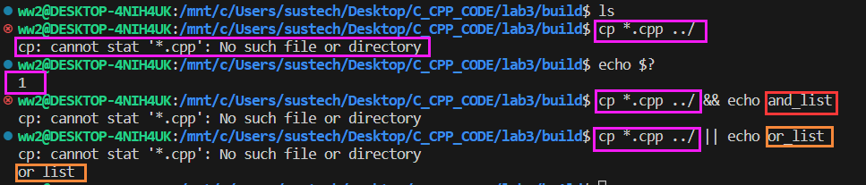
1.2 lists of commands, pipelines
1.2.1 lists of commands
An AND list has the form： command1 && command2
command2 is executed if, and only if, command1 returns an exit status of zero (success).
An OR list has the form： command1 || command2
command2 is executed if, and only if, command1 returns a non-zero exit status.
Command Sequence: command1 ; command2
Commands separated by a ‘;’ are executed sequentially;
TIPS:
For the shell’s purposes, a command which exits with a zero exit status has succeeded. A non-zero exit status indicates failure.
The exit status of the last command is available in the special parameter $?
https://www.gnu.org/software/bash/manual/bash.html#Lists
https://www.gnu.org/software/bash/manual/bash.html#Exit-Status

Slide 15
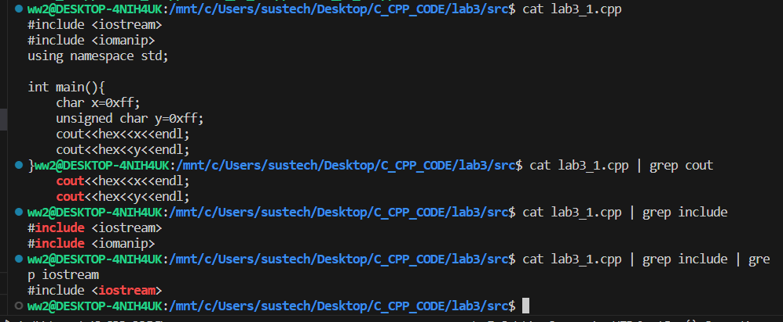
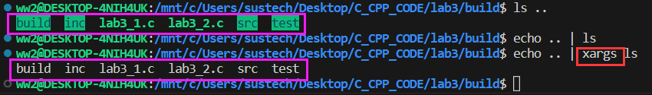
1.2 lists of commands, pipelines
1.2.2 pipelines
A pipeline is a sequence of one or more commands separated by one of the control operators ‘|’ or ‘|&’.
The output of each command in the pipeline is connected via a pipe to the input of the next command. That is, each command reads the previous command’s output. This connection is performed before any redirections specified by command1.
https://www.gnu.org/software/bash/manual/bash.html#Pipelines

Slide 16

TIPS: Shortcut keys
Up and down arrow keys can list the commands you typed.
Tab key can complete the command. For a long command, you can type first few letters and press Tab key to complete the command or list alternate commands.
Type the first few letters of a command,
and then press Tab key. If there is completion,
press Tab key again, it will list the alternate
commands.
clear is a standard Unix computer operating system command that is used to clear the terminal screen.

Slide 17
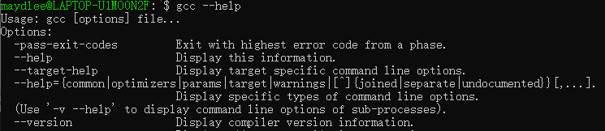
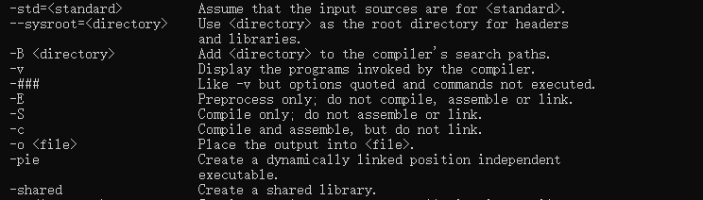
gcc & g++
gcc and g++ are GNU C or C++ compilers respectively, which issued for preprocessing,
compilation, assembly and linking of source code to generate an executable file.
Type command gcc or g++ --help, you can get the common options of the gcc or g++. g++ accepts
mostly the same options as gcc.

Slide 18
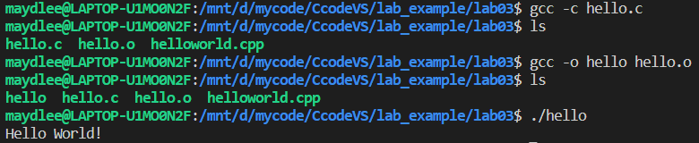
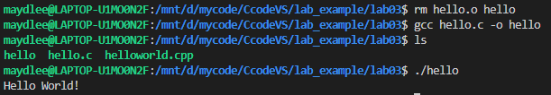
gcc & g++
-c Compile or assemble the source files, but do not link. The ultimate output is in the form of an object file
for each source file. The object file name for a source file is made by replacing the suffix .c with .o.
-o <file> Place output in file file. This applies regardless to whatever sort of output is being produced,
whether it be an executable file, an object file, an assembler file or preprocessed C code.
If -o is not specified, the default is to put an executable file in a.out.
gcc source_file.c -o program_name or gcc source_file.o -o program_name
compile
link
#include <stdio.h>
int main()
{
printf("Hello World!\n");
return 0;
}
run
compile and
link
run

Slide 19

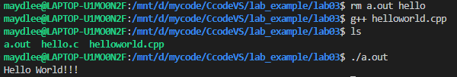
gcc & g++
With one step to generate an executable target file:
gcc file_name or g++ file_name
This command is used to compile and create an executable file a.out (default target name).
#include <iostream>
using namespace std;
int main()
{
cout << "Hello World!!!" << endl;
return 0;
}

Slide 20
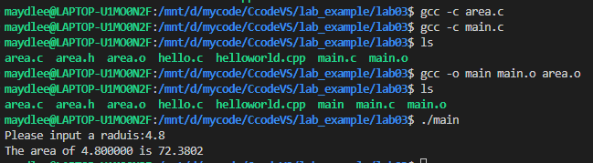

gcc & g++
compile multiple files
You can compile the files one by one and then link them to an executable file.
Another choice is using one step to list all the .c(or .cpp) files after gcc(or g++) command and create an executable file named a.out.
//area.h
#define PI 3.1415
double compute_area(double r);
//main.c
#include <stdio.h>
#include "area.h"
int main()
{
double r, area;
printf("Please input a radius:");
scanf("%lf", &r);
area = compute_area(r);
printf("The area of %lf is %.4lf\n", r, area);
return 0;
}
//area.c
#include "area.h"
double compute_area(double r)
{
return PI * r * r;
}

Slide 21
Makefile
What is a Makefile?
Makefile is a tool to simplify and organize compilation. Makefile is a set of commands with variable names and targets . You can compile your project(program) or only compile the update files in the project by using Makefile.

Slide 22
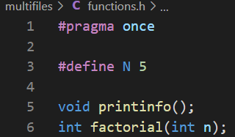
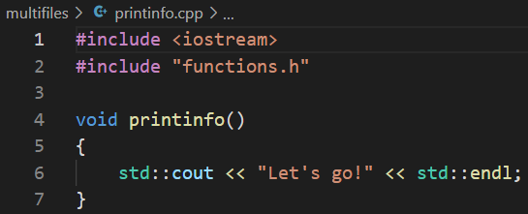
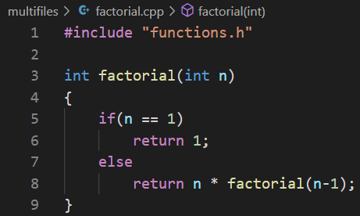
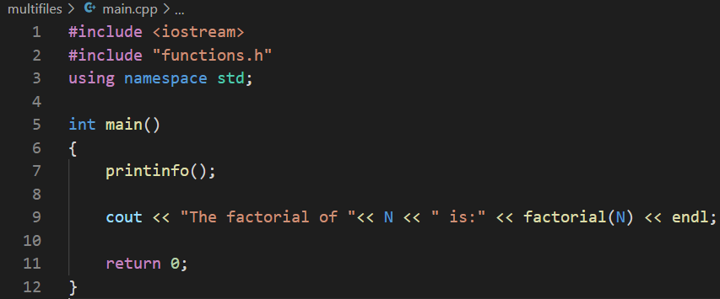
Suppose we have four source files as follows:
Normally, you can compile these files by the following
command:
or

Slide 23
How about if there are hundreds of files to compile? If only one source file is modified, need we compile all the files? Makefile will help you.
The name of makefile must be either makefile or Makefile without extension.
You can write makefile in any text editor. A rule of makefile including three
elements: targets, prerequisites and commands. There are many rules in the
makefile.

Slide 24
A makefile consists of a set of rules. A rule including three elements: target,
prerequisites and commands.
targets : prerequisites
<TAB> command
The target is an object file, which is generated by a program.
Typically, there is only one per rule.
The prerequisites are file names, separated by spaces, as input to create the target.
The commands are a series of steps that make carries out.
These need to start with a tab character, not spaces.

Slide 25
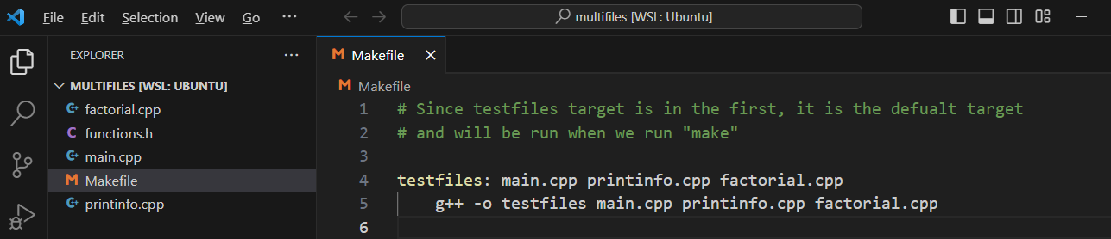
comments begins with #
prerequisites
target
Place the
Makefile
together
with your
programs.
start with <TAB>
commands
g++ is compiler name, -o is linker flag and
testfiles is binary file name.

Slide 26
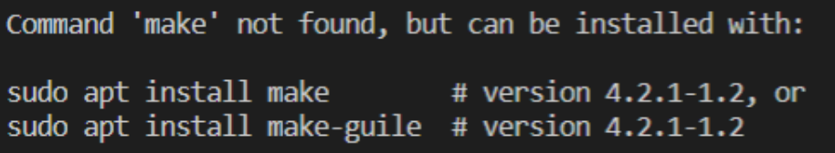

Type the command make in VScode
If you don’t install make in VScode, the information will display on the screen.
Install it first according to the instruction.
Run the commands in the makefile automatically.
Run your program
output

Slide 27
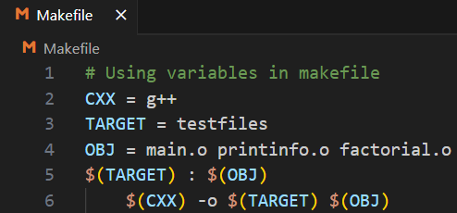
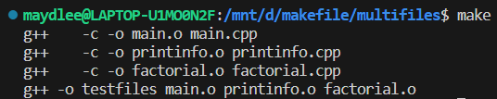
Define Macros/Variables in the makefile
To improve the efficiency of the makefile, we use variables.
variables
start with <TAB>
Write target, prerequisite and commands by variables using ‘$()’
Compile and link the source file
one by one
Note: Deletes all the .o files and executable file created previously before using make command. Otherwise, it’ll display:

Slide 28
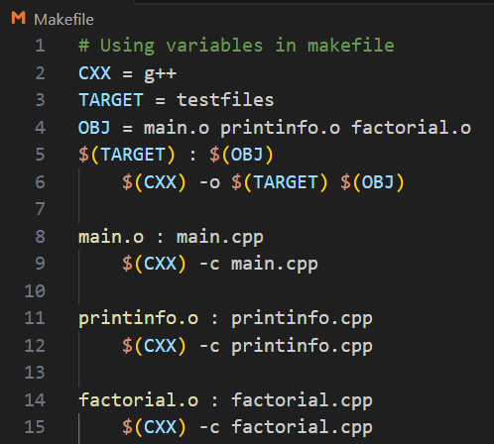

If only one source file is modified, we need not compile all the files. So, let’s
modify the makefile.
If main.cpp is modified, it is compiled
by make.
targets

Slide 29
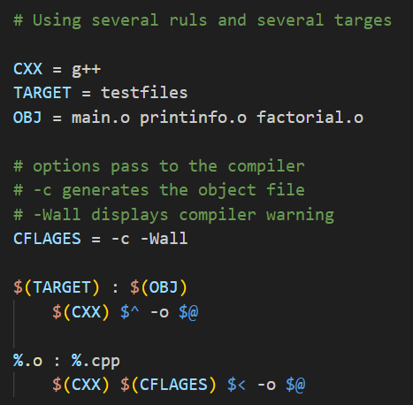
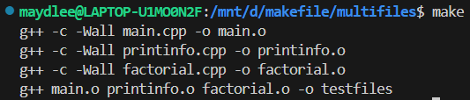


All the .cpp files are compiled to the .o files, so we can modify the makefile like this:
$@: the target file
$^: all the prerequisites files
$<: the first prerequisite file
or
This is a model rule, which indicates that all the .o objects depend on the .cpp files

Slide 30
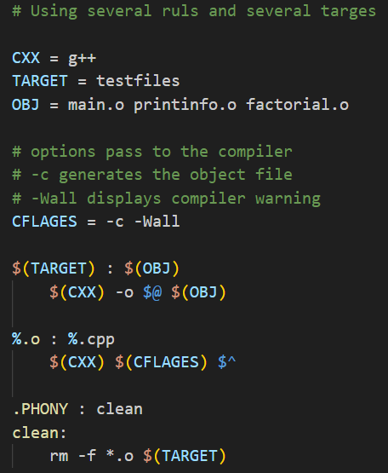
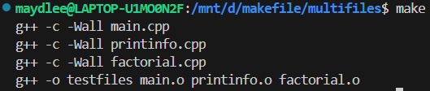
Using phony target to clean up compiled results automatically
Because clean is a label not a target, the command make clean can execute the clean part. Only make command can not execute clean part.
After clean, you can run make again
Adding .PHONY to a target will prevent making from confusing the phony target with a file name.

Slide 31
Functions in makefile
Search all the .cpp files in the current directory, and return to SRC
wildcard: search file
for example:
SRC = $(wildcard ./*.cpp)
All .cpp files in the current directory

Slide 32

patsubst(pattern substitution): replace file
$(patsubst original pattern, target pattern, file list)
Replace all .cpp files with .o files
for example:
OBJ = $(patsubst %.cpp, %.o, $(SRC))
Replace all .cpp files with .o files

Slide 33
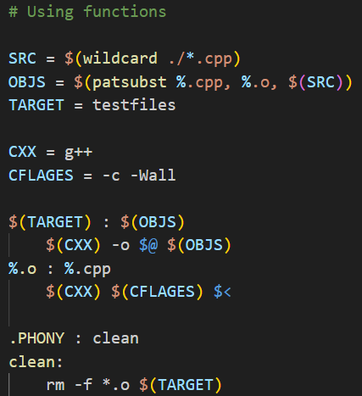
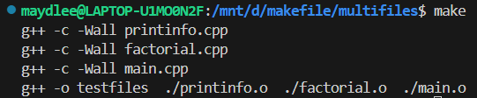
vs

Slide 34
Use Options to Control Optimization
-O1, the compiler tries to reduce code size and execution time, without performing any optimizations that take a great deal of compilation time.
-O2,Optimize even more. GCC performs nearly all supported optimizations that do not involve a space-speed tradeoff. As compared to -O1, this option increases both compilation time and the performance of the generated code.
-O3, Optimize yet more. O3 turns on all optimizations specified by -O2.
https://gcc.gnu.org/onlinedocs/gcc/Optimize-Options.html
https://blog.csdn.net/xinianbuxiu/article/details/51844994

Slide 35
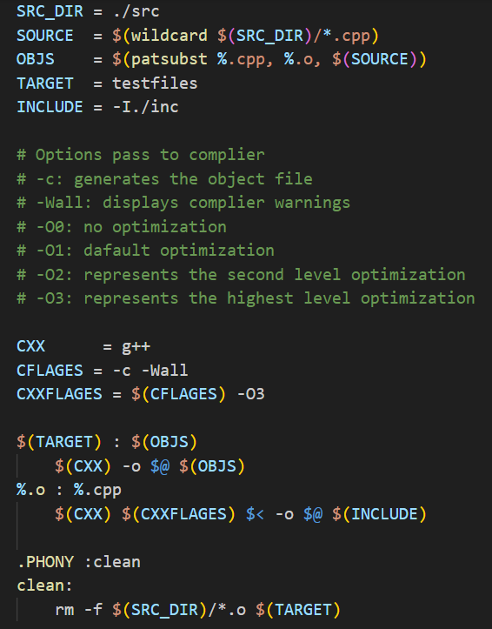
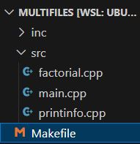
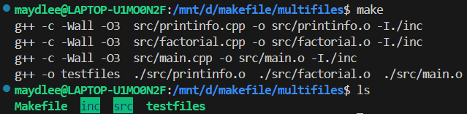
All .h files are in inc
-I means search file(s) in the specified folder i.e. inc folder
All .cpp files are in src
GNU Make Manual
http://www.gnu.org/software/make/manual/make.html

Slide 36
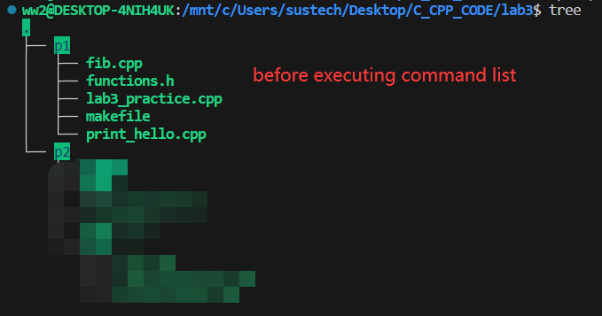
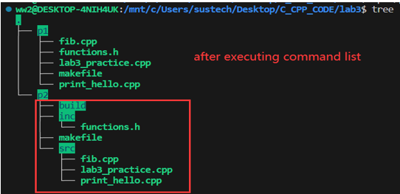
The existing directory structure is shown in the upper right image. There are different types of C/C++files in the “p1” directory while the directory structure under p2 is unknown. Task. use the command list to create subdirectories as needed and place files of different types into different subdirectories in the “p2” directory (as shown in the lower right image).Place the header file in p2/inc, and the cpp source file in p2/src, and create p2/build. NOTE: 1. when using commands, if there is already an “inc” subdirectories, do not create “inc” repeatly. If there is no “inc” subdirectories, create it; The same requirement also applies to “src” and “build”. 2. File copying work should only be performed after the destination subdirectories have been created. 3. Use as few command lists as possible to complete this exercise (options include “and list”, “or list”, “command sequence”, which can be combined as needed)
Exercises 1. commands and command list

Slide 37
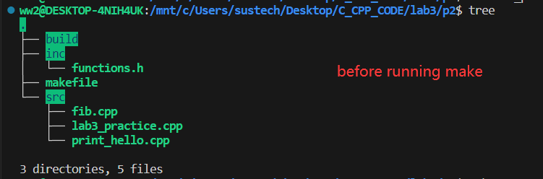
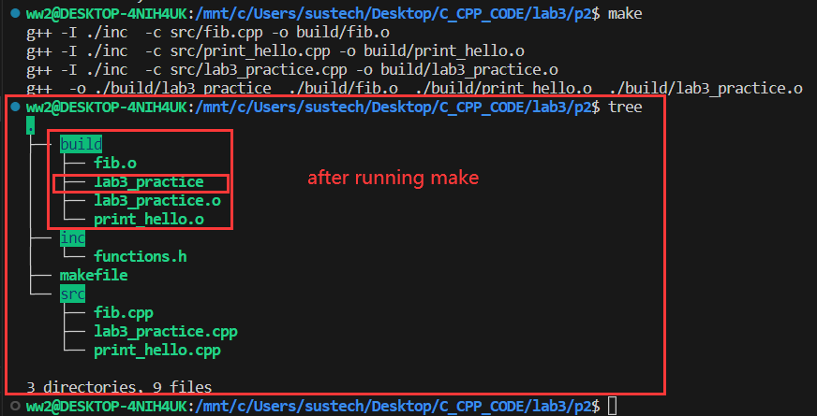
Exercises 2. Makefile and make(1)
create a makefile, run it by command “make” or “make clean” to complete following tasks:
1. compile your project(program) or only compile the update files in the project by running “make”based on makefile to generate the executable file “lab3_practice”.
notes: the object file *.o and the executable file “lab3_practice” should be in the directory “build”
2. remove all the files in the directory “build” by running “make clean”

Slide 38

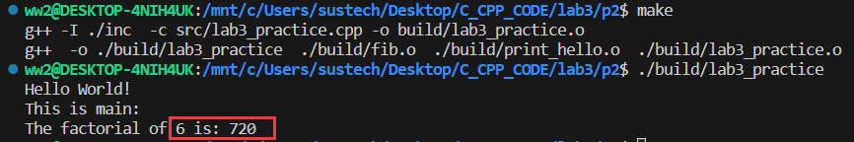
Exercises 2. Makefile and make(2)
//print_hello.cpp
#include <iostream>
#include "functions.h"
using namespace std;
void print_hello(){
cout<<"Hello World!"<<endl;
}
//functions.h
void print_hello();
int fib(int n);
//lab3_practice.cpp
#include <iostream>
#include "functions.h"
using namespace std;
int main(){
print_hello();
cout<<"This is main:"<<endl;
cout<<"The factorial of 5 is: "
<<fib(5)<<endl;
return 0;
}
//fib.cpp
#include "functions.h"
int factorial(int n) {
if(1==n) return 1;
else return n * fib(n-1);
}
3. edit the source file “lab3_practice.cpp” (change parameter 5 to another number), save it, then run “make” again, which object file would be updated in the process?

Slide 39
Exercises
3. Run the following source code and explain the result.
You need to explain the reason to a SA to pass the test.
#include <iostream>
using namespace std;
int main()
{
for(size_t n = 2; n >= 0; n--)
cout << "n = " << n << " ";
return 0;
}

Slide 40
Exercises
4. Run the following source code and explain the result.
You need to explain the reason to a SA to pass the test.
#include <iostream>
using namespace std;
int main()
{
int n = 5;
int sum;
while(n >0){
sum += n;
cout << "n = " << n << " ";
cout << "sum = " << sum << " ";
}
return 0;
}
#include <iostream>
using namespace std;
int main()
{
unsigned int n = 5;
int sum;
while(n >0){
sum += n;
cout << "n = " << (n-=2) <<endl;
cout << "sum = " << sum << " ";
}
return 0;
}

Slide 41
Exercises
5. Run the following source code and explain the result.
You need to explain the reason to a SA to pass the test.
#include <iostream>
using namespace std;
int main()
{
int n,fa;
do{
fa *= n;
n++;
}while(n <= 10);
cout << "fa = " << fa << endl;
return 0;
}
Notes:
保留，数据

