Slide 1
Advanced Programming
Lab 6, static library, parameters
廖琪梅 王大兴 于仕琪 王薇

Slide 2
Topic
Static library
build
use
makefile
CMake
Parameters of function
pass by value
fundamental type
pointer
pass by reference
pass a huge structure vs pass its pointer
Practice

Slide 3
1. Static library and Dynamic library
Static Linking and Static Libraries (also known as an archive) is the result of the linker making copy of all used library functions to the executable file. Static Linking creates larger binary files, and need more space on disk and main memory. Examples of static libraries are, .a files in Linux and .lib files in Windows.
Dynamic linking and Dynamic Libraries Dynamic Linking doesn’t require the code to be copied, it is done by just placing name of the library in the binary file. The actual linking happens when the program is run, when both the binary file and the library are in memory. If multiple programs in the system link to the same dynamic link library, they all reference the library. Therefore, this library is shared by multiple programs and is called a "shared library" . Examples of Dynamic libraries are, .so in Linux and .dll in Windows.

Slide 4
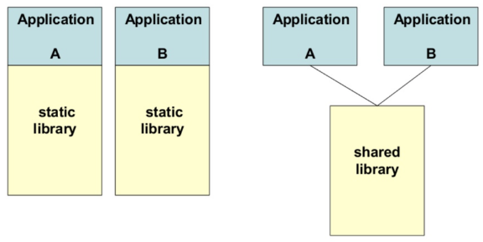
 | advantages | disadvantages
Static Library | 1. Make the executable has fewer dependencies, has been packaged into the executable file. 2. The link is completed in the compilation stage, and the code is loaded quickly during execution. | 1. Make the executable file larger. 2. Being a library dependent on another library will result in redundant copies because it must be packaged with the target file. 3. Upgrade is not convenient and easy. The entire executable needs to be replaced and recompiled.
Dynamic Library | 1.Dynamic library can achieve resource sharing between processes, there can be only one library file. 2. The upgrade procedure is simple, do not need to recompile. | 1. Loading during runtime will slow down the execution speed of code. 2. Add program dependencies that must be accompanied by an executable file.

Slide 5
1.1 Building a static library
Suppose we have written the following code:
// mymath.h
#ifndef __MY_MATH_H__
#define __MY_MATH_H__
float arraySum(const float *array, size_t size);
#endif
// main.cpp
#include <iostream>
#include "mymath.h"
int main()
{
float arr1[8]{1.f, 2.f, 3.f, 4.f, 5.f, 6.f, 7.f, 8.f};
float * arr2 = NULL;
float sum1 = arraySum(arr1, 8);
float sum2 = arraySum(arr2, 8);
std::cout << "The result1 is " << sum1 << std::endl;
std::cout << "The result2 is " << sum2 << std::endl;
return 0;
}
// mymath.cpp
#include <iostream>
#include "mymath.h"
float arraySum(const float *array, size_t size)
{
if(array == NULL)
{
std::cerr << "NULL pointer!" << std::endl;
return 0.0f;
}
float sum = 0.0f;
for(size_t i = 0; i < size; i++)
sum += array[i];
return sum;
}

Slide 6
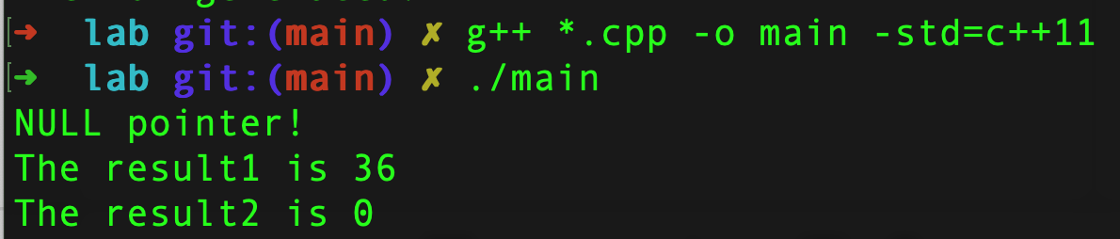
1.1 Building a static library
In previous class we do the following:
This will compile the “main.cpp” and “mymath.cpp” into “main”
And then run “main”

Slide 7
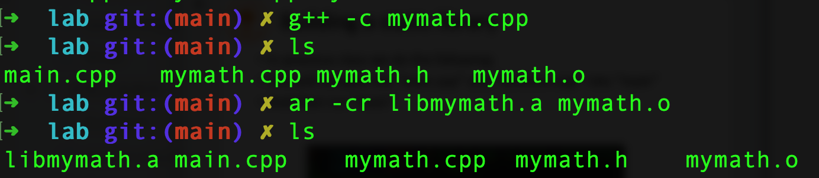
1.1 Building a static library
A static library is created by .o file.
Remember to use “ar” command with arguments “-cr” when building it.
Now we should see “libmymath.a” in the current directory
The name of .a must be started with “lib” followed by the .cpp name in which a function is defined.
Compile the source file to the object file.
c: create a static library.
r: add the object file to the static library.
ar is a linux command.

Slide 8
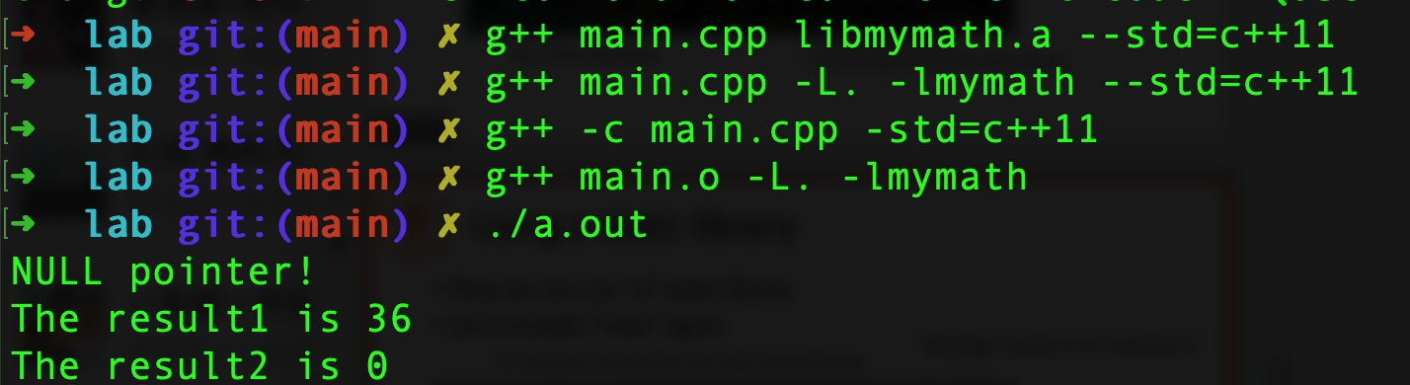
1.2 Using a static library
Now we can use “.a” static library.
Let’s compile “main” again:
“-lmymath” indicates to use “libmymath.a” or “libmymath.so”
“-L.” indicates to find a library file in the current directory.
The 3 methods
are equivalent.
-L: indicates the directory of libraries
-l: indicates the library name, the compiler can give the “lib” prefix to the library name and follows with .a as extension name.

Slide 9
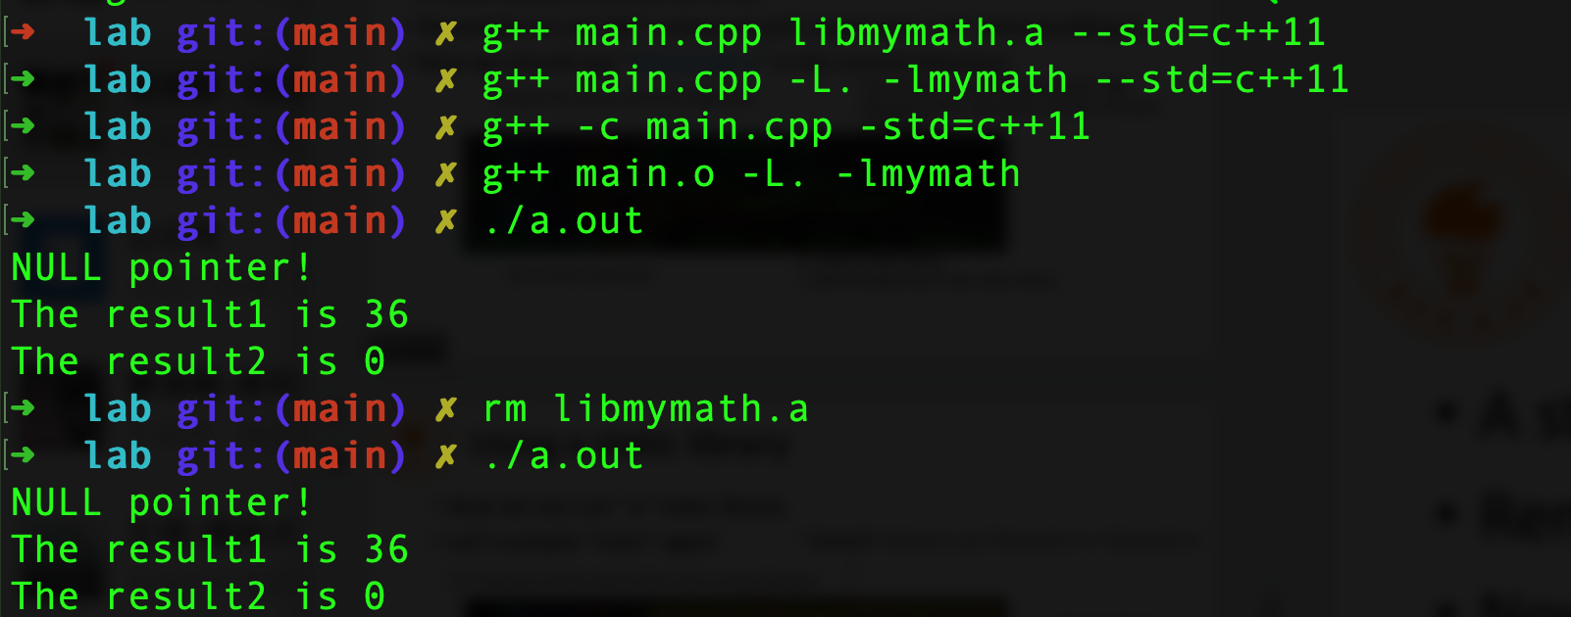
1.2 Using a static library
If the static library is removed, the program can run normally.
remove the static library file.
To create a static library from multiple object files:
ar –cr libtest.a test1.o test2.o

Slide 10
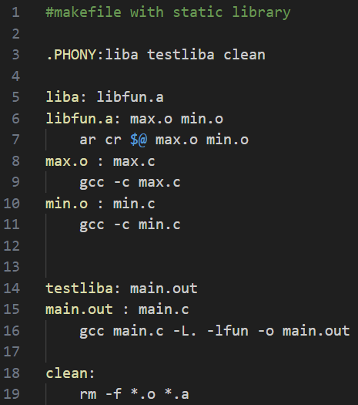
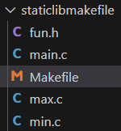

1.3 Static library in makefile
three targets
the first target with its prerequisite
All the files are in
the same folder.
the second target with its prerequisite
the third target with no prerequisite
By default, the first target can run with only make command.
The target name followed make command can run the target.

Slide 11
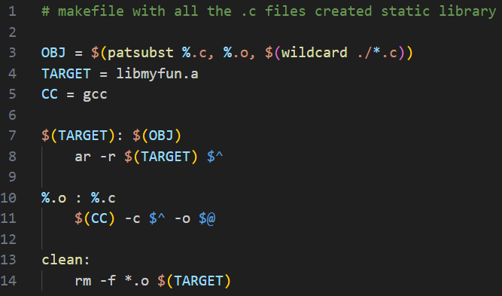
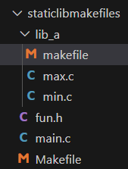
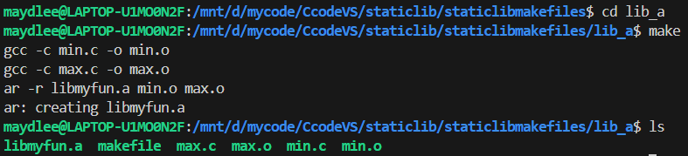
The first step, creates a static library file with these two .o files in the current makefile.
This time we put the functions in the “lib_a” folder, and create a makefile in this folder.

Slide 12
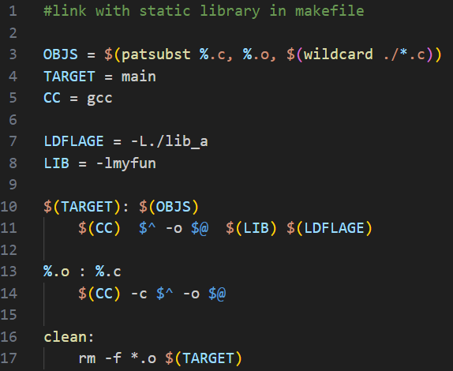
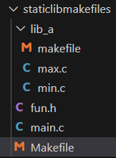
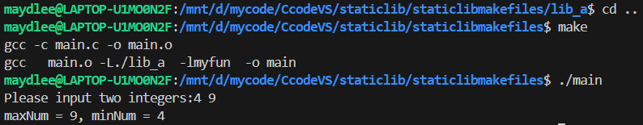
Links the executable file with the static library.
The second step, creates another makefile in the upper-level folder to link the static library into the executable file.

Slide 13
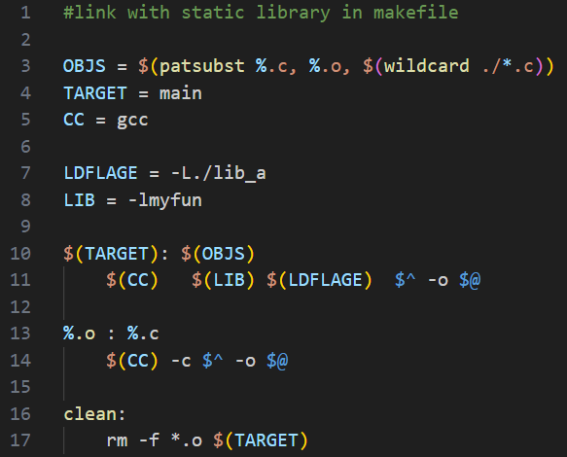
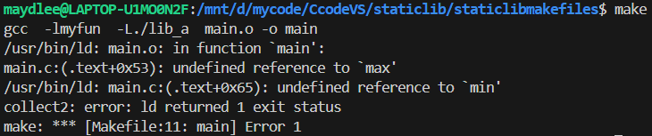
If you put the flag before $^, it will cause error.

Slide 14
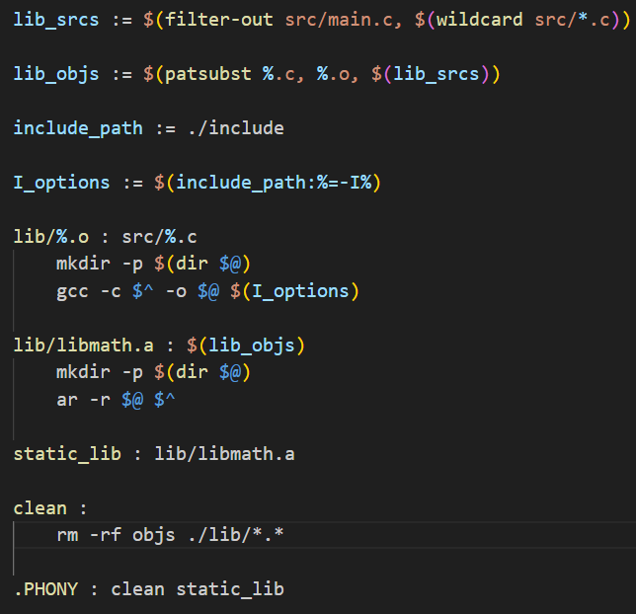
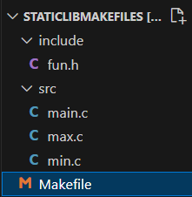

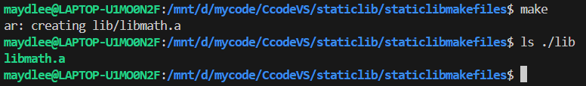
The first part of the
makefile just
creates a static
library named
libmath.a
This time we put all the source files in the “src” folder, the function header file in the “include” folder, and create a makefile in the current folder.(Only one makefile)

Slide 15
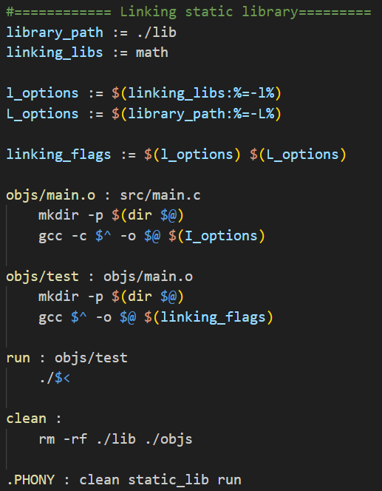
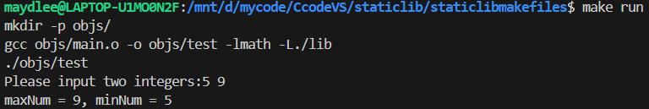
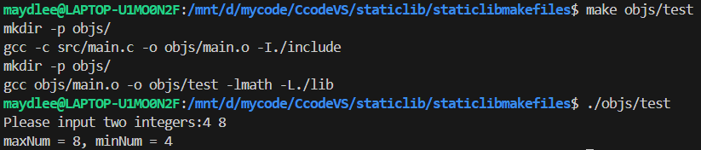
The second part of the
makefile links the static
library libmath.a to the
executable file test in the
“objs” folder.
or

Slide 16
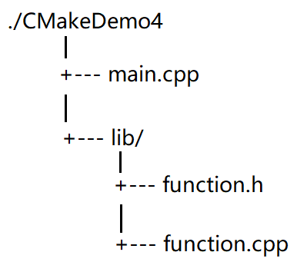
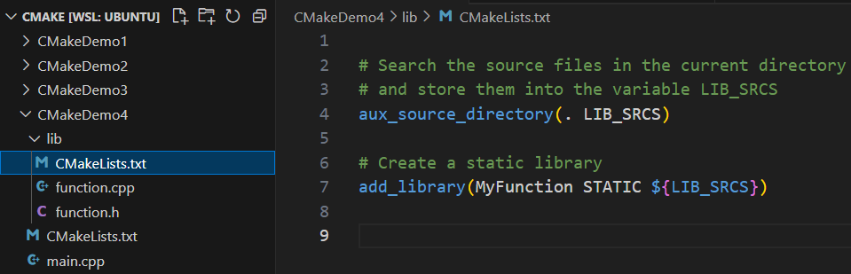
1.4 Creating and linking a static library by CMake
We want to create a static(or dynamic) library by function.cpp and call the static library in main.cpp. This time we write two CMakeLists.txt files, one in CmakeDemo4 folder and another in lib folder.
The CMakeLists.txt in lib folder creates a static library.
library file name
static library
The directory from which
the library file originates.
Create a static library named libMyFunction.a by the files in the current directory.

Slide 17
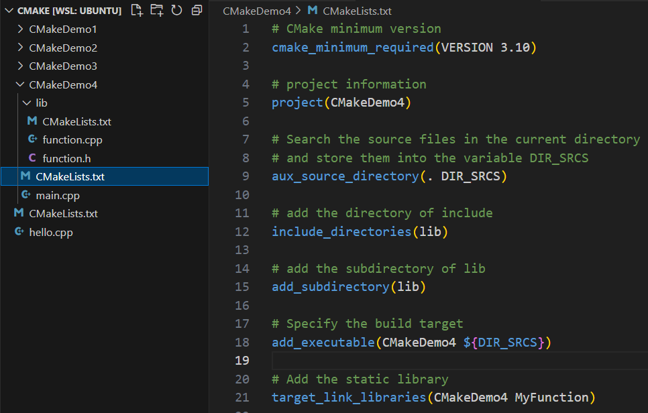
The CMakeLists.txt in CMakeDemo4 folder creates the project.
add_subdirectory command
indicates there is a subdirectory
in the project. When running the
command, it will execute the
CMakeLists.txt in the subdirectory
automatically.
Indicates that the project needs link a library named MyFunction, MyFunction can be a static library file or a dynamic library file.
project name
library file name
If there are more than one file, list them using space as the separator.

Slide 18
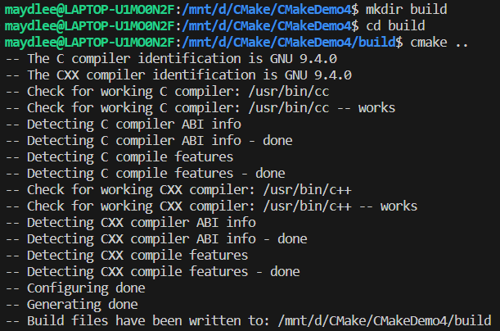
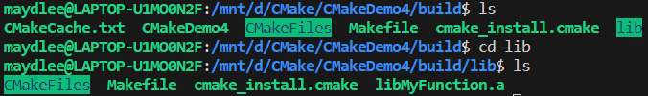
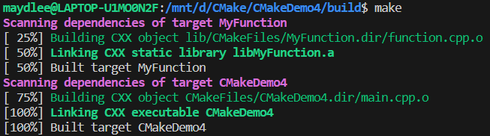

Slide 19
2. Parameters
#include<stdio.h>
int add1(int a,int b){
int sum = (a++)+(b++);
return sum;
}
int add2(int *x,int *y){
int sum = ((*x)++)+((*y)++);
return sum;
}
int add3(int &c,int &d){
int sum = (c++)+(d++);
return sum;
}
int main(){
int i=0,j=0;
scanf("%d",&i);
scanf("%d",&j);
printf("i_address:%p,j_address:%p\n",&i,&j);
int sum=add1(i,j);
printf("%d+%d=%d\n",i,j,sum);
sum=add3(i,j);
printf("%d+%d=%d\n",i,j,sum);
return 0;
}
Q1. How to compile the source code on the left hand, by using gcc or g++ ?
Q2. Is there any compiling error on the source code, if no, compile it, if yes, correct and compile.
Q3. What’s the output of this piece of code while input data is 1 and 2?
A | B | C | D
1+2=3 1+2=3 1+2=3 | 1+2=3 2+3=5 2+3=5 | 1+2=3 2+3=3 3+4=5 | 1+2=3 2+3=5 3+4=7

Slide 20
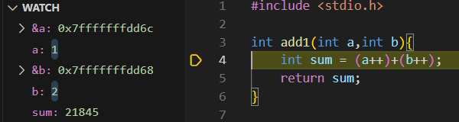
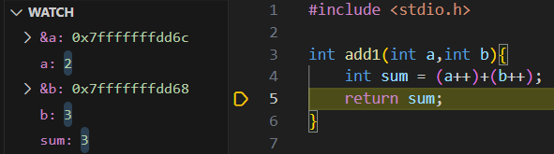
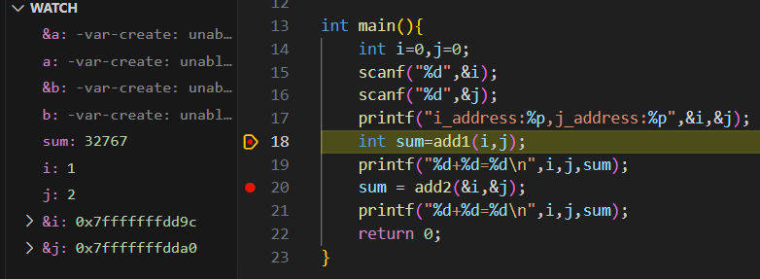
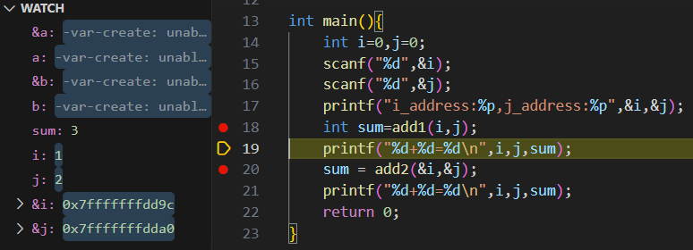
2.1 Pass by value: fundamental type
Using “-g” option while compiling to generate the executable file, then set break point and debug.
Q1. What’s the address of variable “i” and “j” ?
Q2. Is the address of variable “a” same with the address of “i”? how about “b” and “j” ?
Q3. Do variables a and b still exist after returning from the “add1” to the “main” ?

Slide 21
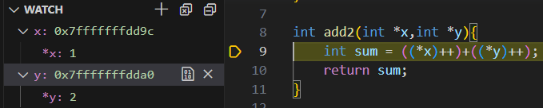
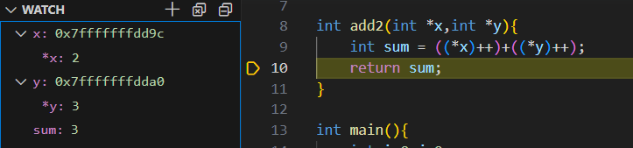
2.2 Pass by value: pointer
Using “-g” option while compiling to generate the executable file, then set break point and debug.
Q1. Is the value of variable “x” same with the address of “i”? how about the value of “b” and the address of “j” ?
Q2. Do variables x and y still exist after returning from the “add2” to the “main” ?
Q3. Which following piece(s) of add2 would cause segment falut, or both ? Why?
//option A
int add2(int*x,int*y){
int sum= ((*x)++)+((*y)++);
return sum;
free(x);
free(y);
x=NULL;
y=NULL;
}
//option B
int add2(int*x,int*y){
int sum= ((*x)++)+((*y)++);
free(x);
free(y);
x=NULL;
y=NULL;
return sum;
}

Slide 22
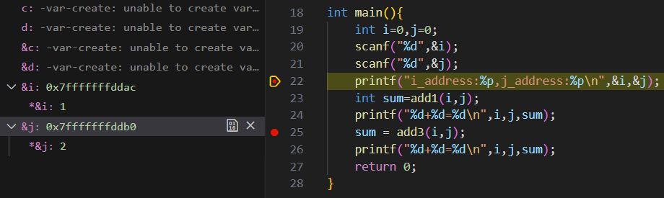
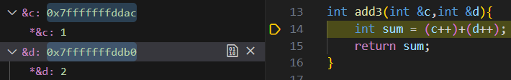
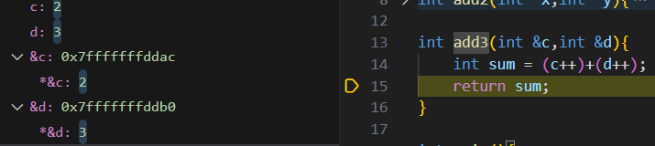
2.3 Pass by reference
Using “-g” option while compiling to generate the executable file, then set break point and debug.
Q1. Is the address of variable “c” same with the address of “i”? how about the address of “b” and the address of “j” ?
Q2. For the following code “add3_x”, is the space of “e” belongs to heap or stack?
What’s the problem of the following code? Fix it and make the return value is 4.
int add3_x(int &c,int &d){
int sum= (c++)+(d++);
int *e= (int*)malloc(sizeof(int));
c=*e;
d=*e;
*e=1;
sum= (c++)+(d++);
return sum;
}

Slide 23
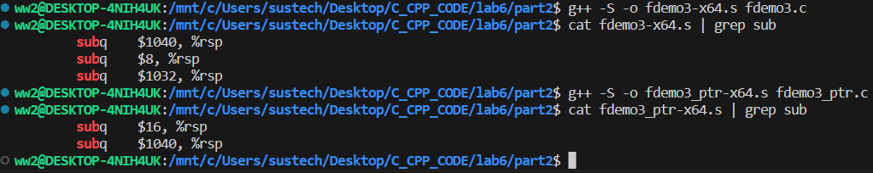
2.4 pass a huge structure vs pass its pointer(1)
using “g++ -S -o” to generate assembly code based on x64.
(The CPU of the testing machine is based on x64)
In x64, register “rsp” is stack pointer.
here passing the value of a huge struct needs more stack space (1040+8+1032) than passing the value of a pointer which points the buge struct(16+1040).
#include<stdio.h> //fdemo3.c
typedef struct {
int id;
char description[1024];
}Stu;
void disp_struct(Stu stud){
printf("Student_id:%d\tinfo:%s\n",
stud.id,stud.description);
}
int main(){
Stu stum={3,"NAZHA"};
disp_struct(stum);
return 0;
}
#include<stdio.h> //fdemo3_ptr.c
typedef struct {
int id;
char description[1024];
}Stu;
void disp_struct(Stu* stud){
printf("Student_id: %d\tinfo:%s\n",
stud->id,stud->description);
}
int main(){
Stu stum={3,"NAZHA"};
disp_struct(&stum);
return0;
}

Slide 24
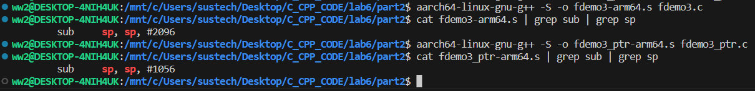
2.4 pass a huge structure vs pass its pointer(2)
using “aarch64-linux-gnu-g++ -S -o” to generate assembly code based on ARM64.
In ARM64, register “sp” is stack pointer.
here passing the value of the huge struct needs more stack space (2096) than passing the value of a pointer which points the buge struct(1056).
#include<stdio.h> //fdemo3.c
typedef struct {
int id;
char description[1024];
}Stu;
void disp_struct(Stu stud){
printf("Student_id:%d\tinfo:%s\n",
stud.id,stud.description);
}
int main(){
Stu stum={3,"NAZHA"};
disp_struct(stum);
return 0;
}
#include<stdio.h> //fdemo3_ptr.c
typedef struct {
int id;
char description[1024];
}Stu;
void disp_struct(Stu* stud){
printf("Student_id: %d\tinfo:%s\n",
stud->id,stud->description);
}
int main(){
Stu stum={3,"NAZHA"};
disp_struct(&stum);
return0;
}

Slide 25
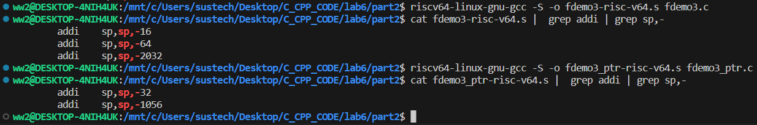
2.4 pass a huge structure vs pass its pointer(3)
using “riscv64-linux-gnu-gcc -S -o” to generate assembly code based on RISC-V64.
In RISC-V64, register “sp” is stack pointer.
here passing the value of the huge struct needs more stack space (16+64+2032) than passing the value of a pointer which points the buge struct(32+1056).
#include<stdio.h> //fdemo3.c
typedef struct {
int id;
char description[1024];
}Stu;
void disp_struct(Stu stud){
printf("Student_id:%d\tinfo:%s\n",
stud.id,stud.description);
}
int main(){
Stu stum={3,"NAZHA"};
disp_struct(stum);
return 0;
}
#include<stdio.h> //fdemo3_ptr.c
typedef struct {
int id;
char description[1024];
}Stu;
void disp_struct(Stu* stud){
printf("Student_id: %d\tinfo:%s\n",
stud->id,stud->description);
}
int main(){
Stu stum={3,"NAZHA"};
disp_struct(&stum);
return0;
}

Slide 26
Exercise 1
#include <iostream>
using namespace std;
int * create_array(int size)
{
int arr[size];
for(int i = 0; i < size; i++)
arr[i] = i * 10;
return arr;
}
int main()
{
int len = 16;
int *ptr = create_array(len);
for(int i = 0; i < len; i++)
cout << ptr[i] << " ";
return 0;
}
What compilation warnings occur when
you compile the program? Why?
What will happen if you ignore the warning
and run the program?
Fix bugs of the program and run it correctly
without memory leak.

Slide 27
Exercise 2
Define a function that swaps two values of integers. Write a test program to call the function and display the result.
You are required to compile the function into a static library “libswap.a”, and then compile and run your program with this static library.

Slide 28
Exercise 3
3-1. Run the demo code on page 21 and 22, answer the questions on these pages.
3-2. Change fdemo3_ptr.c on page 23 to pass the reference instead of pass the pointer, generate the assembly soure code on your PC and answer the question: Would passing the reference use more stack space than passing the pointer in this situation ?
3-3. Compare the differences between pointers and references in C++, as well as the differences between references in C++and Python, make a summay.

