Slide 1
Advanced Programming
Lab 7, shared library, function and memory
廖琪梅，王大兴，于仕琪，王薇

Slide 2
Topic
Shared library
Build
Use
Makefile
CMakelists.txt
Function and Memory
function address
maps, executable memory
Practice

Slide 3
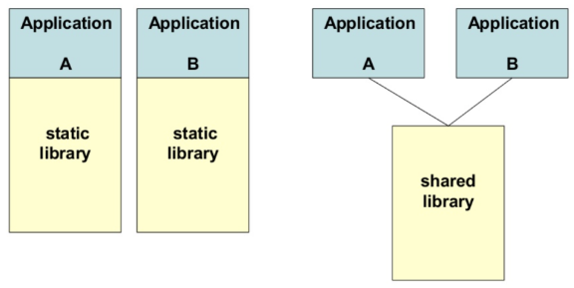
 | advantages | disadvantages
Static Library | 1. Make the executable has fewer dependencies, has been packaged into the executable file. 2. The link is completed in the compilation stage, and the code is loaded quickly during execution. | 1. Make the executable file larger. 2. Being a library dependent on another library will result in redundant copies because it must be packaged with the target file. 3. Upgrade is not convenient and easy. The entire executable needs to be replaced and recompiled.
Dynamic Library | 1.Dynamic library can achieve resource sharing between processes, there can be only one library file. 2. The upgrade procedure is simple, do not need to recompile. | 1. Loading during runtime will slow down the execution speed of code. 2. Add program dependencies that must be accompanied by an executable file.

Slide 4
Building a shared library
Suppose we have written the following code:
// mymath.h
#ifndef __MY_MATH_H__
#define __MY_MATH_H__
float arraySum(const float *array, size_t size);
#endif
// main.cpp
#include <iostream>
#include "mymath.h"
int main()
{
float arr1[8]{1.f, 2.f, 3.f, 4.f, 5.f, 6.f, 7.f, 8.f};
float * arr2 = NULL;
float sum1 = arraySum(arr1, 8);
float sum2 = arraySum(arr2, 8);
std::cout << "The result1 is " << sum1 << std::endl;
std::cout << "The result2 is " << sum2 << std::endl;
return 0;
}
// mymath.cpp
#include <iostream>
#include "mymath.h"
float arraySum(const float *array, size_t size)
{
if(array == NULL)
{
std::cerr << "NULL pointer!" << std::endl;
return 0.0f;
}
float sum = 0.0f;
for(size_t i = 0; i < size; i++)
sum += array[i];
return sum;
}

Slide 5
Building shared libraries
A shared library packs compiled code of functionality that the developer wants to share with other developers.
Shared libraries in linux are .so files.
Remember to use arguments “-shared” and “-fPIC” when building it.
Now we should see “libmymath.so” in the directory
The name of .so must be started with “lib” followed by the .cpp name in which a function is defined.
Create a shared library.
Generate Position-Independent-Code.

Slide 6
Using shared library
Now we can use the “.so” shared library.
Let’s compile “main”:
“lmymath” indicates to use “libmymath.so”
“-L.” indicates to find a library file in the current directory.
-L: indicates the directory of libraries
-l: indicates the library name, the compiler can give the “lib” prefix to the library name and follows with .so as extension name.

Slide 7
Using shared library
After the “main” has been compiled, try to run it:
It failed because “main” now relys on “libmymath.so”. By default, libraries are located in /usr/local/lib or /usr/lib , but our “libmymath.so” is not in that directory. You must tell the terminal where to find “libmymath.so”.

Slide 8
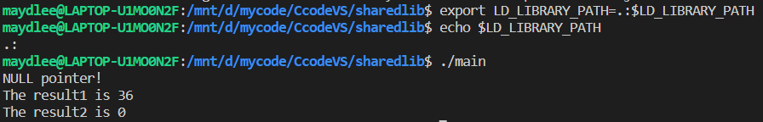
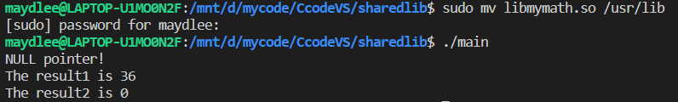
Using a shared library
Using export command to set environment variable “LD_LIBRARY_PATH”
And then run “main” again
export LD_LIBRARY_PATH=.:$LD_LIBRARY_PATH
There is no space on either side of the equal sign
. indicates the current directory
Another choice is to move your .so file to /usr/lib folder by mv command

Slide 9
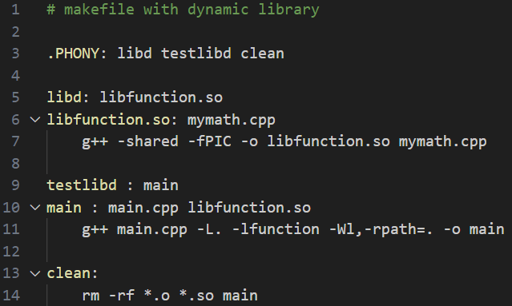
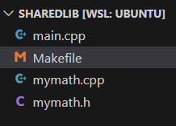
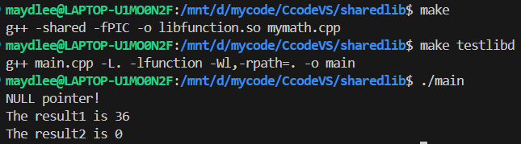
Shared library in makefile
All the files are in
the same folder.
–Wl option allows you to pass subsequent arguments to the linker.
–rpath option is used to specify the directories that the runtime dynamic linker(ld.so)
should search when looking for dynamic libraries during execution.
Run the first target to create the dynamic library.
Run the second target to link the dynamic library to the executable file.
Run the executable file.

Slide 10
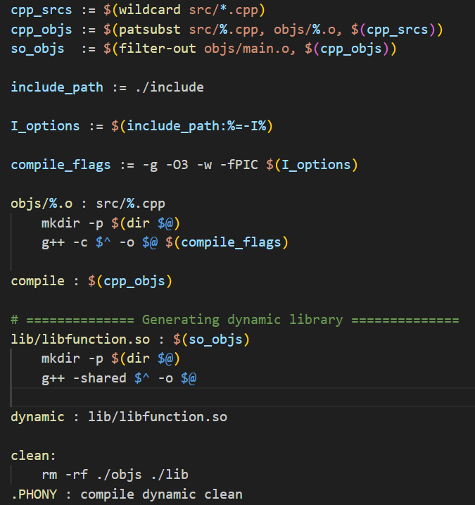
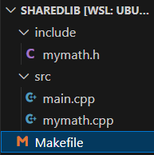
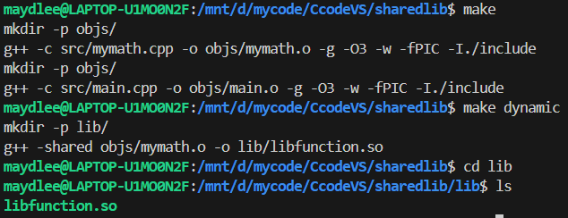
The first part of the makefile just creates a dynamic library named libfunction.so
This time we put all the source files in the “src” folder, the function header file in the “include” folder, and create a makefile in the current folder.

Slide 11
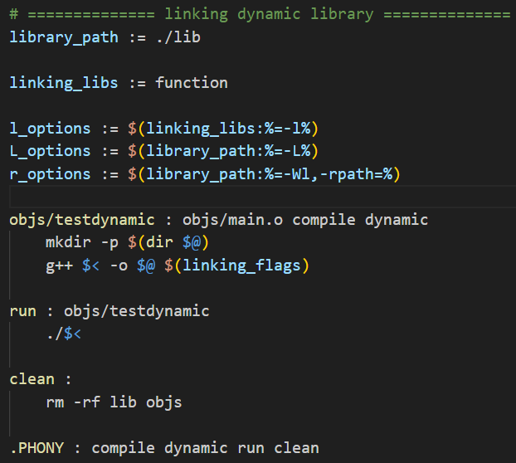
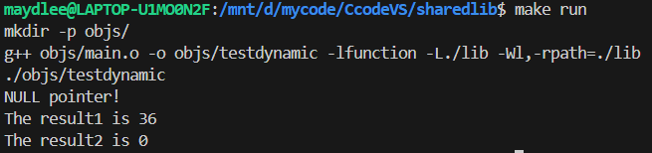
The second part of the makefile links
the dynamic library libfunction.so to
the executable file testdynamic in the
“objs” folder.

Slide 12
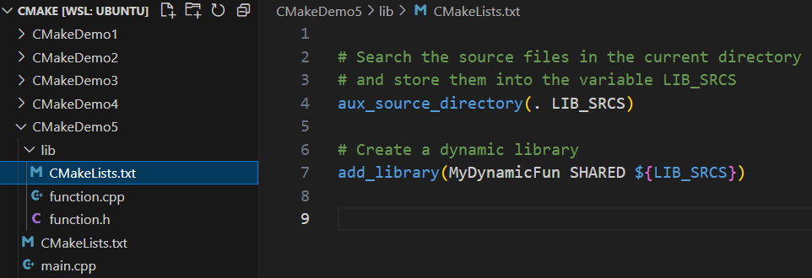
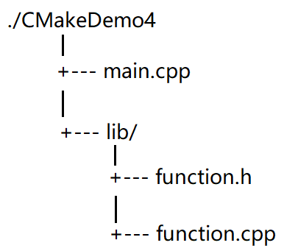
Creating and linking a dynamic library by CMake
We want to create a dynamic library by function.cpp and call the dynamic library in main.cpp. This time we write two CMakeLists.txt files, one in CmakeDemo5 folder and another in lib folder.
The CMakeLists.txt in lib folder creates a dynamic library.
./CMakeDemo5
dynamic library
The directory from which
the library file originates.
library file name
Create a static library named libMyDynamicFun.so by the files in the current directory.

Slide 13
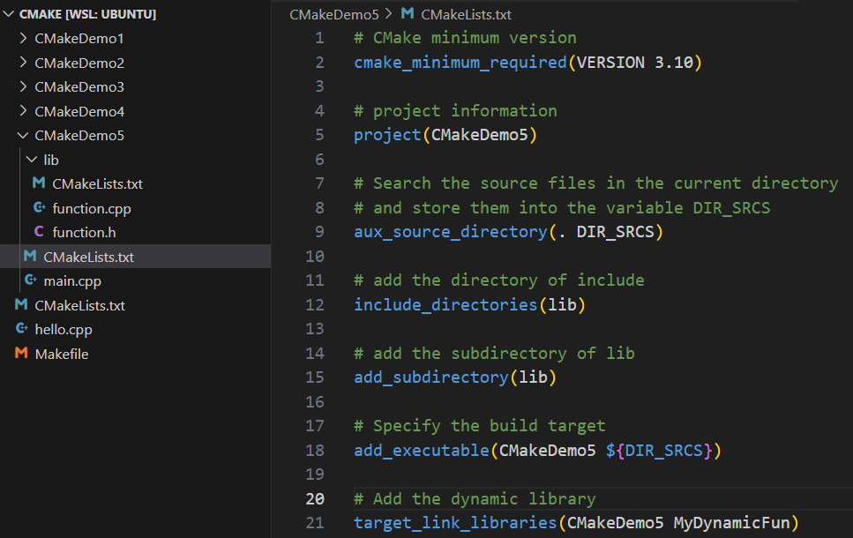
The CMakeLists.txt in CMakeDemo5 folder creates the project.
Indicates that the project needs link a library named MyDynamicFun, MyDynamicFun can be a static library file or a dynamic library file.
add_subdirectory command
indicates there is a subdirectory
in the project. When running the
command, it will execute the
CMakeLists.txt in the subdirectory
automatically.
project name
library file name
If there are more than one file, list them using space as the separator.

Slide 14
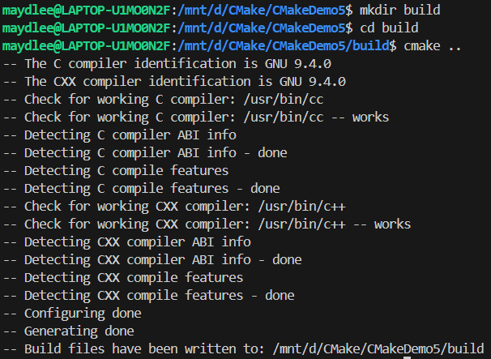
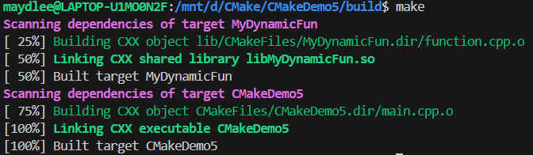

Slide 15
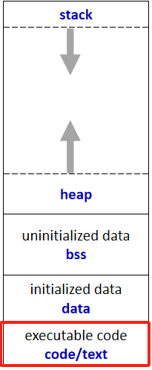
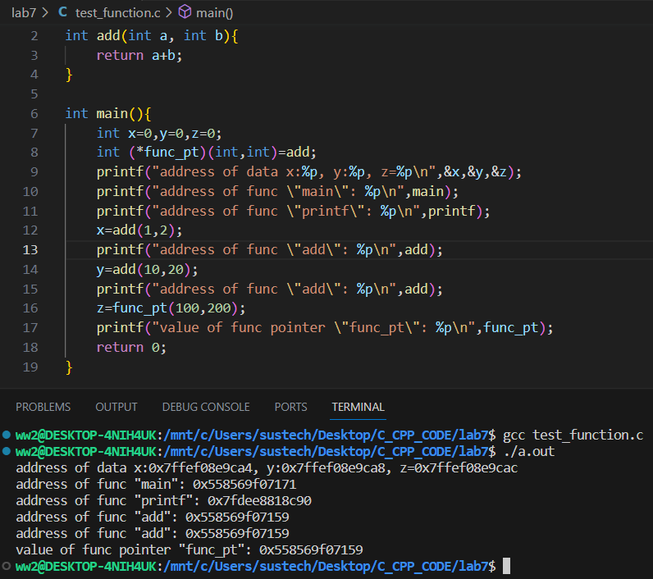
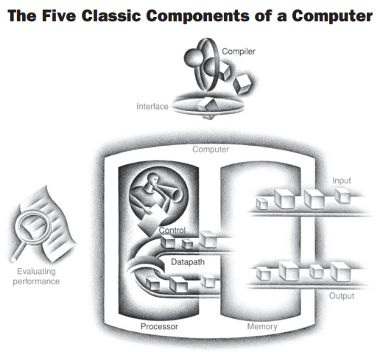
Function and Memory(1)

Slide 16
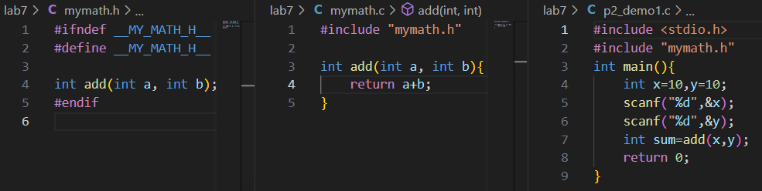
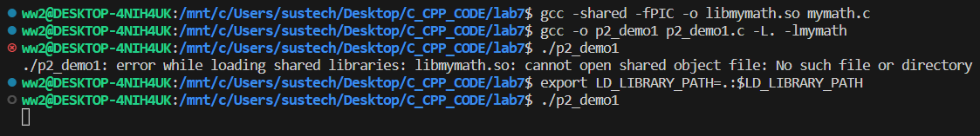
Function and Memory(2)
Q. What the specific memory usage during the execution of the “p3_demo1” program ?
Tips:
1. Use “pgrep” tool to view the process number of the currently running process that matches the specified name
2. Use “cat” to find current usage of memory by the process according to the “maps” of the process.
The “perms” field is a set of permissions: r = read, w = write, x = execute, s = shared, p = private (copy on write)
https://man7.org/linux/man-pages/man5/proc_pid_maps.5.html

Slide 17
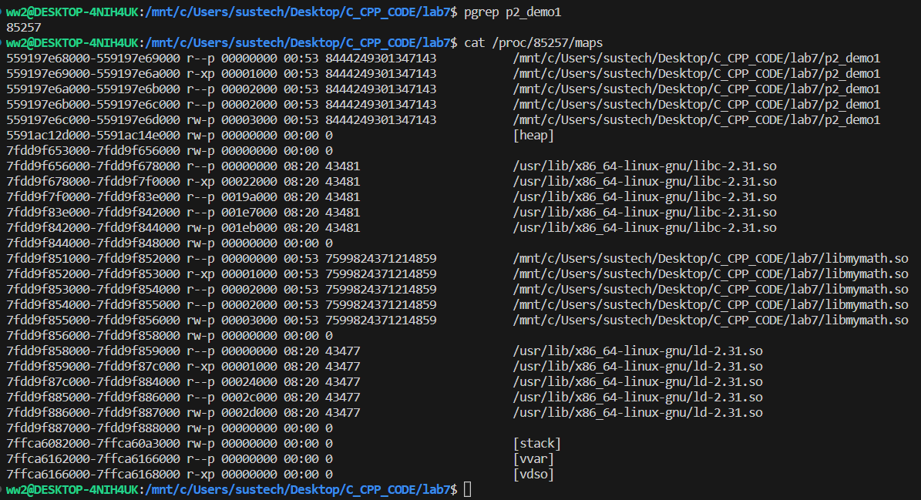
Function and Memory(3)

Slide 18
Exercise 1
Overload a function bool vabs(int * p, int n) which can compute the absolute value for every element of an array, the array can be int, float and double.
Should n be int or size_t? what's the difference? Remember to check whether the pointer is valid.
Create a shared library “libvabs.so” with 3 overloaded vabs() functions in it, and then compile and run your program with this shared library. Test the address of each overloaded vabs() functions.
Create a static library “libvabs.a” with 3 overloaded vabs() functions in it, and then compile and run your program with this static library.Test the address of each overloaded vabs() functions.
Conclude the difference between static library and shared library according to your experimental results.

Slide 19


Exercise 2
Write a program that uses a function template called Compare to compare the relationship between the values of the two arguments and return 1 when the first argument is greater than the second one; return -1 when the first argument is smaller than the second one, return 0 when the both values are equal. Test the program using integer, character and floating-point number arguments and print the result of the comparation.
If there is a structure as follows, how to define an explicit specialization of the template function Compare and print the result of the comparation?
struct stuinfo{
string name;
int age;
};
The prototype of the Compare:
The output:

