Slide 1
C/C++ Program Design
CS205
Prof. Shiqi Yu (于仕琪)
yusq@sustech.edu.cn
http://faculty.sustech.edu.cn/yusq/

Slide 2
Improve Your Source Code

Slide 3
Suggestions to your Project 3
Use size_t for mat.cols and mat.rows
Use memcpy() to copy data. Element assignment has a lower efficiency.
Use 1D array (float*) nor 2D array (float**) for matrix data.
Redundant computation in loops
Do parameter checking in functions: null pointers, dimension matching in matrix operations, etc.
Do not bind the create matrix function with file I/O.
File name: 1.c, 2.c, 3.h
Good implementation VS good homework.
matrix/

Slide 4
Acceleration using GPU

Slide 5
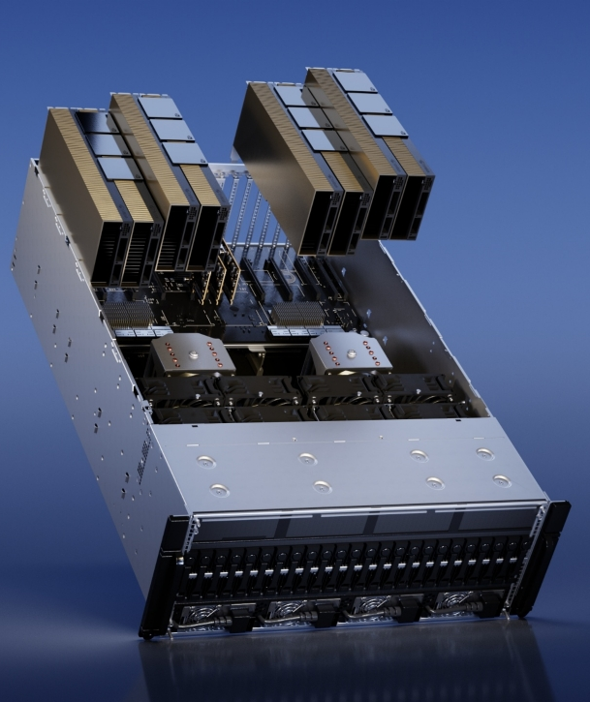
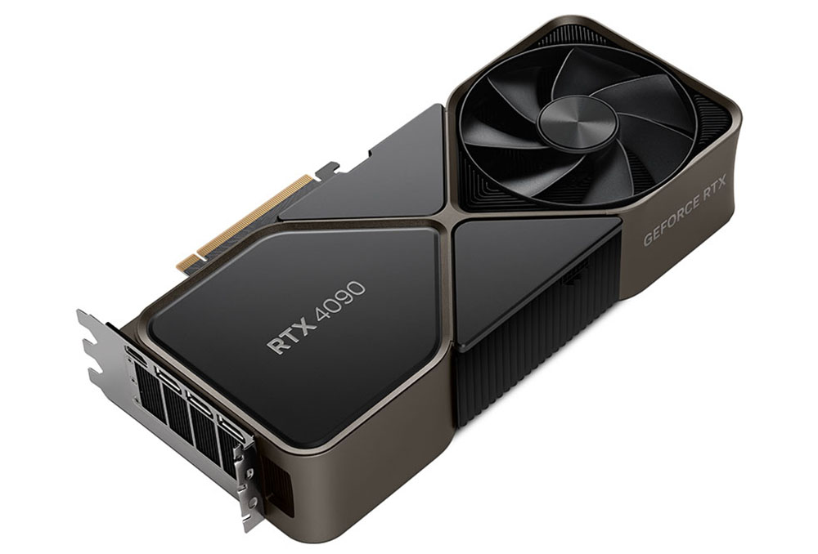
Typical GPUs
Graphics Processing Unit (GPU)
Higher instruction throughput and memory bandwidth than CPU
Devices: Nvidia GeForce RTX 4090, Nvidia H100, Huawei Ascend (昇腾) 910B, etc

Slide 6
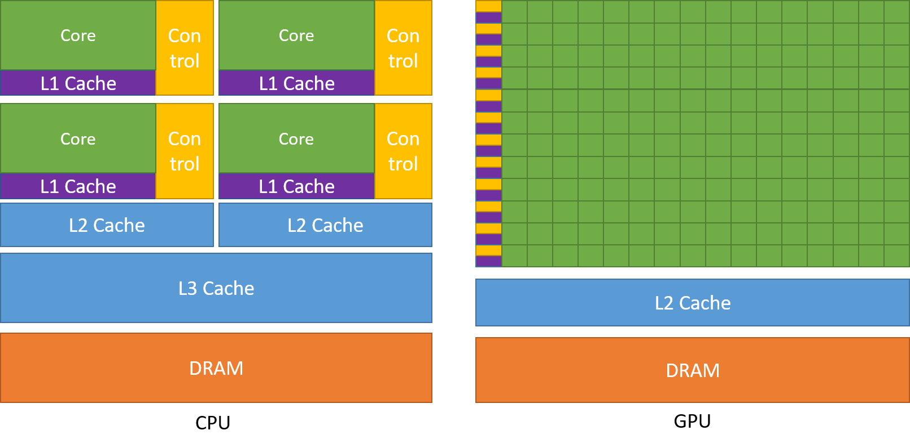
CPU vs GPU
GPU has much more cores, good for parallel computations, not good for a single-thread program with complex logics.
The data transfer between the CPU memory and GPU memory maybe a bottleneck.
https://docs.nvidia.com/cuda/cuda-c-programming-guide/index.html

Slide 7


CUDA
Ascend C
By Nvidia, a parallel compute engine in Nvidia GPUs
A software environment,
Use a subset of C++ as its high-level programming language.
By Huawei, for Huawei GPUs
Similar to CUDA

Slide 8
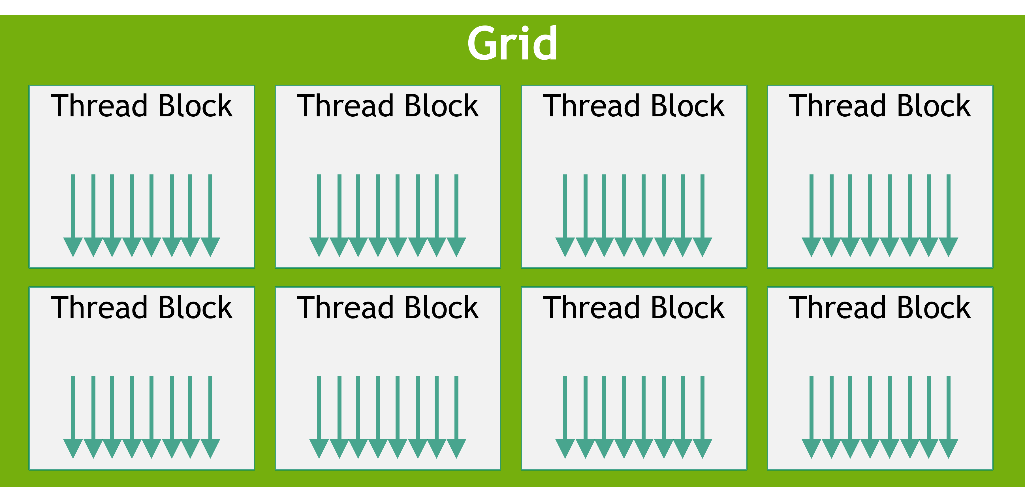
Hello, CUDA
The keyword __global__ indicates the function:
Runs on the device (GPU)
Can be called from the host (CPU)
__global__ void mykernel()
{
printf("Hello, CUDA. I'm Thread %d in Block %d. blockDim=%d.\n",
threadIdx.x, blockIdx.x, blockDim.x);
}
int main()
{
...
mykernel<<<2,2>>>();
...
return 0;
}
hellocuda.cu
https://docs.nvidia.com/cuda/cuda-c-programming-guide/index.html

Slide 9
Array addition by CUDA
__global__ void add(const float * input1, const float * input2, float * output, size_t len)
{
int i = blockDim.x * blockIdx.x + threadIdx.x;
if(i < len)
output[i] = input1[i] + input2[i];
}
int main()
{
... add<<<2,2>>>(cudaVec1, cudaVec2, cudaVec3, len);
... return 0;
}
arrayadd.cu

Slide 10
Matrix addition by CUDA
typedef struct
{
size_t rows;
size_t cols;
float * data; // CPU memory
float * data_device; //GPU mememory
} Matrix;
Matrix * createMatrix(size_t r, size_t c);
void freeMatrix(Matrix ** pp);
bool addCPU(const Matrix * pMat1, const Matrix * pMat2, Matrix * pMat3);
bool addGPU(const Matrix * pMat1, const Matrix * pMat2, Matrix * pMat3);
matadd.cu

