Slide 1
Advanced Programming
Lab 10, Class(2): operator overloading
廖琪梅，王大兴, 于仕琪，王薇

Slide 2
Topic
Operator overloading in C++
Member function vs Non-member function( e.g. Friend function)
Returning object vs Returning reference
Conversion of class
implicit conversion vs explicit conversion
conversion function
‘Operateor overloading’ in Python
x + y : type(x).__add__(x, y)
x + y: type(y).__radd__(y, x)
__str__()
Exercises

Slide 3
Operator overloading in C++

Slide 4
Operator overloading
To overload an operator, use a special function form called an operator function.
return_type operator op(argument-list)
op is the symbol for the operator being overloaded
An operator function must either be a member function of a class or have at least one parameter of class type.

Slide 5
member function, non-member function, friend function
Non-member operator overloads are required to enable type conversion on the left operand. If a function needs such conversion, define it as a non-member. If it also requires access to non-public members, declare it as a friend of the class.
Other cases beyond the above, define the function as a member function.
The assignment (=)operators must be defined as member functions. However, IO operators(<< and >>) must be non-member functions.

Slide 6
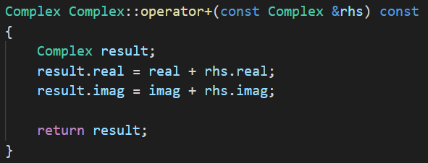
Returning object
Return the value, or the reference?
1. Returning an object
When a function returns an object, a temporary object will be created. There is the added expense of calling the copy constructor to create the temporary object, it is less efficient. It is invisible and does not appear in your source code. The temporary object is automatically destroyed when the function call terminates.

Slide 7
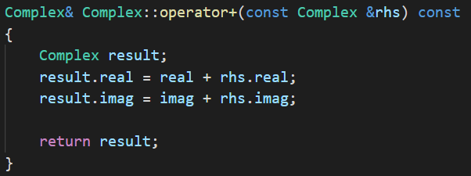
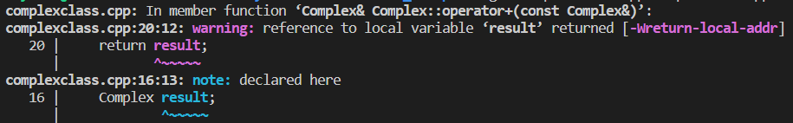
Do not return the reference of a local object, because when the function terminates, the reference would be a reference to a non-existent object.

Slide 8
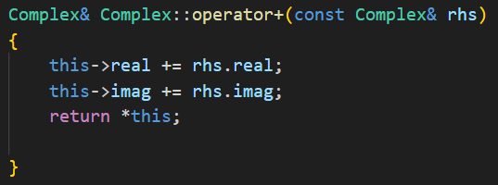
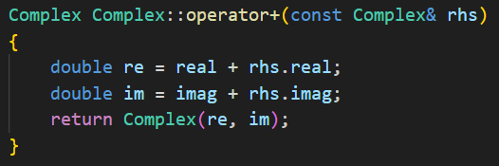
Returning a reference to this object works efficiently, but it modifies the values of the data member of this object.
This return style is known as return constructor argument. By using this style instead of returning an object, the compiler can eliminate the cost of the temporary object. This even has a name: the return value optimization.

Slide 9
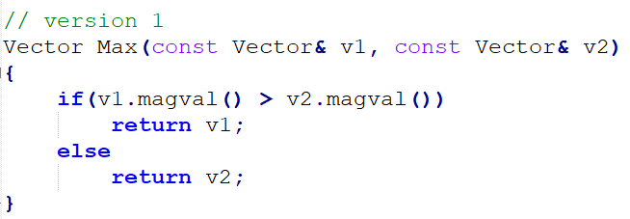
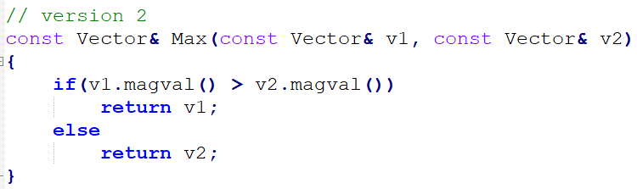
2. Returning a reference to an object
Returning an object invokes the copy constructor, whereas returning a reference doesn’t. Thus version 2 does less work and is more efficient.
The reference should be to an object that exists when the calling function is executing.
Both v1 and v2 are declared as being const references, so the return type has to be const to match.
Two common examples of returning a non-const object are overloading the assignment operator and overloading the << operator for use with cout.

Slide 10
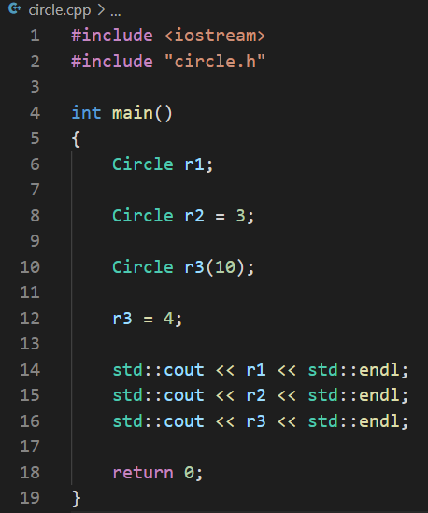
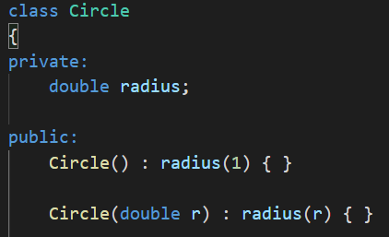
Conversion of class
1. Implicit Class-Type Conversions
Every constructor that can be called with a single argument defines an implicit conversion to a class type. Such constructors are sometimes referred to as converting constructors.
Convert int
to Circle type
when we use the copy form of initialization or assignment (with an =), implicit conversions happens.
Convert int
to Circle type
Converting constructor

Slide 11
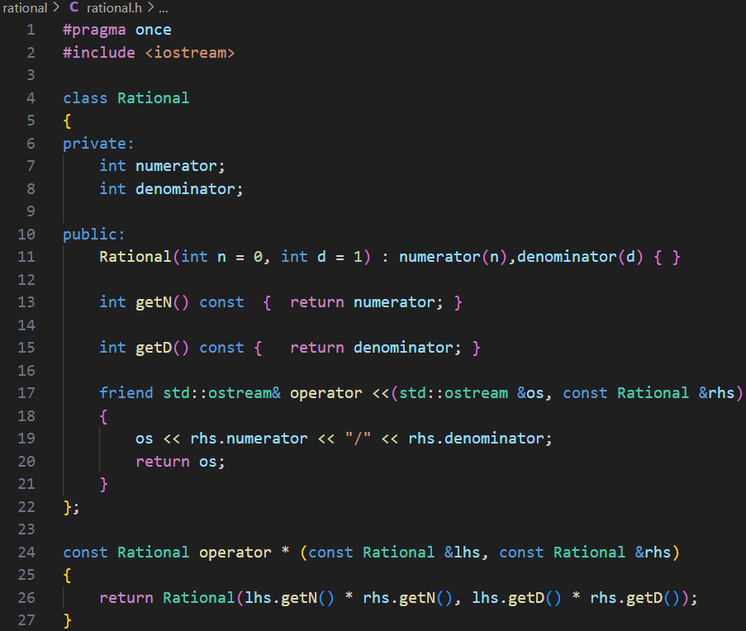
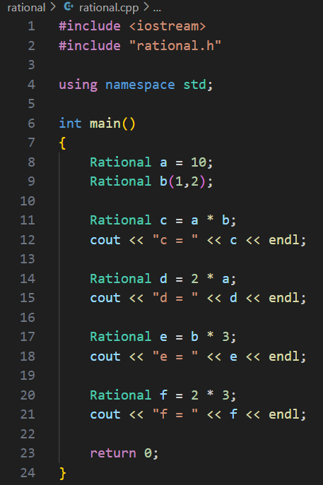

Convert int to Rational type
Constructor with default arguments works as a converting constructor.
We define the operator * as a normal function not a friend function of the Rational class.

Slide 12
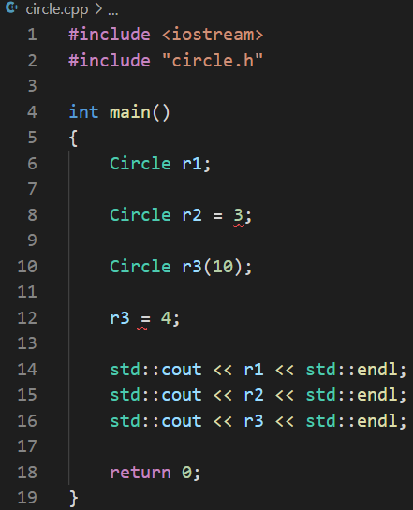
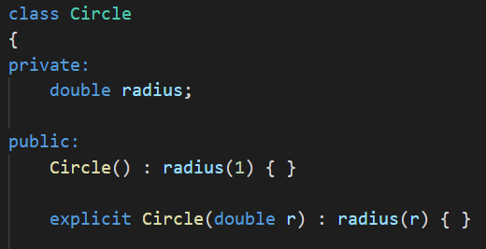

Use explicit to supper the implicit conversion
We can prevent the use of a constructor in a context that requires an implicit conversion by declaring the constructor as explicit:
Can not do the implicit conversion
Turn off implicit conversion
Use these two styles for explicit conversion

Slide 13
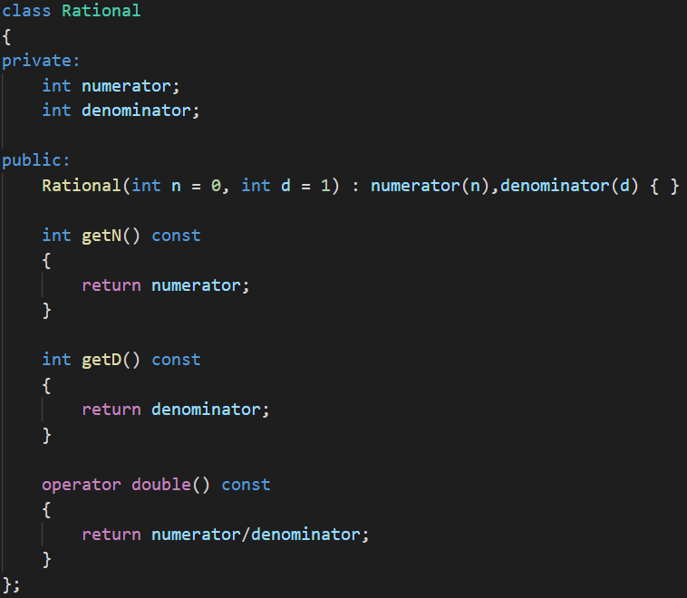


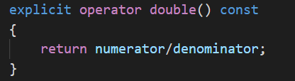
2. Conversion function
Conversion function is a member function with the name operator followed by a type specification, no return type, no arguments.
operator typeName( );
Convert Rational object a to double by conversion function
Declare a conversion operator as explicit for calling it explicitly
Caution: You should use implicit conversion functions with care. Often a function that can only be invoked explicitly is the best choice.
conversion function

Slide 14
Operator overloading in Python

Slide 15
‘Operateor overloading’ in Python
In Python, operator overloading is accomplished by implementing special methods of classes (also known as magic methods). These methods start and end with double underscores (such as __add__).
implement the binary arithmetic operations
object.__add__(self, other) object.__sub__(self, other) object.__mul__(self, other) object.__matmul__(self, other) object.__truediv__(self, other) object.__floordiv__(self, other) object.__mod__(self, other) object.__divmod__(self, other) object.__pow__(self, other[, modulo]) object.__lshift__(self, other) object.__rshift__(self, other) object.__and__(self, other) object.__xor__(self, other) object.__or__(self, other)
These methods are called to implement the binary arithmetic operations (+, -, *, @, /, //, %, divmod(), pow(), **, <<, >>, &, ^, |).
For instance, to evaluate the expression x + y, where x is an instance of a class that has an __add__() method,
type(x).__add__(x, y) is called.
https://docs.python.org/3/reference/datamodel.html#emulating-numeric-types

Slide 16
Implement the binary arithmetic operations with reflected (swapped) operands
object.__radd__(self, other) object.__rsub__(self, other) object.__rmul__(self, other) object.__rmatmul__(self, other) object.__rtruediv__(self, other) object.__rfloordiv__(self, other) object.__rmod__(self, other) object.__rdivmod__(self, other) object.__rpow__(self, other[, modulo]) object.__rlshift__(self, other) object.__rrshift__(self, other) object.__rand__(self, other) object.__rxor__(self, other) object.__ror__(self, other)
These methods are called to implement the binary arithmetic operations (+, -, *, @, /, //, %, divmod(), pow(), **, <<, >>, &, ^, |) with reflected (swapped) operands.
These functions are only called if the left operand does not support the corresponding operation and the operands are of different types.
For instance, to evaluate the expression x - y, where y is an instance of a class that has an __rsub__() method, type(y).__rsub__(y, x) is called
if type(x).__sub__(x, y) returns NotImplemented.
https://docs.python.org/3/reference/datamodel.html#emulating-numeric-types

Slide 17
#include <iostream> //MyTime.cpp
class MyTime{
int hours;
int minutes;
public:
MyTime(): hours(0), minutes(0){}
MyTime(int h, int m): hours(h), minutes(m){}
MyTime operator+(int m) const{
MyTime sum;
sum.minutes=this->minutes+m;
sum.hours=this->hours;
sum.hours+=sum.minutes/60;
sum.minutes%=60;
return sum;
}
friend MyTimeoperator+(int m, const MyTime&t){
return t+m;
}
friend std::ostream& operator<<(std::ostream&os, const MyTime&t){
std::string str=std::to_string(t.hours) +" hours and "
+std::to_string(t.minutes) +" minutes.";
os<<str;
return os;
}
};
int main(){
MyTime mt(1,59);
std::cout<<mt+2<<std::endl;
std::cout<<1+mt<<std::endl;
return 0;
}
class MyTime: #MyTime.py
def __init__(self, h=0, m=0):
self.hours=h
self.minutes=m
def __add__(self, other):
if isinstance(other, int):
total_min=self.minutes+other
new_hours=self.hours+total_min//60
new_minutes=total_min%60
return MyTime(new_hours, new_minutes)
return NotImplemented
def __radd__(self, other):
return self.__add__(other)
def __str__(self):
return f"{self.hours} hours and {self.minutes} minutes."
if__name__=="__main__":
mt=MyTime(1, 59)
print(mt+2)
print(1+mt)

Slide 18
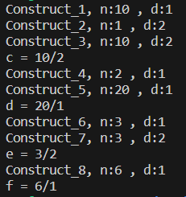
Exercise1
Modify the code(rational.h) so that the program runs as shown in the screenshot on the right and explain the output where each constructor is run.
// rational.h
#pragma once
#include <iostream>
class Rational{
private:
staticint id;
int numerator;
int denominator;
public:
Rational(int n=0, int d=1): numerator(n), denominator(d){
std::cout<<"Construct_"<<id<<", n:"<<numerator<<" , d:"<<denominator<<std::endl;
}
int getN() const { return numerator; }
int getD() const { return denominator; }
friend std::ostream & operator<<(std::ostream& os, const Rational&rhs){
os<<rhs.numerator<<"/"<<rhs.denominator;
returnos;
}
};
int Rational::id=0;
const Rational operator*(constRational&lhs, const Rational&rhs){
return Rational(lhs.getN()*rhs.getN(), lhs.getD()*rhs.getD() );
}
#include <iostream>
#include "rational.h"
using namespace std;
int main(){
Rational a=10;
Rational b(1,2);
Rational c=a*b;
cout<<"c = "<<c<<endl;
Rational d=2*a;
cout<<"d = "<<d<<endl;
Rational e=b*3;
cout<<"e = "<<e<<endl;
Rational f=2*3;
cout<<"f = "<<f<<endl;
return0;
}

Slide 19
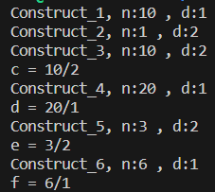
Exercise2
Please modify the code(rational.h) in Exercise1 to the program runs as shown in the screenshot. Explain what modifications have been made and wy.
// rational.h
#pragma once
#include <iostream>
class Rational{
private:
staticint id;
int numerator;
int denominator;
public:
Rational(int n=0, int d=1): numerator(n), denominator(d){
std::cout<<"Construct_"<<id<<", n:"<<numerator<<" , d:"<<denominator<<std::endl;
}
int getN() const { return numerator; }
int getD() const { return denominator; }
friend std::ostream & operator<<(std::ostream& os, const Rational&rhs){
os<<rhs.numerator<<"/"<<rhs.denominator;
returnos;
}
};
int Rational::id=0;
const Rational operator*(constRational&lhs, const Rational&rhs){
return Rational(lhs.getN()*rhs.getN(), lhs.getD()*rhs.getD() );
}
#include <iostream>
#include "rational.h"
using namespace std;
int main(){
Rational a=10;
Rational b(1,2);
Rational c=a*b;
cout<<"c = "<<c<<endl;
Rational d=2*a;
cout<<"d = "<<d<<endl;
Rational e=b*3;
cout<<"e = "<<e<<endl;
Rational f=2*3;
cout<<"f = "<<f<<endl;
return0;
}

Slide 20
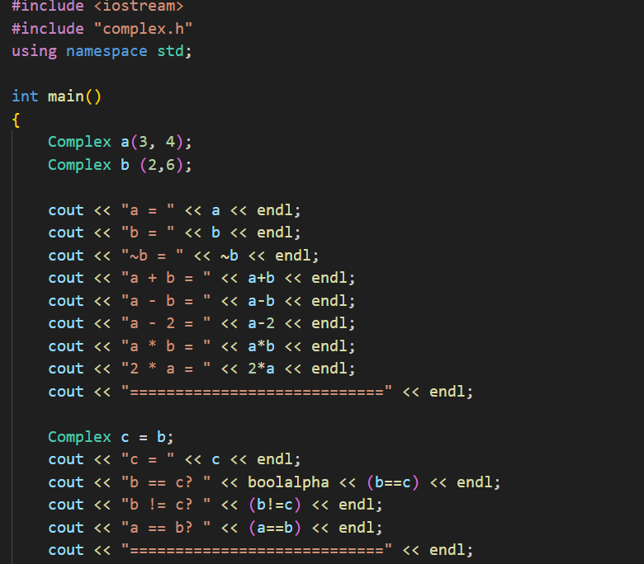
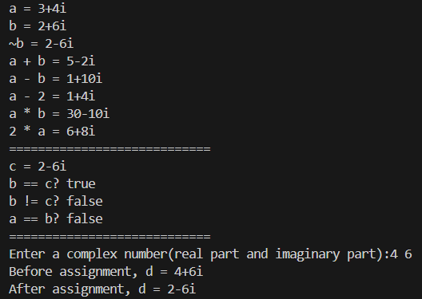
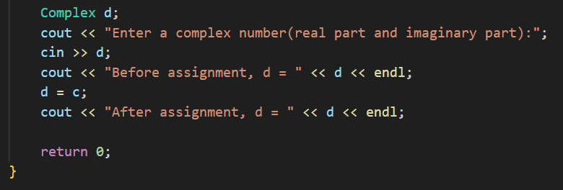
Exercise3
Continue to improve the Complex class and add more operations for it, such as: -, *, ~, ==, != etc. Make the following program run correctly.
Note that you have to overload the << and >> operators. Use the references to objects and const whenever warranted.
The sample should run as follows:

