Slide 1
C/C++ Program Design
CS205
Prof. Shiqi Yu (于仕琪)
yusq@sustech.edu.cn
http://faculty.sustech.edu.cn/yusq/

Slide 2
Some Default Operations

Slide 3
Default Constructors
Default constructor: a constructor which can be called without arguments
If you define no constructors, the compiler automatically provide one
MyTime::MyTime(){}
If you define constructors, the compiler will not generate a default one.
class MyTime
{
public:
MyTime(int n){ ... }
};
MyTime mt; //no appropriate constructor
To avoid ambiguous
class MyTime
{
public: //two default constructors
MyTime(){ ... }
MyTime(int n = 0){ ... }
};
MyTime mt; //which constructor?

Slide 4
Implicitly-defined Destructor
If no destructor is defined, the compiler will generate an empty one.
MyTime::~MyTime(){}
Memory allocated in constructors is normally released in a destructor.

Slide 5
Default Copy Constructors
A copy constructor. Only one parameter, or the rest have default values
MyTime::MyTime(MyTime & t){ ... }
MyTime t1(1, 59);
MyTime t2(t1); //copy constructor
MyTime t3 = t1; //copy constructor
Default copy constructor:
If no user-defined copy constructors, the compiler will generate one.
Copy all non-static data members.

Slide 6
Default Copy Assignment
Assignment operators: =, +=, -=, ...
Copy assignment operator
Default copy assignment operator
If no user-defined copy assignment constructors, the compiler will generate one.
Copy all non-static data members.
MyTime & MyTime::operator=(MyTime & ){...}
MyTime t1(1, 59);
MyTime t2 = t1; //copy constructor
t2 = t1; //copy assignment

Slide 7
An Example with Dynamic Memory

Slide 8
A Simple String Class
class MyString
{
int buf_len;
char * characters;
public:
MyString(int buf_len = 64, const char * data = NULL)
{
this->buf_len = 0;
this->characters = NULL;
create(buf_len, data);
}
~MyString()
{
delete []this->characters;
}
...
};
example1

Slide 9
Dynamic Memory in Objects
str1 | characters
 | buf_len: 10
\0
n
e
h
z
n
e
h
S
MyString str1(10, "Shenzhen");
MyString str2 = str1;
MyString str3;
str3 = str1;
0x600002eb4030
str2 | characters
 | buf_len: 10
str3 | characters
 | buf_len: 64
10
0x6000039b01c0

Slide 10
Solution 1: Hard Copy

Slide 11
Copy Constructor
Provide a user-defined copy constructor.
MyString::MyString(const MyString & ms)
{
this->buf_len = 0;
this->characters = NULL;
create(ms.buf_len, ms.characters);
}
create() release the current memory and allocate a new one.
this->characters will not point to ms.characters .
It’s a hard copy!

Slide 12
Copy Assignment
Provide a user-defined copy assignment
MyString & operator=(const MyString &ms)
{
create(ms.buf_len, ms.characters);
return *this;
}
example2

Slide 13
Solution 2: Soft Copy

Slide 14
Problem of Hard Copy
Frequently allocate and free memory.
Time consuming when the memory is big.
But...
If several objects share the same memory, who should release it?

Slide 15
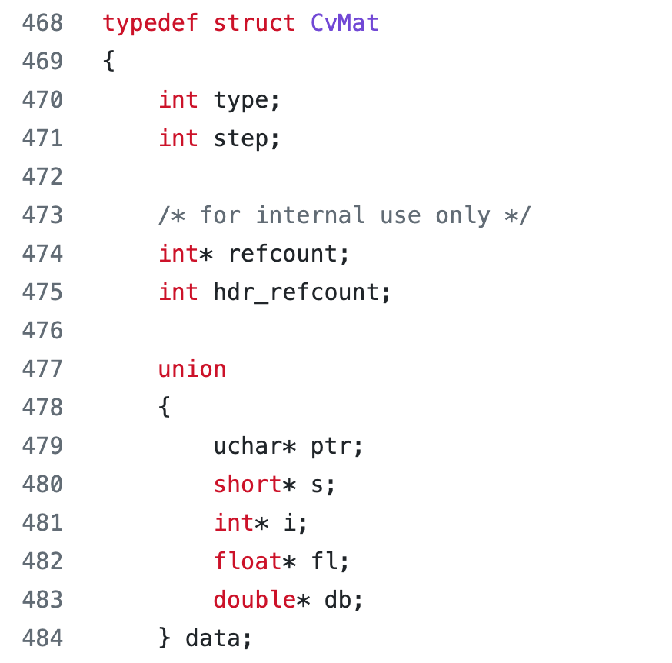
CvMat struct
modules/core/include/opencv2/core/types_c.h

Slide 16
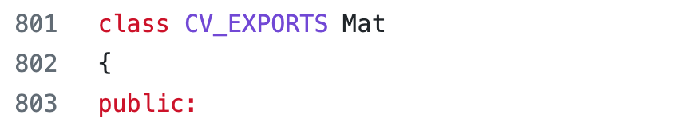
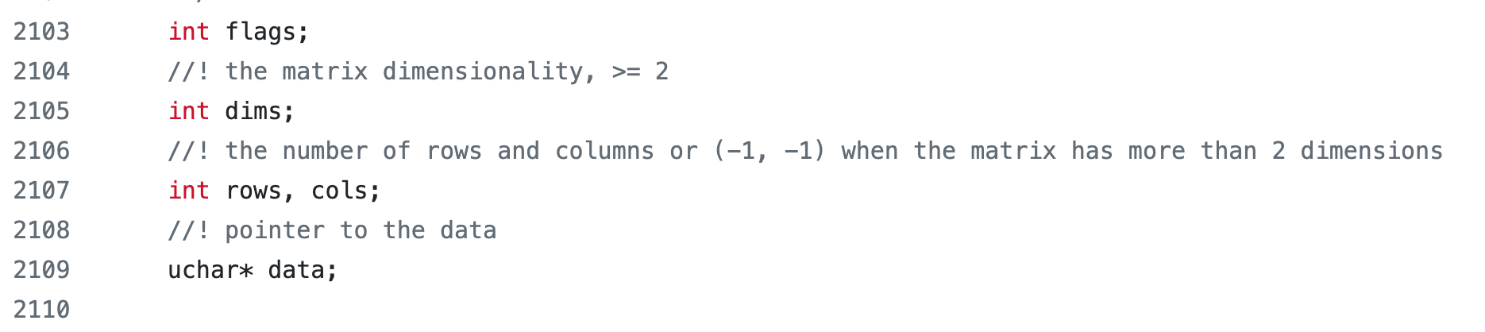
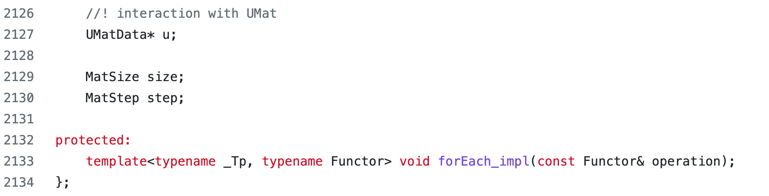
cv::Mat class
d
Allocated at the same time

Slide 17
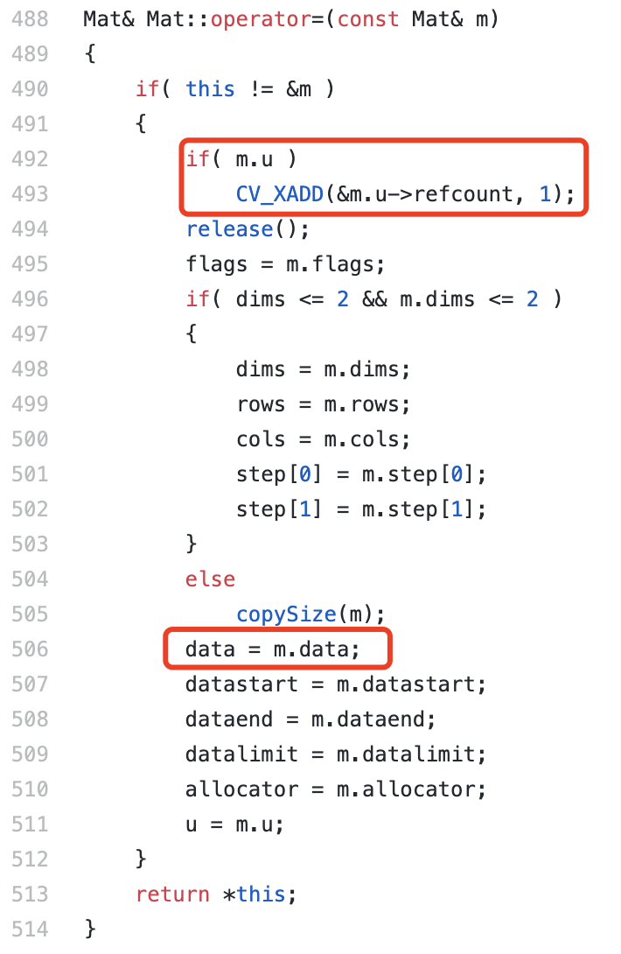
Solution in OpenCV
modules/core/src/matrix.cpp
The allocated memory can be used by multiple object
Mat::u->refcount is used to count the times the memory is referenced
CV_XADD: macro for atomic add

Slide 18
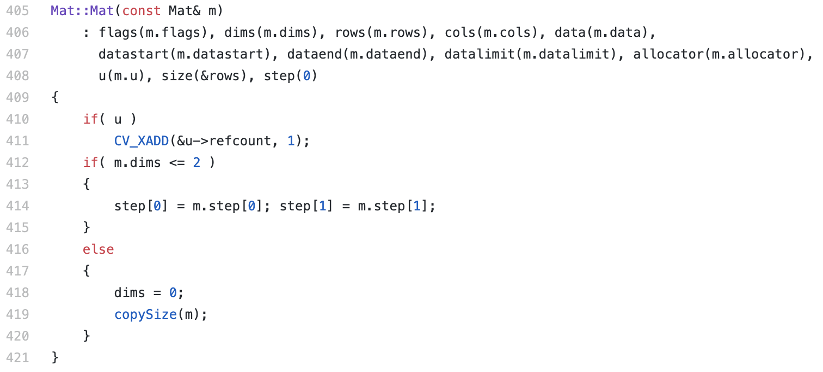
Solution in OpenCV
Copy constructor of cv::Mat
modules/core/src/matrix.cpp

Slide 19
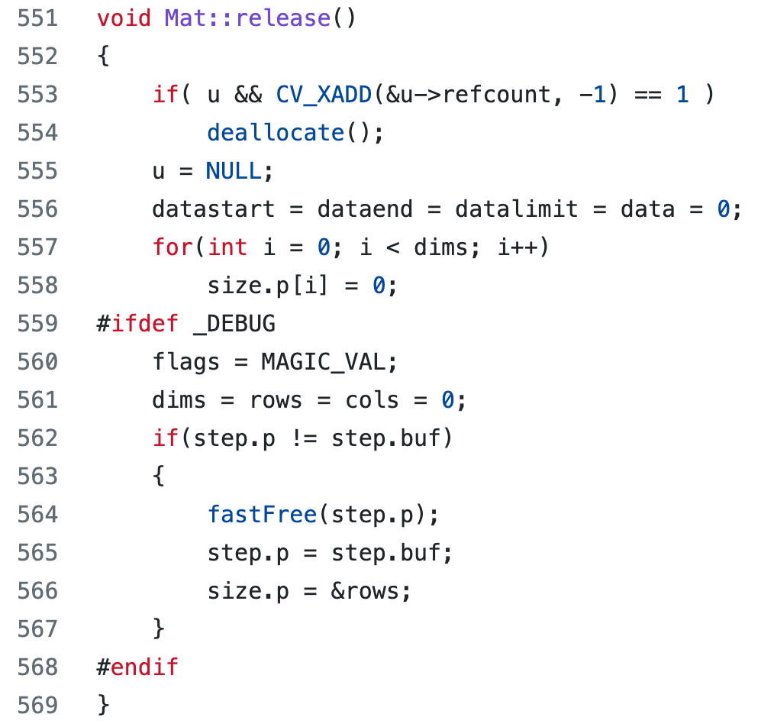
Solution in OpenCV
modules/core/src/matrix.cpp

Slide 20
Dynamic Memory in Objects
\0
n
e
h
z
n
e
h
S
MyString str1(10, "Shenzhen");
MyString str2 = str1;
MyString str3;
str3 = str1;
str1 | characters
 | refcount
 | buf_len：10
str2 | characters
 | refcount
 | buf_len：10
0x6000034dc040
3
str3 | characters
 | refcount
 | buf_len：10
0x6000023d81c0
1
example3

Slide 21
If refcount is not a pointer, is a int
\0
n
e
h
z
n
e
h
S
str1 | characters
 | refcount：1
 | buf_len：10
str2 | characters
 | refcount：2
 | buf_len：10
0x6000034dc040
str3 | characters
 | refcount：3
 | buf_len：10

Slide 22
Smart Pointers

Slide 23
std::shared_ptr
Smart pointers are used to make sure that an object can be deleted when it is no longer used. 😍
Several shared pointers can share/point to the same object.
The object is destroyed when no shared_ptr points to it.
std::shared_ptr<MyTime> mt1(new MyTime(10));
std::shared_ptr<MyTime> mt2 = mt1;
auto mt1 = std::make_shared<MyTime>(1, 70);

Slide 24
std::unique_ptr
Different from std::shared_ptr, a std::unique_ptr will point to an object, and not allow others to point to.
But an object pointed by a std::unique_ptr can be moved to another pointer.
std::unique_ptr<MyTime> mt1(new MyTime(10));
std::unique_ptr<MyTime> mt2 = std::make_unique<MyTime>(80); //c++17
std::unique_ptr<MyTime> mt3 = std::move(mt1);

Slide 25
How to Understand Smart Pointers
Let’s look at their definitions.
mt1 and mt2 are two objects of type shared_ptr<>.
You can do a lot in the constructors and the destructor.
template< class T > class shared_ptr;
template< class T, class Deleter = std::default_delete<T>
> class unique_ptr;
std::shared_ptr<MyTime> mt1(new MyTime(10));
std::shared_ptr<MyTime> mt2 = mt1;

