Slide 1
C/C++ Program Design
CS205
Prof. Shiqi Yu (于仕琪)
yusq@sustech.edu.cn
http://faculty.sustech.edu.cn/yusq/

Slide 2
Class Templates

Slide 3
Review: Function Templates
A function template is not a type, or a function, or any other entity.
No code is generated from a source file that contains only template definitions.
The template arguments must be determined, then the compiler can generate an actual function
"Function templates" vs "template functions".
template<typename T>
T sum(T x, T y)
{
cout << "The input type is " << typeid(T).name() << endl;
return x + y;
}
// instantiates sum<double>(double, double)
template double sum<double>(double, double);
// instantiates sum<char>(char, char), template argument deduced
template char sum<>(char, char);
// instantiates sum<int>(int, int), template argument deduced
template int sum(int, int);

Slide 4
Review: Function Templates
Implicit instantiation occurs when a function template is not explicitly instantiated.
template<typename T>
T sum(T x, T y)
{
cout << "The input type is " << typeid(T).name() << endl;
return x + y;
}
// Implicitly instantiates sum<int>(int, int)
cout << ”sum = " << sum<int>(2.2f, 3.0f) << endl;
// Implicitly instantiates sum<float>(float, float)
cout << ”sum = " << sum(2.2f, 3.0f) << endl;

Slide 5
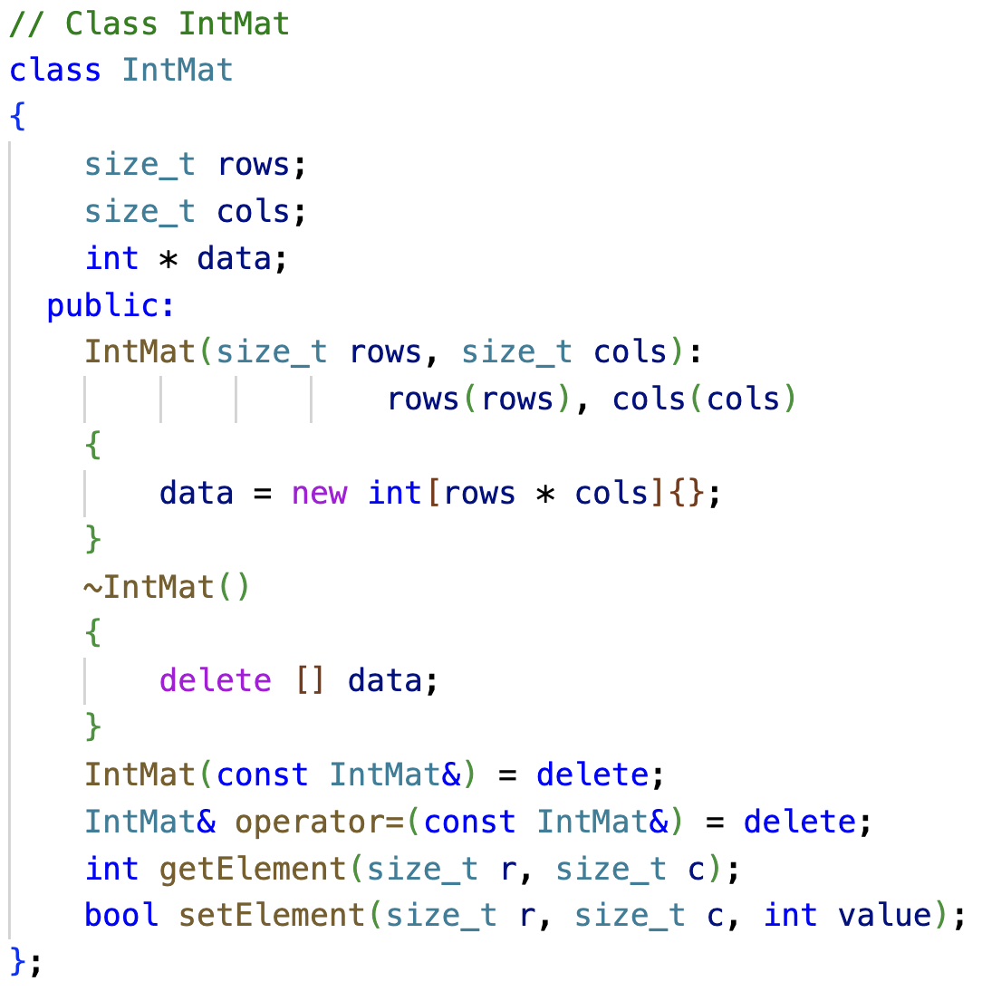
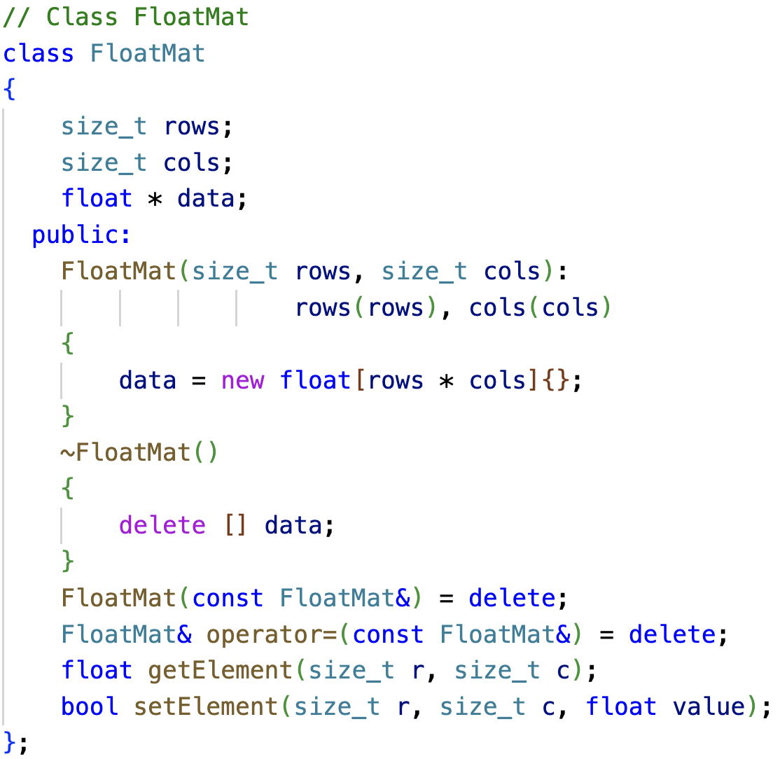
Different Classes for Different Type Matrices
Matrix with int elements, Matrix with float elements
matclass.cpp

Slide 6
Class Templates
A class template defines a family of classes.
Class template instantiation.
// Explicitly instantiate
template class Mat<int>;
template<typename T>
class Mat
{
size_t rows;
size_t cols;
T * data;
public:
Mat(size_t rows, size_t cols): rows(rows), cols(cols)
{
data = new T[rows * cols]{};
}
~Mat()
{
delete [] data;
}
T getElement(size_t r, size_t c);
bool setElement(size_t r, size_t c, T value);
};
mattemplate.cpp

Slide 7
Class Template
How to handle different combinations?
Mat<int> imat(3,4);
Mat<float> fmat(3,4);
Mat<double> dmat = imat + fmat; //?

Slide 8
Matrix type in OpenCV
#define CV_CN_MAX 512
#define CV_CN_SHIFT 3
#define CV_DEPTH_MAX (1 << CV_CN_SHIFT)
#define CV_8U 0
#define CV_8S 1
#define CV_16U 2
#define CV_16S 3
#define CV_32S 4
#define CV_32F 5
#define CV_64F 6
#define CV_16F 7
#define CV_MAT_DEPTH_MASK (CV_DEPTH_MAX - 1)
#define CV_MAT_DEPTH(flags) ((flags) & CV_MAT_DEPTH_MASK)
class CV_EXPORTS Mat
{
public:
/** @brief Returns the depth of a matrix element.
The method returns the identifier of the matrix element depth (the type of each individual channel).
For example, for a 16-bit signed element array, the method returns CV_16S . A complete list of
matrix types contains the following values:
- CV_8U - 8-bit unsigned integers ( 0..255 )
- CV_8S - 8-bit signed integers ( -128..127 )
- CV_16U - 16-bit unsigned integers ( 0..65535 )
- CV_16S - 16-bit signed integers ( -32768..32767 )
- CV_32S - 32-bit signed integers ( -2147483648..2147483647 )
- CV_32F - 32-bit floating-point numbers ( -FLT_MAX..FLT_MAX, INF, NAN )
- CV_64F - 64-bit floating-point numbers ( -DBL_MAX..DBL_MAX, INF, NAN )
*/
int depth() const;
/*! includes several bit-fields:
- the magic signature
- continuity flag
- depth
- number of channels
*/
int flags;
...
}
inline
int Mat::depth() const
{
return CV_MAT_DEPTH(flags);
}

Slide 9
Matrix type in OpenCV
modules/imgproc/src/thresh.cpp
if (srcStripe.depth() == CV_8U)
{
thresh_8u( srcStripe, dstStripe, (uchar)thresh, (uchar)maxval, thresholdType );
}
else if( srcStripe.depth() == CV_16S )
{
thresh_16s( srcStripe, dstStripe, (short)thresh, (short)maxval, thresholdType );
}
else if( srcStripe.depth() == CV_16U )
{
thresh_16u( srcStripe, dstStripe, (ushort)thresh, (ushort)maxval, thresholdType );
}
else if( srcStripe.depth() == CV_32F )
{
thresh_32f( srcStripe, dstStripe, (float)thresh, (float)maxval, thresholdType );
}
else if( srcStripe.depth() == CV_64F )
{
thresh_64f(srcStripe, dstStripe, thresh, maxval, thresholdType);
}

Slide 10
Template Non-Type Parameters

Slide 11
Non-Type Parameters
vector<int> vec1;
vector<int, 16> vec2;
To declare a template
The parameters can be
type template parameters
template template parameters
non-type template parameters
integral types
floating-point type
pointer types
lvalue reference types
...
template < parameter-list > declaration

Slide 12
Non-Type Parameters
If we want to create a static matrix (no dynamic memory allocation inside)
template<typename T, size_t rows, size_t cols>
class Mat
{
T data[rows][cols];
public:
Mat(){}
T getElement(size_t r, size_t c);
bool setElement(size_t r, size_t c, T value);
};
int r=3, c=3;
Mat<int> vec1(r, c);
Mat<int> vec2(3, 3);
Mat<int, 3, 3> vec3;
nontypeparam.cpp

Slide 13
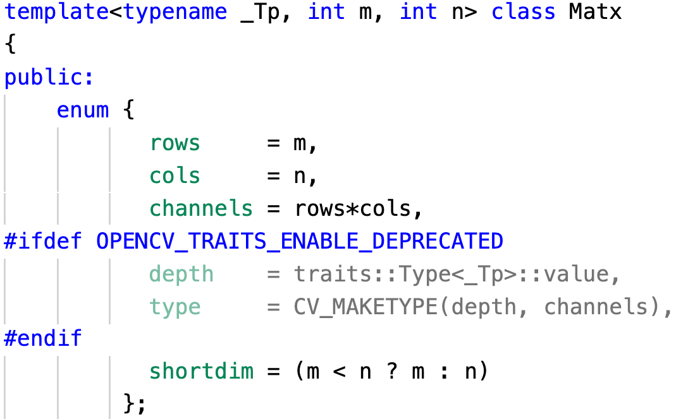
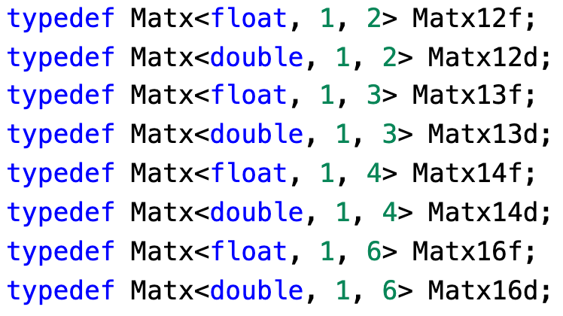
Template in OpenCV

Slide 14
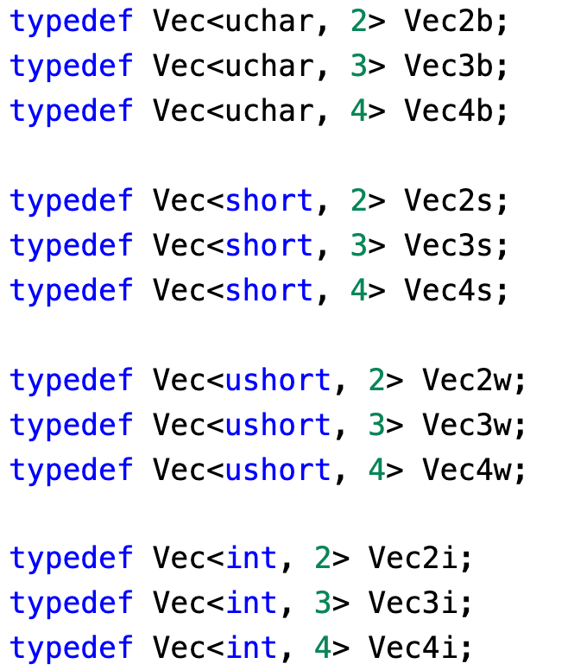
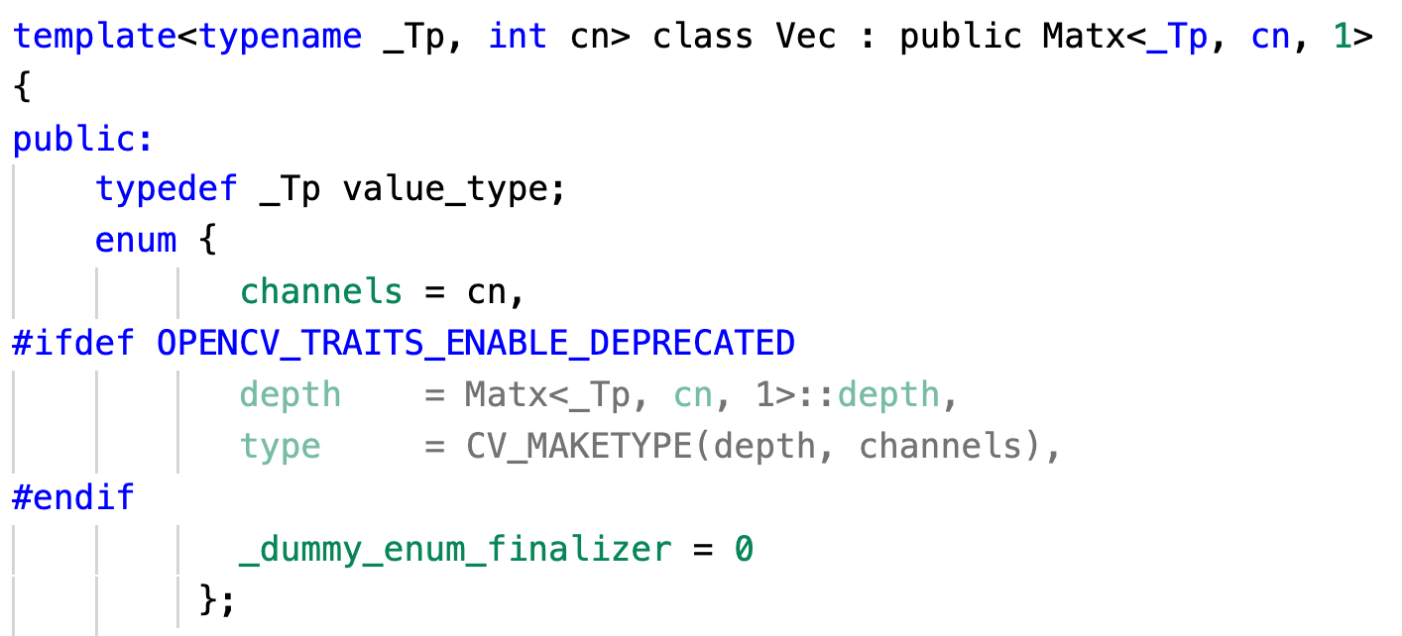
Template in OpenCV

Slide 15
Class Template Specialization

Slide 16
Class template specialization
The class template can be for most types
But we want to save memory for type bool (1 byte or 1 bit).
template<typename T>
class MyVector
{
size_t length;
T * data;
public:
MyVector(size_t length): length(length)
{ data = new T[length]{}; }
~MyVector()
{ delete [] data; }
MyVector(const MyVector&) = delete;
MyVector& operator=(const MyVector&) = delete;
T getElement(size_t index);
bool setElement(size_t index, T value);
};

Slide 17
Class template specialization
template<>
class MyVector<bool>
{
size_t length;
unsigned char * data;
public:
MyVector(size_t length): length(length)
{
int num_bytes = (length - 1) / 8 + 1;
data = new unsigned char[num_bytes]{};
}
~MyVector()
{
delete [] data;
}
MyVector(const MyVector&) = delete;
MyVector& operator=(const MyVector&) = delete;
bool getElement(size_t index);
bool setElement(size_t index, bool value);
};
Specialize MyVector for bool
specialization.cpp

Slide 18
std classes

Slide 19
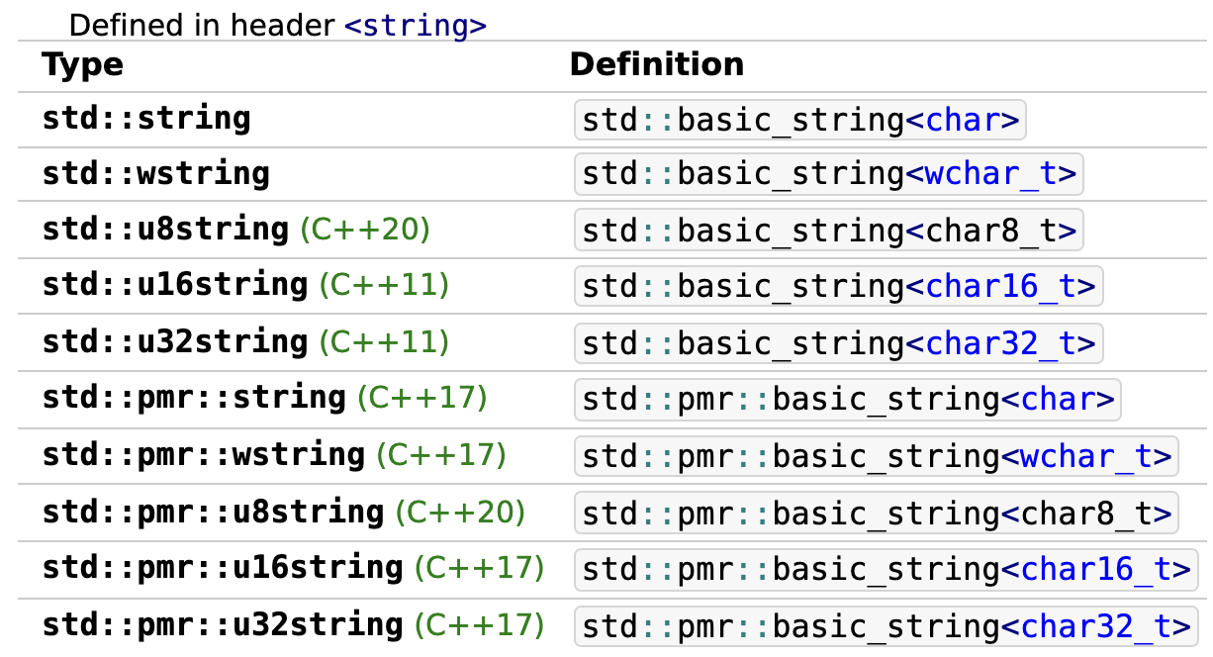
std::basic_string
Store and manipulate sequences of char-like objects.

Slide 20
std::array
a container that encapsulates fixed size arrays.
template<
class T,
std::size_t N
> struct array;
std::array<int, 3> a2 = {1, 2, 3};
*Keyword: typename/class, class/struct

Slide 21
Some other templates
template< class T, class Allocator = std::allocator<T>
> class list;
template< class Key, class Compare = std::less<Key>, class Allocator = std::allocator<Key>
> class set;
template< class T, class Allocator = std::allocator<T>
> class vector;
template< class Key, class T, class Compare = std::less<Key>, class Allocator = std::allocator<std::pair<const Key, T> >
> class map;
template< class T, class Container = std::deque<T>
> class stack;

