Slide 1
Advanced Programming
Lab 1, C/C++ environment configuration
Shiqi Yu

Slide 2
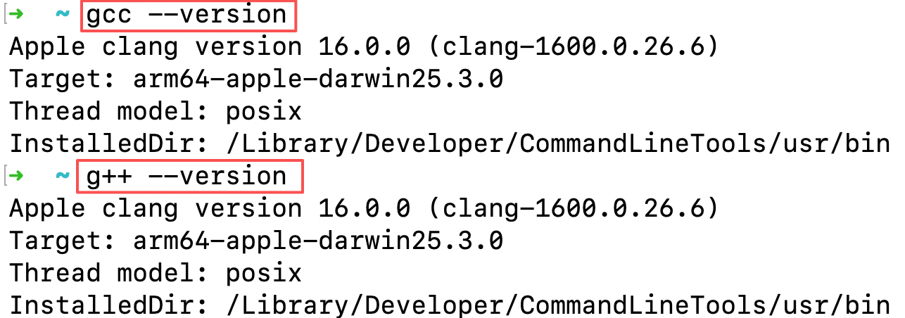
Topics
Install C and C++ compilers
Windows: WSL, and then install gcc/g++ in WSL
macOS: clang
Linux: gcc/g++ or clang
Verify your compilers
Example

Slide 3
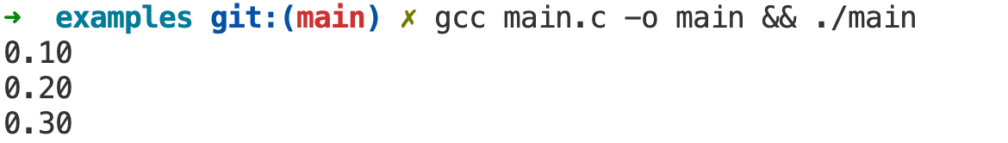
Exercises 1
Write a C program that initializes three double-precision floating-point variables with the values 0.1, 0.2, and 0.3, respectively. Then, use the fprintf()function to print each variable to standard output, formatting them to display exactly two decimal places.

Slide 4
Exercises 2
Put the provided code into three files, then compile and link them to produce an executable. Identify and fix any bugs that may be present in the code.
Steps:
1. Compile main.cpp into an object file.
2. Compile add.cpp into an object file.
3. Link the two object files to generate the final executable.
main.cpp
add.h
#include <iostream>
#include "Add.h"
int main()
{
int num1 = 2147483647;
int num2 = 1;
int result = 0;
result = add(num1, num2)；
cout << “The result is ” << result << endl;
return 0;
}
#pragma once
int add(int n1, int n2);
add.cpp
#include "add.h"
int Add(int number1, int number2);
{
return n1 + n2;
}

