Slide 1
Advanced Programming
Lab 3 Common Commands in Linux, Makefile
于仕琪，王大兴，廖琪梅, 王薇

Slide 2
topics
1. Commands in Linux
Commands: directory, file, etc.
Commonly used commands, pipelines
2. Makefile
file: makefile/Makefile
command: make, make clean
3. Execises
commands, makefile
branch, loop

Slide 3
1. Commands in Linux
1.1 Linux directory and file commands:
Command | Meaning
pwd | Print the name of current/working directory.
cd <directory name> | Change the current directory.
ls | List of content of a directory.
mkdir <directory name> | Make a new directory under any directory.
rmdir <directory name> | Remove directories without files.
cat <file name> | Display content of the file.
rm <file name> | Remove a file.
cp <source> <dest> | Copy a file or files to another
mv<source><dest> | Move a file or files to another directory
cat/tail/head, less/more, nano/vim, file, whereis, echo
https://www.javatpoint.com/linux-commands

Slide 4
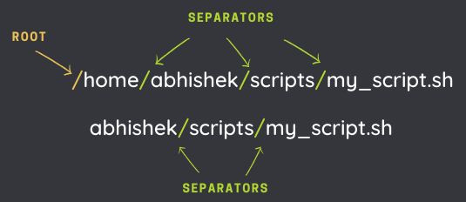
Absolute path and relative path
A path is how you refer to files and directories. It gives the location of a file or directory in the Linux directory structure. It is composed of a name and slash syntax.
If the path starts with slash "/", the first slash denotes root. The rest of the slashes in the path are just separators.
The absolute path always starts from the root directory (/).
A relative path starts from the current directory.
Two special relative paths:
. ( single dot) denotes the current directory in the path.
.. (two dots) denotes the parent directory, i.e., one level above.

Slide 5
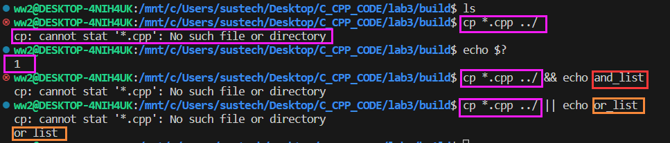
1.2 lists of commands, pipelines
1.2.1 lists of commands
An AND list has the form： command1 && command2
command2 is executed if, and only if, command1 returns an exit status of zero (success).
An OR list has the form： command1 || command2
command2 is executed if, and only if, command1 returns a non-zero exit status.
Command Sequence: command1 ; command2
Commands separated by a ‘;’ are executed sequentially;
TIPS:
For the shell’s purposes, a command which exits with a zero exit status has succeeded. A non-zero exit status indicates failure.
The exit status of the last command is available in the special parameter $?
https://www.gnu.org/software/bash/manual/bash.html#Lists
https://www.gnu.org/software/bash/manual/bash.html#Exit-Status

Slide 6
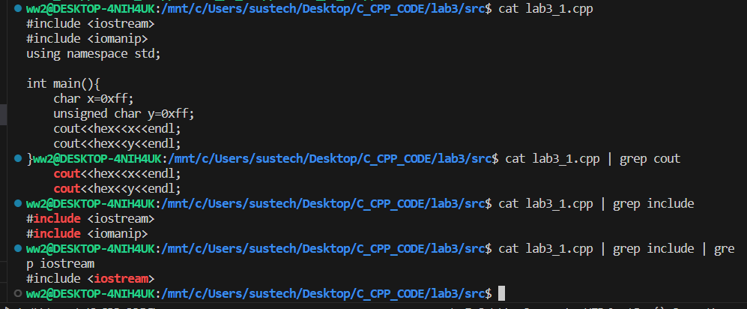
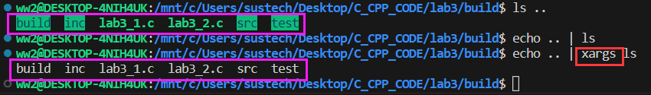
1.2 lists of commands, pipelines
1.2.2 pipelines
A pipeline is a sequence of one or more commands separated by one of the control operators ‘|’ or ‘|&’.
The output of each command in the pipeline is connected via a pipe to the input of the next command. That is, each command reads the previous command’s output. This connection is performed before any redirections specified by command1.
https://www.gnu.org/software/bash/manual/bash.html#Pipelines

Slide 7

TIPS: Shortcut keys
Up and down arrow keys can list the commands you typed.
Tab key can complete the command. For a long command, you can type first few letters and press Tab key to complete the command or list alternate commands.
Type the first few letters of a command,
and then press Tab key. If there is completion,
press Tab key again, it will list the alternate
commands.
clear is a standard Unix computer operating system command that is used to clear the terminal screen.

Slide 8
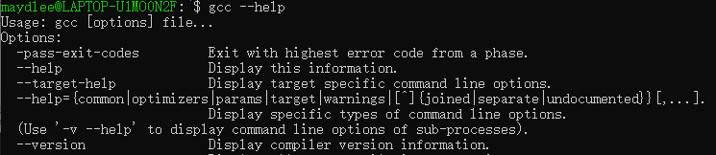
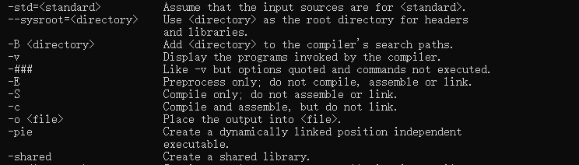
gcc & g++
gcc and g++ are GNU C or C++ compilers respectively, which issued for preprocessing,
compilation, assembly and linking of source code to generate an executable file.
Type command gcc or g++ --help, you can get the common options of the gcc or g++. g++ accepts
mostly the same options as gcc.

Slide 9
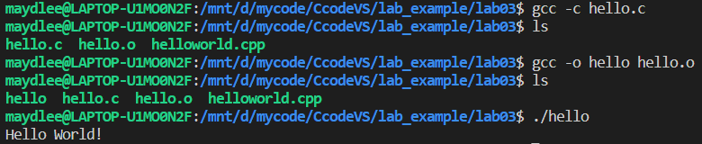
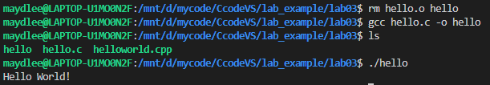
gcc & g++
-c Compile or assemble the source files, but do not link. The ultimate output is in the form of an object file
for each source file. The object file name for a source file is made by replacing the suffix .c with .o.
-o <file> Place output in file file. This applies regardless to whatever sort of output is being produced,
whether it be an executable file, an object file, an assembler file or preprocessed C code.
If -o is not specified, the default is to put an executable file in a.out.
gcc source_file.c -o program_name or gcc source_file.o -o program_name
compile
link
#include <stdio.h>
int main()
{
printf("Hello World!\n");
return 0;
}
run
compile and
link
run

Slide 10

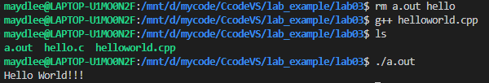
gcc & g++
With one step to generate an executable target file:
gcc file_name or g++ file_name
This command is used to compile and create an executable file a.out (default target name).
#include <iostream>
using namespace std;
int main()
{
cout << "Hello World!!!" << endl;
return 0;
}

Slide 11
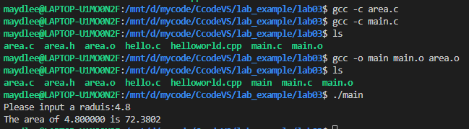

gcc & g++
compile multiple files
You can compile the files one by one and then link them to an executable file.
Another choice is using one step to list all the .c(or .cpp) files after gcc(or g++) command and create an executable file named a.out.
//area.h
#define PI 3.1415
double compute_area(double r);
//main.c
#include <stdio.h>
#include "area.h"
int main()
{
double r, area;
printf("Please input a radius:");
scanf("%lf", &r);
area = compute_area(r);
printf("The area of %lf is %.4lf\n", r, area);
return 0;
}
//area.c
#include "area.h"
double compute_area(double r)
{
return PI * r * r;
}

Slide 12
Makefile
What is a Makefile?
Makefile is a tool to simplify and organize compilation. Makefile is a set of commands with variable names and targets . You can compile your project(program) or only compile the update files in the project by using Makefile.

Slide 13
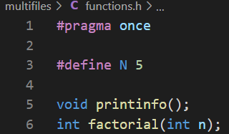
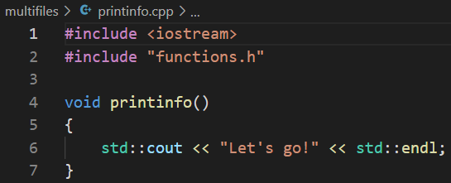
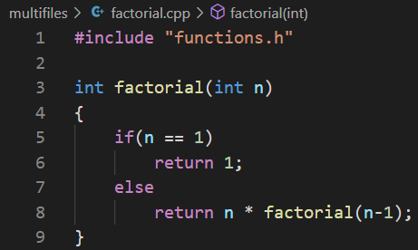
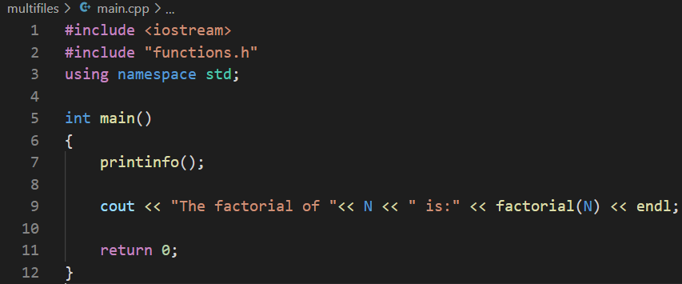
Suppose we have four source files as follows:
Normally, you can compile these files by the following
command:
or

Slide 14
How about if there are hundreds of files to compile? If only one source file is modified, need we compile all the files? Makefile will help you.
The name of makefile must be either makefile or Makefile without extension.
You can write makefile in any text editor. A rule of makefile including three
elements: targets, prerequisites and commands. There are many rules in the
makefile.

Slide 15
A makefile consists of a set of rules. A rule including three elements: target,
prerequisites and commands.
targets : prerequisites
<TAB> command
The target can be an object file, which will be generated by the command.
The prerequisites are file names, separated by spaces. The targets generation depends on the prerequisites.
The commands will be run to generate targets.
These need to start with a tab, not spaces.

Slide 16
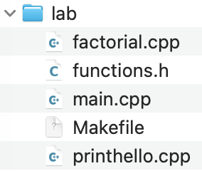
Makefile example

Slide 17
Exercises 1. Makefile and make
/* functions.h */
#ifndef _FUNCTIONS_H_
#define _FUNCTIONS_H_
void printhello();
int factorial(int n);
#endif
Write a simple Makefile, which can:
Generate object files.
Generate an executable file.
Remove all generated files by running “make clean”.
/* main.cpp */
#include <iostream>
#include "functions.h"
using namespace std;
int main()
{
printhello();
cout << "This is main:" << endl;
cout << "The factorial of 5 is: " << factorial(5) << endl;
return 0;
}
/* factorial.cpp */
#include "functions.h"
int factorial(int n)
{
if (n == 1)
return 1;
else
return n * factorial(n - 1);
}
/* printhello.cpp */
#include <iostream>
#include "functions.h"
using namespace std;
void printhello()
{
int i = 0;
cout << "Hello World!" << endl;
}

Slide 18
Exercises
2. Run the following source code and explain the result.
#include <iostream>
using namespace std;
int main()
{
for(size_t n = 2; n >= 0; n--)
cout << "n = " << n << " ";
return 0;
}

Slide 19
Exercises
3. Run the following source code and explain the result.
#include <iostream>
using namespace std;
int main()
{
int n,fa;
do{
fa *= n;
n++;
}while(n <= 10);
cout << "fa = " << fa << endl;
return 0;
}
Notes:
保留，数据

