Slide 1
Advanced Programming
Prof. Shiqi Yu (于仕琪)
yusq@sustech.edu.cn
http://faculty.sustech.edu.cn/yusq/

Slide 2
Questions
In OpenCV there is a class cv::Mat for matrices. Find the answers to the questions from the source code of OpenCV at https://github.com/opencv/opencv
How many data types does OpenCV's cv::Mat class support for matrix elements?
How does cv::Mat handle data types when the size of int may not be 32 bits on different platforms?

Slide 3
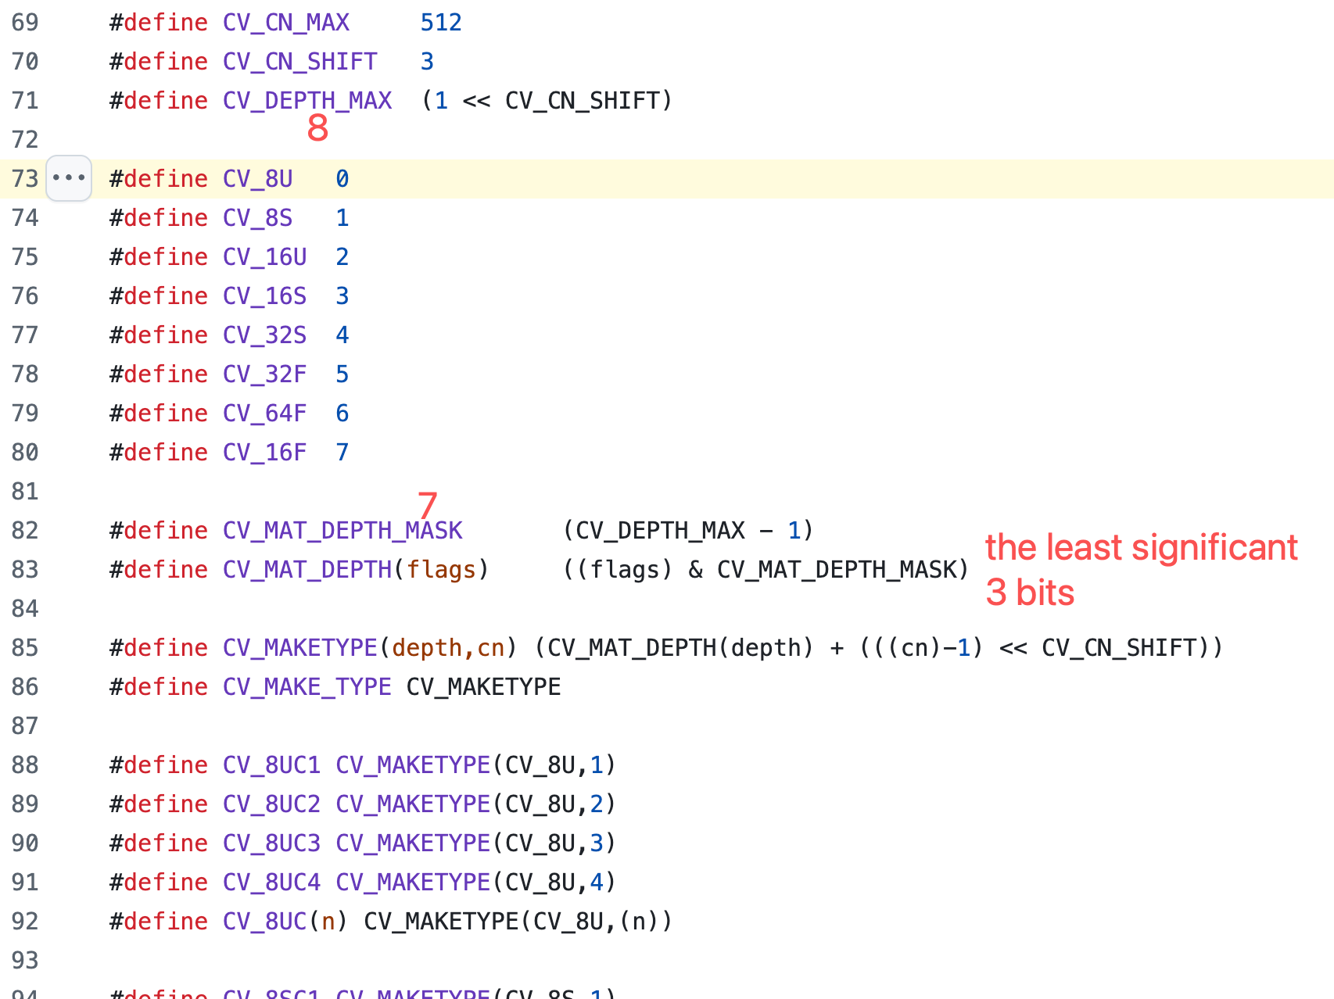
Hints
/modules/core/include/opencv2/core/hal/interface.h
CV_8U -> CV_MAKETYPE

Slide 4
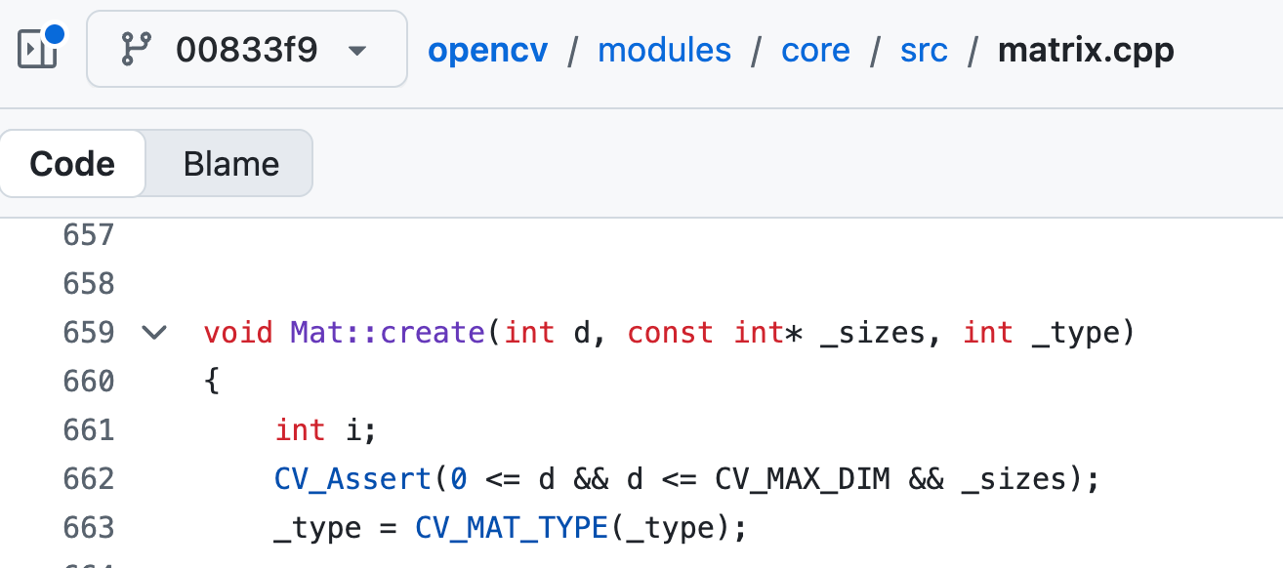
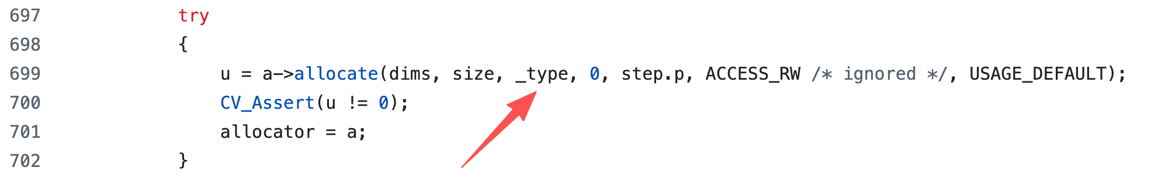
Hints
/modules/core/src/matrix.cpp

Slide 5
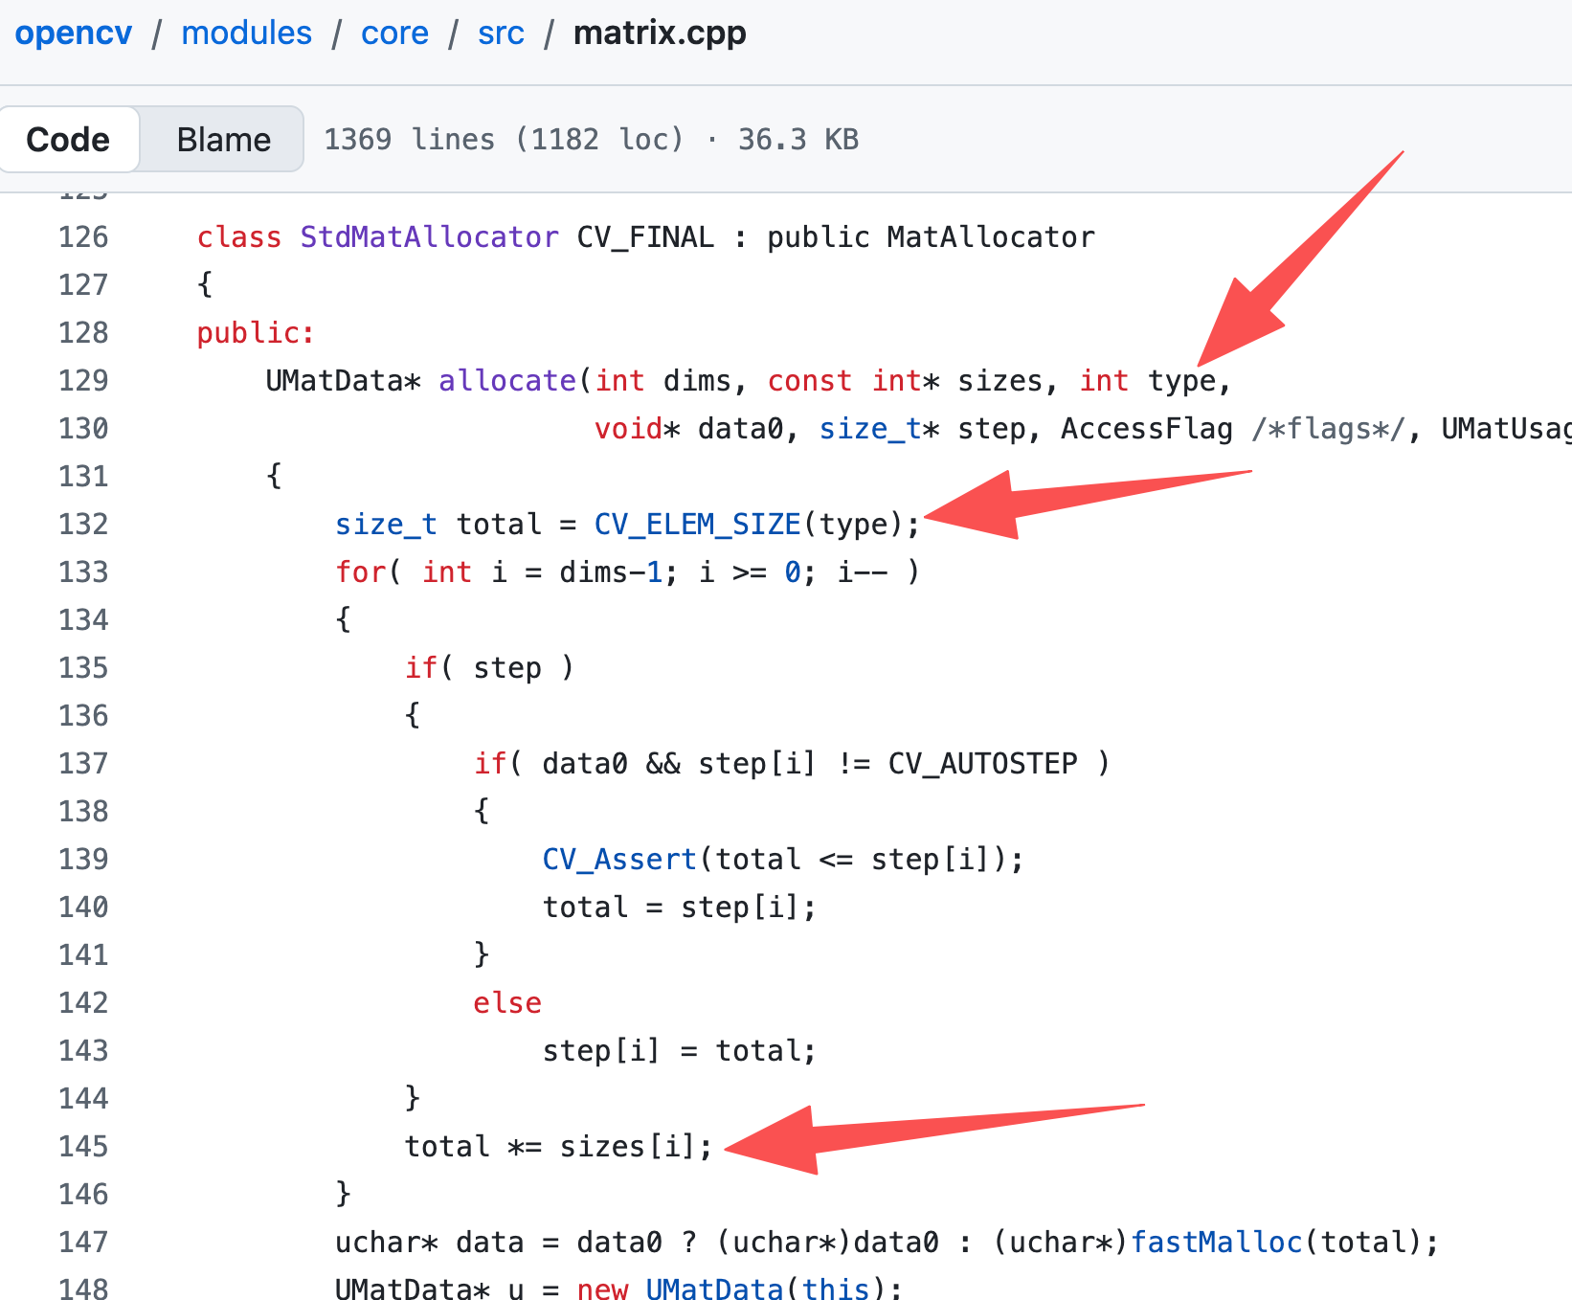
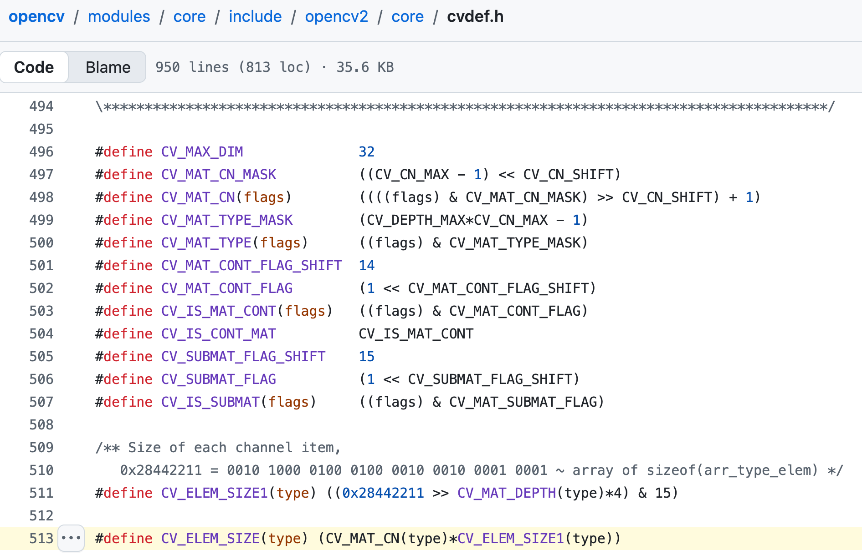
Hints
/modules/core/src/matrix.cpp
/modules/core/include/opencv2/core/cvdef.h

Slide 6
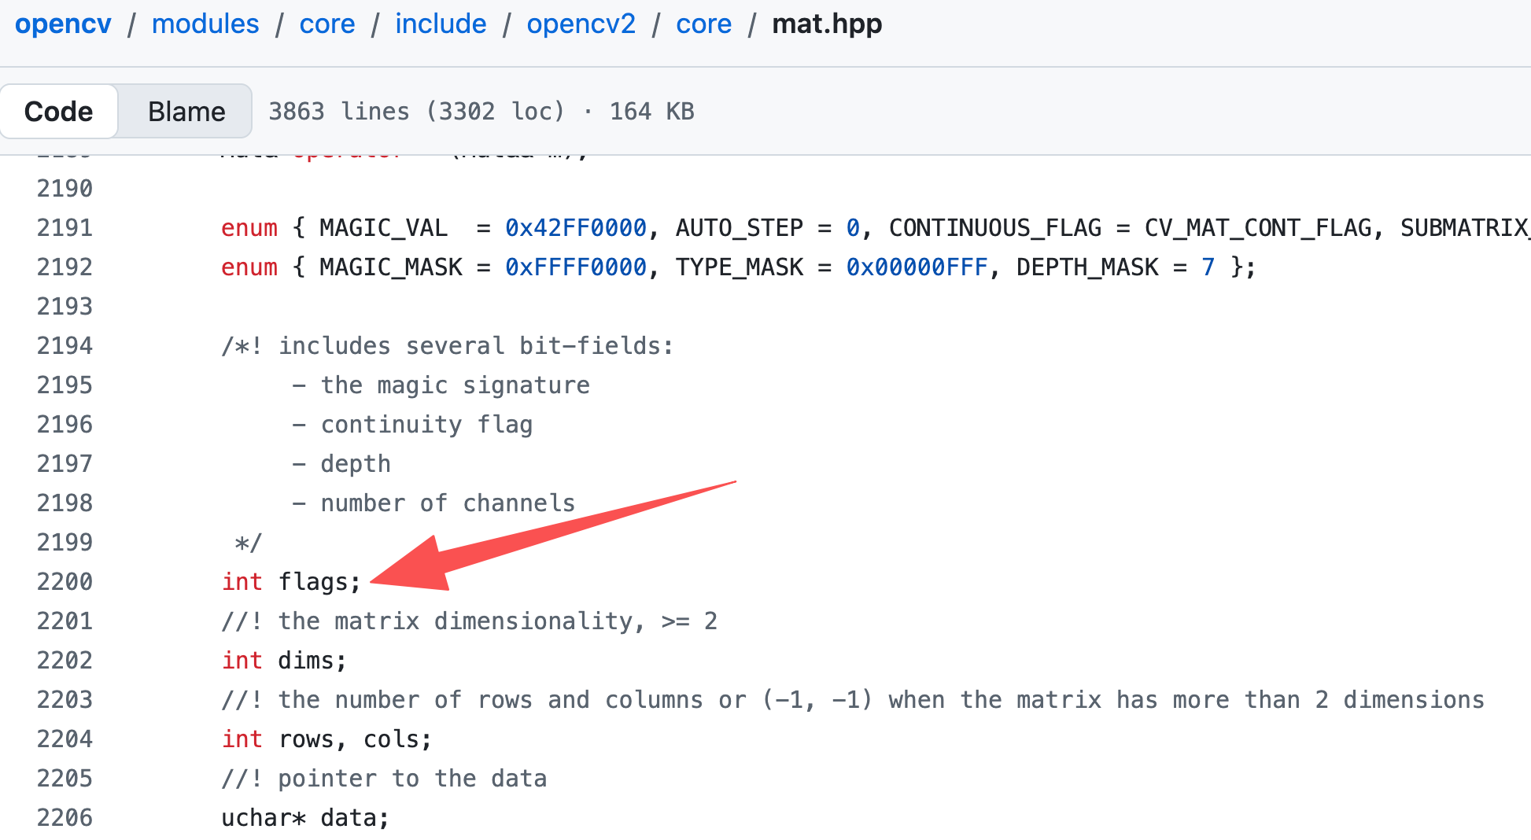
Hints
modules/core/include/opencv2/core/mat.hpp

Slide 7
if Statement

Slide 8
if and if-else
Statements are executed conditionally
int num = 10;
if (num < 5)
cout << "The number is less than 5. " << endl;
if (num == 5 )
{
cout << "The number is 5." << endl;
}
else
cout << "The number is not 5." << endl;

Slide 9
if-else if-else
if (num < 5)
cout << "The number is less than 5." << endl;
else if (num > 10)
cout << "The number is greater than 10." << endl;
else
cout << "The number is in range [5, 10]." << endl;

Slide 10
A little more complex
When will "Where I'm?" be printed?
How to make the code easier to understand?
if(num < 10)
if(num < 5)
cout << "The number is less than 5" << endl;
else
cout << "Where I'm?" << endl;

Slide 11
? : operator
When can we use the ternary conditional operator?
bool isPositive = true;
int factor = 0;
//some operations may change isPositive's value
if(isPositive)
factor = 1;
else
factor = -1;
factor = isPositive ? 1 : -1;
factor = (isPositive) * 2 - 1;

Slide 12
Conditions

Slide 13
Condition
What should be a condition?
The condition should be an expression which is convertible to bool
Its value can be bool, char, int, float
int num = 10;
if (num < 5)
cout << "The number is less than 5. " << endl;

Slide 14
Relational Expressions
The condition can be a relational expression
The 6 relational/comparison operators
Return 1 if the condition (such as a==b) is true,
Return 0 if the condition is false.
Operator name | Example
equal to | a == b
not equal to | a != b
less than | a < b
greater than | a > b
less than or equal to | a <= b
greater than or equal to | a >= b

Slide 15
Logical Expressions
If an operand is not bool, it will be converted to bool implicitly.
Precedence: ! > && > ||
What’s the value of the follow expressions?
if(-2 && true)
cout << "The condition is true." << endl;
if(not -2)
cout << " (!-2) is true, really?" << endl;
Operator name | Symbol-like operator | Keyword-like operator | Example
negation | ! | not | !a
AND | && | and | a && b
Inclusive OR | || | or | a || b

Slide 16
Non-Boolean Expressions
They will be converted to bool implicitly if it is feasible.
float count = 0.2f;
if (count) //not recommend to use a float-point number
cout << "There are some." << endl;
Pointers are also frequently used as conditions
int * p = new int[1024];
if (!p) // if(p == NULL)
cout << "Memory allocation failed." << endl;

Slide 17
while loop

Slide 18
while loop
Syntax :
while( expression )
{
//...
}
If the condition is true, the statement (loop body) will be executed.
int num = 10;
while(num > 0)
{
cout << "num = " << num << endl;
num--;
}
while.cpp

Slide 19
do-while loop
The test takes place after each iteration in a do-while loop.
The test takes place before each iteration in a while loop.
int num = 10;
do
{
cout << "num = " << num << endl;
num--;
}while (num > 0);
while.cpp

Slide 20
break statement
Terminate a loop
int num = 10;
while (num > 0)
{
if (num == 5)
break;
cout << "num = " << num << endl;
num--;
}
while.cpp

Slide 21
continue statement
Skip the remaining part of the loop body and continue the next iteration.
int num = 10;
while (num > 0)
{
if (num == 5)
continue;
cout << "num = " << num << endl;
num--;
}
while.cpp

Slide 22
The Condition, Be Careful!
Can you find any problem from the code?
size_t num = 10;
while(num >= 0)
{
cout << "num = " << num << endl;
num--;
}

Slide 23
The Condition, Be Careful!
bool flag = true;
int count = 0;
while(flag = true)
{
cout << "count = " << count++ << endl;
// and do sth
if (count == 10) //meet a condition
flag = false; //set flag to false to break the loop
}

Slide 24
Why?
Expression 3+4 has a value;
Expression a+b has a value;
Expression (a==b) has value (true or false);
a=b is an assignment, also an expression and has a value
The follow code can be compiled successfully!
int b = 0;
int m = (b = 8);
cout << "m="<< m << endl;

Slide 25
for loop

Slide 26
for loop
Syntax
for (init-clause; cond-expression; iteration-expression)
loop-statement
Example
int sum = 0;
for(int i = 0; i < 10; i++)
{
sum += i;
cout << "Line " << i << endl;
}
cout << "sum = " << sum << endl;
for.cpp

Slide 27
for loop VS while loop
int sum = 0;
int i = 0;
while (i < 10)
{
sum += i;
cout << "Line " << i << endl;
i++;
}
int sum = 0;
for(int i = 0; i < 10; i++)
{
sum += i;
cout << "Line " << i << endl;
}

Slide 28
for loop VS while loop
while(num > 0)
{
cout << "num = " << num << endl;
num--;
}
for(; num > 0; )
{
cout << "num = " << num << endl;
num--;
}

Slide 29
Endless loop
Sometimes we need it
for(;;)
{
// some statements
cout << "endless loop!" << endl;
}
while(true)
{
// some statements
cout << "endless loop!" << endl;
}

Slide 30
break/continue statement
break and continue statements behavior the same with while loops.

Slide 31
goto and switch Statements

Slide 32
goto Statement
Jump to the desired location
An unrecommended statement
goto.cpp
float mysquare(float value)
{
float result = 0.0f;
if(value >= 1.0f || value <= 0)
{
cerr << "The input is out of range." << endl;
goto EXIT_ERROR;
}
result = value * value;
return result;
EXIT_ERROR:
//do sth such as closing files here
return 0.0f;
}

Slide 33
switch Statement
Execute one of several statements, depending on the value of an expression.
break prevents executing some following statements. Don’t forget break!
More similar to goto, not if-else if-else
switch (input_char)
{
case 'a':
case 'A':
cout << "Move left." << endl;
break;
case 'd':
case 'D':
cout << "Move right." << endl;
break;
default:
cout << "Undefined key." << endl;
break;
}
switch.cpp

Slide 34
Questions
In OpenCV, the function cv::add() add two matrices. Find the source code to implement the addition at https://github.com/opencv/opencv
How many data types does the function cv::add() support?
For 8-bit unsigned int matrices, what will be the results when overflow happens?

