Slide 1
18-447
Computer Architecture
Lecture 3: ISA Tradeoffs
Prof. Onur Mutlu
Carnegie Mellon University
Spring 2015, 1/16/2015

Slide 2
Agenda for Today
Deep dive into ISA and its tradeoffs

Slide 3
Upcoming Readings
Next Week (More ISA Tradeoffs + Your Lab + Homework):
  MIPS ISA Tutorial
  P&P Chapter 5: LC-3 ISA
  P&P, revised Appendix A – LC3b ISA
The Week After (Microarchitecture):
  P&H, Chapter 4, Sections 4.1-4.4
  P&P, revised Appendix C – LC3b datapath and microprogrammed operation
We have provided example critical reviews for you to see, on the course website

Slide 4
Last Lecture Recap
Levels of Transformation
  Algorithm, ISA, Microarchitecture
Moore’s Law
What is Computer Architecture
Why Study Computer Architecture
Fundamental Concepts
Von Neumann Model
Dataflow Model
ISA vs. Microarchitecture
Assignments: HW0 (today!), Lab1 (Jan 23), HW1 (Jan 28)

Slide 5
Review: ISA vs. Microarchitecture
ISA
  Agreed upon interface between software and hardware
    SW/compiler assumes, HW promises
  What the software writer needs to know to write and debug system/user programs
Microarchitecture
  Specific implementation of an ISA
  Not visible to the software
Microprocessor
  ISA, uarch, circuits
  “Architecture” = ISA + microarchitecture
Problem
Algorithm
Program
ISA
Microarchitecture
Circuits
Electrons
Notes:
ISA is the interface between hardware and software… It is a contract that the hardware promises to satisfy.
Builder/user interface

Slide 6
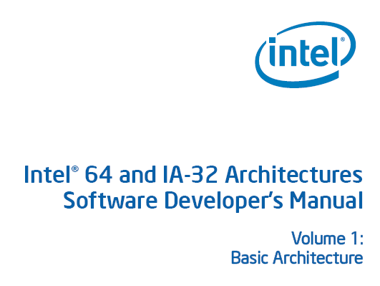
Review: ISA
Instructions
  Opcodes, Addressing Modes, Data Types
  Instruction Types and Formats
  Registers, Condition Codes
Memory
  Address space, Addressability, Alignment
  Virtual memory management
Call, Interrupt/Exception Handling
Access Control, Priority/Privilege
I/O: memory-mapped vs. instr.
Task/thread Management
Power and Thermal Management
Multi-threading support, Multiprocessor support

Slide 7
Microarchitecture
Implementation of the ISA under specific design constraints and goals
Anything done in hardware without exposure to software
  Pipelining
  In-order versus out-of-order instruction execution
  Memory access scheduling policy
  Speculative execution
  Superscalar processing (multiple instruction issue?)
  Clock gating
  Caching? Levels, size, associativity, replacement policy
  Prefetching?
  Voltage/frequency scaling?
  Error correction?

Slide 8
Property of ISA vs. Uarch?
ADD instruction’s opcode
Number of general purpose registers
Number of ports to the register file
Number of cycles to execute the MUL instruction
Whether or not the machine employs pipelined instruction execution
Remember
  Microarchitecture: Implementation of the ISA under specific design constraints and goals

Slide 9
Design Point
A set of design considerations and their importance
  leads to tradeoffs in both ISA and uarch
Considerations
  Cost
  Performance
  Maximum power consumption
  Energy consumption (battery life)
  Availability
  Reliability and Correctness
  Time to Market
Design point determined by the “Problem” space (application space), the intended users/market
Problem
Algorithm
Program
ISA
Microarchitecture
Circuits
Electrons

Slide 10
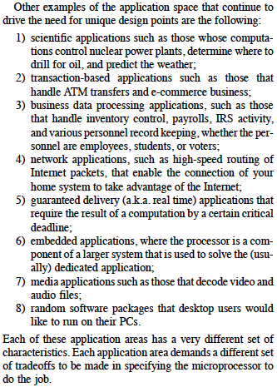
Application Space
Dream, and they will appear…

Slide 11
Tradeoffs: Soul of Computer Architecture
ISA-level tradeoffs
Microarchitecture-level tradeoffs
System and Task-level tradeoffs
  How to divide the labor between hardware and software
Computer architecture is the science and art of making the appropriate trade-offs to meet a design point
  Why art?

Slide 12
Why Is It (Somewhat) Art?
We do not (fully) know the future (applications, users, market)
New demands
from the top
(Look Up)
Problem
Algorithm
Program/Language
User
New demands and
personalities of users
(Look Up)
Runtime System
(VM, OS, MM)
ISA
Microarchitecture
New issues and
capabilities
at the bottom
(Look Down)
Logic
Circuits
Electrons
Notes:
ISA is the interface between hardware and software… It is a contract that the hardware promises to satisfy.

Slide 13
Why Is It (Somewhat) Art?
And, the future is not constant (it changes)!
Changing demands
at the top
(Look Up and Forward)
Problem
Algorithm
Program/Language
User
Changing demands and
personalities of users
(Look Up and Forward)
Runtime System
(VM, OS, MM)
ISA
Microarchitecture
Changing issues and
capabilities
at the bottom
(Look Down and Forward)
Logic
Circuits
Electrons
Notes:
ISA is the interface between hardware and software… It is a contract that the hardware promises to satisfy.

Slide 14
Analogue from Macro-Architecture
Future is not constant in macro-architecture, either
Example: Can a power plant boiler room be later used as a classroom?

Slide 15
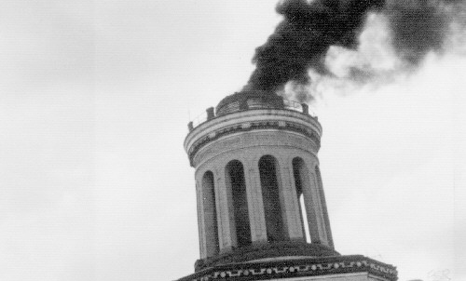
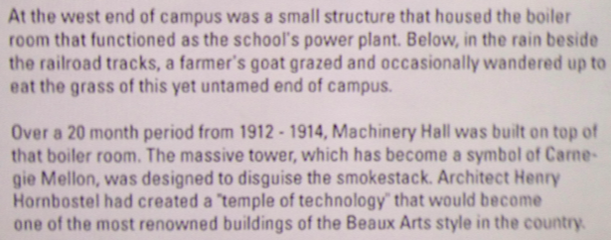
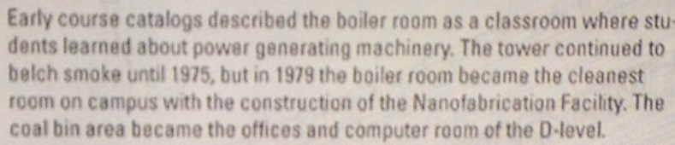
Macro-Architecture: Boiler Room

Slide 16
How Can We Adapt to the Future
This is part of the task of a good computer architect
Many options (bag of tricks)
  Keen insight and good design
  Good use of fundamentals and principles
    Efficient design
    Heterogeneity
    Reconfigurability
    …
  Good use of the underlying technology
  …

Slide 17
ISA Principles and Tradeoffs

Slide 18
Many Different ISAs Over Decades
x86
PDP-x: Programmed Data Processor (PDP-11)
VAX
IBM 360
CDC 6600
SIMD ISAs: CRAY-1, Connection Machine
VLIW ISAs: Multiflow, Cydrome, IA-64 (EPIC)
PowerPC, POWER
RISC ISAs: Alpha, MIPS, SPARC, ARM
What are the fundamental differences?
  E.g., how instructions are specified and what they do
  E.g., how complex are the instructions

Slide 19
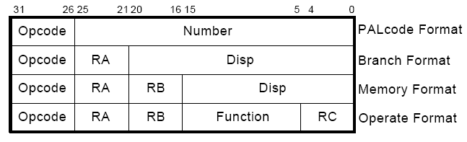
Instruction
Basic element of the HW/SW interface
Consists of
  opcode: what the instruction does
  operands: who it is to do it to
  Example from the Alpha ISA:

Slide 20

MIPS
0
6-bit
rs
5-bit
rt
5-bit
rd
5-bit
shamt
5-bit
funct
6-bit
R-type
opcode
6-bit
rs
5-bit
rt
5-bit
immediate
16-bit
I-type
opcode
6-bit
immediate
26-bit
J-type

Slide 21
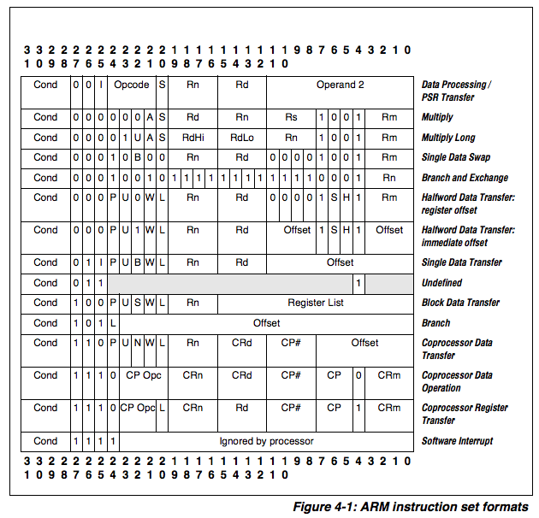
ARM

Slide 22
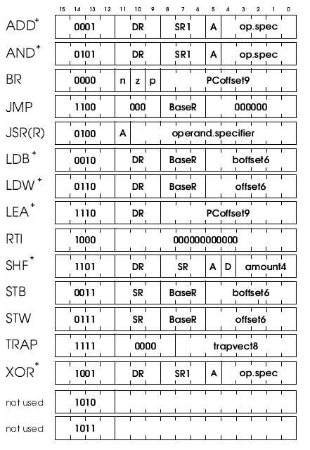
Set of Instructions, Encoding, and Spec
Example from LC-3b ISA
  http://www.ece.utexas.edu/~patt/11s.460N/handouts/new_byte.pdf
x86 Manual
Why unused instructions?
Aside: concept of “bit steering”
  A bit in the instruction determines the interpretation of other bits

Slide 23
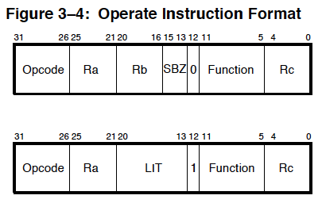
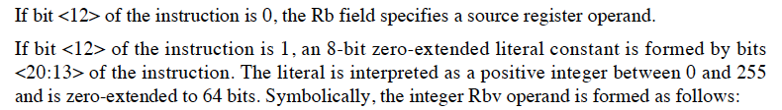
Bit Steering in Alpha

Slide 24
What Are the Elements of An ISA?
Instruction sequencing model
  Control flow vs. data flow
  Tradeoffs?
Instruction processing style
  Specifies the number of “operands” an instruction “operates” on and how it does so
  0, 1, 2, 3 address machines
    0-address: stack machine (op, push A, pop A)
    1-address: accumulator machine (op ACC, ld A, st A)
    2-address: 2-operand machine (op S,D; one is both source and dest)
    3-address: 3-operand machine (op S1,S2,D; source and dest separate)
  Tradeoffs? See your homework question
    Larger operate instructions vs. more executed operations
    Code size vs. execution time vs. on-chip memory space

Slide 25
An Example: Stack Machine
+ Small instruction size (no operands needed for operate instructions)
  Simpler logic
  Compact code
+ Efficient procedure calls: all parameters on stack
  No additional cycles for parameter passing
-- Computations that are not easily expressible with “postfix notation” are difficult to map to stack machines
  Cannot perform operations on many values at the same time (only top N values on the stack at the same time)
  Not flexible

Slide 26
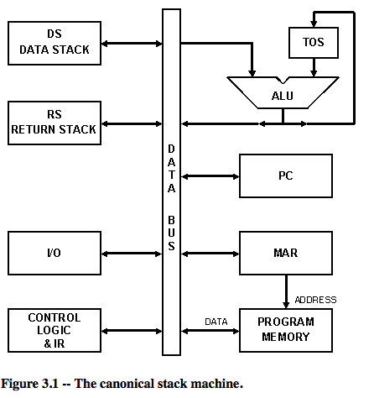
An Example: Stack Machine (II)
Koopman, “Stack Computers: The New Wave,” 1989.
http://www.ece.cmu.edu/~koopman/stack_computers/sec3_2.html

Slide 27
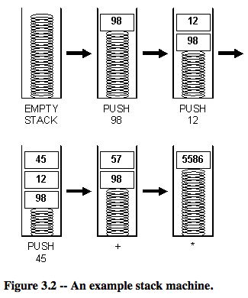
An Example: Stack Machine Operation
Koopman, “Stack Computers: The New Wave,” 1989.
http://www.ece.cmu.edu/~koopman/stack_computers/sec3_2.html

Slide 28
Other Examples
PDP-11: A 2-address machine
  PDP-11 ADD: 4-bit opcode, 2 6-bit operand specifiers
  Why? Limited bits to specify an instruction
  Disadvantage: One source operand is always clobbered with the result of the instruction
    How do you ensure you preserve the old value of the source?
X86: A 2-address (memory/memory) machine
Alpha: A 3-address (load/store) machine
MIPS?
ARM?

Slide 29
What Are the Elements of An ISA?
Instructions
  Opcode
  Operand specifiers (addressing modes)
    How to obtain the operand?
Data types
  Definition: Representation of information for which there are instructions that operate on the representation
  Integer, floating point, character, binary, decimal, BCD
  Doubly linked list, queue, string, bit vector, stack
    VAX: INSQUEUE and REMQUEUE instructions on a doubly linked list or queue; FINDFIRST
    Digital Equipment Corp., “VAX11 780 Architecture Handbook,” 1977.
    X86: SCAN opcode operates on character strings; PUSH/POP
Why are there different addressing modes?

Slide 30
Data Type Tradeoffs
What is the benefit of having more or high-level data types in the ISA?
What is the disadvantage?
Think compiler/programmer vs. microarchitect
Concept of semantic gap
  Data types coupled tightly to the semantic level, or complexity of instructions
Example: Early RISC architectures vs. Intel 432
  Early RISC: Only integer data type
  Intel 432: Object data type, capability based machine

Slide 31
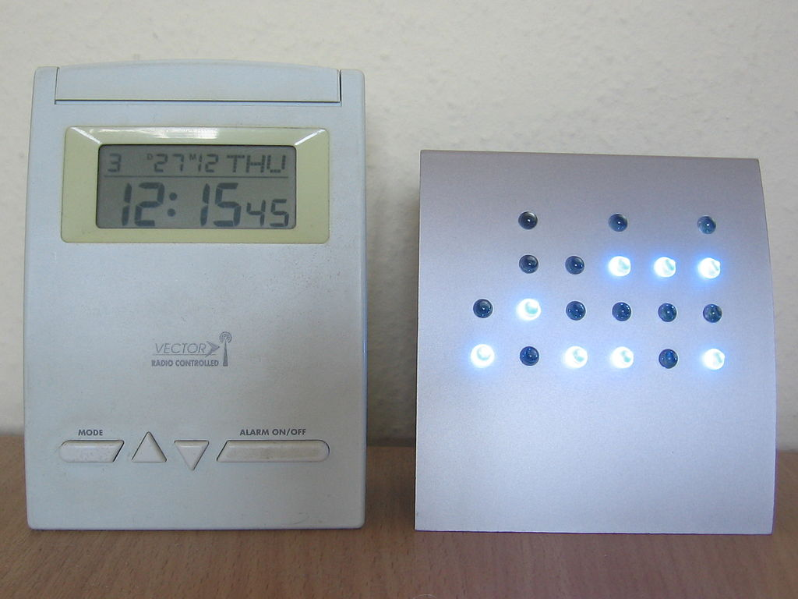
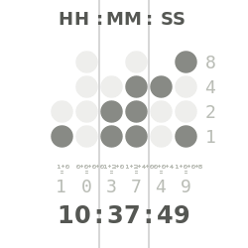
An Example: BCD
Each decimal digit is encoded with a fixed number of bits
"Binary clock" by Alexander Jones & Eric Pierce - Own work, based on Wapcaplet's Binary clock.png on the English Wikipedia. Licensed under CC BY-SA 3.0 via Wikimedia Commons - http://commons.wikimedia.org/wiki/File:Binary_clock.svg#mediaviewer/File:Binary_clock.svg
"Digital-BCD-clock" by Julo - Own work. Licensed under Public Domain via Wikimedia Commons - http://commons.wikimedia.org/wiki/File:Digital-BCD-clock.jpg#mediaviewer/File:Digital-BCD-clock.jpg

Slide 32
What Are the Elements of An ISA?
Memory organization
  Address space: How many uniquely identifiable locations in memory
  Addressability: How much data does each uniquely identifiable location store
    Byte addressable: most ISAs, characters are 8 bits
    Bit addressable: Burroughs 1700. Why?
    64-bit addressable: Some supercomputers. Why?
    32-bit addressable: First Alpha
    Food for thought
      How do you add 2 32-bit numbers with only byte addressability?
      How do you add 2 8-bit numbers with only 32-bit addressability?
      Big endian vs. little endian? MSB at low or high byte.
  Support for virtual memory

Slide 33
Some Historical Readings
If you want to dig deeper
Wilner, “Design of the Burroughs 1700,” AFIPS 1972.
Levy, “The Intel iAPX 432,” 1981.
  http://www.cs.washington.edu/homes/levy/capabook/Chapter9.pdf

Slide 34
What Are the Elements of An ISA?
Registers
  How many
  Size of each register
Why is having registers a good idea?
  Because programs exhibit a characteristic called data locality
  A recently produced/accessed value is likely to be used more than once (temporal locality)
    Storing that value in a register eliminates the need to go to memory each time that value is needed

Slide 35
Programmer Visible (Architectural) State
M[0]
M[1]
M[2]
M[3]
Registers
- given special names in the ISA
(as opposed to addresses)
- general vs. special purpose
M[4]
M[N-1]
Memory
array of storage locations
indexed by an address
Program Counter
memory address
of the current instruction
Instructions (and programs) specify how to transform
the values of programmer visible state

Slide 36
Aside: Programmer Invisible State
Microarchitectural state
Programmer cannot access this directly
E.g. cache state
E.g. pipeline registers

Slide 37
Evolution of Register Architecture
Accumulator
  a legacy from the “adding” machine days
Accumulator + address registers
  need register indirection
  initially address registers were special-purpose, i.e., can only be loaded with an address for indirection
  eventually arithmetic on addresses became supported
General purpose registers (GPR)
  all registers good for all purposes
  grew from a few registers to 32 (common for RISC) to 128 in Intel IA-64

Slide 38
Instruction Classes
Operate instructions
  Process data: arithmetic and logical operations
  Fetch operands, compute result, store result
  Implicit sequential control flow
Data movement instructions
  Move data between memory, registers, I/O devices
  Implicit sequential control flow
Control flow instructions
  Change the sequence of instructions that are executed

Slide 39
What Are the Elements of An ISA?
Load/store vs. memory/memory architectures
  Load/store architecture: operate instructions operate only on registers
    E.g., MIPS, ARM and many RISC ISAs
  Memory/memory architecture: operate instructions can operate on memory locations
    E.g., x86, VAX and many CISC ISAs

Slide 40
What Are the Elements of An ISA?
Addressing modes specify how to obtain the operands
  Absolute LW rt, 10000
  use immediate value as address
  Register Indirect: LW rt, (r_{base})
  use GPR[r_{base}] as address
  Displaced or based: LW rt, offset(r_{base})
  use offset+GPR[r_{base}] as address
  Indexed: LW rt, (r_{base}, r_{index})
  use GPR[r_{base}]+GPR[r_{index}] as address
  Memory Indirect LW rt ((r_{base}))
  use value at M[ GPR[ r_{base} ] ] as address
  Auto inc/decrement LW Rt, (r_{base})
  use GRP[r_{base}] as address, but inc. or dec. GPR[r_{base}] each time
Notes:
Indexed mode for gather scatter.

Slide 41
What Are the Benefits of Different Addressing Modes?
Another example of programmer vs. microarchitect tradeoff
Advantage of more addressing modes:
  Enables better mapping of high-level constructs to the machine: some accesses are better expressed with a different mode → reduced number of instructions and code size
    Think array accesses (autoincrement mode)
    Think indirection (pointer chasing)
    Sparse matrix accesses
Disadvantage:
  More work for the compiler
  More work for the microarchitect

Slide 42
ISA Orthogonality
Orthogonal ISA:
  All addressing modes can be used with all instruction types
  Example: VAX
    (~13 addressing modes) x (>300 opcodes) x (integer and FP formats)
Who is this good for?
Who is this bad for?

Slide 43
Is the LC-3b ISA Orthogonal?

Slide 44
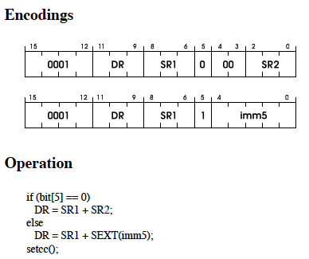
LC-3b: Addressing Modes of ADD

Slide 45
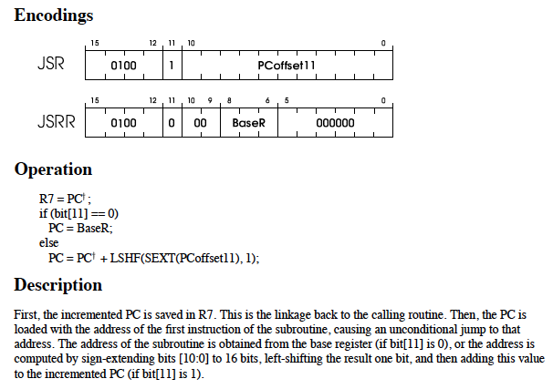
LC-3b: Addressing Modes of of JSR(R)

Slide 46
What Are the Elements of An ISA?
How to interface with I/O devices
  Memory mapped I/O
    A region of memory is mapped to I/O devices
    I/O operations are loads and stores to those locations
  Special I/O instructions
    IN and OUT instructions in x86 deal with ports of the chip
  Tradeoffs?
    Which one is more general purpose?

Slide 47
What Are the Elements of An ISA?
Privilege modes
  User vs supervisor
  Who can execute what instructions?
Exception and interrupt handling
  What procedure is followed when something goes wrong with an instruction?
  What procedure is followed when an external device requests the processor?
  Vectored vs. non-vectored interrupts (early MIPS)
Virtual memory
  Each program has the illusion of the entire memory space, which is greater than physical memory
Access protection
We will talk about these later
Notes:
MIPS started out without having interrupt vectors… When an interrupt happens, SW figured out who interrupted… Costly in terms of time…

Slide 48
Another Question or Two
Does the LC-3b ISA contain complex instructions?
How complex can an instruction be?

Slide 49
Complex vs. Simple Instructions
Complex instruction: An instruction does a lot of work, e.g. many operations
  Insert in a doubly linked list
  Compute FFT
  String copy
Simple instruction: An instruction does small amount of work, it is a primitive using which complex operations can be built
  Add
  XOR
  Multiply

Slide 50
Complex vs. Simple Instructions
Advantages of Complex instructions
  + Denser encoding → smaller code size → better memory utilization, saves off-chip bandwidth, better cache hit rate (better packing of instructions)
  + Simpler compiler: no need to optimize small instructions as much
Disadvantages of Complex Instructions
  - Larger chunks of work → compiler has less opportunity to optimize (limited in fine-grained optimizations it can do)
  - More complex hardware → translation from a high level to control signals and optimization needs to be done by hardware

Slide 51
ISA-level Tradeoffs: Semantic Gap
Where to place the ISA? Semantic gap
  Closer to high-level language (HLL) → Small semantic gap, complex instructions
  Closer to hardware control signals? → Large semantic gap, simple instructions
RISC vs. CISC machines
  RISC: Reduced instruction set computer
  CISC: Complex instruction set computer
    FFT, QUICKSORT, POLY, FP instructions?
    VAX INDEX instruction (array access with bounds checking)

Slide 52
ISA-level Tradeoffs: Semantic Gap
Some tradeoffs (for you to think about)
Simple compiler, complex hardware vs. complex compiler, simple hardware
  Caveat: Translation (indirection) can change the tradeoff!
Burden of backward compatibility
Performance? Energy Consumption?
  Optimization opportunity: Example of VAX INDEX instruction: who (compiler vs. hardware) puts more effort into optimization?
  Instruction size, code size

Slide 53
X86: Small Semantic Gap: String Operations
An instruction operates on a string
  Move one string of arbitrary length to another location
  Compare two strings
Enabled by the ability to specify repeated execution of an instruction (in the ISA)
  Using a “prefix” called REP prefix
Example: REP MOVS instruction
  Only two bytes: REP prefix byte and MOVS opcode byte (F2 A4)
  Implicit source and destination registers pointing to the two strings (ESI, EDI)
  Implicit count register (ECX) specifies how long the string is

Slide 54
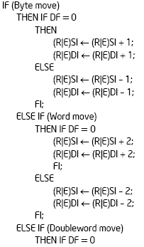
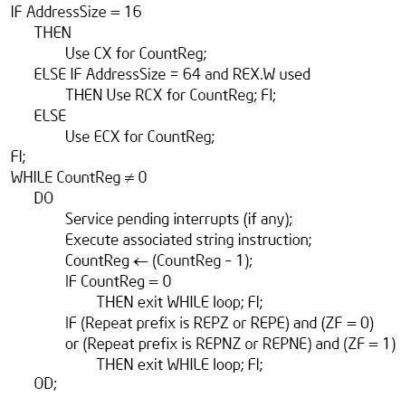
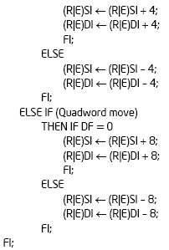
X86: Small Semantic Gap: String Operations
REP MOVS (DEST SRC)
How many instructions does this take in MIPS?
Notes:
Shows the evolution of the ISA as well.

Slide 55
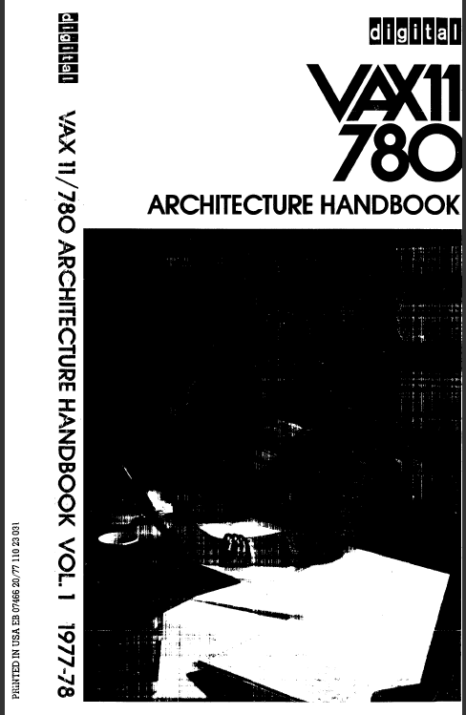
Small Semantic Gap Examples in VAX
FIND FIRST
  Find the first set bit in a bit field
  Helps OS resource allocation operations
SAVE CONTEXT, LOAD CONTEXT
  Special context switching instructions
INSQUEUE, REMQUEUE
  Operations on doubly linked list
INDEX
  Array access with bounds checking
STRING Operations
  Compare strings, find substrings, …
Cyclic Redundancy Check Instruction
EDITPC
  Implements editing functions to display fixed format output
Digital Equipment Corp., “VAX11 780 Architecture Handbook,” 1977-78.

Slide 56
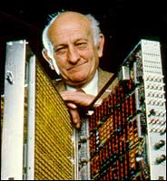
Small versus Large Semantic Gap
CISC vs. RISC
  Complex instruction set computer → complex instructions
    Initially motivated by “not good enough” code generation
  Reduced instruction set computer → simple instructions
    John Cocke, mid 1970s, IBM 801
      Goal: enable better compiler control and optimization
RISC motivated by
  Memory stalls (no work done in a complex instruction when there is a memory stall?)
    When is this correct?
  Simplifying the hardware → lower cost, higher frequency
  Enabling the compiler to optimize the code better
    Find fine-grained parallelism to reduce stalls

Slide 57
An Aside
An Historical Perspective on RISC Development at IBM
  http://www-03.ibm.com/ibm/history/ibm100/us/en/icons/risc/

Slide 58
How High or Low Can You Go?
Very large semantic gap
  Each instruction specifies the complete set of control signals in the machine
  Compiler generates control signals
  Open microcode (John Cocke, circa 1970s)
    Gave way to optimizing compilers
Very small semantic gap
  ISA is (almost) the same as high-level language
  Java machines, LISP machines, object-oriented machines, capability-based machines

Slide 59
A Note on ISA Evolution
ISAs have evolved to reflect/satisfy the concerns of the day
Examples:
  Limited on-chip and off-chip memory size
  Limited compiler optimization technology
  Limited memory bandwidth
  Need for specialization in important applications (e.g., MMX)
Use of translation (in HW and SW) enabled underlying implementations to be similar, regardless of the ISA
  Concept of dynamic/static interface: translation/interpretation
  Contrast it with hardware/software interface

Slide 60
Effect of Translation
One can translate from one ISA to another ISA to change the semantic gap tradeoffs
  ISA (virtual ISA) → Implementation ISA
Examples
  Intel’s and AMD’s x86 implementations translate x86 instructions into programmer-invisible microoperations (simple instructions) in hardware
  Transmeta’s x86 implementations translated x86 instructions into “secret” VLIW instructions in software (code morphing software)
Think about the tradeoffs

Slide 61
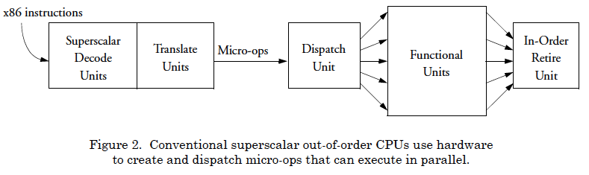
Hardware-Based Translation
Klaiber, “The Technology Behind Crusoe Processors,” Transmeta White Paper 2000.

Slide 62
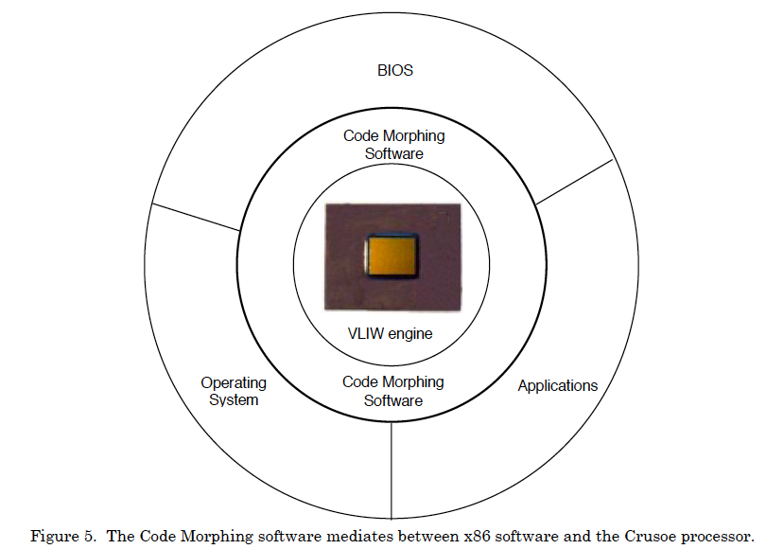
Software-Based Translation
Klaiber, “The Technology Behind Crusoe Processors,” Transmeta White Paper 2000.

Slide 63
We did not cover the following slides in lecture. These are for your preparation for the next lecture.

Slide 64
ISA-level Tradeoffs: Instruction Length
Fixed length: Length of all instructions the same
  + Easier to decode single instruction in hardware
  + Easier to decode multiple instructions concurrently
  -- Wasted bits in instructions (Why is this bad?)
  -- Harder-to-extend ISA (how to add new instructions?)
Variable length: Length of instructions different (determined by opcode and sub-opcode)
    + Compact encoding (Why is this good?)
    Intel 432: Huffman encoding (sort of). 6 to 321 bit instructions. How?
    -- More logic to decode a single instruction
    -- Harder to decode multiple instructions concurrently
Tradeoffs
  Code size (memory space, bandwidth, latency) vs. hardware complexity
  ISA extensibility and expressiveness vs. hardware complexity
  Performance? Smaller code vs. ease of decode
Notes:
Huffman encoding: shorter encoding for more commonly occurring instructions
Goal of Huffman encoding: minimize expected code length.

Slide 65
ISA-level Tradeoffs: Uniform Decode
Uniform decode: Same bits in each instruction correspond to the same meaning
  Opcode is always in the same location
  Ditto operand specifiers, immediate values, …
  Many “RISC” ISAs: Alpha, MIPS, SPARC
  + Easier decode, simpler hardware
  + Enables parallelism: generate target address before knowing the instruction is a branch
  -- Restricts instruction format (fewer instructions?) or wastes space
Non-uniform decode
  E.g., opcode can be the 1st-7th byte in x86
  + More compact and powerful instruction format
  -- More complex decode logic

Slide 66
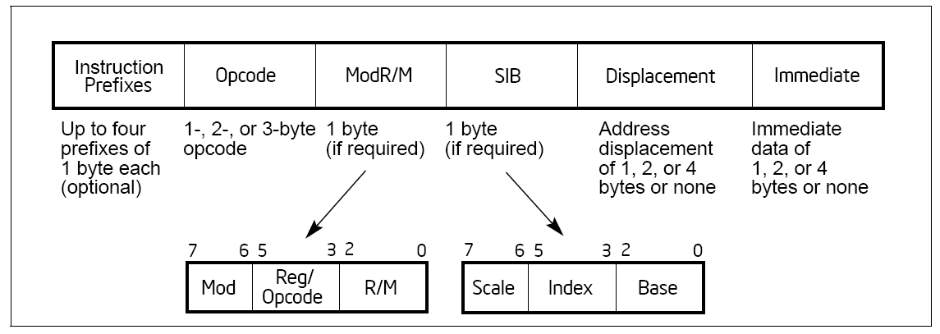
x86 vs. Alpha Instruction Formats
x86:
Alpha:

Slide 67
MIPS Instruction Format
R-type, 3 register operands
I-type, 2 register operands and 16-bit immediate operand
J-type, 26-bit immediate operand
Simple Decoding
  4 bytes per instruction, regardless of format
  must be 4-byte aligned (2 lsb of PC must be 2b’00)
  format and fields easy to extract in hardware
0
6-bit
rs
5-bit
rt
5-bit
rd
5-bit
shamt
5-bit
funct
6-bit
R-type
opcode
6-bit
rs
5-bit
rt
5-bit
immediate
16-bit
I-type
opcode
6-bit
immediate
26-bit
J-type

Slide 68
ARM

Slide 69
A Note on Length and Uniformity
Uniform decode usually goes with fixed length
In a variable length ISA, uniform decode can be a property of instructions of the same length
  It is hard to think of it as a property of instructions of different lengths

Slide 70
A Note on RISC vs. CISC
Usually, …
RISC
  Simple instructions
  Fixed length
  Uniform decode
  Few addressing modes
CISC
  Complex instructions
  Variable length
  Non-uniform decode
  Many addressing modes

Slide 71
ISA-level Tradeoffs: Number of Registers
Affects:
  Number of bits used for encoding register address
  Number of values kept in fast storage (register file)
  (uarch) Size, access time, power consumption of register file
Large number of registers:
  + Enables better register allocation (and optimizations) by compiler → fewer saves/restores
  -- Larger instruction size
  -- Larger register file size

Slide 72
ISA-level Tradeoffs: Addressing Modes
Addressing mode specifies how to obtain an operand of an instruction
  Register
  Immediate
  Memory (displacement, register indirect, indexed, absolute, memory indirect, autoincrement, autodecrement, …)
More modes:
  + help better support programming constructs (arrays, pointer-based accesses)
  -- make it harder for the architect to design
  -- too many choices for the compiler?
    Many ways to do the same thing complicates compiler design
    Wulf, “Compilers and Computer Architecture,” IEEE Computer 1981

Slide 73
x86 vs. Alpha Instruction Formats
x86:
Alpha:

Slide 74
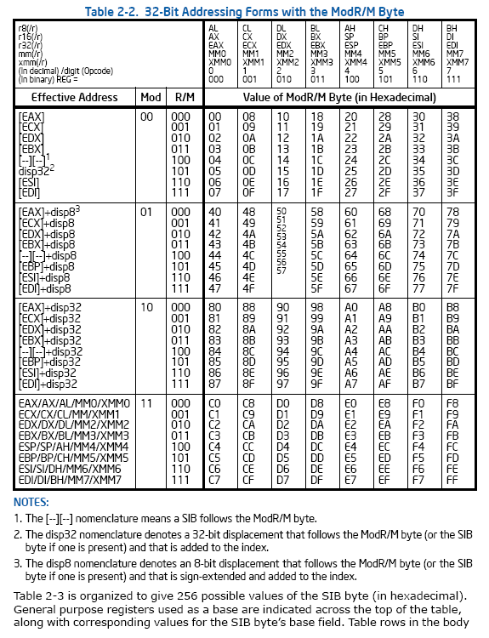
x86
register
indirect
absolute
register +
displacement
register

Slide 75
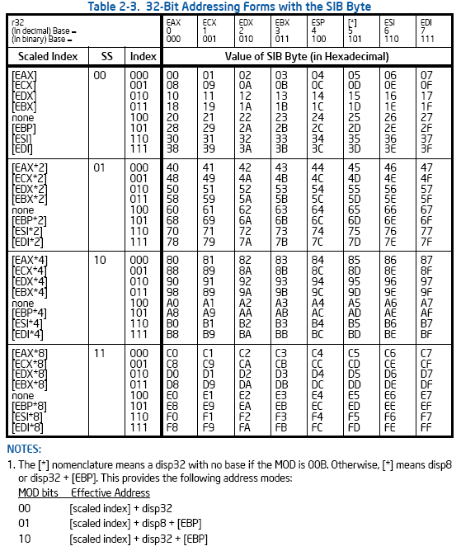
x86
indexed
(base + index)
scaled
(base +
index*4)

Slide 76
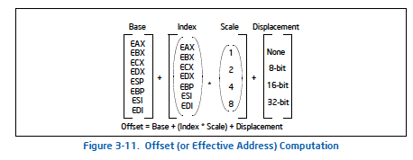
X86 SIB-D Addressing Mode
x86 Manual Vol. 1, page 3-22 -- see course resources on website
Also, see Section 3.7.3 and 3.7.5

Slide 77
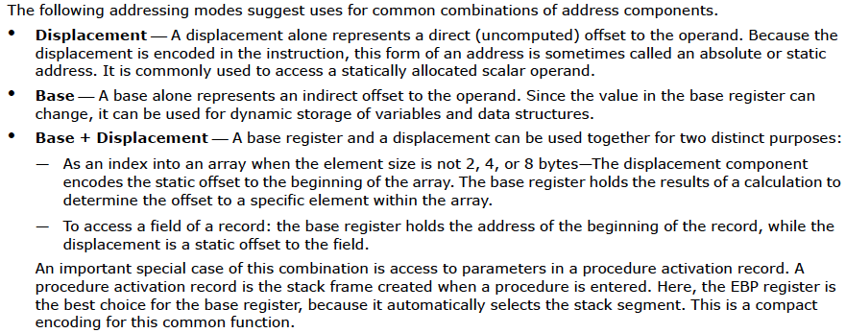
X86 Manual: Suggested Uses of Addressing Modes
x86 Manual Vol. 1, page 3-22 -- see course resources on website
Also, see Section 3.7.3 and 3.7.5

Slide 78
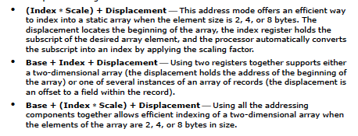
X86 Manual: Suggested Uses of Addressing Modes
x86 Manual Vol. 1, page 3-22 -- see course resources on website
Also, see Section 3.7.3 and 3.7.5

Slide 79
Other Example ISA-level Tradeoffs
Condition codes vs. not
VLIW vs. single instruction
Precise vs. imprecise exceptions
Virtual memory vs. not
Unaligned access vs. not
Hardware interlocks vs. software-guaranteed interlocking
Software vs. hardware managed page fault handling
Cache coherence (hardware vs. software)
…

Slide 80
Back to Programmer vs. (Micro)architect
Many ISA features designed to aid programmers
But, complicate the hardware designer’s job
Virtual memory
  vs. overlay programming
  Should the programmer be concerned about the size of code blocks fitting physical memory?
Addressing modes
Unaligned memory access
  Compile/programmer needs to align data

Slide 81
MIPS: Aligned Access
MSB
byte-3
byte-2
byte-1
byte-0
LSB
LW/SW alignment restriction: 4-byte word-alignment
  not designed to fetch memory bytes not within a word boundary
  not designed to rotate unaligned bytes into registers
Provide separate opcodes for the “infrequent” case
  LWL/LWR is slower
  Note LWL and LWR still fetch within word boundary
byte-7
byte-6
byte-5
byte-4
A
B
C
D
LWL rd 6(r0) →
byte-6
byte-5
byte-4
D
LWR rd 3(r0) →
byte-6
byte-5
byte-4
byte-3

Slide 82
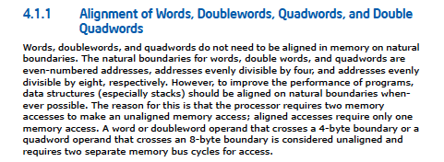
X86: Unaligned Access
LD/ST instructions automatically align data that spans a “word” boundary
Programmer/compiler does not need to worry about where data is stored (whether or not in a word-aligned location)

Slide 83
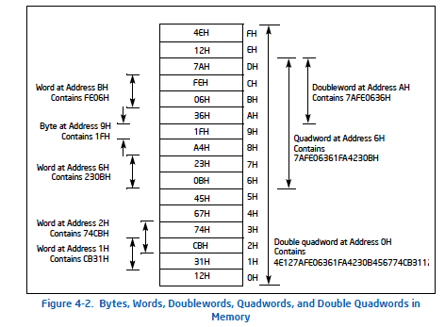
X86: Unaligned Access

Slide 84
What About ARM?
https://www.scss.tcd.ie/~waldroj/3d1/arm_arm.pdf
  Section A2.8

Slide 85
Aligned vs. Unaligned Access
Pros of having no restrictions on alignment
Cons of having no restrictions on alignment
Filling in the above: an exercise for you…

