Slide 1
18-447
Computer Architecture
Recitation 1
Kevin Chang
Carnegie Mellon University
Spring 2015, 1/23/2015

Slide 2
Agenda for Today
Quick recap on the previous lectures
Practice questions
Q&A on HW1, lab1, and lecture materials
Important deadlines:
  Lab 1 due tonight at 11:59:59 PM. Handin through AFS.
  Wednesday (1/28): HW 1 due
Notes:
We start with where we left off last week on ISA tradeoffs and we will finish it today.

Slide 3
Quick Review
DRAM-based memory system
  Cells, banks, refresh, performance hog, row hammer
Notes:
Modern main memory is predominantly built with DRAM cells, which stores data in capacitors

Slide 4
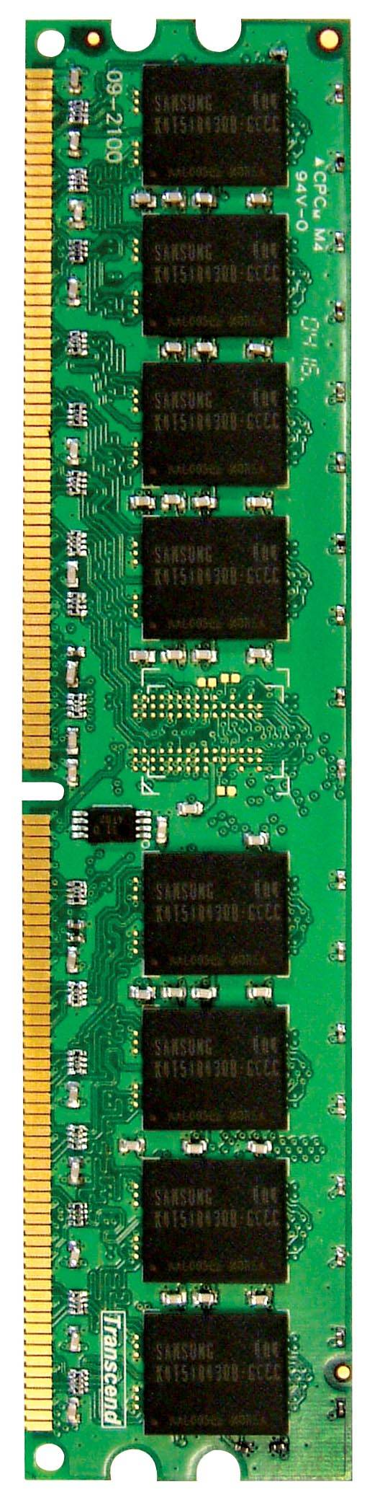
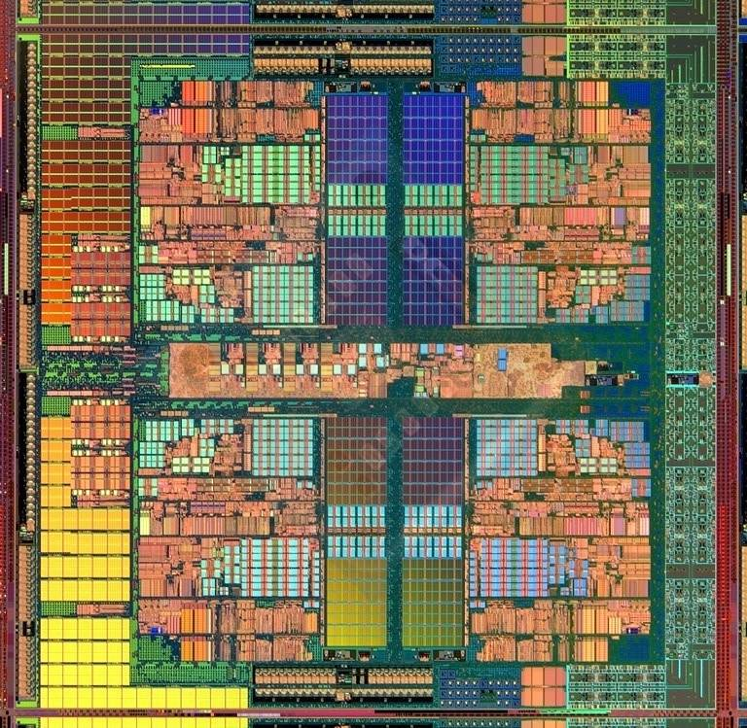
DRAM in the System
Multi-Core
Chip
CORE 0
L2 CACHE 1
CORE 1
L2 CACHE 0
SHARED L3 CACHE
DRAM INTERFACE
DRAM MEMORY CONTROLLER
DRAM BANKS
L2 CACHE 2
CORE 3
CORE 2
L2 CACHE 3
*Die photo credit: AMD Barcelona

Slide 5
DRAM in the System: Refresh
Bank 3
Wordline
Bank 2
Access
transistor
MEMORY CONTROLLER
Refresh
Memory
Bus
Bitline
Bank 0
Capacitor
Downsides of refresh:
1. Energy consumption
2. Performance degradation
3. QoS/predictability impact
4. Refresh rate limits DRAM capacity scaling
Notes:
Modern DRAM system is subdivided into multiple DRAM banks, where a bank is
A two-dimensional array of capacitor-based DRAM cells, organized in rows and columns, along with some other peripherals.
The reason for having multiple banks is that DRAM can serve requests in parallel across individual banks independently
Talk about DRAM cells.
Sense amps that sense the charge in the cell and converts the charge to a digital value of either 1 or 0.
A row of sense amplifiers is also referred as a row buffer.
One major issue with using DRAM cells is that they leak charge over time. The minimum amount of time that a cell can retain enough charge is called the retention time.
To prevent data loss, the memory controller periodically sends a refresh command to DRAM to trigger a refresh operation. Each refresh operation can refresh at least one row, up to 8 rows. For simplicity, we will assume that a refresh only works on one row at a time.
I’ve omitted some of the details in terms of retention time and refresh intervals. You can go back to

Slide 6
DRAM in the System: Performance Hog
Bank 3
matlab
Bank 2
MEMORY CONTROLLER
Memory
Bus
Bank 1
gcc
Bank 0
Memory performance hog:
Applications are being unfairly slowed down b/c DRAM controller is designed to maximize throughput
Notes:
-In a multi-core chip, different cores share some hardware resources. In particular, they share the DRAM memory system.
When we run matlab on one core, and gcc on another core, both cores generate memory requests to access the DRAM banks. When these requests arrive at the DRAM controller, the controller favors matlab’s requests over gcc’s requests. As a result, matlab can make progress and continues generating memory requests. These requests are again favored by the DRAM controller over gcc’s requests. Therefore, gcc starves waiting for its requests to be serviced in DRAM whereas matlab makes very quick progress as if it were running alone.
Why does this happen? This is because the algorithms employed by the DRAM controller are unfair.
But, why are these algorithms unfair? Why do they unfairly prioritize matlab accesses?
To understand this, we need to understand how a DRAM bank operates.

Slide 7
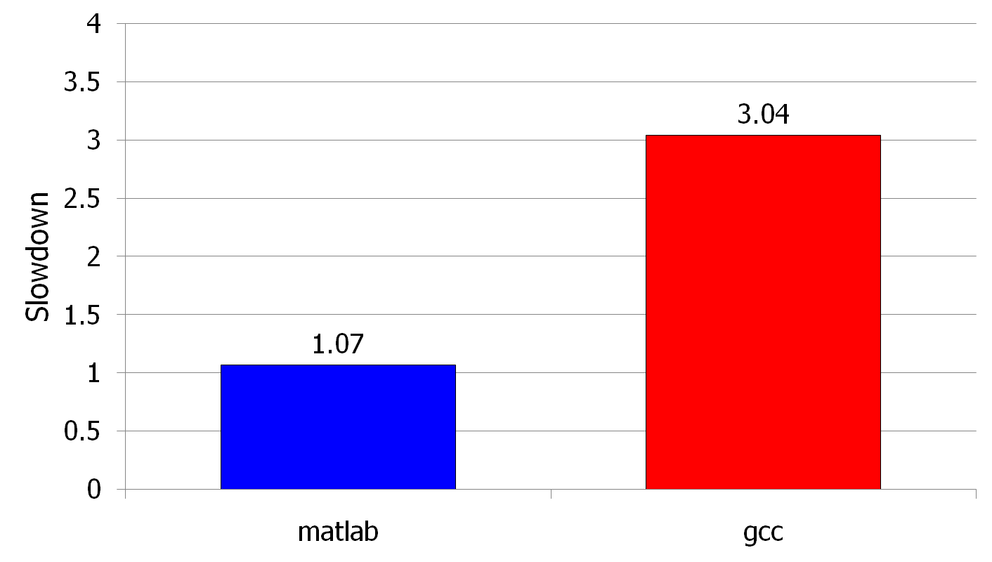
Unexpected Slowdowns in Multi-Core
Unfairly slowed down
(Core 0)
(Core 1)
Moscibroda and Mutlu, “Memory performance attacks: Denial of memory service
in multi-core systems,” USENIX Security 2007.
Notes:
What kind of performance do we expect when we run two applications on a multi-core system? To answer this question, we performed an experiment. We took two applications we cared about, ran them together on different cores in a dual-core system, and measured their slowdown compared to when each is run alone on the same system. This graph shows the slowdown each app experienced. (DATA explanation…)
Why do we get such a large disparity in the slowdowns?
Is it the priorities? No. We went back and gave high priority to gcc and low priority to matlab. The slowdowns did not change at all. Neither the software or the hardware enforced the priorities.
Is it the contention in the disk? We checked for this possibility, but found that these applications did not have any disk accesses in the steady state. They both fit in the physical memory and therefore did not interfere in the disk.
What is it then? Why do we get such large disparity in slowdowns in a dual core system?
I will call such an application a “memory performance hog”
Now, let me tell you why this disparity in slowdowns happens.
Is it that there are other applications or the OS interfering with gcc, stealing its time quantums? No.

Slide 8
Disturbance Errors in Modern DRAM
Row of Cells
Wordline
Row
Victim Row
Row
Aggressor Row
V_{LOW}
Opened
V_{HIGH}
Closed
Row
Victim Row
Row
Repeatedly opening and closing a row enough times within a refresh interval induces disturbance errors in adjacent rows in most real DRAM chips you can buy today
Kim+, “Flipping Bits in Memory Without Accessing Them: An Experimental Study of DRAM Disturbance Errors,” ISCA 2014.

Slide 9
Quick Review
DRAM-based memory system
  Cells, banks, refresh, row hammer, performance hog
Key components of a computer
The von Neumann vs. dataflow model
ISA vs. microarchitecture
Elements of an ISA
  Instructions: opcodes, data types, registers, formats, etc
  Memory: address space, addressing modes, alignment, etc
ISA tradeoffs
  CISC vs. RISC
  Semantic gap
Notes:
Von Neumann model: An instruction is fetched and executed in control flow order
Stored program and sequentially process instructions
What major machines use today
Dataflow model: An instruction is fetched and executed in data flow order without a pc
* The program is executed based on the inputs feeding into dataflow nodes which perform the computation
A data flow node fires (fetched and executed) when all it inputs are ready
ISA: Specifies how the programmer sees instructions to be executed
Microarchitecture: How the underlying implementation actually executes instructions
 Microarchitecture can execute instructions in any order as long as it obeys the semantics specified by the ISA when making the instruction results visible to software
Programmer should see the order specified by the ISA
Implementation (uarch) can be various as long as it satisfies the specification (ISA)
Data types:
Simple – int
Complex – linked list, string, bit vectors
Memory organization: byte addressable? How big is the address space?
----
CISC: does a lot of work, such as inserting a node to a linked list
RISC: does little and primitive work, such add or xor
----
Semantic gap: where to place your isa: closer to HLL or HW control signals. Tradeoffs b/w compilers and HW.
Small gap: rep movs

Slide 10

Practice Questions

Slide 11
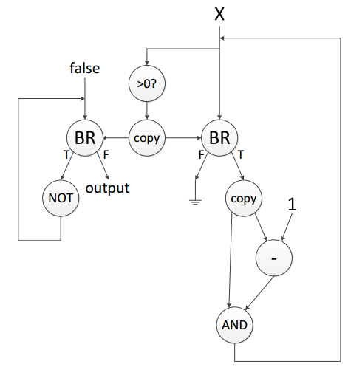
Practice Question 1: Dataflow

Slide 12
Practice Question 2: MIPS ISA
int foo(int *A, int n) {
int s;
if (n>=2) {
s=foo(A, n-1);
s=s+A[n-2];
}
else {
s=1;
}
A[n]=s+1;
return A[n];
}
_foo:
// TODO
_branch:
// TODO
_true:
// TODO
_false:
// TODO
_join:
// TODO
_done:
// TODO
MIPS
Assembly
1. A and n are passed in to r4 and r5
2. Result should be returned in r2, and r31 stores the return address
3. r29 (stack ptr), r8-r15 (caller saved), r16-r23 (called saved)

Slide 13
Q & A

