Slide 1
What happens after a fill?
BID FILL
ASK FILL
We buy 1 unit
Reservation price falls
Both quotes move down
We sell 1 unit
Reservation price rises
Both quotes move up
inventory q increases
r = S − qγσ²τ
buy less · sell sooner
inventory q decreases
move back toward q = 0
buy sooner · sell less
Two different effects
A–S quote response
Adverse market impact tested
our policy reacts
≠
$0.40 per fill
$0.05 / $0.10 per fill
the market reacts
Goal: test how much the independence assumption overstates P&L
Notes:
A fill means one of our posted orders trades. A bid fill makes us long, so the A–S model moves both quotes down to reduce inventory; an ask fill does the reverse. Do not confuse the forty-cent quote response with the five- or ten-cent adverse market impact tested in Problem 5.

Slide 2
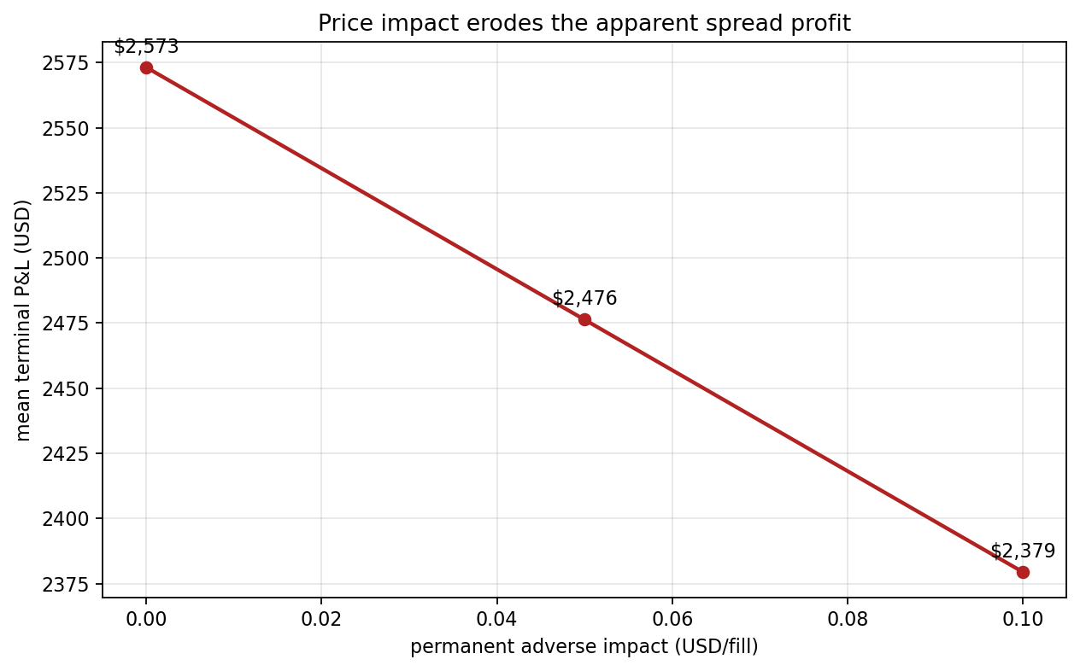
Price impact erodes expected P&L
1,000 simulated days
$0.00 / fill
$2,573
baseline
$0.05 / fill
$2,476
−3.8%
$0.10 / fill
$2,379
−7.5%
Ignoring own-price impact overstates profitability
Notes:
Across one thousand simulated days, mean terminal P&L falls from about 2,573 dollars with no impact to 2,476 dollars at five cents per fill and 2,379 dollars at ten cents per fill. That is a 3.8 and 7.5 percent reduction. The nearly straight line follows from our linear impact assumption: some apparent spread profit disappears once fills predict adverse price moves.

