Slide 1

Week 1 — Introduction & Progress Review
Roadmap, deliverables, grading, data sources, and resources
Optimal Market Making for Cryptocurrency Options · NC State University

Slide 2
Contents
• Learning objectives
• Where We Are (Week 1 Progress Review)
• Tooling & How to Get Help
• Timeline & Deliverable Clarification
• Syllabus & Grading Walkthrough
• Data Sources Discussion (Coincall)
• Additional Resources -- Math-Heavy Sections
• Illustration
• Getting the data from Coincall
• Code: coincall_client.py
• Summary & key takeaways
• Glossary of key terms
• Reading
• References

Slide 3
Learning Objectives
• Understand the arc of the program and what you will build
• Be clear on the timeline, the three milestones, and how you are graded
• Know where the data comes from (Coincall) and how to pull it
• Have the Python + PyTorch and C++/pybind11 toolchains running

Slide 4
Where We Are (Week 1 Progress Review)
• Maker vs. taker: we build the MAKER -- continuously quoting both sides
• The spine of the course is the Avellaneda-Stoikov model
• Week 1 status: environment setup, data access, and this orientation
• By Week 5 you ship a calibrated quoting engine (Milestone 1)

Slide 5
Tooling & How to Get Help
• Problem sets: Python + PyTorch (autograd does differentiation for you)
• Fast computation (Week 7): C++ exposed to Python via pybind11
• Mentorship is asynchronous (email/Telegram); tutors run day-to-day
• Office hours with tutors; come with a minimal reproducible snippet

Slide 6
Timeline & Deliverable Clarification
• 10 weeks. Week 1 introduction (done). Weeks 2-10 technical.
• Milestone 1 (Wk 5): Avellaneda-Stoikov engine, Python/PyTorch
• Milestone 2 (Wk 7): fast pricing/Greeks library, C++ via pybind11
• Milestone 3 (Wk 9): full options market-making backtest
• Final (Wk 10): one advanced extension + report (<=30pp) + 20-min talk
• Problem sets are due Sunday 23:59 ET; milestones Friday of the week

Slide 7
Syllabus & Grading Walkthrough
• Problem sets 30% | Milestones (3) 30% | Final 30% | Participation 10%
• Code graded on correctness, reproducibility, quality -- in that order
• Numerical-verification problems: right setup + right error magnitude
• Milestone 2 latency is a HARD GATE (sub-5ms surface) -- caps at 70 if missed
• Late PS: -20% until Tue; nothing after. Milestones: no late submission.
• Set random seeds: reproducibility is explicitly graded

Slide 8
Data Sources Discussion (Coincall)
• Exchange: Coincall. REST base: https://api.coincall.com
• Provided as Parquet: BTC/ETH options L2 + trades, perp L2, funding, SVI
• Coincall orderbook is L2 (aggregated depth) -- there is NO L3 feed
• You can also pull live via the REST/WebSocket API (next slides)
• Auth: API key + HMAC-SHA256 signature; market data is largely public
• Always cross-check exact endpoints at https://docs.coincall.com/

Slide 9
Additional Resources -- Math-Heavy Sections
• Stochastic control: Pham (2009), Ch. 3-4 (HJB, verification)
• Market making theory: Gueant (2016), Ch. 4; Cartea et al., Ch. 10-11
• Options/vol surface: Gatheral (2006); Gatheral-Jacquier (2014)
• Hedging: Taleb (1997), gamma scalping & the gamma-theta identity
• El Aoud-Abergel (2015): multi-Greek option market making (Week 8)
• We DERIVE the key results in lecture and explain every modeling choice

Slide 10
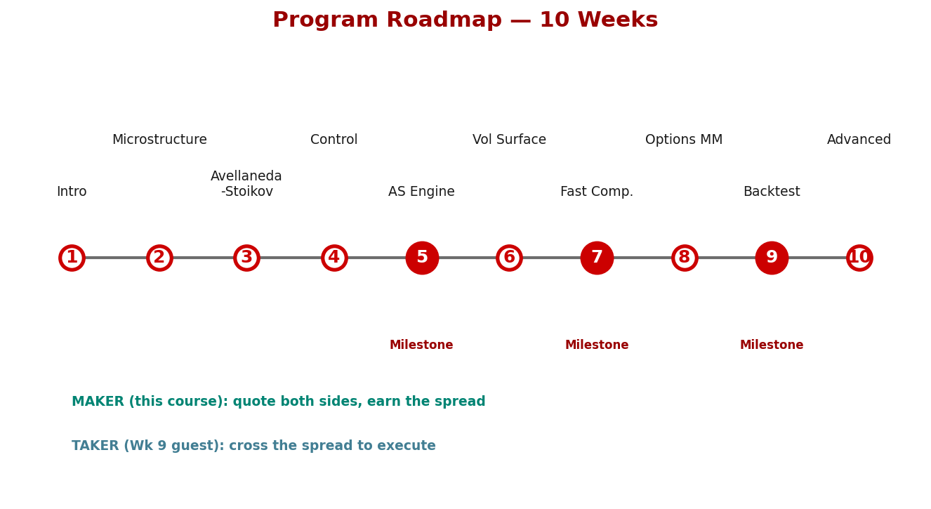
Illustration

Slide 11
Getting the Data from Coincall
Cross-check exact paths at https://docs.coincall.com/
• Base URL: https://api.coincall.com | Python SDK: github.com/CoincallExchange
• Signed request headers: X-CC-APIKEY, sign (HMAC-SHA256, upper hex), ts (ms), X-REQ-TS-DIFF
• Signing: sort params alphabetically, append uuid, ts, x-req-ts-diff, HMAC-SHA256 with secret
• Rate limits (per docs): orderbook 30/2s per user; public config 10/2s per IP
• Key endpoints you will use across the program:
Instruments: GET /open/option/getInstruments/{baseCurrency}
Option chain: GET /open/option/get/v1/{index}
Option book: GET /open/option/order/orderbook/v1/{symbol} (100 depth)
Option detail: GET /open/option/detail/v1/{symbol} (mark, IV, delta/gamma/vega/theta)
Trades: GET /open/option/trade/lasttrade/v1/{symbol}
Futures book: GET /open/futures/order/orderbook/v1/{symbol}
Funding: GET /open/public/fundingRate/v1?symbol=BTCUSD
Klines: GET /open/option/market/kline/history/v1/{optionName}?period=h1
• WebSocket channels: /options/pricing, /options/orderbook, /options/lasttrade, /options/kline
• ALWAYS verify the exact path/params against https://docs.coincall.com/ -- the API evolves.

Slide 12
Code — coincall_client.py -- signed REST helper (verify signing vs. live docs)
import time, hmac, hashlib, uuid, requests
BASE = "https://api.coincall.com"
def signed_get(path, params=None, api_key="", api_secret=""):
"""Minimal Coincall signed GET. Public market-data endpoints often work
unsigned; this shows the signed pattern used for account endpoints."""
params = params or {}
ts, window = str(int(time.time() * 1000)), "5000"
items = sorted(params.items()) # sort alphabetically
payload = "&".join(f"{k}={v}" for k, v in items)
payload += f"&uuid={uuid.uuid4().hex}&ts={ts}&x-req-ts-diff={window}"
sign = hmac.new(api_secret.encode(), payload.encode(),
hashlib.sha256).hexdigest().upper()
headers = {"X-CC-APIKEY": api_key, "sign": sign,
"ts": ts, "X-REQ-TS-DIFF": window}
r = requests.get(BASE + path, params=params, headers=headers, timeout=10)
r.raise_for_status()
return r.json()
# Example: list all BTC option instruments
print(signed_get("/open/option/getInstruments/BTC"))

Slide 13
Summary — Key Takeaways
• We build the MAKER side: continuously quote bid/ask and earn the spread
• Avellaneda-Stoikov is the spine; you ship a calibrated engine by Week 5
• Python/PyTorch for problem sets; C++ via pybind11 for fast computation
• Three milestones (Wk 5, 7, 9); grading is 30/30/30/10
• Data is Coincall (L2 only, no L3); confirm endpoints at docs.coincall.com

Slide 14
Glossary — Key Terms
Market maker — liquidity provider that continuously quotes bid and ask, earning the spread
Taker — participant that crosses the spread for immediate execution
Bid-ask spread — best ask minus best bid; the maker's revenue and risk premium
Inventory — the maker's net position; the main source of risk
Milestone — graded software deliverable, due in Weeks 5, 7, and 9
PyTorch / autograd — Python ML library; automatic differentiation computes Greeks for you
pybind11 — library that exposes C++ functions to Python (used in Week 7)

Slide 15
Reading
• Cartea-Jaikumar-Penalva, Ch. 1; Avellaneda-Stoikov (2008) -- skim
• Coincall API docs: https://docs.coincall.com/ (read 'Getting Started')

Slide 16
References
• Avellaneda, M., & Stoikov, S. (2008). High-frequency trading in a limit order book. Quantitative Finance, 8(3), 217-224.
• Gueant, O. (2016). The Financial Mathematics of Market Liquidity. Chapman & Hall/CRC.
• Cartea, A., Jaikumar, S., & Penalva, J. (2015). Algorithmic and High-Frequency Trading. Cambridge Univ. Press.
• Coincall API documentation. https://docs.coincall.com/

