Slide 1

Week 2 — Foundations of Market Microstructure
From the limit order book to the role of the market maker
Optimal Market Making for Cryptocurrency Options · NC State University

Slide 2
Contents
• Learning objectives
• Lecture 1: Order Book Mechanics
• Lecture 2: Spread Decomposition
• Illustration
• Getting the data from Coincall
• Code: week2_orderbook.py
• Summary & key takeaways
• Glossary of key terms
• Reading
• References

Slide 3
Learning Objectives
• Reconstruct an L2 order book from Coincall data
• Decompose the bid-ask spread (Roll, Glosten-Milgrom, Kyle)
• Explain the market maker as a continuous liquidity provider

Slide 4
Lecture 1: Order Book Mechanics
• Order types: market, limit, IOC, post-only, hidden
• Price-time priority and the matching algorithm
• L1 and L2 views (Coincall provides L2; there is no L3 / per-order feed)
• Because data is L2, we model aggregate intensity, not queue position

Slide 5
Lecture 2: Spread Decomposition
• Adverse selection + inventory + order-processing costs
• Roll (1984): effective spread from trade prices
• Glosten-Milgrom (1985): asymmetric information sets the spread
• Realized spread, effective spread, price impact

Slide 6
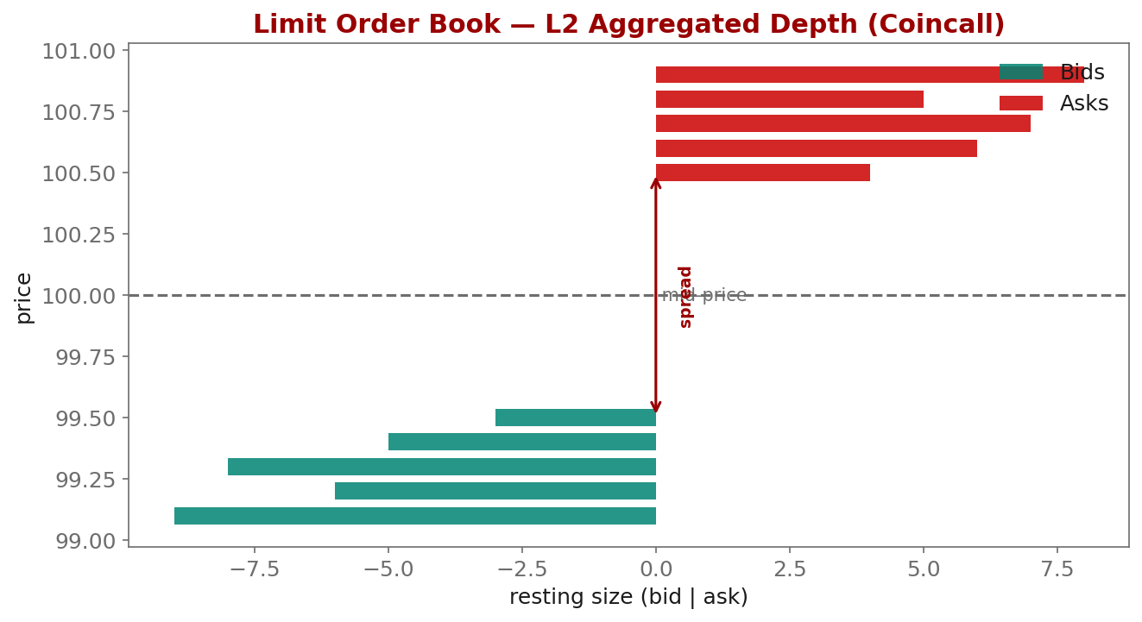
Illustration

Slide 7
Getting the Data from Coincall
Cross-check exact paths at https://docs.coincall.com/
• Goal: pull a single option's order book and recent trades, build mid/spread.
• Option order book (100 depth): GET /open/option/order/orderbook/v1/{symbol}
• Recent trades: GET /open/option/trade/lasttrade/v1/{symbol}
• List symbols first: GET /open/option/getInstruments/BTC
• Response gives arrays of [price, size] for bids and asks -> aggregate (L2)
• For replay/backtests use the provided Parquet L2 snapshots (1s for options)
• Live updates: subscribe to the /options/orderbook WebSocket channel

Slide 8
Code — week2_orderbook.py -- mid & spread from a Coincall L2 book
from coincall_client import signed_get # from Week 1
def l2_top_of_book(symbol, key, secret):
ob = signed_get(f"/open/option/order/orderbook/v1/{symbol}", {}, key, secret)
data = ob["data"] # confirm field names in the docs
bids = sorted(data["bids"], key=lambda x: -float(x[0]))
asks = sorted(data["asks"], key=lambda x: float(x[0]))
best_bid, best_ask = float(bids[0][0]), float(asks[0][0])
mid = 0.5 * (best_bid + best_ask)
spread = best_ask - best_bid
return mid, spread, best_bid, best_ask
# For an offline backtest, replay the provided Parquet instead:
# import pandas as pd
# book = pd.read_parquet("coincall_btc_options_l2_2025Q4.parquet")
# book["mid"] = 0.5 * (book.bid_px_0 + book.ask_px_0)

Slide 9
Summary — Key Takeaways
• A limit order book is resting orders by price; mid = (best bid + best ask)/2
• The spread pays for adverse selection, inventory, and order processing
• Roll, Glosten-Milgrom, and Kyle each isolate a different spread component
• Coincall gives L2 depth -> we model aggregate intensity, not queue position
• Deliverable mindset: a clean, reusable order-book reconstructor

Slide 10
Glossary — Key Terms
Limit order book (LOB) — all resting limit orders organized by price level
L1 / L2 / L3 — top-of-book / aggregated depth / per-order; Coincall provides L2 only
Mid-price — the average of the best bid and best ask
Adverse selection — loss from trading against better-informed counterparties
Effective spread — actual cost relative to mid (estimated by the Roll measure)
Price impact — how far the mid moves in the direction of an incoming trade
Order-flow toxicity — the degree to which incoming flow is informed

Slide 11
Reading
• Cartea-Jaikumar-Penalva, Ch. 1-3; Roll (1984); Glosten-Milgrom (1985)

Slide 12
References
• Roll, R. (1984). A simple implicit measure of the effective bid-ask spread. Journal of Finance, 39(4), 1127-1139.
• Glosten, L. R., & Milgrom, P. R. (1985). Bid, ask and transaction prices in a specialist market. J. Financial Economics, 14(1), 71-100.
• Kyle, A. S. (1985). Continuous auctions and insider trading. Econometrica, 53(6), 1315-1335.
• O'Hara, M. (1995). Market Microstructure Theory. Blackwell.
• Cartea, Jaikumar, & Penalva (2015). Algorithmic and High-Frequency Trading, Ch. 1-3.

