Slide 1

Week 3 — The Avellaneda-Stoikov Model
Optimal market making via stochastic control -- derived from scratch
Optimal Market Making for Cryptocurrency Options · NC State University

Slide 2
Contents
• Learning objectives
• Lecture 1: Setup & Dynamics
• Lecture 2: HJB, Ansatz, Closed Form
• Illustration
• Derivation & rationale
• Getting the data from Coincall
• Code: week3_as_quotes.py
• Summary & key takeaways
• Glossary of key terms
• Reading
• References

Slide 3
Learning Objectives
• Set up the Avellaneda-Stoikov control problem
• Follow the HJB derivation and understand every modeling choice
• Interpret the reservation price and the optimal half-spread

Slide 4
Lecture 1: Setup & Dynamics
• Mid-price: dS_t = sigma dW_t (arithmetic Brownian motion)
• Fill intensity: lambda(delta) = A exp(-kappa delta)
• Wealth from fills; inventory q jumps by +/-1 on a fill
• Exponential (CARA) utility of terminal wealth

Slide 5
Lecture 2: HJB, Ansatz, Closed Form
• Dynamic programming -> HJB partial differential equation
• Separation ansatz collapses HJB to ODEs in inventory
• Asymptotic (long-horizon) closed-form quotes
• Reservation price skews quotes against inventory

Slide 6
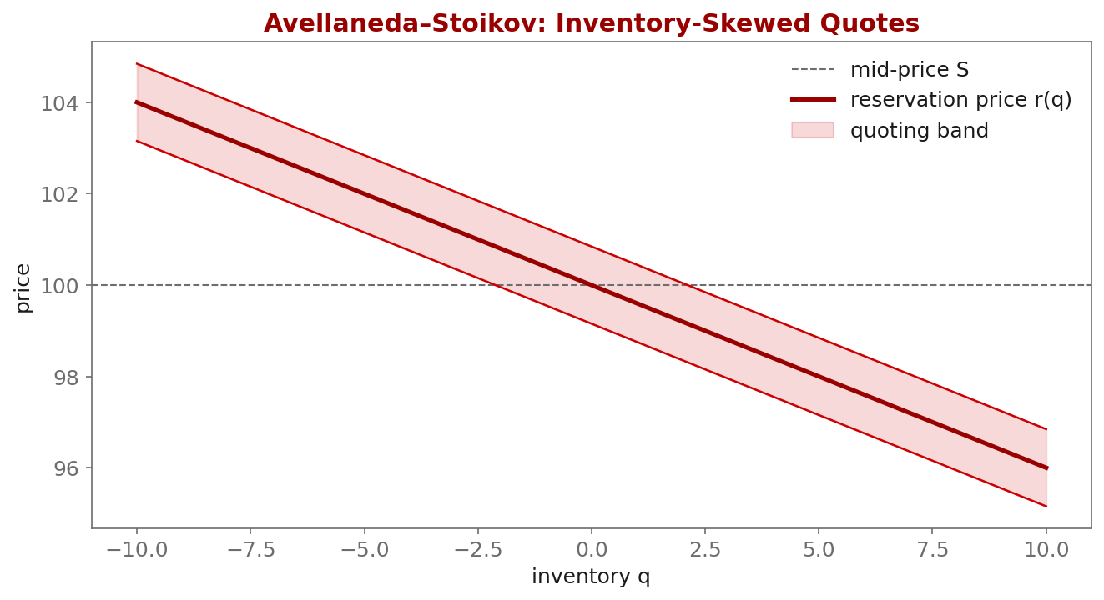
Illustration

Slide 7
Key Equations & Why We Choose Them
Full derivations in the PDF deck
dS_t = \sigma\, dW_t
• why: Arithmetic (not geometric) Brownian motion is chosen because over a short market-making horizon price changes are small and roughly additive; it keeps the HJB linear in $S$ and makes the cash dynamics exact.
\lambda(\delta) = A\, e^{-\kappa \delta}
• why: Fill intensity decays with quote distance $\delta$. The exponential form is the simplest law consistent with 'further from mid $\Rightarrow$ fewer fills'; $A$ sets the base rate, $\kappa$ the decay. It also yields a closed-form optimum.
\max\ \mathbb{E}\!\left[-e^{-\gamma\,(X_T + q_T S_T)}\right]
• why: CARA (exponential) utility is used because constant absolute risk aversion makes the value function factor out wealth, so the optimal quotes do not depend on the cash level -- exactly what we want for a market maker.
\partial_t V + \tfrac12\sigma^2 \partial_{SS} V + \max_{\delta^b}\lambda(\delta^b)\big[V(q{+}1,x{-}S{+}\delta^b)-V\big]+ \max_{\delta^a}\lambda(\delta^a)\big[V(q{-}1,x{+}S{+}\delta^a)-V\big]=0
• why: The HJB equation: the diffusion term prices inventory risk; each $\max$ term is the dealer optimally choosing the bid/ask offset, trading fill probability against captured spread.
V(t,x,S,q) = -e^{-\gamma(x+qS)}\,\theta(t,q)
• why: This ansatz is not a guess from nowhere: under CARA $+$ arithmetic dynamics the value function inherits a multiplicative structure across $(x, qS)$, so all the wealth/price dependence is exponential and only $\theta(t,q)$ remains to solve.
r(t,q) = S - q\,\gamma\,\sigma^2 (T-t)
• why: The reservation (indifference) price: it sits BELOW mid when you are long ($q>0$) so you quote to sell down inventory. The skew scales with risk aversion $\gamma$, variance $\sigma^2$, and time left -- more risk $\Rightarrow$ more skew.
\delta^* = \tfrac{1}{\gamma}\ln\!\big(1+\tfrac{\gamma}{\kappa}\big) + \tfrac{\gamma\sigma^2}{2}(T-t)
• why: The optimal half-spread = an order-flow term $\tfrac1\gamma\ln(1+\gamma/\kappa)$ (how hard fills are to get) plus an inventory-risk term $\tfrac{\gamma\sigma^2}{2}(T-t)$. You widen when risk-averse, when volatile, and when far from the horizon.

Slide 8
Getting the Data from Coincall
Cross-check exact paths at https://docs.coincall.com/
• This week uses simulated dynamics (no live data needed).
• For realistic sigma, estimate it from Coincall perp klines:
GET /open/option/market/kline/history/v1/{name}?period=m1 (or futures klines)
• You will calibrate A, kappa from real fills in Week 5.

Slide 9
Code — week3_as_quotes.py -- closed-form quotes in PyTorch
import torch
def as_quotes(S, q, gamma, sigma, kappa, tau):
"""Asymptotic Avellaneda-Stoikov bid/ask. Vectorized over inventory q."""
reservation = S - q * gamma * sigma**2 * tau
half_spread = (1.0/gamma) * torch.log1p(gamma/kappa) \
+ 0.5 * gamma * sigma**2 * tau
return reservation - half_spread, reservation + half_spread # bid, ask
S = torch.tensor(100.0); q = torch.arange(-10, 11).float()
bid, ask = as_quotes(S, q, gamma=0.1, sigma=2.0, kappa=1.5, tau=1.0)
print("inventory ->", q.tolist())
print("bid ->", bid.round(decimals=2).tolist())

Slide 10
Summary — Key Takeaways
• Model: arithmetic mid, exponential fill intensity, CARA utility
• HJB + the exponential ansatz collapse the problem to ODEs in inventory
• Reservation price skews quotes against inventory; r = S - q*gamma*sigma^2*(T-t)
• Half-spread = order-flow term + inventory-risk term
• Every modeling choice is made for tractability and has a clear interpretation

Slide 11
Glossary — Key Terms
Reservation price — inventory-adjusted indifference price that quotes are centered on
Half-spread — distance from the reservation price to each quote
HJB equation — the PDE characterizing the optimal value function
Ansatz — an assumed functional form that reduces the HJB to ODEs
CARA utility — constant absolute risk aversion, U(w) = -exp(-gamma w)
Intensity lambda(delta) — Poisson fill rate as a function of quote distance delta
Risk aversion gamma — parameter setting inventory skew and spread width

Slide 12
Reading
• Avellaneda-Stoikov (2008); Cartea-Jaikumar-Penalva, Ch. 10

Slide 13
References
• Avellaneda, M., & Stoikov, S. (2008). High-frequency trading in a limit order book. Quantitative Finance, 8(3), 217-224.
• Gueant, O. (2016). The Financial Mathematics of Market Liquidity, Ch. 4. Chapman & Hall/CRC.
• Cartea, Jaikumar, & Penalva (2015). Algorithmic and High-Frequency Trading, Ch. 10.

