Slide 1

Week 4 — Stochastic Optimal Control
The general theory behind the Avellaneda-Stoikov worked example
Optimal Market Making for Cryptocurrency Options · NC State University

Slide 2
Contents
• Learning objectives
• Lecture 1: Dynamic Programming & HJB
• Lecture 2: Verification & Utilities
• Illustration
• Derivation & rationale
• Getting the data from Coincall
• Code: week4_merton.py
• Summary & key takeaways
• Glossary of key terms
• Reading
• References

Slide 3
Learning Objectives
• Apply the dynamic programming principle in continuous time
• Understand the HJB equation and the verification theorem
• See why CARA / CRRA utilities give tractable problems

Slide 4
Lecture 1: Dynamic Programming & HJB
• Controlled diffusions and admissible controls
• The dynamic programming principle (Bellman)
• The infinitesimal generator and the HJB equation

Slide 5
Lecture 2: Verification & Utilities
• Verification theorem: a smooth HJB solution IS the value function
• CARA vs CRRA: where wealth enters the optimal policy
• Why market making uses CARA

Slide 6
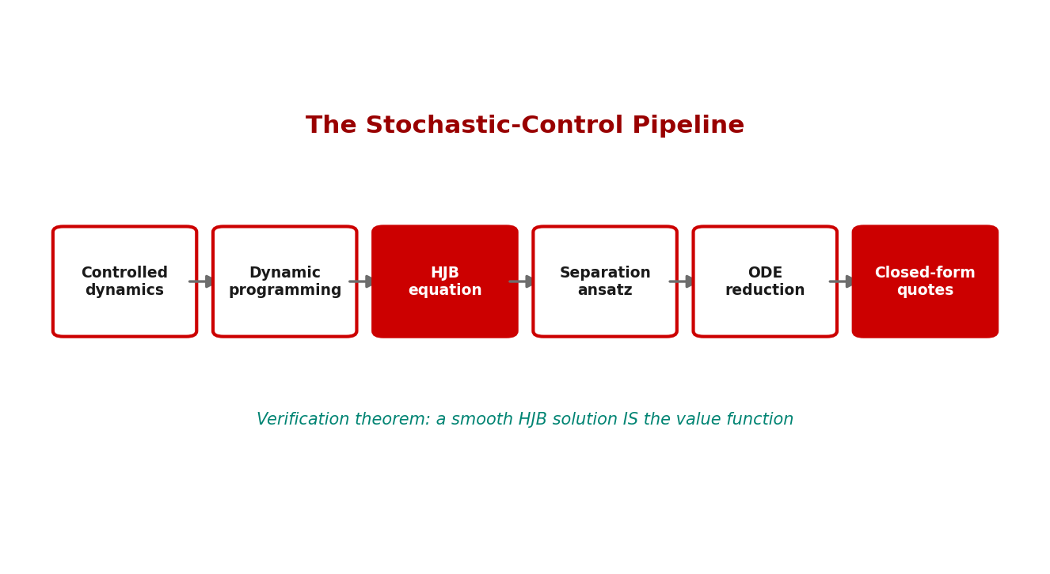
Illustration

Slide 7
Key Equations & Why We Choose Them
Full derivations in the PDF deck
V(t,x)=\sup_{u}\ \mathbb{E}\!\left[\int_t^T f(s,X_s,u_s)\,ds + g(X_T)\right]
• why: The value function is the best achievable expected reward from $(t,x)$ onward. We define the whole problem through $V$ because Bellman's principle then gives a local (differential) equation instead of an intractable global optimization.
V(t,x)=\sup_u \mathbb{E}\big[V(t{+}dt, X_{t+dt}) + f\,dt\big]
• why: The dynamic programming principle: an optimal policy is optimal from every later state too. Expanding $V(t+dt,\cdot)$ with Ito's lemma turns this into the HJB PDE.
\partial_t V + \sup_{u}\big\{\mathcal{L}^u V + f(t,x,u)\big\}=0,\quad V(T,x)=g(x)
• why: The HJB equation. $\mathcal{L}^u$ is the generator of the controlled diffusion; the $\sup$ is the instantaneous optimal control. This is the engine behind every model in the course -- Avellaneda-Stoikov is one special case.
\text{CARA: } U(w)=-e^{-\gamma w}\ \Rightarrow\ \text{policy independent of } w
• why: Constant absolute risk aversion makes marginal utility scale-free in wealth, so the optimal quotes do not move with the cash balance. CRRA ($U=w^{1-\gamma}/(1-\gamma)$) instead makes the policy scale WITH wealth -- natural for investment, awkward for a desk.

Slide 8
Getting the Data from Coincall
Cross-check exact paths at https://docs.coincall.com/
• Theory week -- no Coincall data required.
• Optional: estimate drift/vol from perp klines to parameterize Merton.

Slide 9
Code — week4_merton.py -- HJB value iteration (CARA) in PyTorch
import torch
# Merton under CARA, solved by backward value iteration on a wealth grid.
w = torch.linspace(-5, 5, 401); dt = 1e-3; mu, r, sig, gam = 0.08, 0.02, 0.2, 1.0
V = -torch.exp(-gam * w) # terminal utility
for _ in range(1000): # march backward in time
# optimal risky holding pi* = (mu - r)/(gam*sig^2) is wealth-independent (CARA)
pi = (mu - r) / (gam * sig**2)
drift = (r*w + pi*(mu - r))
diff = 0.5 * (pi*sig)**2
dV = torch.gradient(V, spacing=(w[1]-w[0]).item())[0]
d2V = torch.gradient(dV, spacing=(w[1]-w[0]).item())[0]
V = V + dt * (drift*dV + diff*d2V)
print("pi* (constant in wealth):", (mu - r)/(gam*sig**2))

Slide 10
Summary — Key Takeaways
• Dynamic programming -> HJB is the engine behind every model in the course
• The verification theorem certifies that an HJB solution is THE value function
• CARA makes the optimal policy wealth-independent (ideal for a desk)
• CRRA makes the policy scale with wealth (ideal for investment)
• Avellaneda-Stoikov is one special case of this general template

Slide 11
Glossary — Key Terms
Stochastic optimal control — choosing controls to optimize an expected objective under randomness
Dynamic programming principle — an optimal policy stays optimal from every later state
Value function — the best achievable expected reward from a given state onward
Infinitesimal generator — operator giving the expected instantaneous change of a function
Verification theorem — conditions under which an HJB solution is the value function
CRRA utility — constant relative risk aversion; the policy scales with wealth
Admissible control — a control satisfying the problem's constraints

Slide 12
Reading
• Pham (2009), Ch. 3-4; Cartea-Jaikumar-Penalva, Ch. 6

Slide 13
References
• Pham, H. (2009). Continuous-time Stochastic Control and Optimization with Financial Applications. Springer.
• Fleming, W. H., & Soner, H. M. (2006). Controlled Markov Processes and Viscosity Solutions (2nd ed.). Springer.
• Oksendal, B. (2003). Stochastic Differential Equations (6th ed.). Springer.
• Almgren, R., & Chriss, N. (2001). Optimal execution of portfolio transactions. Journal of Risk, 3(2), 5-40.

