Slide 1

Week 5 — The Avellaneda-Stoikov Engine
Implementation, calibration, and backtest -- Milestone 1
Optimal Market Making for Cryptocurrency Options · NC State University

Slide 2
Contents
• Learning objectives
• Lecture 1: From Closed Form to Code
• Lecture 2: Calibration & Validation
• Illustration
• Derivation & rationale
• Getting the data from Coincall
• Code: week5_calibrate.py
• Summary & key takeaways
• Glossary of key terms
• Reading
• References

Slide 3
Learning Objectives
• Implement the quotes as a tested PyTorch engine
• Calibrate the fill intensities by maximum likelihood
• Backtest on one month of Coincall BTC-PERP data

Slide 4
Lecture 1: From Closed Form to Code
• Engine architecture; state from the L2 book
• Map continuous-time quantities to discrete events
• Calibrate lambda(delta) = A exp(-kappa delta) from fills

Slide 5
Lecture 2: Calibration & Validation
• Maximum-likelihood fit of A and kappa with goodness-of-fit
• Replay engine + fill simulator + P&L attribution
• Reproducibility under a fixed seed

Slide 6
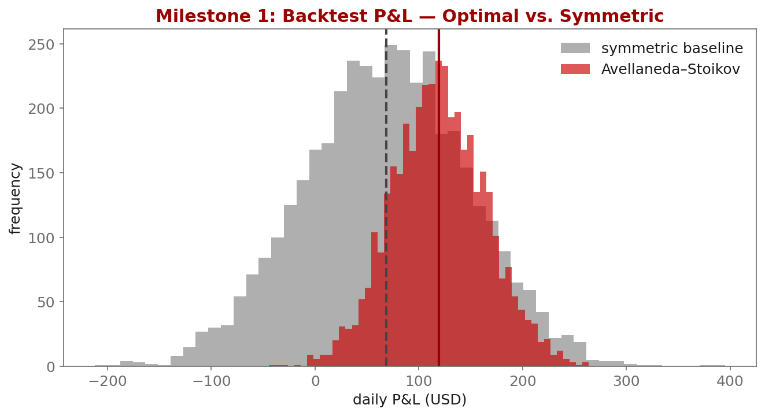
Illustration

Slide 7
Key Equations & Why We Choose Them
Full derivations in the PDF deck
\mathcal{L}(A,\kappa)=\prod_i \lambda(\delta_i)\,e^{-\lambda(\delta_i)\,\Delta t_i}
• why: Fills are a (doubly stochastic) Poisson process, so the likelihood of the observed fills given quote distances $\delta_i$ is a product of Poisson densities. We fit by MAXIMUM LIKELIHOOD rather than least-squares because the data are event counts, not Gaussian residuals.
-\ln\mathcal{L} = \sum_i\big[\lambda(\delta_i)\Delta t_i - \ln\lambda(\delta_i)\big]
• why: Minimizing this negative log-likelihood is convex in $\ln A$ and well-behaved in $\kappa$; PyTorch autograd gives the gradients, so a few hundred Adam steps converge.

Slide 8
Getting the Data from Coincall
Cross-check exact paths at https://docs.coincall.com/
• Build the intensity-calibration set from trades vs. your quotes:
Trades: GET /open/option/trade/lasttrade/v1/{symbol} (or trade history)
Book: GET /open/futures/order/orderbook/v1/{symbol} for the mid
• Offline: coincall_btc_perp_trades_2025Q4.parquet + ..._l2_2025Q4.parquet
• A pre-aggregated coincall_intensity_calibration_set.parquet is provided
• delta_i = |fill price - mid at fill|; group fills by delta bucket for the MLE

Slide 9
Code — week5_calibrate.py -- intensity MLE with PyTorch autograd
import torch
# delta: quote distances at which fills occurred; dt: exposure time per fill
delta = torch.tensor([...]); dt = torch.tensor([...])
logA = torch.zeros(1, requires_grad=True)
kappa = torch.ones(1, requires_grad=True)
opt = torch.optim.Adam([logA, kappa], lr=0.05)
for step in range(2000):
lam = torch.exp(logA) * torch.exp(-kappa.clamp(min=1e-3) * delta)
nll = (lam * dt - torch.log(lam)).sum() # Poisson negative log-lik
opt.zero_grad(); nll.backward(); opt.step()
print("A =", torch.exp(logA).item(), " kappa =", kappa.item())

Slide 10
Summary — Key Takeaways
• Closed-form quotes become a vectorized, tested PyTorch engine
• Calibrate A, kappa by MAXIMUM LIKELIHOOD (fills are Poisson), report chi-square
• Backtest = replay + fill simulator + P&L attribution
• Reproducibility under a fixed seed is graded -- set your seeds
• Milestone 1: engine within +/-50% of the reference P&L, report <= 10 pp.

Slide 11
Glossary — Key Terms
Maximum likelihood (MLE) — fitting parameters by maximizing the likelihood of the data
Poisson process — counting process for random arrivals (here, fills)
Goodness-of-fit (chi-square) — a statistic measuring how well the fit matches the data
Backtest — simulation of a strategy on historical data
Fill simulator — model of which of the maker's quotes get executed
P&L attribution — decomposition of profit into its sources
Reproducibility — identical results on re-run under a fixed random seed

Slide 12
Reading
• Avellaneda-Stoikov (2008) [implementation]; Gueant (2016), Ch. 4

Slide 13
References
• Avellaneda, M., & Stoikov, S. (2008). High-frequency trading in a limit order book. Quantitative Finance, 8(3), 217-224.
• Gueant, O. (2016). The Financial Mathematics of Market Liquidity, Ch. 4. Chapman & Hall/CRC.
• Cartea, Jaikumar, & Penalva (2015). Algorithmic and High-Frequency Trading, Ch. 10.
• Coincall API documentation. https://docs.coincall.com/

