Slide 1
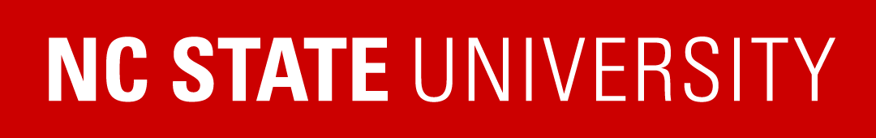
Week 6 — Options Pricing & the Volatility Surface
Greeks, no-arbitrage, and SVI/SABR calibration
Optimal Market Making for Cryptocurrency Options · NC State University

Slide 2
Contents
• Learning objectives
• Lecture 1: Greeks & the Surface
• Lecture 2: SVI & SABR Calibration
• Illustration
• Derivation & rationale
• Getting the data from Coincall
• Code: week6_bs_autograd.py
• Summary & key takeaways
• Glossary of key terms
• Reading
• References

Slide 3
Learning Objectives
• Recall the Greeks, including vanna and volga
• State the no-arbitrage constraints on the surface
• Calibrate SVI and SABR to Coincall data

Slide 4
Lecture 1: Greeks & the Surface
• Black-Scholes and the Greek vector
• Vanna, volga, and volatility risk
• Calendar and butterfly arbitrage constraints

Slide 5
Lecture 2: SVI & SABR Calibration
• Raw and arbitrage-free SVI
• SVI by nonlinear least squares (autograd Jacobians)
• The SABR / Hagan expansion

Slide 6
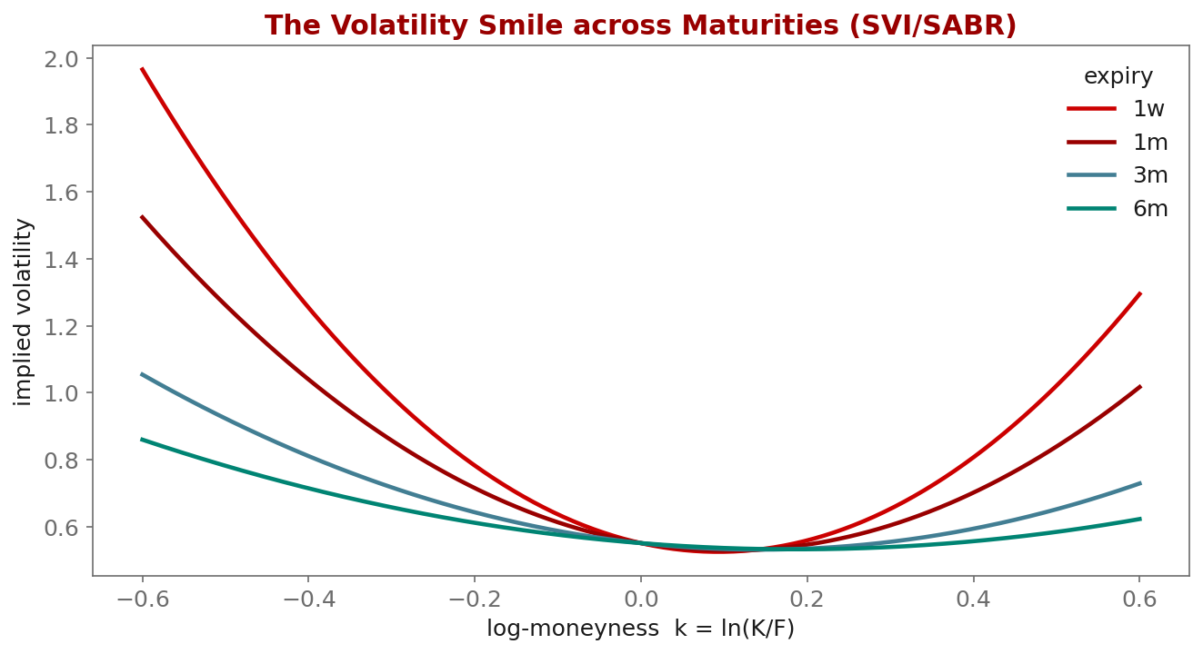
Illustration

Slide 7
Key Equations & Why We Choose Them
Full derivations in the PDF deck
w(k)=a+b\big(\rho(k-m)+\sqrt{(k-m)^2+\varsigma^2}\big)
• why: Raw SVI for total implied variance $w=\sigma^2 T$ in log-moneyness $k$. The hyperbola shape is chosen because it matches observed smiles with only 5 parameters and has closed-form slopes for the no-arbitrage checks.
\text{butterfly: } g(k)\ge 0,\qquad \text{calendar: } \partial_T w(k,T)\ge 0
• why: These inequalities are exactly 'no free option-portfolio arbitrage': a negative $g(k)$ implies a negative risk-neutral density, and decreasing total variance in $T$ implies a calendar arbitrage. We enforce them so the fitted surface is tradeable.

Slide 8
Getting the Data from Coincall
Cross-check exact paths at https://docs.coincall.com/
• Pull a full option chain with mark IV and Greeks per strike:
Chain: GET /open/option/get/v1/{index} (index = BTC/ETH underlying)
Detail: GET /open/option/detail/v1/{symbol} (mark, IV, delta/gamma/vega/theta/rho)
Symbols: GET /open/option/getInstruments/BTC
• Offline: coincall_btc_options_chain_snapshots_2025Q4.parquet (5-min snapshots)
• A baseline coincall_calibrated_svi_surfaces_2025Q4.parquet is provided

Slide 9
Code — week6_bs_autograd.py -- Greeks via PyTorch autograd (no hand AD)
import torch
def bs_call(S, K, T, r, sig):
d1 = (torch.log(S/K) + (r + 0.5*sig**2)*T) / (sig*torch.sqrt(T))
d2 = d1 - sig*torch.sqrt(T)
N = torch.distributions.Normal(0., 1.).cdf
return S*N(d1) - K*torch.exp(-r*T)*N(d2)
S,K,T,r,sig = [torch.tensor(x, requires_grad=True)
for x in (100., 100., 1.0, 0.0, 0.6)] # crypto IV ~ 60%
price = bs_call(S,K,T,r,sig)
vega, = torch.autograd.grad(price, sig, create_graph=True)
vanna, = torch.autograd.grad(vega, S, create_graph=True) # d vega / dS
volga, = torch.autograd.grad(vega, sig) # d vega / d sig
print(float(price), float(vega), float(vanna), float(volga))

Slide 10
Summary — Key Takeaways
• Implied volatility forms a smile; SVI and SABR parameterize it
• Fit with PyTorch autograd Jacobians -- no hand-derived gradients
• Enforce calendar and butterfly no-arbitrage so the surface is tradeable
• Greeks (incl. vanna, volga) come straight from autograd
• Crypto data is noisy: weight by volume/spread and seed from yesterday's fit

Slide 11
Glossary — Key Terms
Implied volatility — the volatility that matches the market option price under Black-Scholes
Volatility smile — implied volatility as a function of strike / moneyness
SVI — Stochastic Volatility Inspired parameterization of total variance
SABR — stochastic alpha-beta-rho model with the Hagan implied-vol expansion
Greeks — price sensitivities: delta, gamma, vega, theta, rho
Vanna / Volga — second-order Greeks: d vega / dS and d vega / d sigma
Calendar / butterfly arbitrage — no-arbitrage constraints the surface must satisfy

Slide 12
Reading
• Gatheral (2006), Ch. 1-5; Gatheral-Jacquier (2014); Hagan et al. (2002)

Slide 13
References
• Gatheral, J. (2006). The Volatility Surface: A Practitioner's Guide. Wiley.
• Gatheral, J., & Jacquier, A. (2014). Arbitrage-free SVI volatility surfaces. Quantitative Finance, 14(1), 59-71.
• Hagan, P. S., Kumar, D., Lesniewski, A. S., & Woodward, D. E. (2002). Managing smile risk. Wilmott Magazine, Sept., 84-108.
• Hull, J. C. (2021). Options, Futures, and Other Derivatives (11th ed.). Pearson.

