Slide 1

Week 7 — Fast Computation: Prices, Greeks, Implied Vol, Surfaces
The latency budget, in C++ via pybind11 -- Milestone 2
Optimal Market Making for Cryptocurrency Options · NC State University

Slide 2
Contents
• Learning objectives
• Lecture 1: CF Pricing & Implied Vol
• Lecture 2: Binding C++ with pybind11
• Illustration
• Derivation & rationale
• Getting the data from Coincall
• Code: fastmm pybind11 module
• Summary & key takeaways
• Glossary of key terms
• Reading
• References

Slide 3
Learning Objectives
• Implement COS / Carr-Madan pricers and robust implied-vol in C++
• Expose the C++ kernels to Python with pybind11
• Validate Greeks against PyTorch autograd; hit the 5 ms budget

Slide 4
Lecture 1: CF Pricing & Implied Vol
• Characteristic functions: Black-Scholes and Heston
• Fang-Oosterlee COS method (the workhorse)
• Robust implied-vol inversion (good guess + safeguarded Newton)

Slide 5
Lecture 2: Binding C++ with pybind11
• Structure a pybind11 module; build with CMake
• Pass NumPy/PyTorch tensors with no copy (buffer protocol)
• Release the GIL around the C++ hot loop
• PyTorch autograd is the REFERENCE for Greeks; C++ is the speed

Slide 6
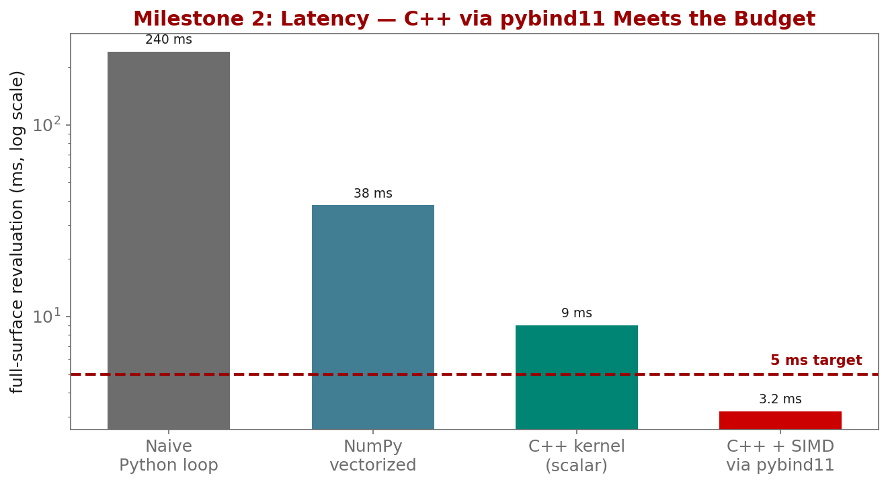
Illustration

Slide 7
Key Equations & Why We Choose Them
Full derivations in the PDF deck
C(K)=e^{-rT}\,\tfrac{1}{\pi}\!\int_0^\infty \mathrm{Re}\!\big[e^{-iu\ln K}\hat{\phi}(u)\big]\,du
• why: Once we leave Black-Scholes (e.g. Heston), there is no closed-form price, but the characteristic function $\phi$ IS known. Pricing becomes a single Fourier integral -- this is why CF methods exist and why they are fast.
C \approx \sum_{n=0}^{N-1}{}' \mathrm{Re}\!\Big[\phi\!\big(\tfrac{n\pi}{b-a}\big)e^{-i n\pi\frac{a}{b-a}}\Big]V_n
• why: The Fang-Oosterlee COS method replaces the integral with a cosine series that converges geometrically for smooth densities. We truncate $[a,b]$ from the cumulants, not by guessing -- that is what makes it reach $10^{-4}$ accuracy in microseconds.

Slide 8
Getting the Data from Coincall
Cross-check exact paths at https://docs.coincall.com/
• Inputs are the calibrated surface from Week 6 plus reference prices:
coincall_btc_options_chain_snapshots_2025Q4.parquet
coincall_calibrated_svi_surfaces_2025Q4.parquet (baseline)
coincall_reference_prices_2025Q4.parquet (accuracy target, 1e-4)
• Live mark/IV/Greeks for spot checks: GET /open/option/detail/v1/{symbol}

Slide 9
Code — fastmm pybind11 module -- C++ kernel exposed to Python
// fastmm.cpp (build with CMake + pybind11; import as `fastmm`)
#include <pybind11/pybind11.h>
#include <pybind11/numpy.h>
namespace py = pybind11;
double cos_price(double S, double K, double T, double r, double sigma); // COS pricer
py::array_t<double> price_surface(py::array_t<double> K, double S,
double T, double r, double sigma) {
auto k = K.unchecked<1>(); auto out = py::array_t<double>(k.shape(0));
auto o = out.mutable_unchecked<1>();
{ py::gil_scoped_release nogil; // release GIL for the hot loop
for (py::ssize_t i = 0; i < k.shape(0); ++i)
o(i) = cos_price(S, k(i), T, r, sigma); }
return out; // zero-copy back to NumPy
}
PYBIND11_MODULE(fastmm, m) { m.def("price_surface", &price_surface); }

Slide 10
Summary — Key Takeaways
• Beyond Black-Scholes there is no closed form -- use the characteristic function
• COS (Fang-Oosterlee) is the workhorse; truncate from the cumulants
• Write the hot kernel in C++ and expose it to Python with pybind11
• PyTorch autograd is the REFERENCE for Greeks; C++ is only the speed
• Milestone 2: full surface < 5 ms (hard gate); release the GIL in the loop

Slide 11
Glossary — Key Terms
Characteristic function — the Fourier transform of the log-return density
COS method — Fourier-cosine series option pricing (Fang-Oosterlee)
Carr-Madan — FFT-based option pricing via a damped payoff
Implied-vol inversion — solving for the IV that reproduces a price (safeguarded Newton)
pybind11 — header-only C++ <-> Python binding
GIL — Python's Global Interpreter Lock; released around the C++ hot loop
Latency budget — the maximum allowed time (sub-5 ms full-surface revaluation)

Slide 12
Reading
• Carr-Madan (1999); Fang-Oosterlee (2008); Jaeckel (2015); pybind11 docs

Slide 13
References
• Carr, P., & Madan, D. (1999). Option valuation using the fast Fourier transform. J. Computational Finance, 2(4), 61-73.
• Fang, F., & Oosterlee, C. W. (2008). A novel pricing method for European options based on Fourier-cosine series expansions. SIAM J. Sci. Comput., 31(2), 826-848.
• Jackel, P. (2015). Let's be rational. Wilmott Magazine.
• Jakob, W., Rhinelander, J., & Moldovan, D. (2017). pybind11. https://github.com/pybind/pybind11
• Paszke, A., et al. (2019). PyTorch: an imperative style, high-performance deep learning library. NeurIPS.

