Slide 1

Week 8 — Options Market Making & Dynamic Hedging
Avellaneda-Stoikov with a vector-valued (Greek) inventory
Optimal Market Making for Cryptocurrency Options · NC State University

Slide 2
Contents
• Learning objectives
• Lecture 1: Multi-Greek Inventory & HJB
• Lecture 2: Dynamic Hedging
• Illustration
• Derivation & rationale
• Getting the data from Coincall
• Code: week8_hedge.py
• Summary & key takeaways
• Glossary of key terms
• Reading
• References

Slide 3
Learning Objectives
• Set up the El Aoud-Abergel multi-Greek framework
• Understand the quadratic inventory penalty
• Quantify the P&L of a delta-hedged book

Slide 4
Lecture 1: Multi-Greek Inventory & HJB
• Inventory becomes a vector q = (Delta, Gamma, vega, ...)
• Quadratic inventory penalty; reduces to AS in 1-D
• Multi-Greek HJB and the separation ansatz

Slide 5
Lecture 2: Dynamic Hedging
• Continuous vs discrete delta hedging
• The gamma-theta-variance identity
• Perp futures as the hedge instrument; funding cost

Slide 6
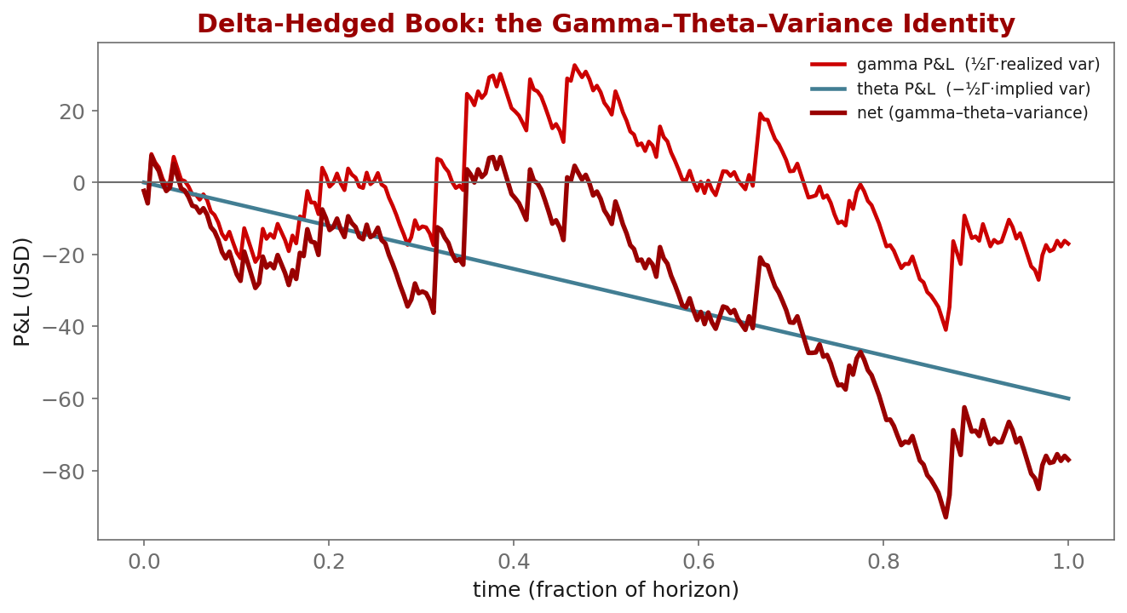
Illustration

Slide 7
Key Equations & Why We Choose Them
Full derivations in the PDF deck
\text{penalty} = \tfrac12\, q^{\mathsf T} \Sigma\, q
• why: Inventory risk for an options book is multi-dimensional (delta, gamma, vega...). A quadratic form is the local (mean-variance) risk of the Greek vector; $\Sigma$ is calibrated to the empirical covariance of the Greeks, so cross-risks are priced, not just diagonal ones. It reduces to AS's $q^2$ penalty when there is one Greek.
d\Pi = \tfrac12\,\Gamma\,S^2\big(\sigma_{\text{real}}^2-\sigma_{\text{impl}}^2\big)\,dt
• why: The gamma-theta-variance identity: a delta-hedged option earns (or pays) the gap between realized and implied variance, scaled by dollar gamma. This single equation explains ~80% of a hedged book's daily P&L and motivates why we track gamma at all.

Slide 8
Getting the Data from Coincall
Cross-check exact paths at https://docs.coincall.com/
• Greeks per contract (for the inventory vector and Sigma):
GET /open/option/detail/v1/{symbol} -> delta, gamma, vega, theta, rho
• Hedge instrument + carry:
Perp book: GET /open/futures/order/orderbook/v1/{symbol}
Funding: GET /open/public/fundingRate/v1?symbol=BTCUSD
• Offline: coincall_funding_rates_2025Q4.parquet for hedge-cost accounting

Slide 9
Code — week8_hedge.py -- aggregate Greeks & threshold delta hedge
import torch
def book_greeks(positions, greeks):
# positions: (n,), greeks: (n,5) columns [delta,gamma,vega,theta,rho]
return (positions[:, None] * greeks).sum(0) # aggregate inventory vector
def delta_hedge(net_delta, perp_pos, threshold=0.1):
if net_delta.abs() > threshold: # rebalance only when breached
trade = -net_delta # hedge with perp futures
return perp_pos + trade, trade
return perp_pos, torch.tensor(0.0)

Slide 10
Summary — Key Takeaways
• Options inventory is a VECTOR of Greeks, penalized by (1/2) q^T Sigma q
• The multi-Greek HJB reduces to Avellaneda-Stoikov in the 1-D limit
• Gamma-theta-variance identity explains ~80% of a hedged book's P&L
• Hedge delta with the perpetual; account for the funding rate
• Calibrate Sigma to the empirical Greek covariance, not the identity

Slide 11
Glossary — Key Terms
Greek inventory vector — aggregated (delta, gamma, vega, ...) exposure of the book
Quadratic penalty — the risk term (1/2) q^T Sigma q on the Greek vector
Delta hedging — neutralizing directional risk using the underlying or a perpetual
Gamma scalping — P&L earned by re-hedging a long-gamma position
Gamma-theta-variance identity — hedged P&L = (1/2) Gamma S^2 (realized var - implied var) dt
Funding rate — periodic payment between perpetual-swap longs and shorts
El Aoud-Abergel — the multi-Greek option market-making framework

Slide 12
Reading
• El Aoud-Abergel (2015); Taleb (1997); Cartea et al., Ch. 11

Slide 13
References
• El Aoud, S., & Abergel, F. (2015). A stochastic control approach to option market making. Market Microstructure and Liquidity, 1(1), 1550006.
• Taleb, N. N. (1997). Dynamic Hedging: Managing Vanilla and Exotic Options. Wiley.
• Cartea, Jaikumar, & Penalva (2015). Algorithmic and High-Frequency Trading, Ch. 11.

