Slide 1

Week 9 — Backtesting, Risk Analysis & Taker Strategies
Assembling the full system -- Milestone 3 (Coincall guest session)
Optimal Market Making for Cryptocurrency Options · NC State University

Slide 2
Contents
• Learning objectives
• Lecture 1: Backtest Architecture & Risk
• Lecture 2 (Guest: Fenni Kang, Coincall): Taker Strategies
• Illustration
• Derivation & rationale
• Getting the data from Coincall
• Code: week9_attribution.py
• Summary & key takeaways
• Glossary of key terms
• Reading
• References

Slide 3
Learning Objectives
• Build an event-driven options backtest
• Produce a full P&L attribution and risk metrics
• Understand taker strategies and order-flow toxicity

Slide 4
Lecture 1: Backtest Architecture & Risk
• Event-driven simulation with deterministic replay
• Fill simulator; state of inventory and Greeks
• Pitfalls: look-ahead, unrealistic fills, expiry handling
• Sharpe with block-bootstrap confidence intervals

Slide 5
Lecture 2 (Guest: Fenni Kang, Coincall): Taker Strategies
• When and why takers cross the spread
• Signals behind aggressive flow: momentum, liquidations, news
• What taker behaviour means for the maker's toxicity

Slide 6
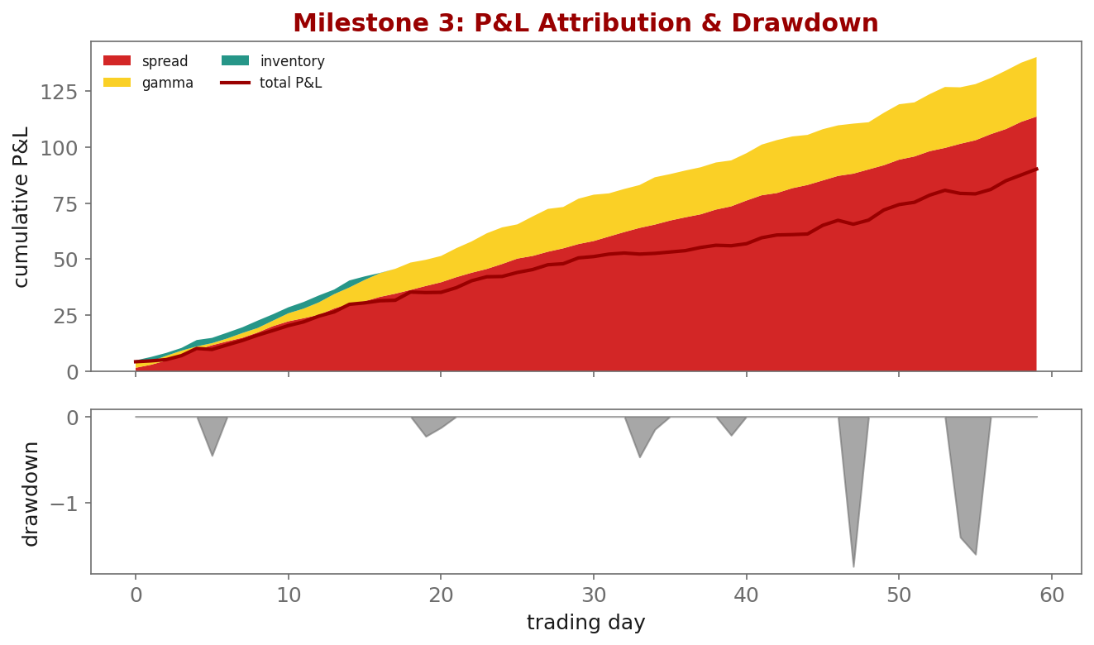
Illustration

Slide 7
Key Equations & Why We Choose Them
Full derivations in the PDF deck
\widehat{SR}=\frac{\bar r}{s_r}\sqrt{252},\quad \text{CI via block bootstrap on } \{r_t\}
• why: Daily Sharpe is annualized by $\sqrt{252}$, but a point estimate over a few months is noisy and serially correlated. We resample BLOCKS of returns (preserving autocorrelation) to get an honest confidence interval -- a high Sharpe with a wide CI is not a real edge.

Slide 8
Getting the Data from Coincall
Cross-check exact paths at https://docs.coincall.com/
• Full options L2 + trades + perp + funding for 3 months:
coincall_btc_options_l2_2025Q4.parquet / ..._trades_...
coincall_eth_options_l2_2025Q4.parquet / ..._trades_...
coincall_btc_eth_perp_l2_2025Q4.parquet ; coincall_funding_rates_...
• Klines for regime context: GET /open/option/market/kline/history/v1/{name}?period=h1
• Trade tape carries mark IV at trade -> calibrate the fill simulator

Slide 9
Code — week9_attribution.py -- P&L attribution + bootstrap Sharpe
import numpy as np
def attribute(spread, inventory, gamma, hedging):
total = spread + inventory + gamma + hedging
assert abs(total.sum() - (spread.sum()+inventory.sum()
+gamma.sum()+hedging.sum())) < 1e-6 # must sum to total
return dict(spread=spread, inventory=inventory, gamma=gamma,
hedging=hedging, total=total)
def bootstrap_sharpe(r, block=5, n=2000, seed=0):
rng = np.random.default_rng(seed); T = len(r); out = []
for _ in range(n):
idx = (rng.integers(0, T-block, T//block)[:,None] + np.arange(block)).ravel()
s = r[idx]; out.append(s.mean()/s.std()*np.sqrt(252))
return np.percentile(out, [2.5, 50, 97.5]) # CI for the Sharpe

Slide 10
Summary — Key Takeaways
• Event-driven, deterministic replay; beware look-ahead and 100% fills
• Attribution MUST sum to total P&L -- a mismatch is always a bug
• Report Sharpe with a block-bootstrap CI, not a bare point estimate
• Taker flow (guest lecture) shapes the toxicity the maker must price
• Milestone 3: full backtest on 3 months BTC & ETH, with a drawdown forensic

Slide 11
Glossary — Key Terms
Event-driven backtest — a simulation that replays timestamped events in order
Deterministic replay — bitwise-identical results on re-run
Look-ahead bias — using information not available at decision time
Sharpe ratio — risk-adjusted return: annualized mean over standard deviation
Block bootstrap — resampling blocks of returns for a CI that keeps autocorrelation
Maximum drawdown — the largest peak-to-trough decline in equity
Taker strategy — aggressive, spread-crossing execution

Slide 12
Reading
• Cartea et al., Ch. 10-11; Bailey-Lopez de Prado (2014); Lopez de Prado (2018)

Slide 13
References
• Cartea, Jaikumar, & Penalva (2015). Algorithmic and High-Frequency Trading, Ch. 10-11.
• Bailey, D. H., & Lopez de Prado, M. (2014). The deflated Sharpe ratio. Journal of Portfolio Management, 40(5), 94-107.
• Lopez de Prado, M. (2018). Advances in Financial Machine Learning. Wiley.
• Coincall API documentation. https://docs.coincall.com/

