Slide 1

Week 10 — Advanced Avellaneda-Stoikov, Structured Products & Finals
Extensions, the corporate view, and communicating results
Optimal Market Making for Cryptocurrency Options · NC State University

Slide 2
Contents
• Learning objectives
• Lecture 1: Advanced Extensions
• Lecture 2 (Guest: Fenni Kang, Coincall): Structured Products
• Illustration
• Derivation & rationale
• Getting the data from Coincall
• Code: week10_collar.py
• Summary & key takeaways
• Glossary of key terms
• Reading
• References

Slide 3
Learning Objectives
• Implement one advanced Avellaneda-Stoikov extension
• Understand corporate structured products
• Write and present a research-grade report

Slide 4
Lecture 1: Advanced Extensions
• Multi-asset market making (BTC + ETH, correlated)
• Adverse-selection-aware and signal-driven quoting
• Robust optimization: worst-case inventory penalty

Slide 5
Lecture 2 (Guest: Fenni Kang, Coincall): Structured Products
• Collars to fix a price band
• Accumulators / decumulators for staged flow
• Coupon / yield-enhancement products
• How that flow lands on the market-maker's book

Slide 6
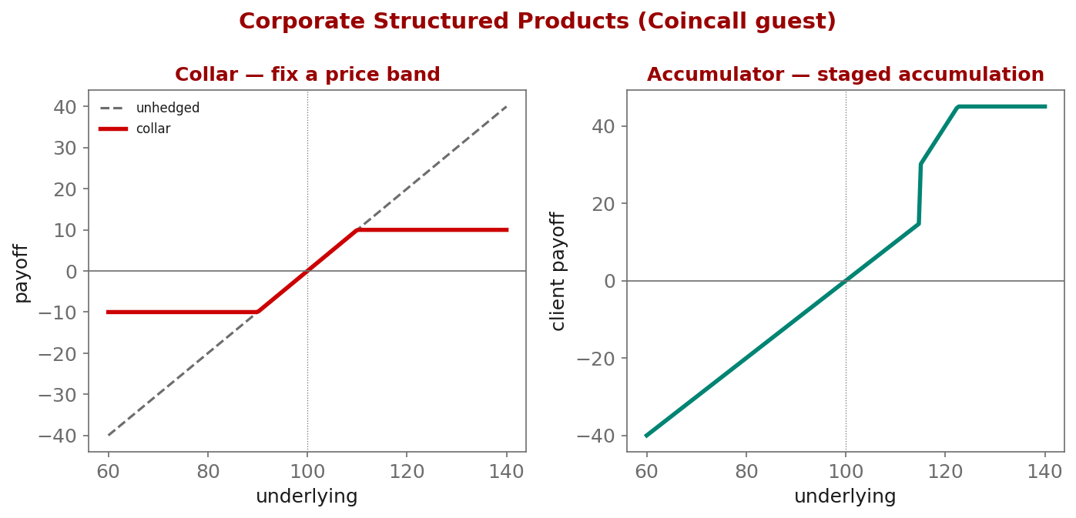
Illustration

Slide 7
Key Equations & Why We Choose Them
Full derivations in the PDF deck
\min_{\delta}\ \max_{\Sigma\in\mathcal{U}}\ \Big\{\text{spread P\&L} - \tfrac12 q^{\mathsf T}\Sigma q\Big\}
• why: Robust market making: we do not trust a single covariance estimate $\Sigma$, so we optimize against the WORST case over an uncertainty set $\mathcal{U}$. This widens quotes exactly where parameter risk is highest -- a principled cure for over-fitting the penalty matrix.

Slide 8
Getting the Data from Coincall
Cross-check exact paths at https://docs.coincall.com/
• Multi-asset extension needs BTC and ETH chains together:
GET /open/option/get/v1/BTC and GET /open/option/get/v1/ETH
• Correlation from perp klines (BTC vs ETH) over your backtest window
• Reuse all Milestone-3 Parquet datasets; no new sources required

Slide 9
Code — week10_collar.py -- structured-product payoff (collar)
import numpy as np
def collar_payoff(S, spot=100.0, put_K=90.0, call_K=110.0):
"""Long underlying + long put(put_K) + short call(call_K): a fixed band."""
return (S - spot) + np.maximum(put_K - S, 0.0) - np.maximum(S - call_K, 0.0)
S = np.linspace(60, 140, 9)
print(dict(zip(S.round(0), collar_payoff(S).round(1)))) # capped above, floored below

Slide 10
Summary — Key Takeaways
• Pick ONE advanced extension; a clean partial result beats a grand unfinished one
• Robust optimization widens quotes where parameter risk is highest
• Corporate structured products (collars, accumulators, coupons) generate flow
• That structured-product flow lands on -- and is hedged by -- the maker's book
• Final: report (<= 30 pp.) + 20-minute talk; acknowledge limitations honestly

Slide 11
Glossary — Key Terms
Multi-asset market making — jointly quoting correlated underlyings (e.g., BTC and ETH)
Robust optimization — optimizing against the worst case over an uncertainty set
Adverse-selection-aware quoting — skewing quotes using order-flow signals
Collar — long put + short call that fixes a price band around a holding
Accumulator / decumulator — products for staged accumulation or liquidation
Coupon product — a yield-enhancement structured note
Structured product — a packaged derivative payoff sold to clients or corporates

Slide 12
Reading
• Gueant (2016) [chosen extension]; El Aoud-Abergel (2015); +1 paper of your choice

Slide 13
References
• Gueant, O. (2016). The Financial Mathematics of Market Liquidity. Chapman & Hall/CRC.
• El Aoud, S., & Abergel, F. (2015). A stochastic control approach to option market making. Market Microstructure and Liquidity, 1(1), 1550006.
• Cartea, Jaikumar, & Penalva (2015). Algorithmic and High-Frequency Trading.
• Plus one paper of your choice relevant to the chosen extension.

