Slide 1
Onboarding Revamp
Unmoderated Usability Test - insights
Facetune design group & UX Research
April 2026

Slide 2
Study Overview
Background
Methodology
We want to improve the onboarding experience to feel more up to date, more engaging, and more interactive - so that users are excited to get started with the app.
We explored two new onboarding concepts and tested them against the current baseline to understand how users react to each approach.
Mix-methods
Unmoderated usability testing & ranking
Participants
40 per concept (n=120 total) 18–40, non-FT users, 50/50 gender split
Platform
UserTesting.com + Figma prototypes

Slide 3

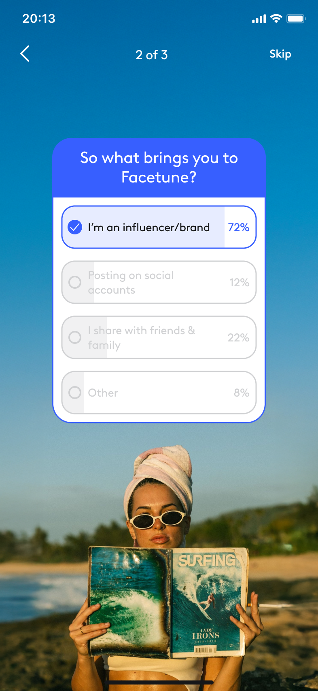
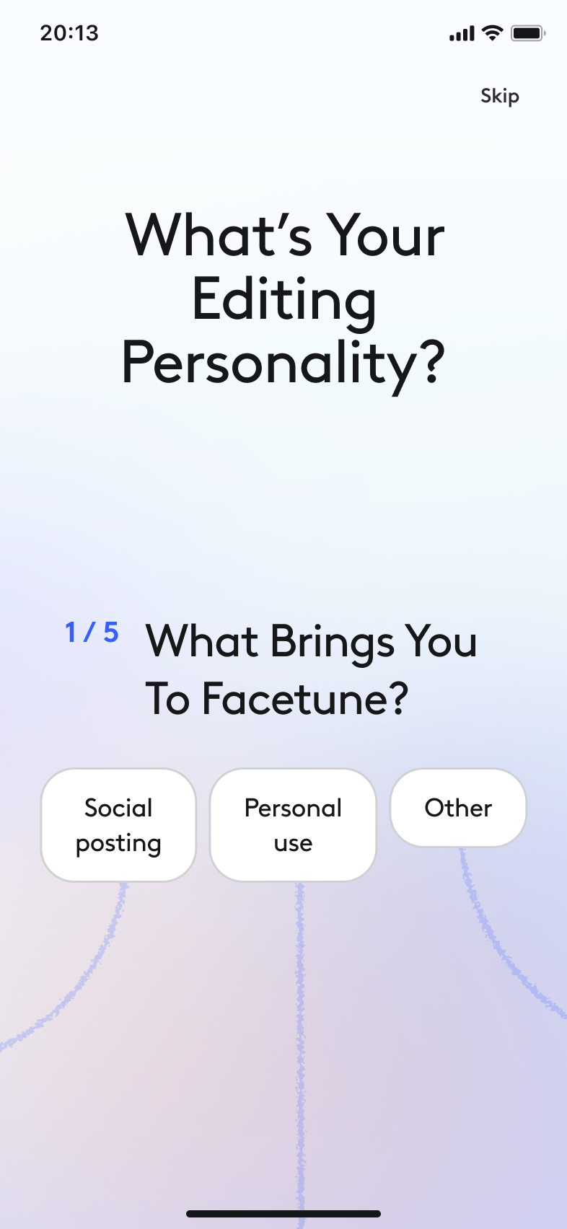
The 3 Onboarding Experiences

Slide 4
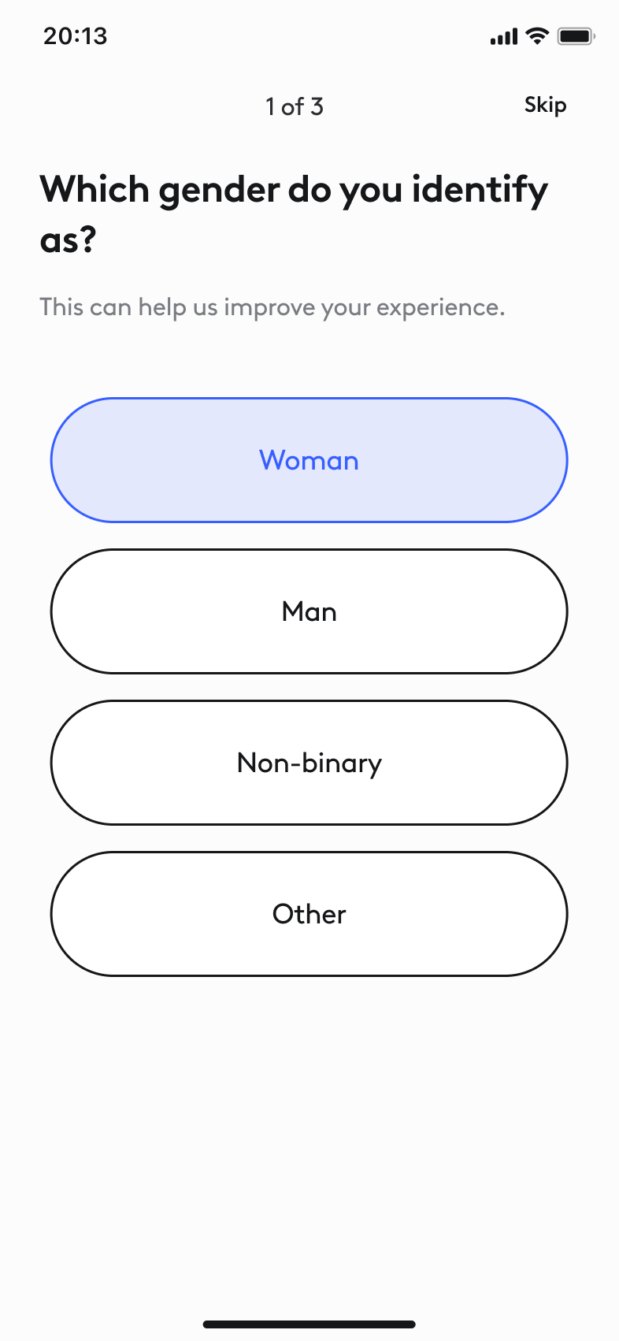

The 3 Onboarding Experiences

Slide 5
The 3 Onboarding Experiences

Slide 6
01
Qualitative Findings
Themes, pain points, and risks per onboarding experience

Slide 7
Baseline - Key Themes
Simplicity is the #1 strength
Clean design, but lacking personality
Users consistently praised the 3-question, skippable flow as short, simple, and easy. The step counter (1/3) set good expectations and made the experience feel quick.
Design praised as modern and clean with large, easy-to-tap buttons. But about a third of users wanted more color, imagery, or visual personality. A subset found emojis "childish".

Slide 8
Baseline - Pain Points & Risks
The gender question felt uncomfortable
“Why does my gender matter when I'm editing a photo?" Nearly half the participants called it intrusive, confusing, or irrelevant. The "this helps us improve" copy was not convincing enough.
No visible personalization payoff
Users questioned why they were being asked these questions and what impact their answers would have. The onboarding promises to "improve your experience" but users finish without a sense of purpose or payoff.
Engagement ceiling is low
With only 3 generic questions, about a third of users rated engagement 2–3/5. The flow is efficient but not memorable - "just another survey."

Slide 9
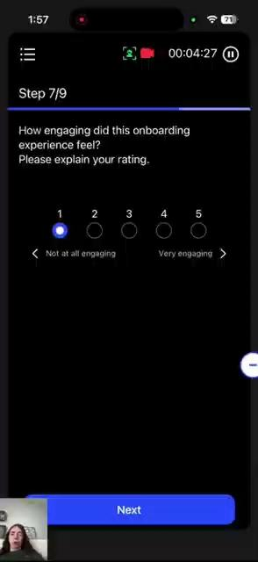
Baseline - Pain Points & Risks

Slide 10
Persona - Key Themes
The experience sparks delight
Visually appealing & clear aesthtic
The flow-chart navigation experience praised as "unique," "creative," "like a journey" - a map, tree, or canvas. Strong emotional differentiation from standard onboarding.
Users consistently praised the visual design as fresh, modern, and artistic. Colors, graphics, imagery, and overall polish contributed to a premium feel that stood out from other apps.
Quick & engaging despite 5 questions
Personality result felt meaningful
Users appreciated that the onboarding was brief and didn't feel time-consuming. The interactive format kept attention and made the 5-question depth feel effortless.
Users who engaged with their personality result found it relevant and true to themselves. The badge/label metaphor created a collectible moment, reminiscent of Spotify Wrapped.

Slide 11
Persona - Pain Points & Risks
The quiz may feel disconnected from the product experience
Users questioned whether their answers would actually shape what they see in the app, fearing that a single selection might lock them into a limited experience. Questions felt broad or "not scientifically accurate," raising doubts about whether the quiz has any real functional value.
Answer options feel too narrow and binary
Users felt pigeonholed by limited choices and wanted more nuance; the ability to select multiple answers or have an "other" option. The current structure doesn't reflect the range of how people actually see themselves.
The flow may not resonate equally across genders
Users who gave lower ratings or expressed criticism were mainly men, which may suggest the flow has a more feminine feel — whether in tone, visual language, or the framing of the questions. This is worth investigating further to understand whether inclusivity plays a role.

Slide 12
Poll - Key Themes
Short, easy, and not overwhelming
Percentages: reactions were mixed
The experience was consistently described as short and easy to go through. The 3-question structure supported a solid baseline level of engagement without feeling like a burden.
Seeing how others answered created a sense of community: users felt "part of something bigger." However, others often described as "nice but not important." Users didn't connect the data to their goals and just wanted to move on.
Aesthetic visuals, but no clear purpose of the app
Design was appealing but didn't communicate what the app does. Felt like nice imagery rather than a showcase of editing capabilities.

Slide 13
Poll - Pain Points & Risks
Percentages lacked clear purpose - felt like a survey
Users repeatedly asked why the percentages were shown. The feature felt like survey data, creating a strong perception that the onboarding is a survey rather than a product experience. No users recognized the intended Instagram story-poll pattern - the social media connection did not come through.
Questions too general and lacking depth
Questions felt too basic and disconnected from the app's features. Users expected specifics - filters, AI tools, types of edits.

Slide 14
02
Quantitative Comparison
Statistical comparison of rating-scale questions across all three groups

Slide 15
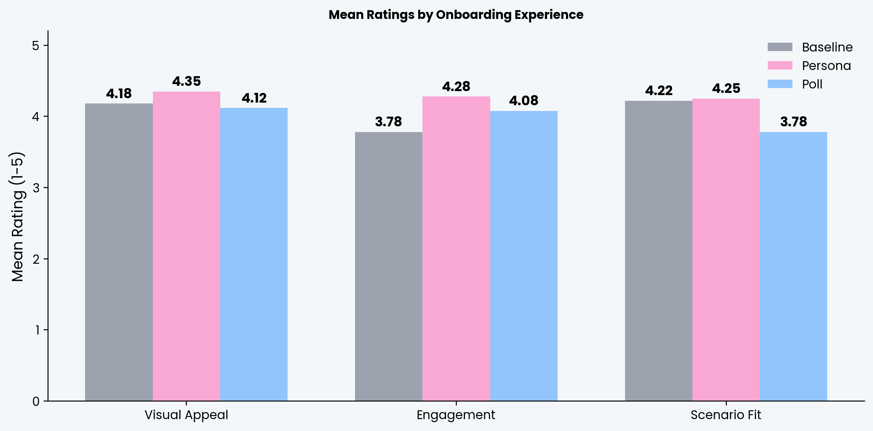
Mean Ratings Across Groups
*No statistically significant differences were found between the three groups.

Slide 16
Statistical significance testing
Question | Baseline Mean (SD) | Persona Mean (SD) | Poll Mean (SD) | p-value | Significant?
Visual Appeal | 4.17 (0.93) | 4.35 (0.77) | 4.12 (0.94) | p = .562 | No
Engagement | 3.77 (1.07) | 4.28 (0.75) | 4.08 (0.94) | p = .107 | No
Scenario Fit | 4.22 (0.95) | 4.25 (0.93) | 3.77 (1.21) | p = .145 | No
Key Takeaway
None of the differences between groups reached statistical significance (all p > .05).
The directional patterns (Persona trending highest on Engagement; Poll trending lowest on Scenario Fit) are consistent with the qualitative findings, but would require larger samples to confirm statistically.

Slide 17
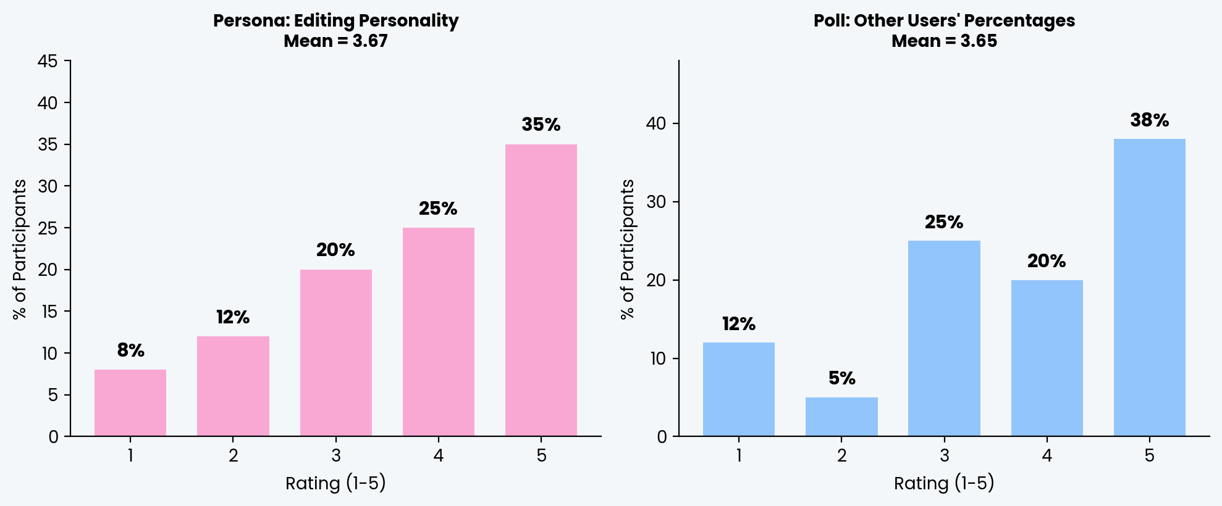
How did users react to each concept's unique feature?
Persona users were asked how they felt seeing their editing personality type. Poll users were asked how they felt seeing other users' percentages. No statistically significant differences were found within each group.

Slide 18
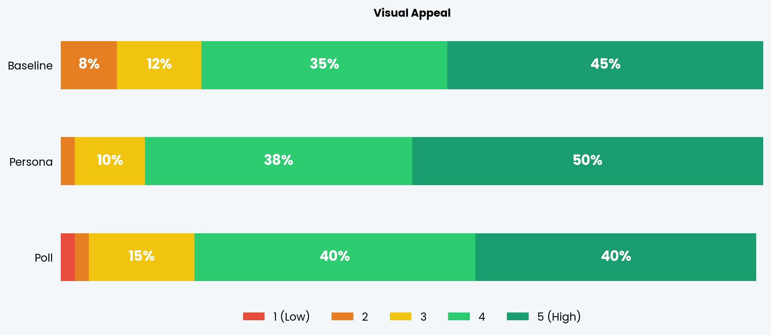
Rating Distribution - Visual Appeal

Slide 19
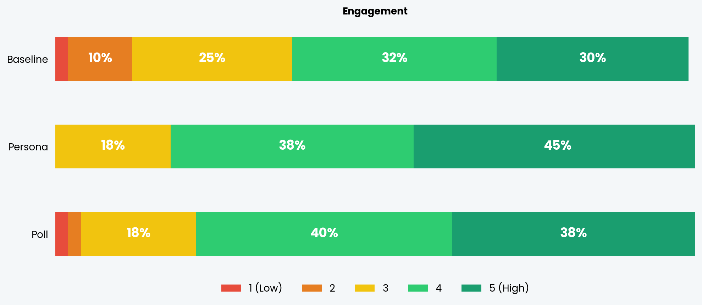
Rating Distribution — Engagement

Slide 20
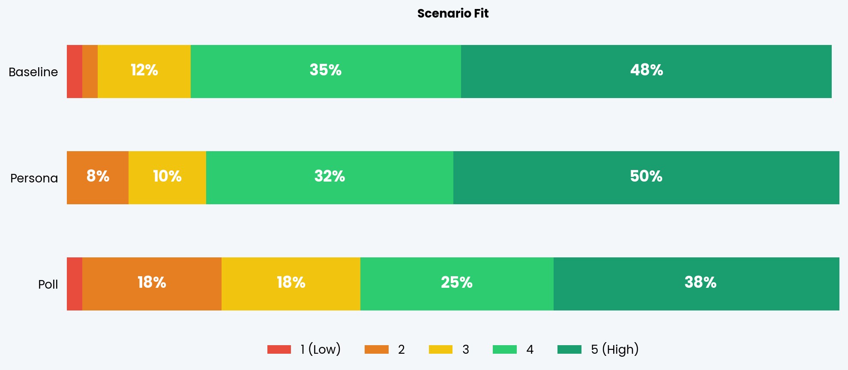
Rating Distribution — Scenario Fit

Slide 21
A note on variance
Standard deviation (SD) measures how much individual ratings spread from the mean. A low SD means users mostly agreed; a high SD means opinions were divided.
Persona shows the tightest spread (SD 0.75–0.93 across the three shared questions) - users mostly agreed these ratings were high. This suggests a consistently positive experience. Poll's Scenario Fit has the widest spread (SD 1.21) - ratings ranged from 1 to 5, with no clear consensus. The percentages feature divides opinion on whether it belongs in a photo editing app. The concept-specific questions are even more polarizing: Persona personality type SD = 1.29, Poll percentages SD = 1.37. Both unique features have fans and skeptics, but Poll is the most divisive overall.

Slide 22
03
Recommendations
Next steps based on the findings

Slide 23
Recommendations
Persona concept is the strongest candidate for further development
1
The flow created a delight and intrest. We should keep improving it - refine the personality quiz with broader answer options and a clear explanation of how the result impacts the in-app experience.
Add a visible personalization payoff
2
In all three experiences, users wanted to see how their answers changed the app. A "based on your answers, we recommend..." moment would close the loop and justify the onboarding effort.
Consider hybrid: Persona flow + Poll element
3
The poll's percentage reveal could enhance the Persona flow without replacing it. Showing social proof at the personality result ("38% of users share your type") could combine the best of both concepts.

Slide 24
Thank You
Questions?

