Slide 1
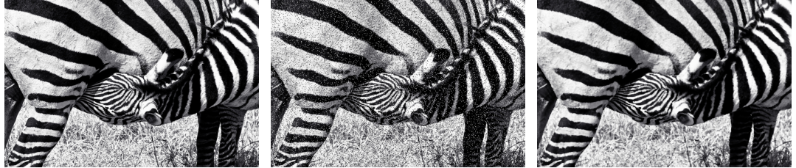
IMAGE PROCESSING & COMPUTER VISION · FINAL PROJECT
Robustness of Image-Processing and Vision Methods to Image Corruption
How much do corrupted images hurt four vision tasks — and how much of the damage can classical restoration and model fine-tuning undo?
4
vision tasks
low-level + deep models
3
corruption types
noise × 2, motion blur
3
severity levels
SNR logged per image
2
recovery strategies
enhance · fine-tune
Ohad Shpizhizen · Shira Tziony
COCO val2017 — fixed 1,521-image evaluation subset
Paired comparisons: identical images & GT in every cell
clean → corrupted (salt & pepper, high) → restored (median 3×3)
Notes:
We benchmark how robust four vision pipelines are to controlled image corruption, on a fixed COCO val2017 subset. The design crosses 4 tasks with 3 corruptions at 3 severities, and tests two repairs: matched classical enhancement and YOLOv8n fine-tuning. Everything is paired — same images and ground truth in every cell.

Slide 2
EXPERIMENTAL DESIGN
2 / 14
One fixed image set — every variant measured against it
Clean
COCO val2017
fixed seeded subset 1,521 images
Inference — 4 models
ORB · YOLOv8n · Keypoint R-CNN · Panoptic FPN
Paired evaluation
same images & GT → tables · curves · examples
Distorted — 3 corruptions × 3 severities
Distorted → matched enhancement
detection only — evaluated on every cell
train2017 subset
9,000 images (seeded)
Fine-tune YOLOv8n
mixture: 25% clean + all 9 distortion cells, half restored
SNR + degradation parameters logged per image · distorted & enhanced images stored as lossless PNG · every cell reproducible via seeded RNG
Notes:
Every experiment starts from the same 1,521 images: they are corrupted, optionally restored, and each variant goes through identical inference and evaluation. A separate 9,000-image train2017 subset feeds YOLOv8n fine-tuning, which is evaluated on the same cells for detection. Logged SNR and degradation parameters are what make matched, non-blind restoration possible.

Slide 3
DATASET
3 / 14
COCO val2017 — one seeded subset behind every number
1,521
11,129
WHY THIS SETUP
Public benchmark: 80 classes, ground truth for boxes, person keypoints and panoptic masks
The same images serve all four tasks — no cross-dataset alignment
Paired comparisons: identical images & GT for every variant, so differences come only from image quality
Custom subset ⇒ published full-val2017 scores are approximate sanity checks, not direct comparisons
evaluation images — seeded sample of 1,500, topped up with 21 for class coverage
ground-truth instances in the subset · 3,273 person instances
r = 0.999
9,000
class-distribution correlation with the full 5,000-image val2017
train2017 images (seeded) — used only for fine-tuning
Class coverage: every category reaches ≥ 20 GT instances, except toaster (9) and hair drier (11) — both exhaust their entire val2017 supply.
Notes:
The evaluation subset is a fixed, seeded 1,521-image sample of COCO val2017, topped up so every class has enough instances for per-class analysis. Its class distribution correlates with the full split at r = 0.999. All comparisons are paired, and a separate 9,000-image train2017 subset is used only for fine-tuning.

Slide 4
TASKS & METRICS
4 / 14
Four tasks — from raw pixel structure to full scene understanding
TASK | LEVEL | MODEL / ALGORITHM | METRIC | WHAT IT MEASURES
Feature matching | Low-level | ORB + BF matcher (Hamming, cross-check) — OpenCV | Match ratio vs clean | Share of clean keypoints re-matched in the degraded image (Hamming ≤ 64) — does local structure survive?
Object detection | High-level · DL | YOLOv8n, COCO-pretrained — ultralytics | mAP@[.5:.95] | Detect + tightly localize 80 classes; AP averaged over 10 IoU thresholds
Keypoint detection | High-level · DL | Keypoint R-CNN, ResNet50-FPN — torchvision | OKS AP | 17 human joints per person; AP with IoU replaced by scale-normalized keypoint similarity
Panoptic segmentation | High-level · DL | Panoptic FPN R50 — detectron2 | PQ = SQ × RQ | Every pixel gets category + segment: mask quality (SQ) × segment recognition (RQ)
All metrics ∈ [0, 1], higher is better. ORB needs no ground truth — each clean image is its own reference. The three learned models are COCO-pretrained; detection is the focus of the fine-tuning comparison.
Notes:
ORB feature matching is the low-level probe: it asks whether corner-like local structure survives corruption. The three deep models cover detection, human keypoints and panoptic segmentation, each with its standard COCO metric. PQ usefully decomposes into mask quality and recognition quality, which we use for diagnosis.

Slide 5
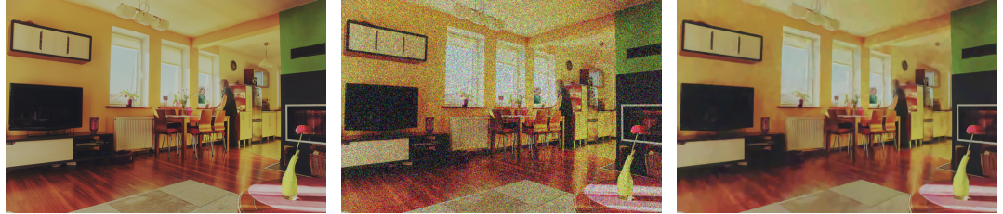
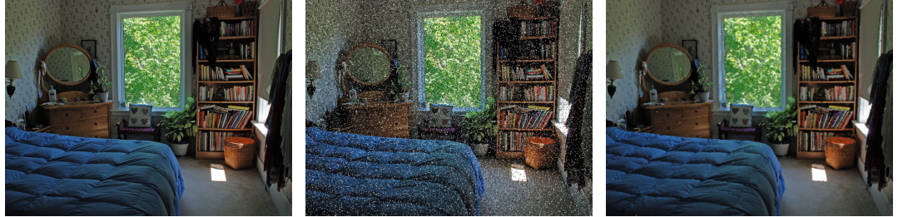
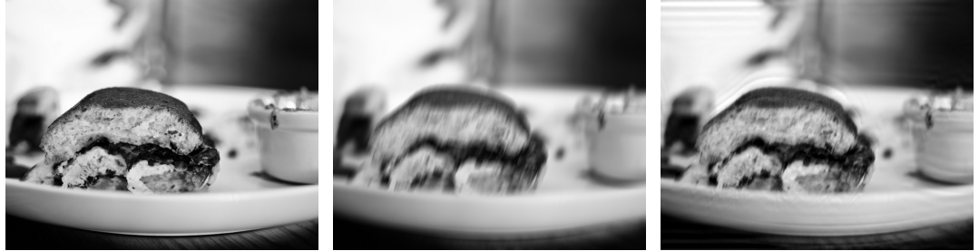
CORRUPTIONS & MATCHED RESTORATION
5 / 14
Three corruptions, three severities — one matched repair each
CORRUPTION | SEVERITY → MEAN SNR | MATCHED ENHANCEMENT
Gaussian noise — sensor noise; variance sampled & recorded per image | 19.5 / 13.9 / 10.0 dB | Non-blind BM3D — σ derived from the recorded variance
Salt & pepper — impulse pixels → 0 or 255; amount 1% / 5% / 12% | 18.7 / 11.8 / 8.2 dB | Median filter 3×3 — discards isolated outliers
Motion blur — global linear kernel 5 / 11 / 21 px; angle sampled & recorded | 20.8 / 17.7 / 15.6 dB | Non-blind Wiener deconvolution — kernel rebuilt from recorded size + angle
Clean
Distorted (high)
Enhanced
Gaussian noise → BM3D
Salt & pepper → median 3×3
Motion blur → Wiener
Severities: low / medium / high. Recorded degradation parameters enable matched, non-blind restoration — no estimation from the corrupted image. All variants stored as lossless PNG.
Notes:
Each corruption models a different physical process, and each gets the classical restoration that matches its forward model: BM3D for Gaussian noise, a 3-by-3 median for impulse noise, Wiener deconvolution with the reconstructed kernel for blur. Note that motion blur has the highest SNR of the three at comparable severity — that will matter later.

Slide 6
CLEAN BASELINES — PHASE 1
6 / 14
Pretrained models on clean images — the reference for every cell
Feature matching
Object detection
Keypoint detection
Panoptic segmentation
ORB match ratio
YOLOv8n · mAP@[.5:.95]
Keypoint R-CNN · OKS AP
Panoptic FPN · PQ
1.000
0.352
0.657
0.410
Δ −0.021
Δ +0.007
Δ −0.005
by construction — each clean image is matched to itself
published full val2017 ≈ 0.373
published full val2017 ≈ 0.650
published ≈ 0.415 · SQ 0.775 · RQ 0.500
Sanity check, not benchmark replication. Published scores use the full 5,000-image val2017; ours use the 1,521-image subset. Differences of −0.021 to +0.007 indicate no issue in annotation handling, format conversion, or evaluation.
Notes:
Clean baselines anchor every later comparison. ORB is 1.0 by construction; the three learned models land within about two metric points of their published full-val2017 scores. Because the image sets differ, we treat that only as an approximate sanity check that the pipeline is sound.

Slide 7
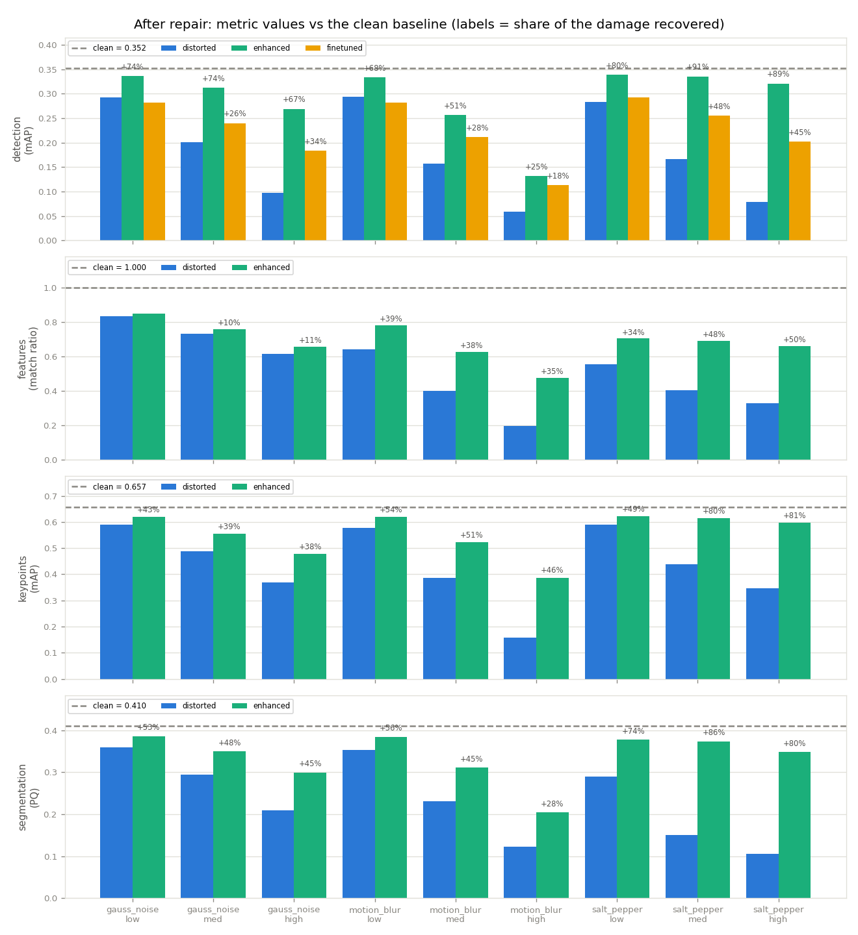
RESULTS — DEGRADATION & RECOVERY
7 / 14
Enhancement recovers ground in every one of the 36 cells
■ distorted ■ enhanced ■ fine-tuned (detection only)
dashed line = clean baseline · bar labels = share of damage recovered
Corruption hurts every task, and more severity hurts more — detection falls as far as −0.293 mAP (motion blur, high).
Classical enhancement improves the raw distorted score in all 36 task × corruption × severity cells.
For detection, enhancement is the best standalone repair in all 9 cells — ahead of fine-tuning alone.
Recovery is largest for salt & pepper (up to +91% of the damage), smallest for heavy motion blur.
36 / 36
9 / 9
cells improved by classical enhancement
detection cells where enhancement is the best standalone repair
Notes:
Each panel is one task; each bar group is one corruption-severity cell. Blue is the distorted score, green after matched enhancement, amber after fine-tuning for detection, and the dashed line is the clean baseline. The headline: enhancement improves every one of the 36 cells, and for detection it is the strongest standalone repair in all 9.

Slide 8
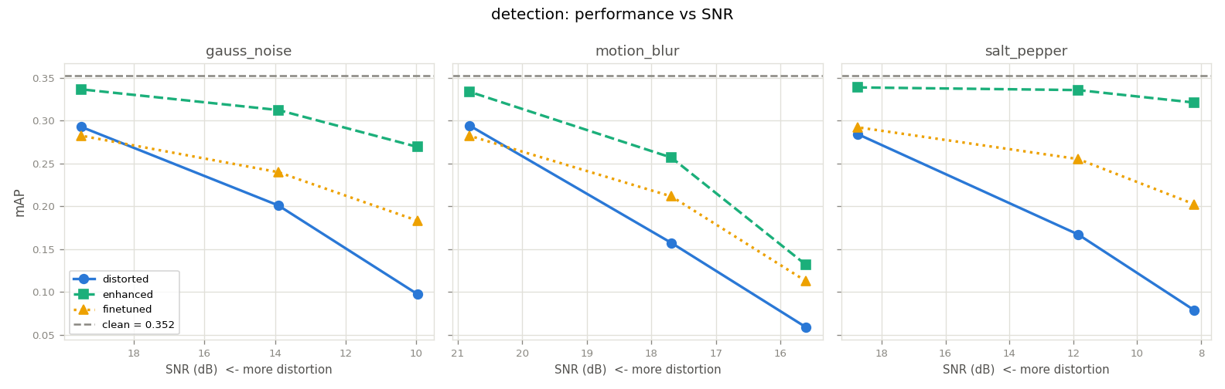
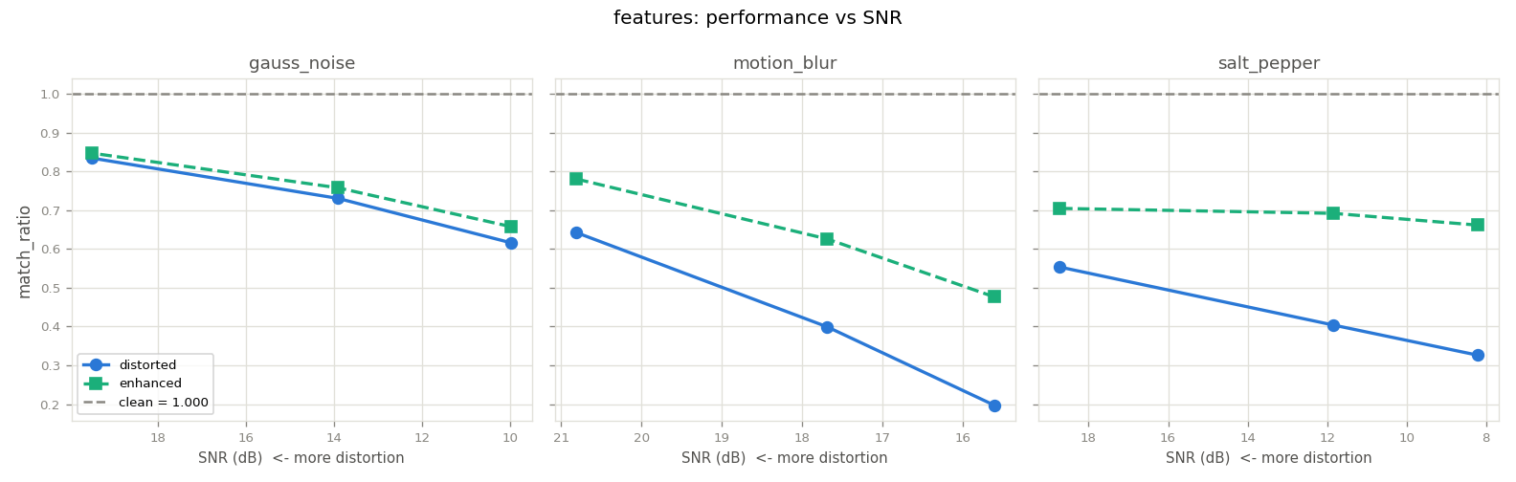
RESULTS — PERFORMANCE VS SNR
8 / 14
SNR tracks severity within a corruption — not damage across corruptions
Within each corruption type, every task degrades monotonically as mean SNR falls.
Across types SNR misleads: high motion blur (15.6 dB) costs ORB −0.80 and keypoints −0.50 — worse than high noise at 10.0 / 8.2 dB.
Interpretation: geometry-sensitive tasks depend on spatial structure, which blur destroys — pixel-wise SNR does not capture that.
Keypoint & segmentation curves → Appendix B
Notes:
One panel per corruption; x is measured per-image SNR, so severity increases right to left. Curves fall monotonically within each corruption family. But comparing across families, high motion blur damages ORB and keypoints far more than the noise corruptions despite its higher SNR — structure loss, not SNR, is what hurts geometry-sensitive tasks.

Slide 9
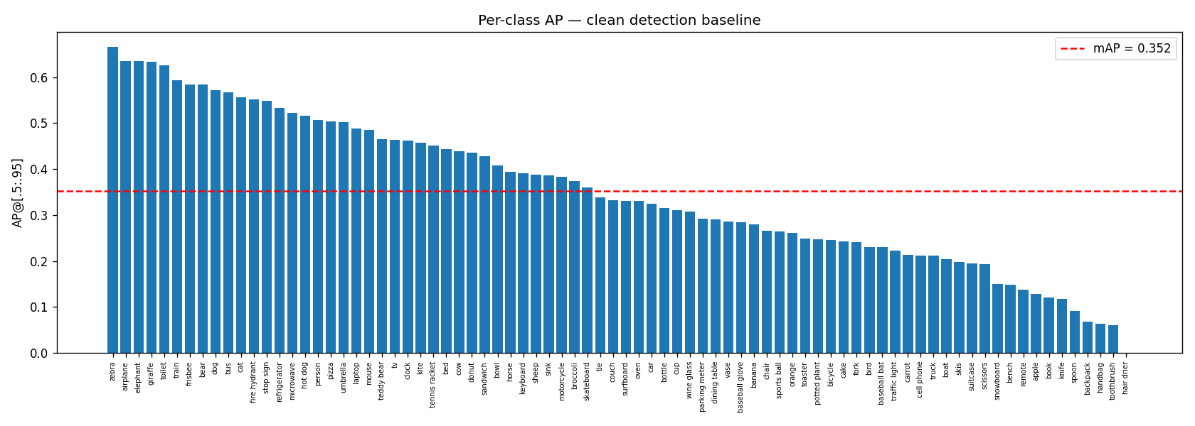
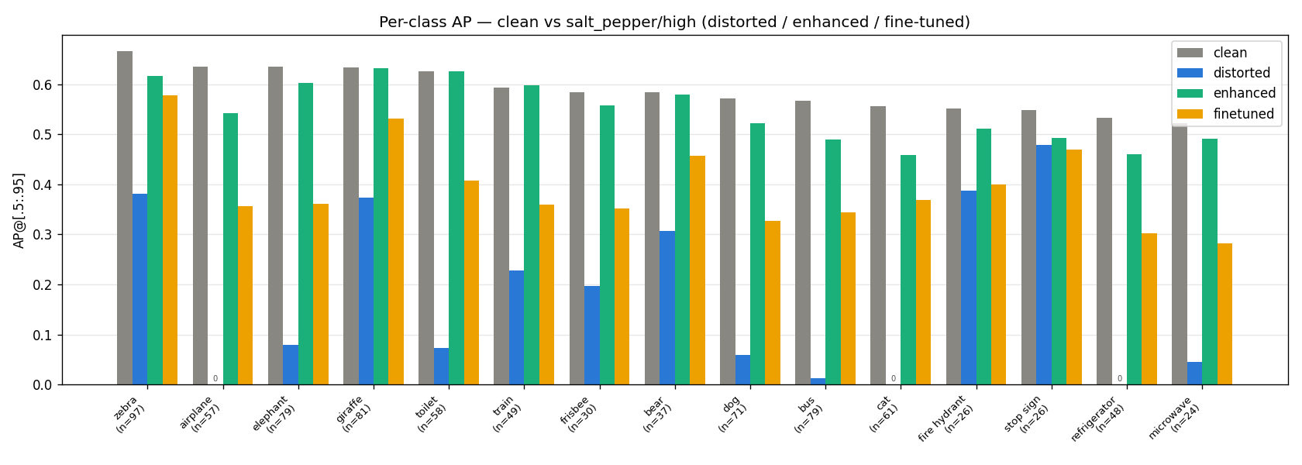
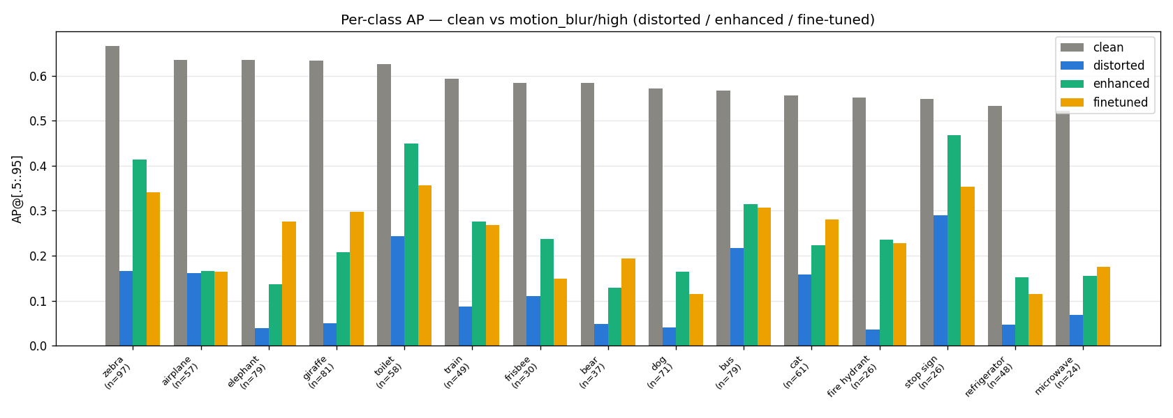
RESULTS — PER-CLASS DETECTION
9 / 14
Which classes break — and which repair brings them back
Top: clean AP for all 80 classes; dashed line = mAP 0.352.
Bottom: the 15 classes with the highest clean AP, at high severity; n = GT instances.
gray clean · blue distorted · green enhanced · amber fine-tuned
Gaussian-noise comparison → Appendix B.
Notes:
The clean baseline varies widely across the 80 classes. The bottom charts track the 15 strongest classes under high-severity corruption: salt and pepper collapses nearly all of them and the median filter restores most of the gap, while under motion blur both repairs recover far less. Instance counts are shown so rare classes are read with care.

Slide 10
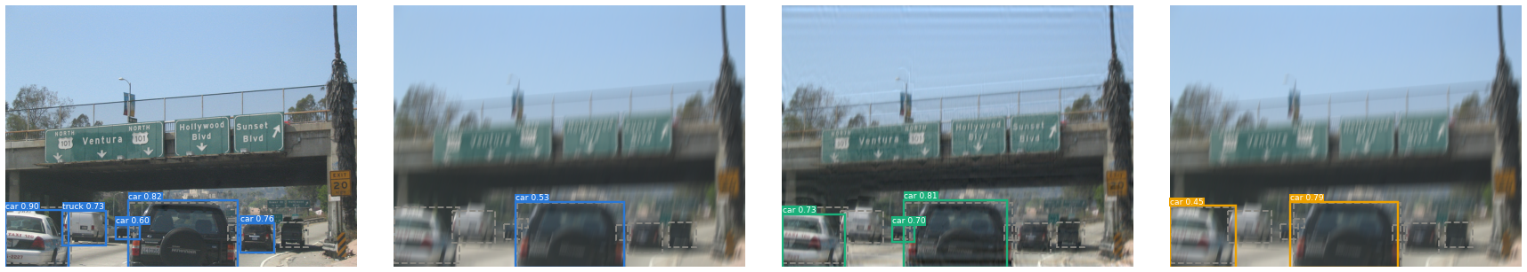
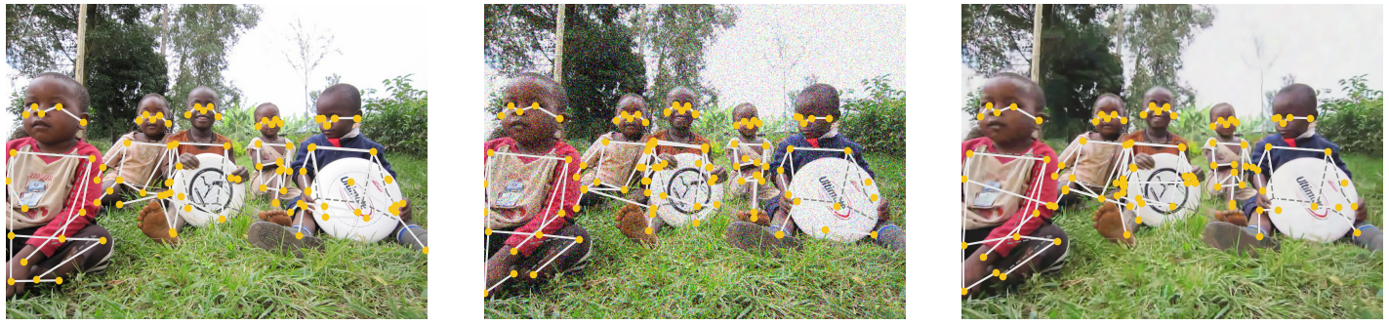
QUALITATIVE — DETECTION & KEYPOINTS
10 / 14
What the numbers look like on real images
Clean + YOLO
Distorted — motion blur (high)
Enhanced — Wiener
Fine-tuned YOLO on distorted
Clean + Keypoint R-CNN
Distorted — Gaussian noise (high)
Enhanced — BM3D
READING THE PANELS
Gray dashed = ground truth; solid boxes / white skeletons + yellow joints = predictions.
Blur wipes out cars and signs; deblurring brings detections back — fine-tuning recovers some directly.
Noise drags joints off body parts; after BM3D the skeletons re-attach.
Notes:
Top row: the same scene through the detection pipeline — the blurred frame loses most cars, the Wiener-restored frame recovers them, and the fine-tuned detector finds some directly on the blurred input. Bottom row: keypoints under heavy Gaussian noise drift off the body and BM3D pulls them back. These examples are drawn from the benchmark subset itself.

Slide 11
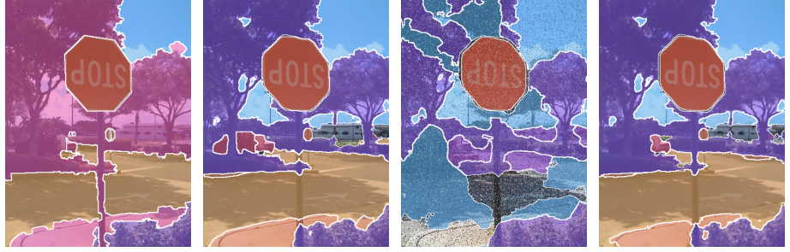
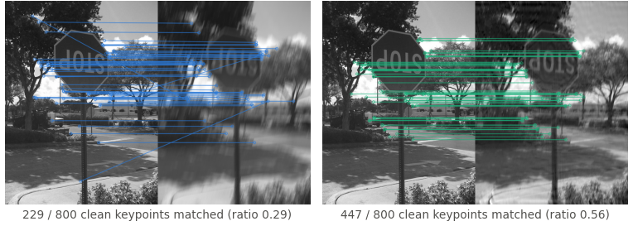
QUALITATIVE — SEGMENTATION & FEATURES
11 / 14
Corruption breaks structure — matched repair rebuilds most of it
Ground truth
Clean · PQ 0.410
Distorted · PQ 0.105
Enhanced · PQ 0.348
PANOPTIC — SALT & PEPPER, HIGH
Color = semantic category, white hairlines = segment boundaries; PQ above each panel.
Impulse noise shatters the scene into false segments: PQ 0.410 → 0.105.
The 3×3 median filter rebuilds the layout — PQ back to 0.348.
Clean ↔ Distorted (blur high)
Clean ↔ Enhanced (Wiener)
ORB MATCHING — MOTION BLUR, HIGH
Lines join good matches (Hamming ≤ 64, cross-checked — the metric's criterion); caption = per-image match ratio.
Heavy blur leaves few good matches; Wiener deconvolution lifts these two examples from 0.29 / 0.05 to 0.56 / 0.39.
Notes:
Under high salt-and-pepper the panoptic prediction disintegrates into false segments, and the median filter restores most of the layout — PQ goes from 0.105 back to 0.348 on this cell. In the ORB pairs, heavy blur leaves few good matches and Wiener deconvolution multiplies them. Spatial structure is the currency both tasks trade in.

Slide 12
RESULTS — REPAIR STRATEGIES (DETECTION)
12 / 14
Enhancement wins alone — stacking wins on heavy motion blur
mAP@[.5:.95] at high severity — clean baseline = 0.352
9 / 9
detection cells where enhancement beats fine-tuning alone
7 / 9
corrupted cells where fine-tuning beats the pretrained detector
44.5%
of the high-blur damage recovered by the stack — vs 24.9% enhancement-only, 18.3% fine-tuning-only
0.3521 → 0.3104
clean mAP after fine-tuning (−0.0417) — the price of robustness
Same ranking at low & medium severity for the standalone repairs — full table in Appendix A.
Stacked repair achieves the best mAP for medium and high motion blur.
Notes:
At high severity, matched enhancement is the strongest single repair for every corruption, and fine-tuning alone always trails it. The two are complementary: stacked, they set the best score on medium and high motion blur, recovering 44.5 percent of the high-blur damage. Fine-tuning also costs about four mAP points on clean images.

Slide 13
RESULTS — FINE-TUNING BY SEVERITY
13 / 14
Fine-tuning pays off once the domain gap is large
Measured — mean fine-tuning recovery vs pretrained (mAP)
WHY — INTERPRETATION
−0.005
LOW SEVERITY
Low severity: inputs sit close to the clean training domain — the pretrained detector is still strong, so adaptation has little headroom.
Fine-tuning trades clean accuracy (−0.042 mAP) for corruption robustness; at low severity that trade can net out slightly negative.
Medium / high severity: the domain gap grows, so training on corrupted + restored examples pays off (+0.060 / +0.088).
The motion-blur plateau marks the limit of adaptation: no amount of fine-tuning reconstructs spatial information the blur kernel destroyed.
gauss −0.010 · blur −0.012 · S&P +0.008
+0.060
MEDIUM SEVERITY
gauss +0.039 · blur +0.054 · S&P +0.088
+0.088
HIGH SEVERITY
gauss +0.086 · blur +0.054 · S&P +0.124
Monotonic for both noise types; motion blur plateaus at ≈ +0.054 for medium and high.
Notes:
The left values are measured: averaged over the three corruptions, fine-tuning recovery grows from slightly negative at low severity to plus 0.088 mAP at high severity. The explanation on the right is our interpretation — a domain-gap account consistent with the reduced clean accuracy and with the motion-blur plateau, where missing spatial information cannot be learned back.

Slide 14
CONCLUSIONS & LIMITATIONS
14 / 14
Match the repair to the corruption — and know when to stack
TAKEAWAYS — MEASURED
LIMITATIONS
Matched classical enhancement is the strongest standalone detection repair in all 9 cells — and improves all 36 cells across the four tasks.
One enhancement pipeline generalized to all four tasks with no retraining; fine-tuning applied only to YOLOv8n detection.
Fine-tuning is complementary: most valuable at high severity, and best overall when stacked on medium / high motion blur.
SNR ranks severities within a corruption family, but not damage across mechanisms — structure loss is what hurts geometry-sensitive tasks.
Synthetic, global, spatially uniform corruptions only
Restoration is non-blind — BM3D / Wiener use recorded corruption parameters
Fine-tuning evaluated only for YOLOv8n detection
Mixed, spatially varying, or unseen real-world corruptions were not evaluated — conclusions do not extend to them
Practical rule of thumb: corruption known & parameterizable → restore classically · heavy, partly irreversible → stack both · unknown at inference → adapt the model.
Notes:
The decision matrix is the practical output: restore classically when the corruption is known and parameterizable, stack restoration with fine-tuning for heavy partially-irreversible corruptions like motion blur, and rely on model adaptation when the corruption is unknown at inference time. The limitations box bounds the claims — everything here is synthetic, global, and non-blind.

Slide 15
APPENDIX A
A1
Full results — every task × corruption × severity cell
task | distortion | sev | SNR (dB) | clean | distorted | enhanced | fine-tuned | ft + enh | degradation | rec (enh) | rec (FT) | rec (comb)
detection | gauss_noise | low | 19.5 | 0.352 | 0.293 | 0.336 | 0.282 | 0.299 | −0.059 | +0.044 | −0.010 | +0.006
detection | gauss_noise | med | 13.9 | 0.352 | 0.201 | 0.312 | 0.240 | 0.279 | −0.151 | +0.111 | +0.039 | +0.078
detection | gauss_noise | high | 10.0 | 0.352 | 0.097 | 0.269 | 0.183 | 0.246 | −0.255 | +0.172 | +0.086 | +0.149
detection | motion_blur | low | 20.8 | 0.352 | 0.294 | 0.334 | 0.282 | 0.299 | −0.058 | +0.039 | −0.012 | +0.005
detection | motion_blur | med | 17.7 | 0.352 | 0.157 | 0.257 | 0.211 | 0.261 | −0.195 | +0.100 | +0.054 | +0.104
detection | motion_blur | high | 15.6 | 0.352 | 0.059 | 0.132 | 0.113 | 0.189 | −0.293 | +0.073 | +0.054 | +0.131
detection | salt_pepper | low | 18.7 | 0.352 | 0.284 | 0.339 | 0.292 | 0.299 | −0.068 | +0.055 | +0.008 | +0.015
detection | salt_pepper | med | 11.8 | 0.352 | 0.167 | 0.336 | 0.255 | 0.297 | −0.185 | +0.169 | +0.088 | +0.130
detection | salt_pepper | high | 8.2 | 0.352 | 0.079 | 0.321 | 0.202 | 0.288 | −0.274 | +0.242 | +0.124 | +0.210
features | gauss_noise | low | 19.5 | 1.000 | 0.834 | 0.847 | — | — | −0.166 | +0.013 | — | —
features | gauss_noise | med | 13.9 | 1.000 | 0.731 | 0.758 | — | — | −0.269 | +0.027 | — | —
features | gauss_noise | high | 10.0 | 1.000 | 0.616 | 0.658 | — | — | −0.384 | +0.042 | — | —
features | motion_blur | low | 20.8 | 1.000 | 0.643 | 0.781 | — | — | −0.357 | +0.138 | — | —
features | motion_blur | med | 17.7 | 1.000 | 0.399 | 0.626 | — | — | −0.601 | +0.227 | — | —
features | motion_blur | high | 15.6 | 1.000 | 0.197 | 0.476 | — | — | −0.803 | +0.280 | — | —
features | salt_pepper | low | 18.7 | 1.000 | 0.554 | 0.705 | — | — | −0.446 | +0.151 | — | —
features | salt_pepper | med | 11.8 | 1.000 | 0.404 | 0.692 | — | — | −0.596 | +0.288 | — | —
features | salt_pepper | high | 8.2 | 1.000 | 0.326 | 0.662 | — | — | −0.674 | +0.336 | — | —
keypoints | gauss_noise | low | 19.5 | 0.657 | 0.590 | 0.619 | — | — | −0.068 | +0.029 | — | —
keypoints | gauss_noise | med | 13.9 | 0.657 | 0.489 | 0.555 | — | — | −0.168 | +0.066 | — | —
keypoints | gauss_noise | high | 10.0 | 0.657 | 0.369 | 0.479 | — | — | −0.288 | +0.110 | — | —
keypoints | motion_blur | low | 20.8 | 0.657 | 0.578 | 0.620 | — | — | −0.080 | +0.043 | — | —
keypoints | motion_blur | med | 17.7 | 0.657 | 0.386 | 0.524 | — | — | −0.272 | +0.138 | — | —
keypoints | motion_blur | high | 15.6 | 0.657 | 0.159 | 0.387 | — | — | −0.499 | +0.229 | — | —
keypoints | salt_pepper | low | 18.7 | 0.657 | 0.590 | 0.623 | — | — | −0.068 | +0.034 | — | —
keypoints | salt_pepper | med | 11.8 | 0.657 | 0.438 | 0.614 | — | — | −0.219 | +0.176 | — | —
keypoints | salt_pepper | high | 8.2 | 0.657 | 0.348 | 0.598 | — | — | −0.310 | +0.250 | — | —
segmentation | gauss_noise | low | 19.5 | 0.410 | 0.359 | 0.386 | — | — | −0.050 | +0.027 | — | —
segmentation | gauss_noise | med | 13.9 | 0.410 | 0.294 | 0.350 | — | — | −0.116 | +0.056 | — | —
segmentation | gauss_noise | high | 10.0 | 0.410 | 0.209 | 0.299 | — | — | −0.201 | +0.090 | — | —
segmentation | motion_blur | low | 20.8 | 0.410 | 0.354 | 0.385 | — | — | −0.056 | +0.031 | — | —
segmentation | motion_blur | med | 17.7 | 0.410 | 0.231 | 0.311 | — | — | −0.179 | +0.081 | — | —
segmentation | motion_blur | high | 15.6 | 0.410 | 0.123 | 0.204 | — | — | −0.287 | +0.081 | — | —
segmentation | salt_pepper | low | 18.7 | 0.410 | 0.290 | 0.378 | — | — | −0.120 | +0.088 | — | —
segmentation | salt_pepper | med | 11.8 | 0.410 | 0.150 | 0.373 | — | — | −0.260 | +0.223 | — | —
segmentation | salt_pepper | high | 8.2 | 0.410 | 0.105 | 0.348 | — | — | −0.304 | +0.243 | — | —
Bold = recovery ≥ +0.04 · “—” = not applicable (fine-tuning is detection-only) · same 1,521 images and GT in every row.
Notes:
Complete comparison table: SNR, clean, distorted, enhanced, fine-tuned and stacked scores with degradation and recovery per cell. Bold marks recoveries of at least 0.04. This is the source for every number quoted in the main slides.

Slide 16
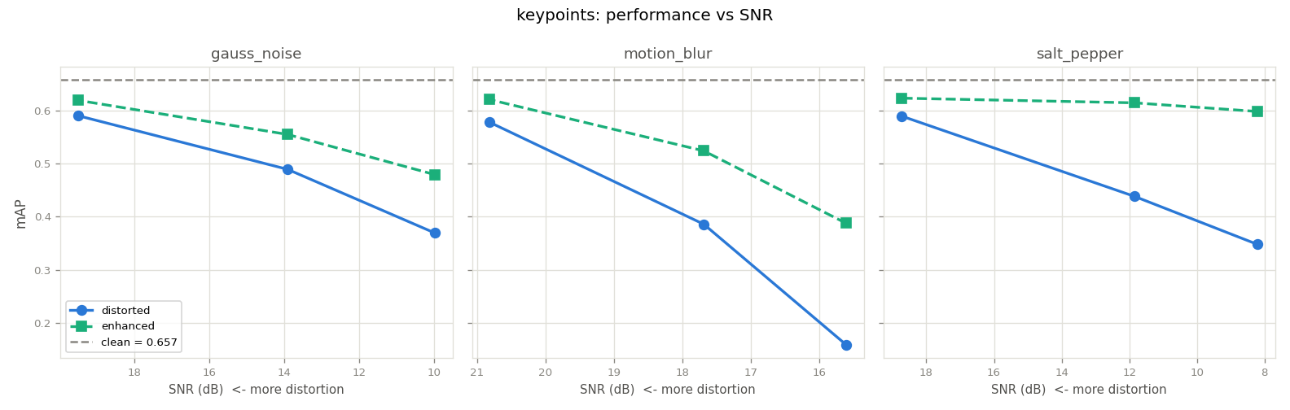
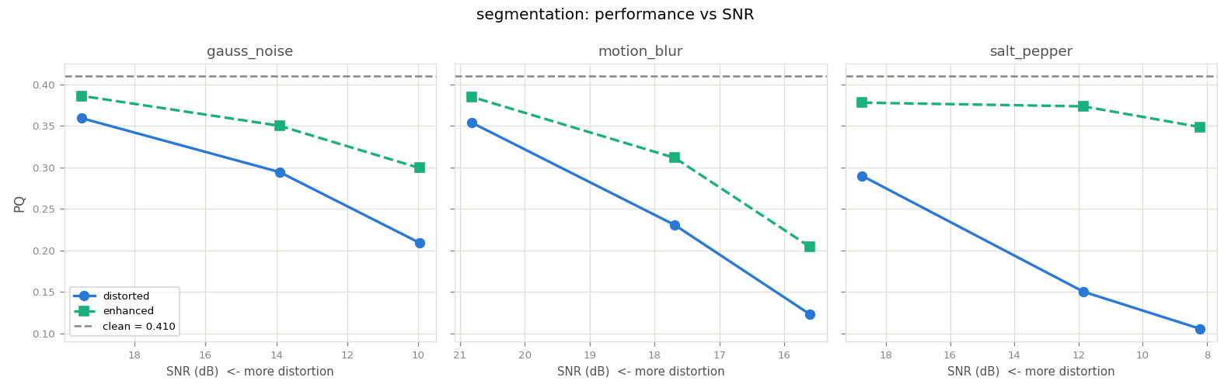
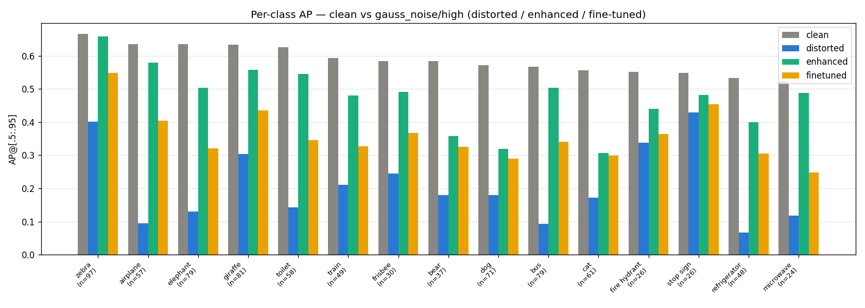
APPENDIX B
A2
Additional evidence — remaining curves and per-class comparison
Top: OKS AP and PQ vs SNR — same monotonic pattern as detection and features.
Left: per-class detection AP under high Gaussian noise — 15 highest-clean-AP classes, same legend as slide 9.
Notes:
The keypoint and segmentation SNR curves complete the picture from slide 8, and the Gaussian-noise per-class chart completes slide 9. Both show the same qualitative story as the figures in the main deck.

