Slide 1
Final Project Report — Image Processing and Computer Vision
Evaluating robustness of vision algorithms under image distortion -- and how well they recover
Dataset: COCO val2017 | 4 Tasks | 3 Distortions | 3 Severities | 2 Improvement Strategies
Team: Ohad Shpizhizen (oshpizhizen@nvidia.com) | Shira Tziony
https://github.com/ShiraTzi/Final-Project-Image-Processing
1 / 24

Slide 2
Table of Contents
1. Project Pipeline
2. Dataset -- COCO val2017
3. Selected Tasks (4 tasks across low-level and high-level vision)
4. Selected Noises and Enhancement Methods
5. Results
Plot 1: Recovery share per distortion x severity x task
Plot 2: Per-class AP -- Gaussian noise, high severity
Plot 3: Task metric vs SNR curves (all four tasks)
Clean baseline table + Plot 4: Per-class AP on clean images
Plots 5-8: Predictions on images (all tasks, all distortions)
Plots 9-11: Raw noise and enhancement examples
6. Conclusions and Discussion
2 / 24

Slide 3
Project Pipeline
Phase 0 -- Setup & Data Download COCO annotations + 1,521-image class-balanced val subset
Phase 1 -- Clean Baseline Run all models on clean images; validate against published scores
Phase 2 -- Distortion Apply 3 corruptions x 3 severities; log SNR + degradation params per image
Phase 3 -- Enhancement Apply matched classical restorer per image (BM3D / median / Wiener)
Phase 4 -- Fine-tuning Fine-tune YOLOv8n on 9,000-image clean + distorted + restored mixture
Phase 5 -- Report Comparison tables, per-class AP bars, metric-vs-SNR curves, visual grids
data --> distort --> enhance --+ | | | +--> infer --> eval --> tables / figures +----------+----------+ ^ finetune (YOLOv8) -+
Key design decision: degradation parameters (noise sigma / blur kernel) are logged per image at Phase 2, enabling non-blind (oracle) restoration at Phase 3 -- the core engineering choice of the benchmark.
3 / 24

Slide 4
Dataset -- COCO val2017
What is COCO?
Common Objects in Context -- 200k+ images, 80 object categories, by Microsoft
Single dataset covers all 4 tasks: bounding boxes + keypoints + panoptic masks on the same images
Official COCOeval toolkit -> metrics directly comparable to published results
All chosen models are COCO-pretrained -> baseline validation is straightforward
Our Subset -- 1,521 images (single source of truth for every experiment)
Seeded random sample + coverage top-up (every class >= 20 GT instances)
Class-proportion correlation with full val2017: r = 0.999 | 11,129 GT instances
All comparisons are paired: identical images and GT across clean / distorted / enhanced
Separate 9,000-image train2017 subset used only for fine-tuning
4 / 24

Slide 5
Selected Tasks -- Low-level and High-level Vision
Task Level Model / Algorithm Library Metric
--------------------------------------------------------------------------------------------
Feature matching Low-level ORB + BFMatcher (Hamming) OpenCV Match ratio vs clean
Object detection High-level YOLOv8n (COCO-pretrained) ultralytics mAP@[.5:.95]
Keypoint detection High-level Keypoint R-CNN ResNet50-FPN torchvision OKS AP
Panoptic segmentation High-level Panoptic FPN R50 detectron2 PQ = SQ x RQ
1 low-level task (ORB): tests raw signal integrity, no ground truth needed
3 high-level tasks: coarse localization (bbox) -> fine localization (joints) -> pixel-level (panoptic)
Together they reveal which aspect of the image each corruption damages most
All metrics are in [0, 1]; higher is better
5 / 24

Slide 6
Task 1 -- Feature Matching (ORB) | Low-level
Algorithm: ORB -- Oriented FAST and Rotated BRIEF (OpenCV)
Detects corner-like keypoints with scale and orientation invariance
Compact binary descriptors; matched with BFMatcher (Hamming distance, cross-check)
Metric: Match ratio
Good matches (Hamming <= 64, cross-checked) / clean keypoints
1.0 = every clean feature survives; 0 = local structure fully destroyed
No ground truth needed -- the clean image itself is the reference
Clean baseline: 1.000 (by construction)
Why chosen:
Sole low-level task: does the raw pixel signal preserve local geometric structure?
Known sensitivity: degrades under noise, collapses under blur -> strong contrast with high-level tasks
Runs on CPU in seconds; complementary to the heavy GPU-based models
6 / 24

Slide 7
Task 2 -- Object Detection (YOLOv8n) | High-level
Algorithm: YOLOv8n (nano) -- single-stage real-time detector (ultralytics)
COCO-pretrained on 80 classes; predicts bounding boxes + class labels in one pass
Metric: mAP@[.5:.95]
Average Precision averaged over 10 IoU thresholds (0.50 to 0.95) and all 80 classes
Strict: rewards tight localization, not just detection -- reacts to corruption early
Clean baseline: 0.352 (published full-val2017: ~0.373 -- validates our pipeline)
Why chosen:
Most canonical high-level robustness benchmark -- widely compared in literature
Fast enough to run the full 1,521-image subset without prohibitive GPU time
Only task for which we apply fine-tuning -> focal point of enhancement vs fine-tuning comparison
7 / 24

Slide 8
Task 3 -- Keypoint Detection (Keypoint R-CNN) | High-level
Algorithm: Keypoint R-CNN -- ResNet-50 + FPN, COCO-pretrained (torchvision)
Localizes 17 human body joints per detected person
Joints: nose, eyes, ears, shoulders, elbows, wrists, hips, knees, ankles
Metric: OKS AP
Object Keypoint Similarity: scale-normalized Euclidean distance between predicted and GT joints
AP machinery (same as detection) but box-IoU is replaced by OKS
Person-only task -- isolates how corruption affects fine spatial localization
Clean baseline: 0.657
Why chosen:
Pixel-accurate joint localization is fundamentally more sensitive than bounding-box detection
Corruption that barely hurts detection can dramatically shift predicted joint positions
The detection-vs-keypoints contrast is one of the most informative axes of the benchmark
8 / 24

Slide 9
Task 4 -- Panoptic Segmentation (Panoptic FPN) | High-level
Algorithm: Panoptic FPN -- ResNet-50 backbone, COCO-pretrained (detectron2)
Assigns every pixel a semantic class AND instance identity
Handles 'things' (cars, people -- countable) AND 'stuff' (sky, road -- amorphous)
Runs in a separate virtualenv (detectron2 requires different torch) via subprocess
Metric: PQ = SQ x RQ
RQ (Recognition Quality): F1 over correctly matched segments -- penalizes missed/false segments
SQ (Segmentation Quality): mean IoU of matched segments -- penalizes sloppy masks
PQ drops when segments are missed (RQ down) OR boundaries are imprecise (SQ down)
Clean baseline: PQ 0.410 (SQ 0.775 / RQ 0.500; things 0.475 / stuff 0.312)
Why chosen:
Most demanding pixel-level task; PQ decomposition provides built-in diagnostic for how corruption hurts
This SQ/RQ diagnostic revealed the v2 NLM denoiser failure (see Conclusions)
9 / 24

Slide 10
Selected Noises and Enhancement Methods
Gaussian Noise (SNR ~19.5 / 13.9 / 10.0 dB)
Model: Additive white Gaussian noise -- sensor / intensity noise; sigma sampled & logged per image
Enhancement: Non-blind BM3D fed the logged per-image sigma (strongest classical AWGN denoiser)
Chosen: canonical noise model with closed-form matched inverse; textbook best case for restoration
Salt-and-Pepper Noise (SNR ~18.7 / 11.8 / 8.2 dB)
Model: Random pixels set to 0 or 255; impulse fraction sampled & logged per image
Enhancement: Median filter (3x3) -- discards impulse outliers exactly; preserves edges
Chosen: qualitatively different from AWGN; matched restoration is near-optimal -> strong upper bound
Motion Blur (SNR ~20.8 / 17.7 / 15.6 dB)
Model: Convolution with linear kernel; length and angle sampled & logged per image
Enhancement: Non-blind Wiener deconvolution with the logged kernel -- optimal linear inverse for known blur
Chosen: destroys spatial structure (not just energy); most damaging for localization tasks
Key: degradation params (sigma / impulse fraction / kernel) logged at corruption time -> enables non-blind restoration -- the core engineering decision of the benchmark
10 / 24

Slide 11
Results
Plot 1 -- Recovery per distortion x severity cell
Plot 2 -- Per-class AP: Gaussian noise high
Plot 3 -- Metric vs SNR (all four tasks)
Clean baseline table + Plot 4 -- Per-class AP on clean images
Plots 5-8 -- Predictions on images (all tasks x all distortions)
Plots 9-11 -- Raw noise and enhancement examples
11 / 24

Slide 12
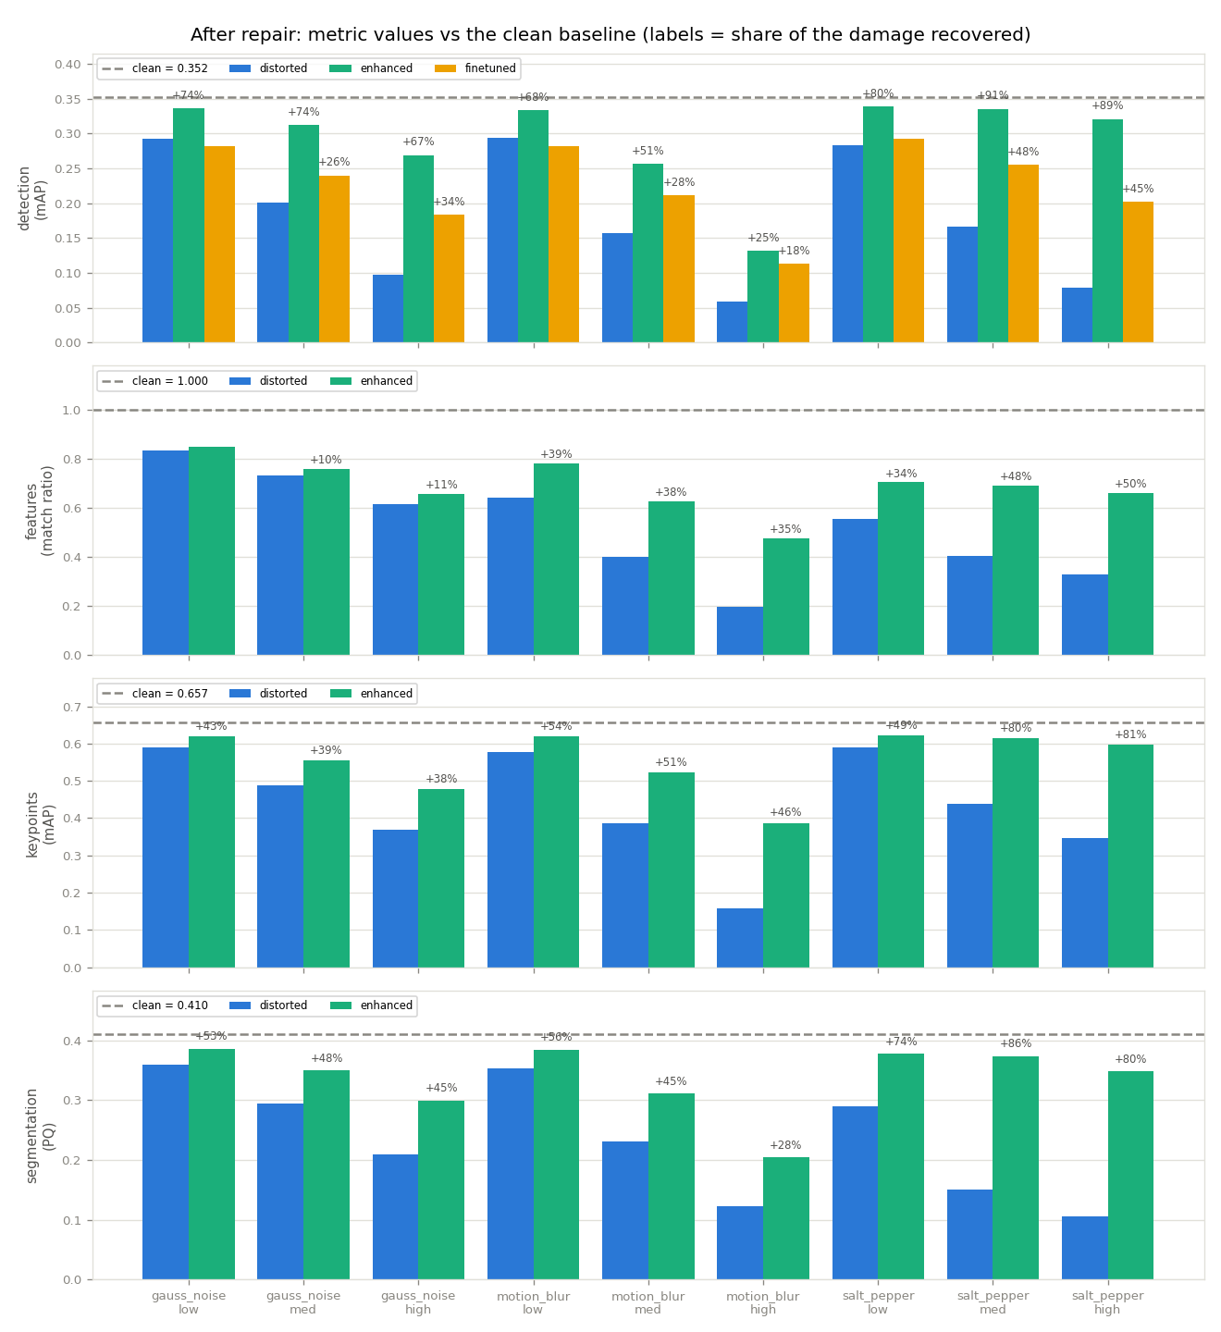
Plot 1 -- Recovery per Distortion x Severity Cell
Each panel = one task. Bar groups = distortion x severity. Blue = distorted; green = enhanced; amber = fine-tuned (detection only). Dashed = clean baseline. Labels show fraction of total damage recovered.
12 / 24

Slide 13
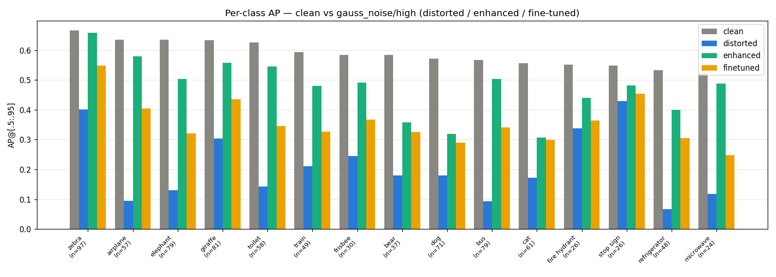
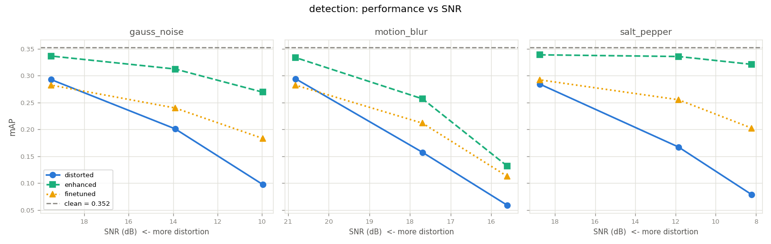
Plots 2 & 3 -- Per-Class AP and Metric vs SNR
Per-class AP -- gauss_noise / high. Gray = clean; blue = distorted; green = enhanced; amber = fine-tuned.
Detection mAP vs SNR (dB). Blue = distorted; green = enhanced; amber = fine-tuned. Gray dashed = clean baseline. Lower SNR = higher severity.
13 / 24

Slide 14
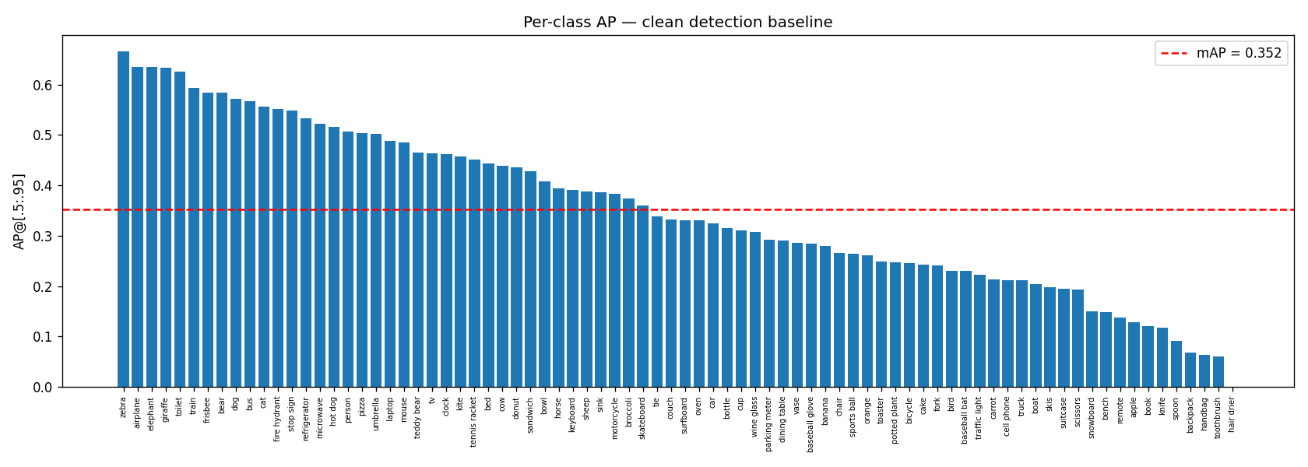
Clean Baselines (Phase 1) and Per-Class AP Distribution
Clean Baselines -- all models within ~0.02 of published full-val2017 scores
Feature matching (ORB) Match ratio 1.000 (by construction)
Object detection (YOLOv8n) mAP@[.5:.95] 0.352 (published ~0.373)
Keypoint detection (Keypoint R-CNN) OKS AP 0.657
Panoptic segmentation (Panoptic FPN) PQ 0.410 (SQ 0.775 / RQ 0.500)
This validates the measurement pipeline before any distortion is introduced.
Per-class YOLOv8n AP on clean images, sorted descending. n= label = GT instance count per class. Dashed = mean AP.
14 / 24

Slide 15
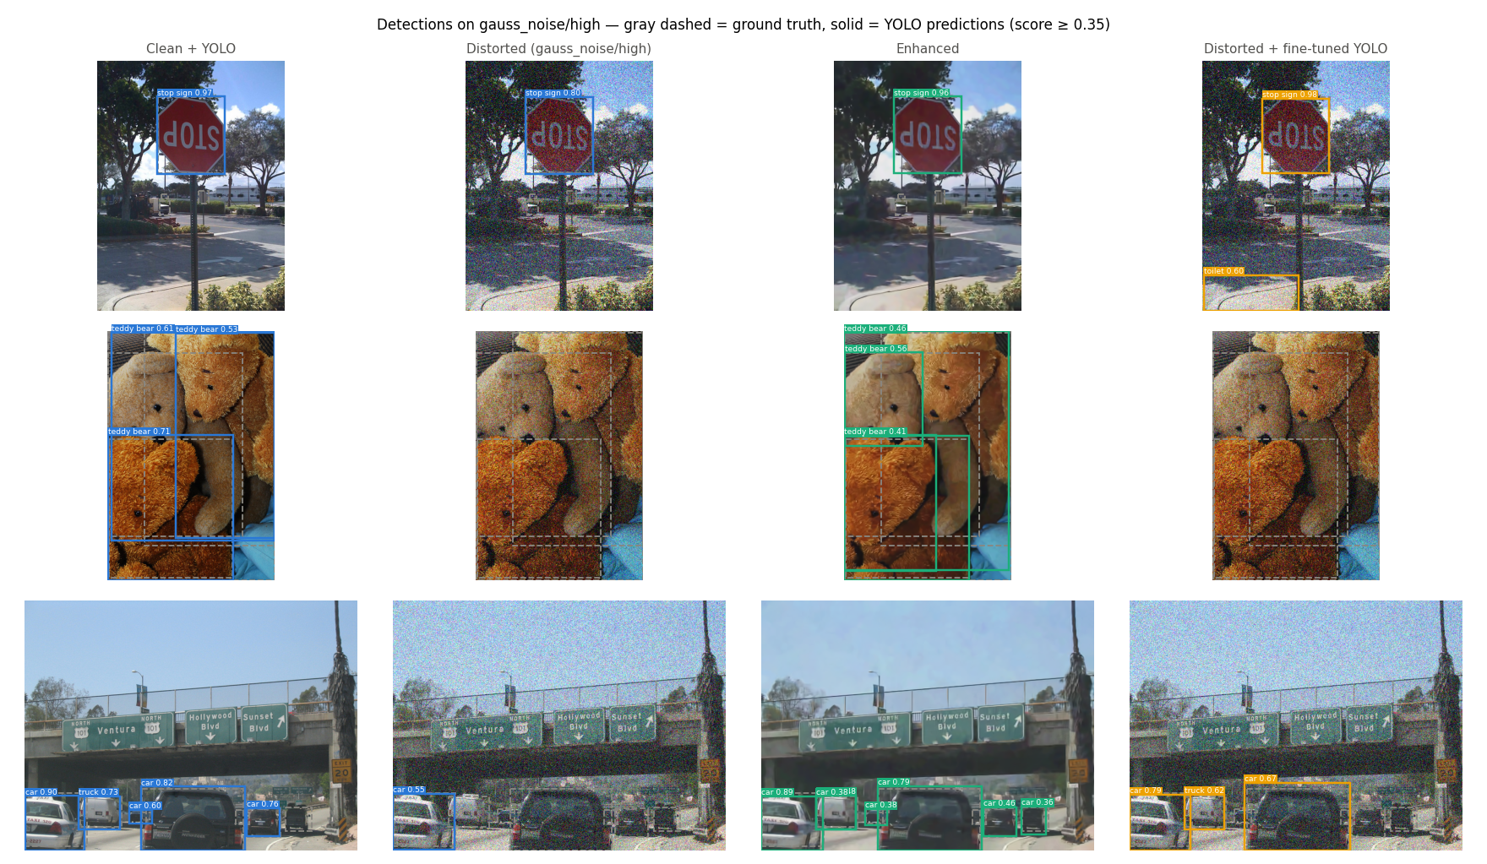
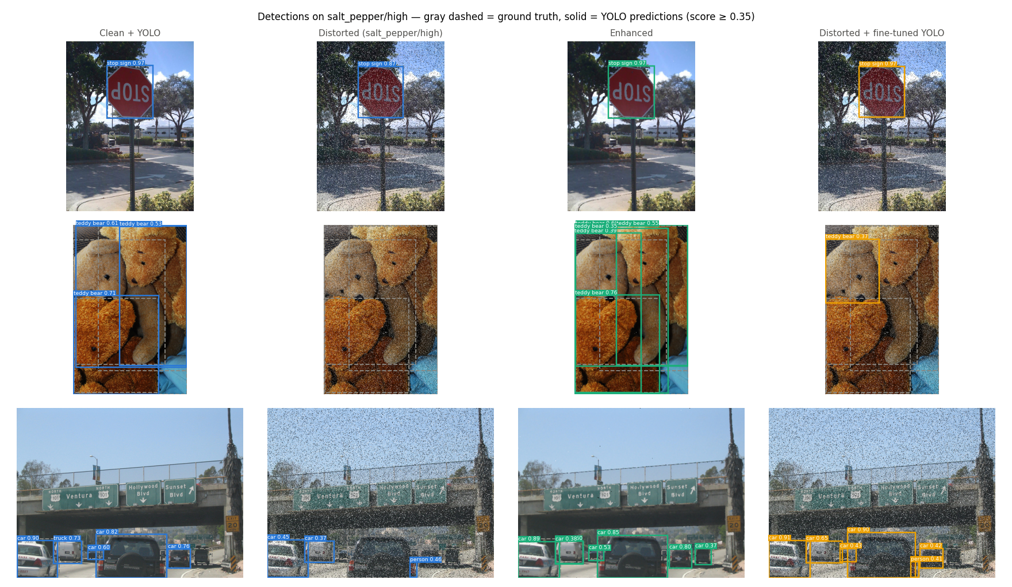
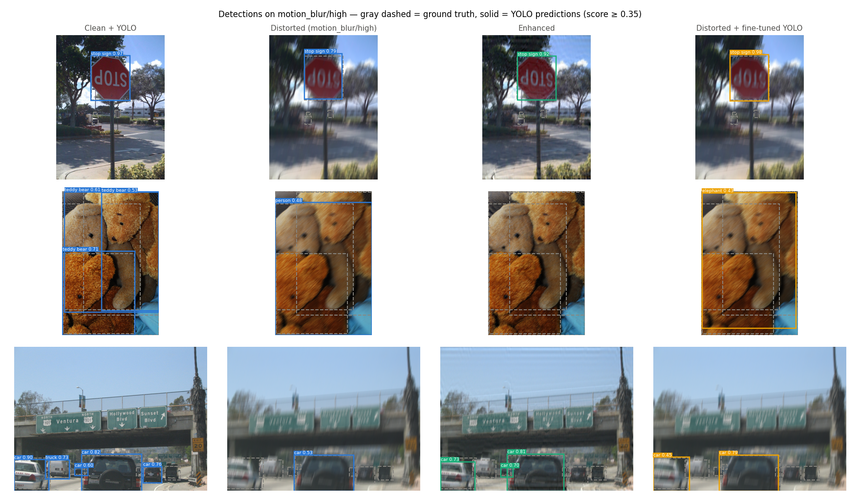
Plot 5 -- Visual Examples: Object Detection (YOLOv8n)
Gray dashed = ground-truth bounding boxes | Colored = YOLO predictions + confidence | Columns: clean / distorted (high) / enhanced / fine-tuned
15 / 24

Slide 16
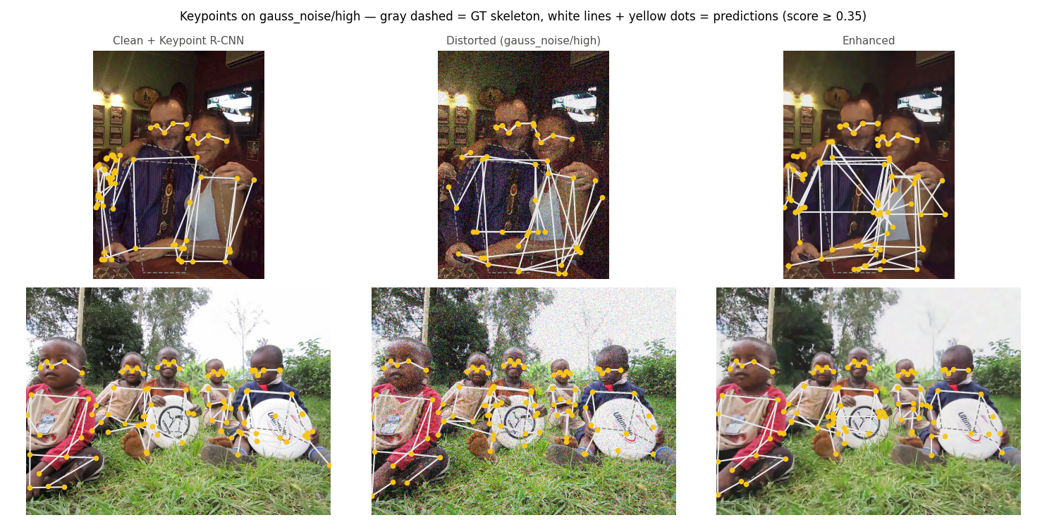
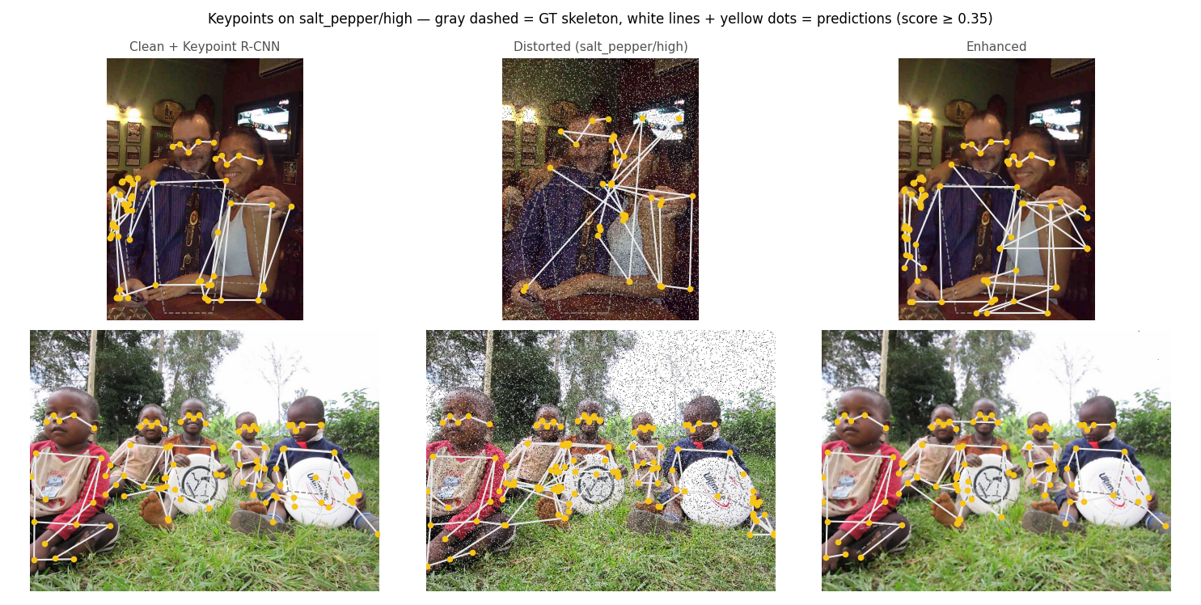
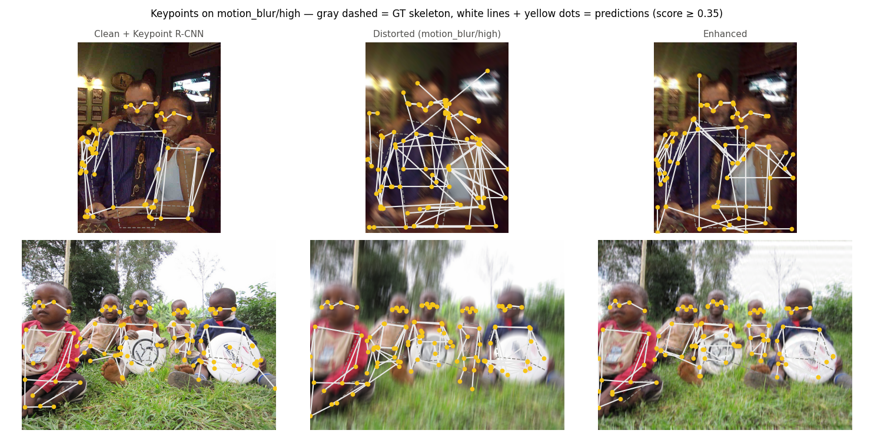
Plot 6 -- Visual Examples: Keypoint Detection (Keypoint R-CNN)
Gray dashed = GT skeleton from COCO keypoints annotation | White skeleton + yellow joints = predictions at score >= 0.35 | Columns: clean / distorted (high) / enhanced
16 / 24

Slide 17
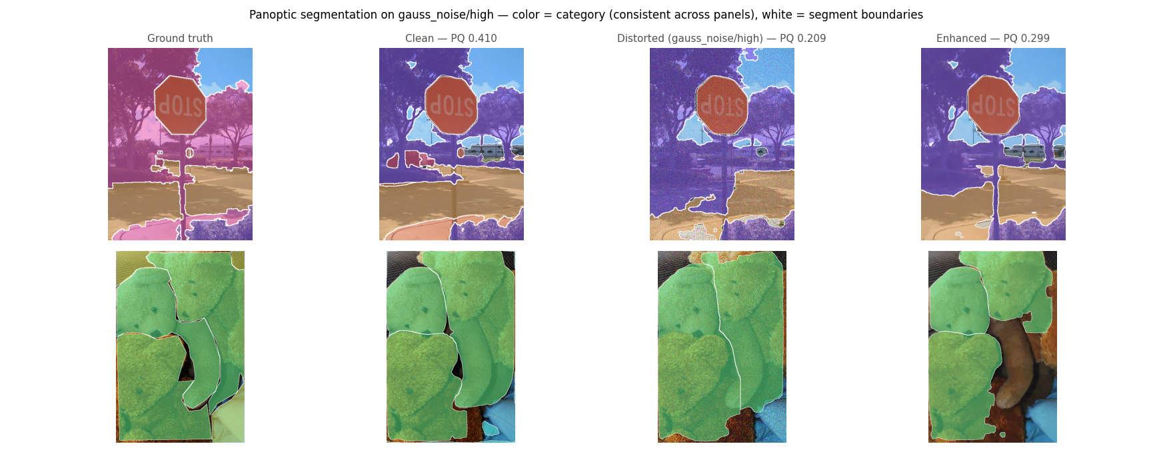
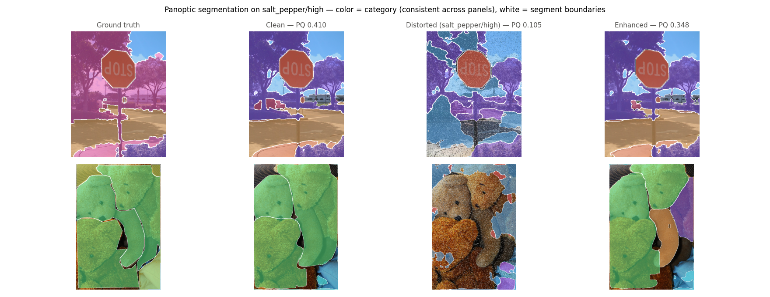
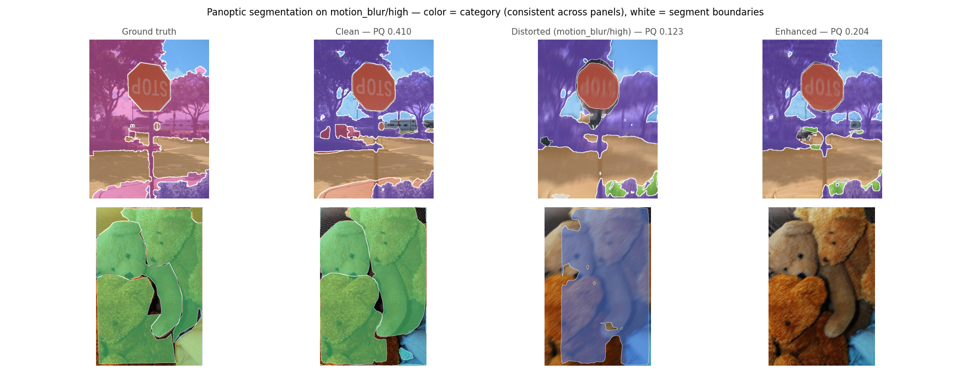
Plot 7 -- Visual Examples: Panoptic Segmentation (Panoptic FPN)
Color = semantic category (consistent palette) | White hairlines = segment boundaries | Column header = cell PQ | Columns: GT / clean / distorted (high) / enhanced
17 / 24

Slide 18
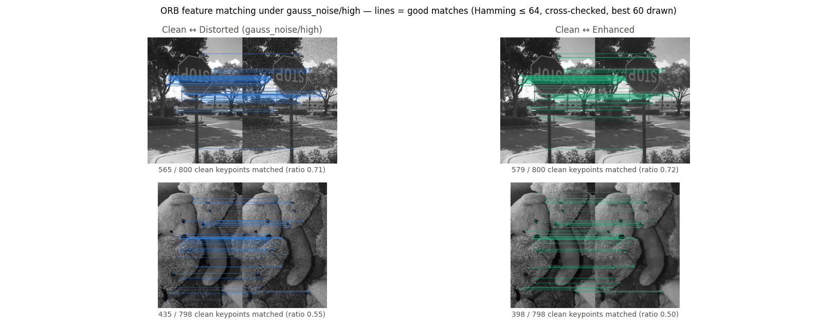
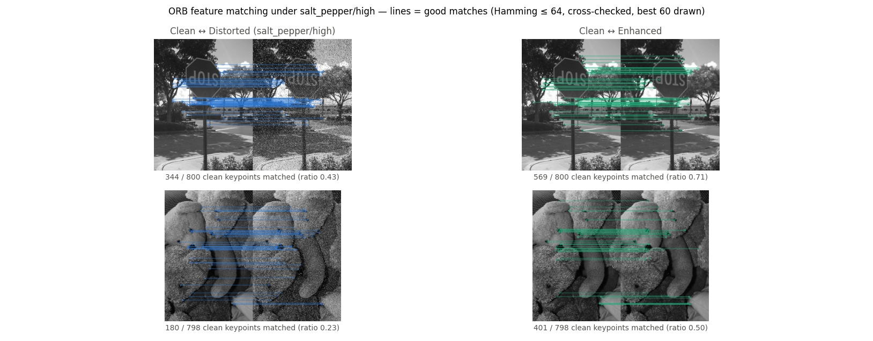
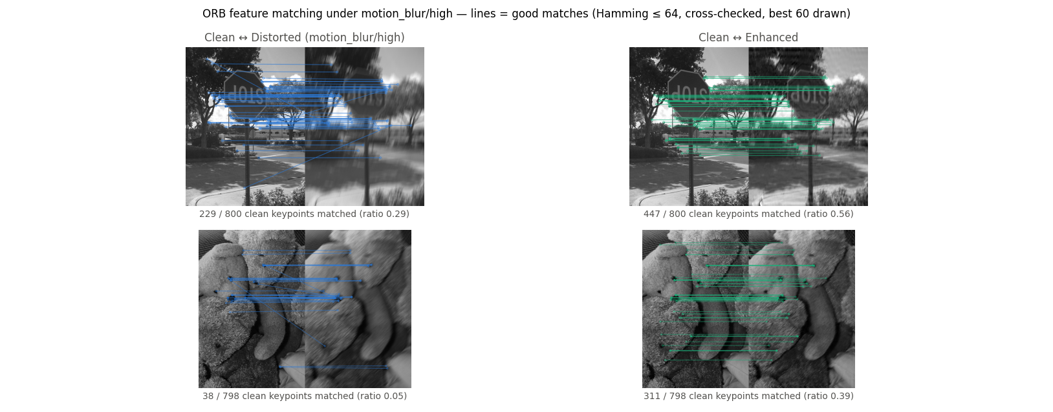
Plot 8 -- Visual Examples: ORB Feature Matching
Clean image (left) matched against distorted or enhanced (right) | Lines = good matches (Hamming <= 64) | Caption = per-image match ratio (good matches / clean keypoints)
18 / 24

Slide 19
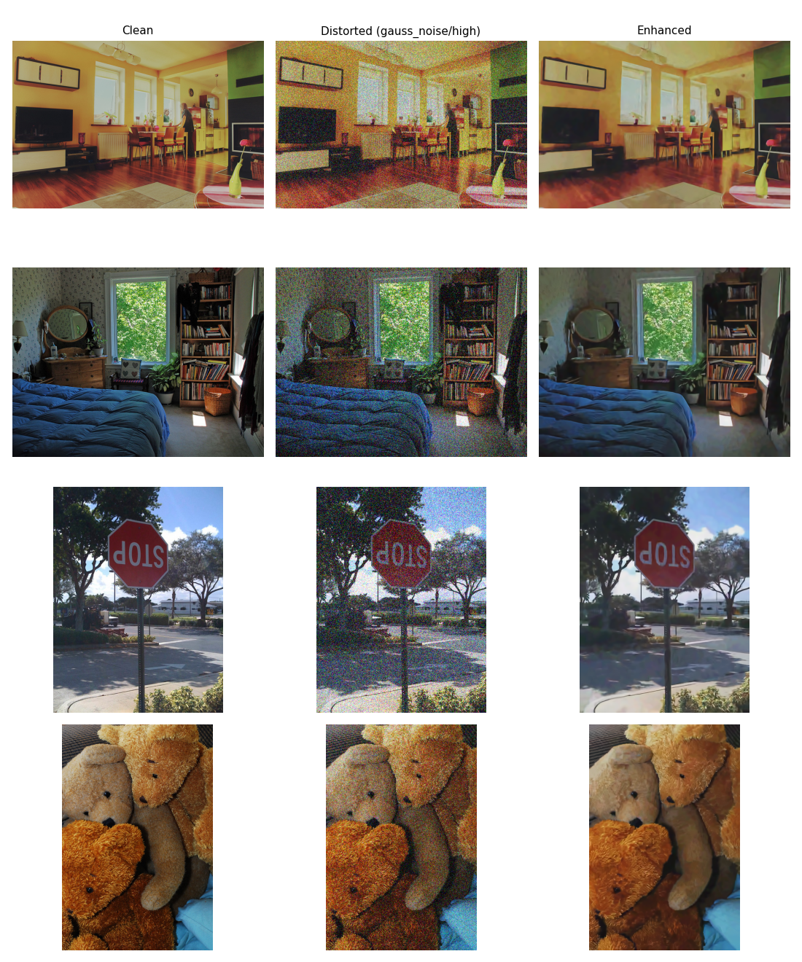
Plot 9 -- Raw Examples: Gaussian Noise (High Severity)
Images different from those shown in Plots 5-8 | Columns: clean / distorted / enhanced | BM3D removes heavy grain while preserving edges and texture detail.
19 / 24

Slide 20
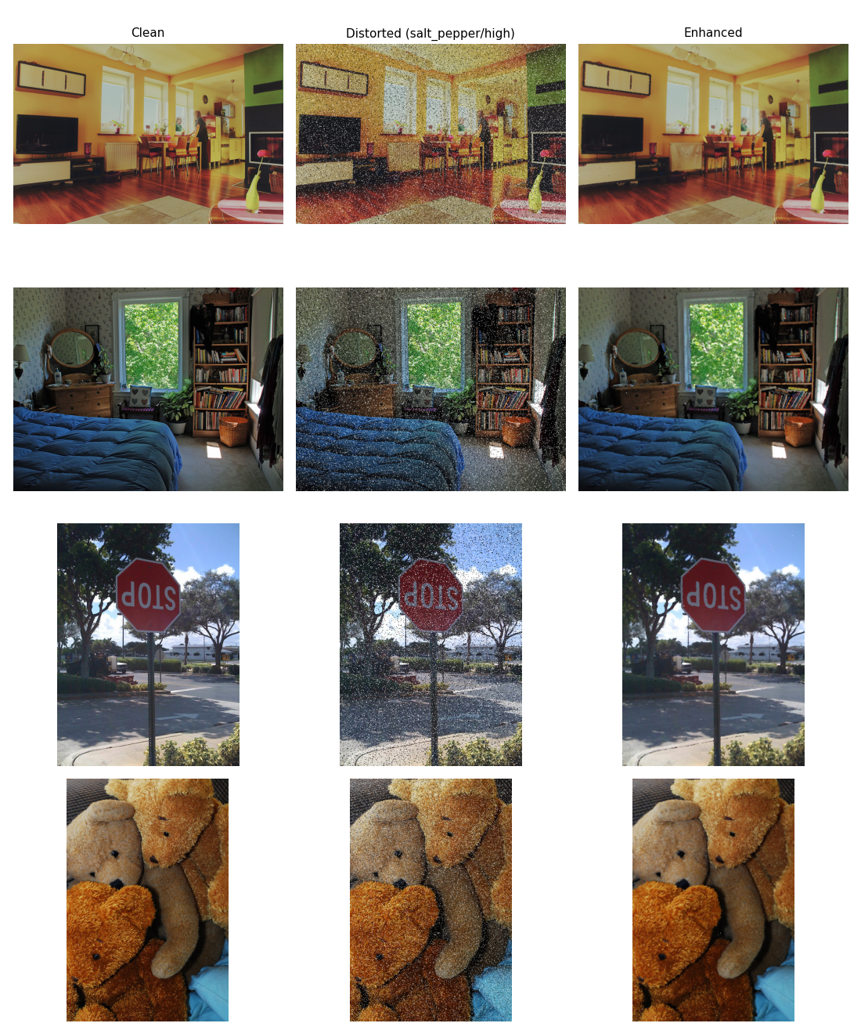
Plot 10 -- Raw Examples: Salt-and-Pepper Noise (High Severity)
Images different from those shown in Plots 5-8 | Columns: clean / distorted / enhanced | Median filter fully removes impulse pixels; clean-looking restoration visible at pixel level.
20 / 24

Slide 21
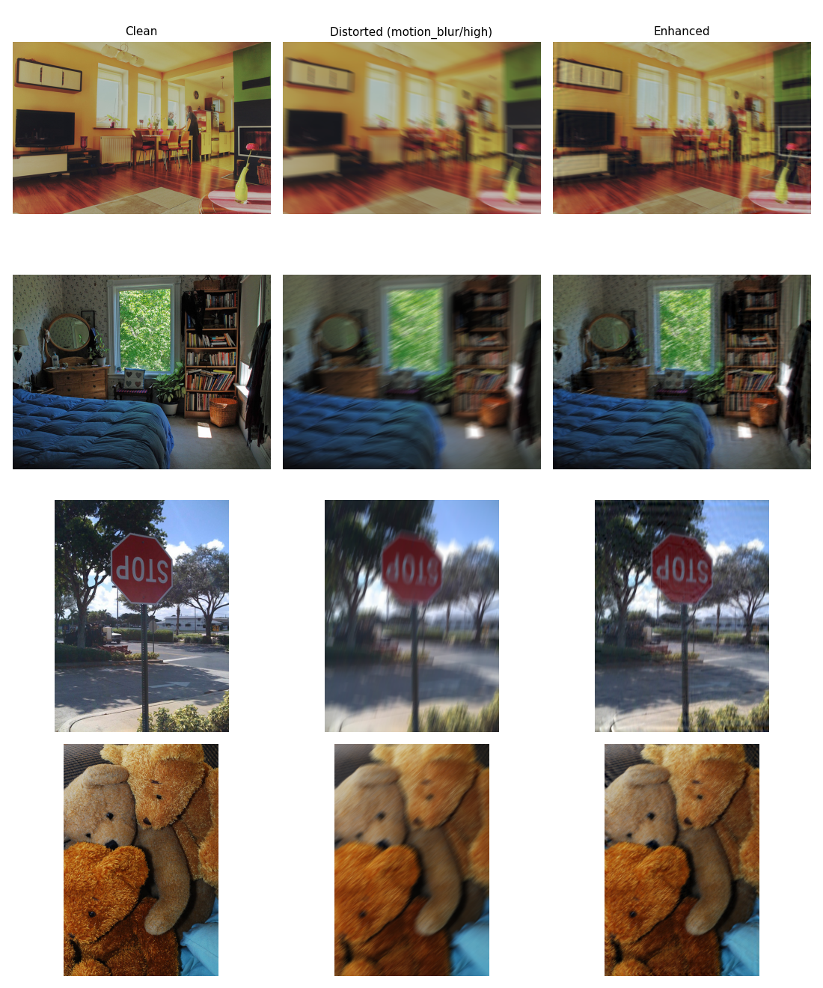
Plot 11 -- Raw Examples: Motion Blur (High Severity)
Images different from those shown in Plots 5-8 | Columns: clean / distorted / enhanced | Non-blind Wiener deconvolution (logged kernel) visibly re-sharpens edges smeared by motion blur.
21 / 24

Slide 22
Discussion -- Why Enhancement Outperforms Fine-tuning (7 of 9 cells)
Four structural reasons:
1. Oracle knowledge: restorer gets exact per-image degradation params; fine-tuned model gets nothing
Evidence: blind kernel guess for motion blur scored WORSE than no restoration at all
2. Distribution shift: enhancement pushes inputs back to the pretrained model's clean-image home
Fine-tuning shifts weights away using only 9,000 images -- pays measured -0.042 clean-mAP cost
3. Textbook best case: synthetic, uniform, closed-form noise models -- exactly what classical restoration is designed for
Real-world corruptions (mixed, spatially-varying, unknown) would close this gap
4. Model-agnostic: same enhanced images lift all 4 tasks; fine-tuning only targeted detection
Fine-tuning still earns its place:
Unknown corruption: fine-tuned model is safe (never more than -0.012 below baseline; up to +0.124 in-domain)
Partially irreversible damage: heavy motion blur zeroes frequency bands no filter restores
Stack wins: motion_blur med/high combined recovery 45% vs 25% (enhance) vs 18% (fine-tune) alone
22 / 24

Slide 23
Discussion -- Additional Findings
SNR predicts degradation direction -- but not damage magnitude across corruptions
Motion blur (SNR ~15.6 dB high) is more destructive for ORB (-0.80) and keypoints (-0.50)
than Gaussian noise at med (SNR ~13.9 dB) -- spatial structure loss != pixel-wise energy
v2 NLM failure -- the filter, not the concept
Sigma-adaptive NLM scored BELOW raw noisy images on every pixel-precise task
Diagnosis: blotchy residual noise + texture loss -> small objects disappeared; PQ RQ collapsed
BM3D (collaborative patch filtering) flipped all 12 Gaussian-noise cells positive
Archived negative result now delimits which filter to deploy, not whether to use classical restoration
Fine-tuning mixture design -- each ingredient fixed a measured failure
v1 (single cell): textbook negative transfer -- lost to baseline on 5/9 cells
v2 (10% clean, no restored images): -0.068 clean mAP + domain mismatch on enhanced val images
v3 (25% clean + restored picks): -0.042 clean mAP; domain mismatch resolved; stack additive on all 9 cells
23 / 24

Slide 24
Conclusion
Image distortion inflicts substantial but largely recoverable damage on modern vision systems
-- provided the restoration strategy matches the degradation model
Classical enhancement with oracle knowledge of corruption parameters is the strongest single repair
on 7 of 9 cells and across all four tasks
Fine-tuning on a carefully designed mixture is the robust fallback for unknown or irreversible corruptions;
stacking both repairs is additive once training includes restored images
PQ -> SQ/RQ decomposition and size-stratified AP provided the diagnostic power to locate
and fix a denoiser that actively hurt the system -- turning a negative result into a design principle
Know your corruption -> choose your weapon.
When the forward model is known and invertible: image space is the cheaper and stronger battlefield.
When it is not: model robustness is your safety net.
GitHub: https://github.com/ShiraTzi/Final-Project-Image-Processing
24 / 24

