Slide 1

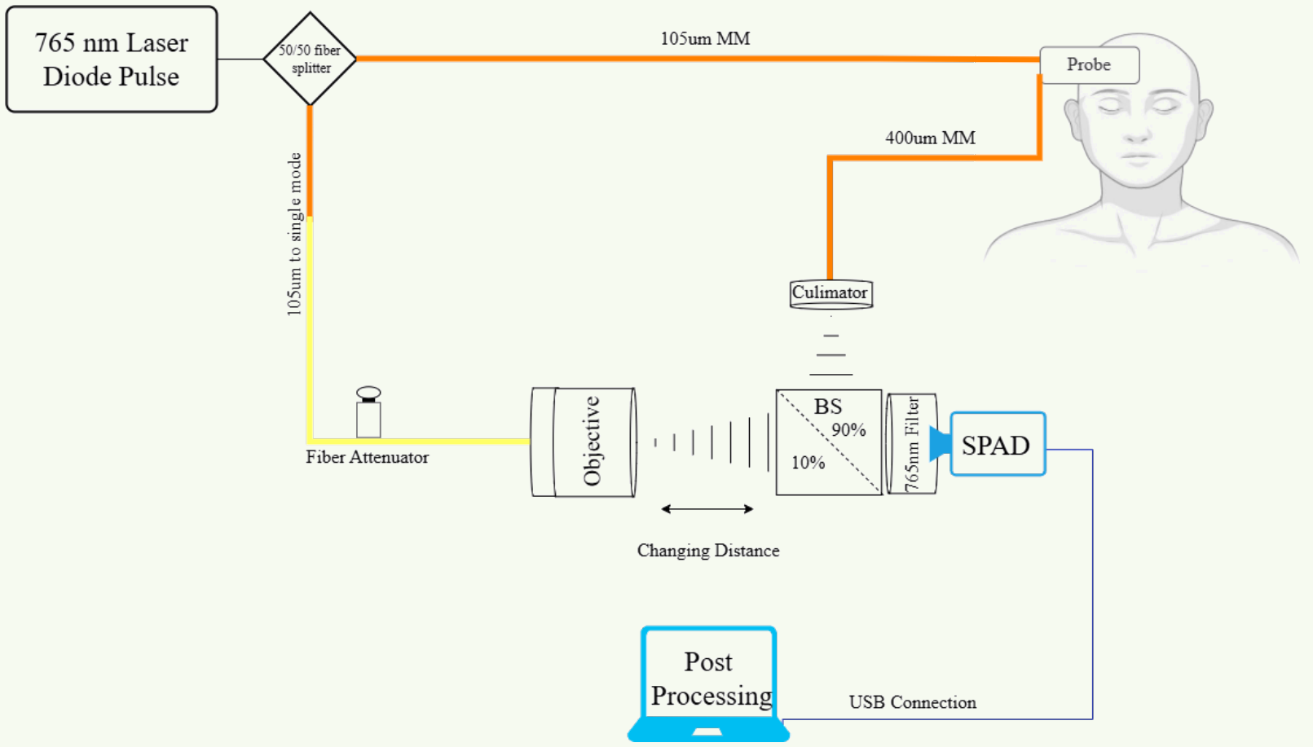
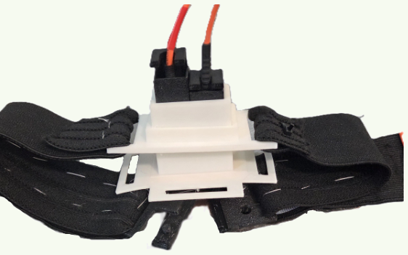
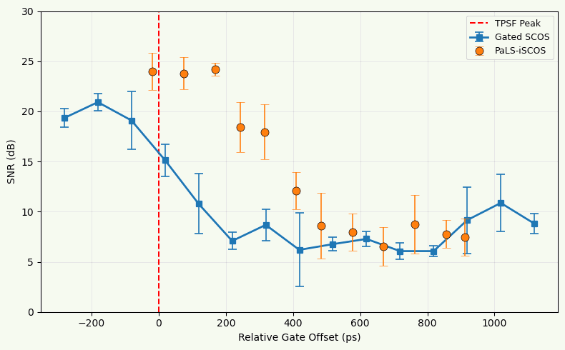
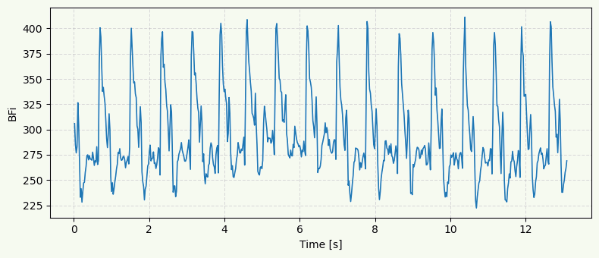
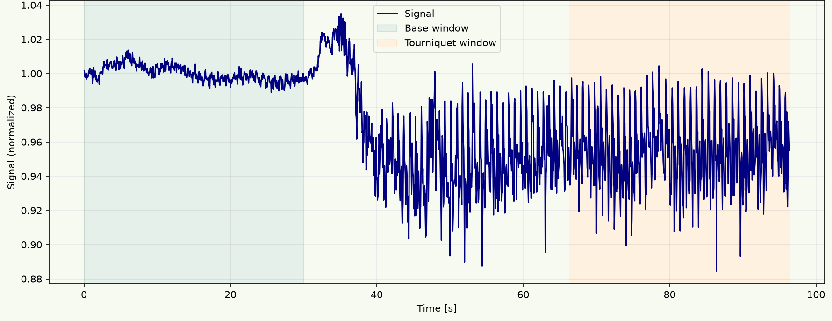
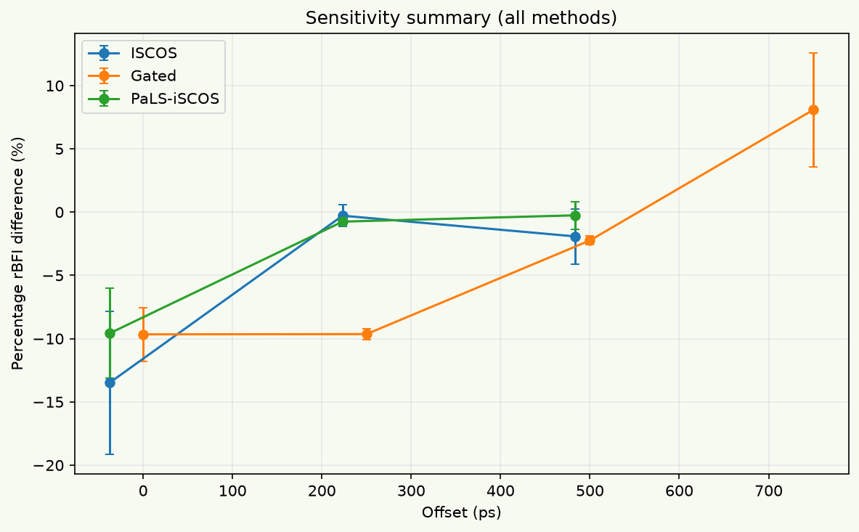
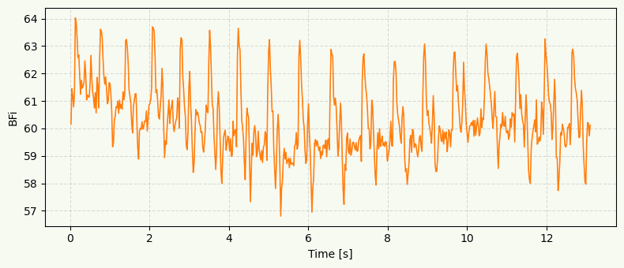
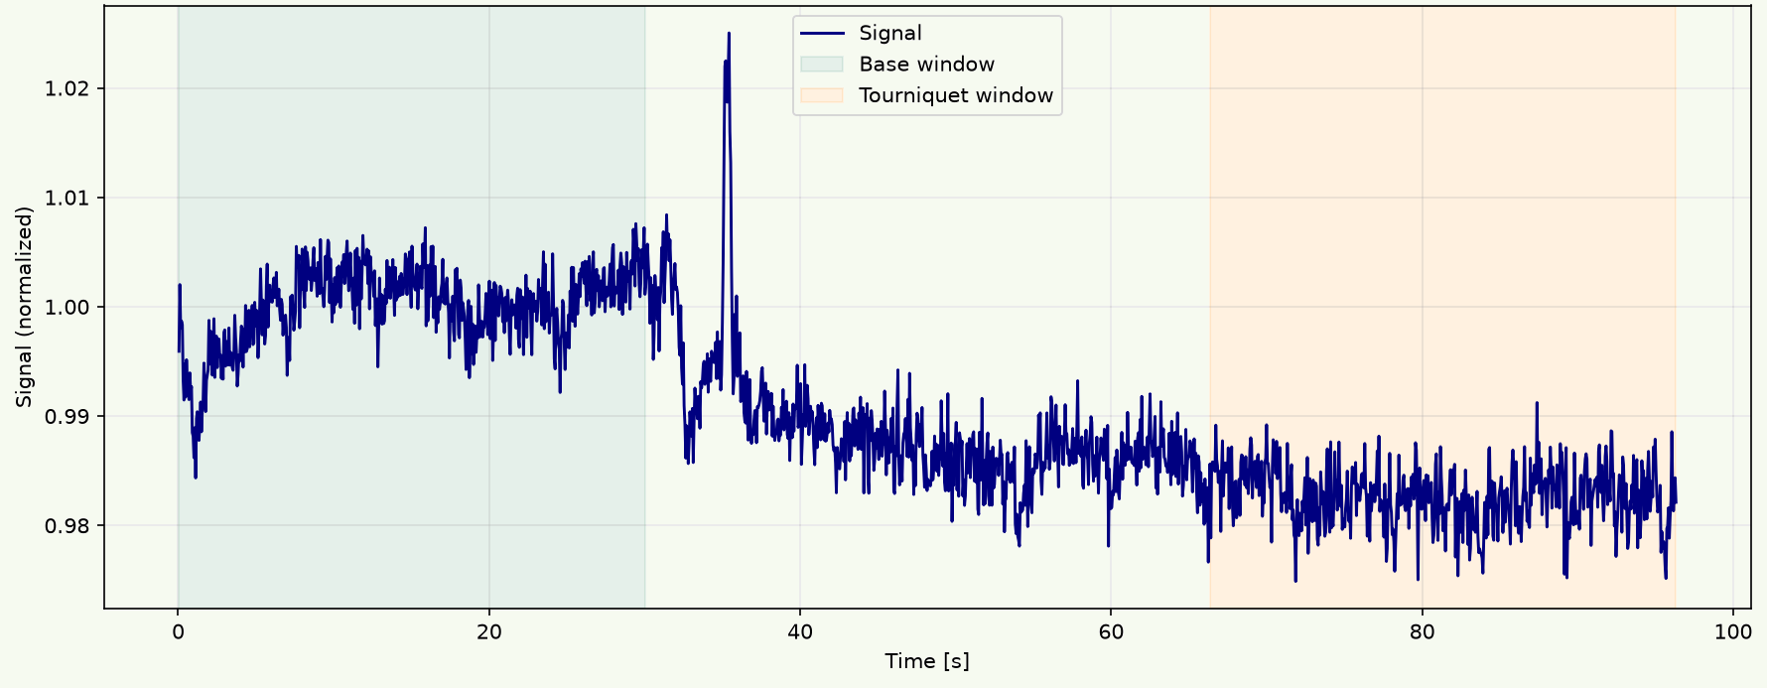
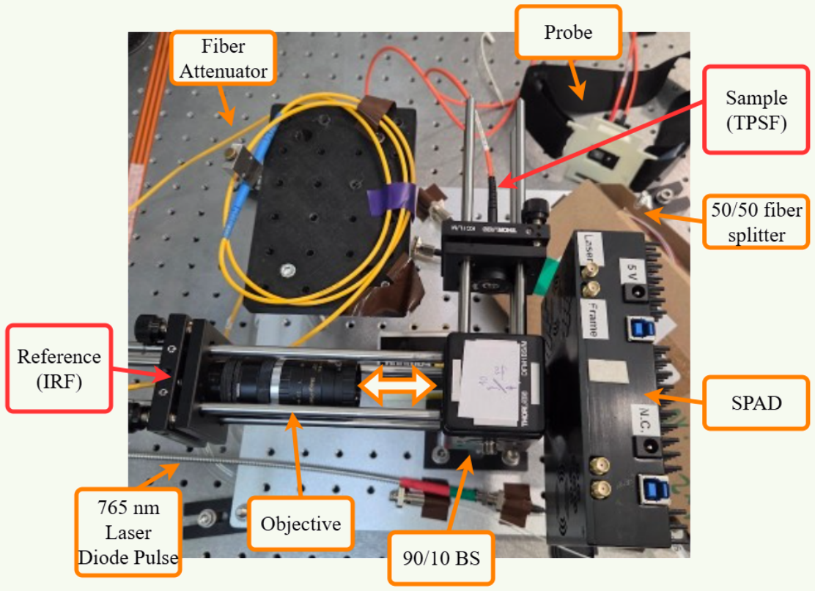
Non-Invasive Methods for Brain Research
Pathlength-Selective, Interferometric Speckle Contrast Optical Spectroscopy (PaLS-iSCOS)
Shira Tziony | Supervisors: Dr. Nisan Ozana, Ms. Marina Vasileva
Optical Neuroimaging Lab, Faculty of Engineering, Bar-Ilan University, Israel
Background
Objectives & Methods
Cerebral blood flow (CBF) monitoring matters for brain-function research and for diagnosing neurological disorders, but established imaging methods are too slow, too large and too costly for continuous bedside use. Optical methods have the resolution bedside monitoring needs; their problem is depth. Most detected photons scatter back from the scalp and skull, and a longer source–detector separation (SDS) reaches deeper tissue only by starving the detector. Pathlength (time-of-flight) gating instead sets depth by time of flight, sampling deep tissue while source and detector stay close, where photons are still plentiful; interferometric detection then amplifies the few that survive the gate.
Combine camera-based SCOS with interferometric detection and coherence gating.
765 nm laser, 386 ps Gaussian pulse; Mach-Zehnder interferometer, adjustable reference arm.
Select photons by optical pathlength to suppress the scalp and skull contribution.
Gated SPAD512 camera, multimode collection fiber, probes at 10, 15 and 25 mm SDS.
Benchmark against Gated SCOS on SNR, heart-rate accuracy and depth sensitivity.
TPSF and IRF measured; Richardson-Lucy deconvolution recovers a ≥446 ps FWHM TPSF.
Optical Technique | Depth specificity | Temporal resolution | SNR / light collection | Scalp signal | Speckle readout
CW-DCS | Low to moderate | ~100 ms – 1 s | Low (single-mode fibre) | High | g₁(τ) per fiber
Un-gated SCOS | Low | ~10 – 50 ms | High (camera averaging) | High | K² from one frame
Gated SCOS | High | ~100 ms – 1 s | Very low (shot-noise limited) | Low | K² from one frame
iSCOS | Moderate | ~5 – 20 ms | High (heterodyne gain) | Moderate | K² from one frame
PaLS-iDCS | Very high | ~10 – 50 ms | High (heterodyne gain) | Minimal | g₁(τ) per channel
PaLS-iSCOS (this work) | Very high | < 50 ms | High (heterodyne + SPAD array) | Minimal | K² from one frame
System layout: 765 nm pulsed laser, Mach-Zehnder reference arm and gated SPAD camera.
The 10 mm SDS probe with the tourniquet add-on used for superficial occlusion testing.
Results
5–10 dB SNR gain
Heart rate preserved
Gate picks the depth
Sensitivity holds
At 1.0 cm SDS PaLS-iSCOS leads from the earliest gates out to ~500 ps; the margin reverses by 2.5 cm SDS.
BPM accuracy and CV match or beat Gated SCOS up to ~500 ps for 1.0 SDS.
The early coherence gate tracks the scalp tourniquet; the late gate barely registers it.
PaLS-iSCOS keeps a negative to near 0 ΔrBFI% across gates, where Gated SCOS turns positive out of noise.
Gated SCOS, −100 ps: 20.1 dB, 73 BPM
Early coherence gate (−25 ps)
SNR vs. gate offset at 1.0 cm SDS: PaLS-iSCOS (orange), Gated SCOS (blue).
PaLS-iSCOS, −74 ps: 25.4 dB, 78 BPM
Late coherence gate (500 ps)
Sensitivity at 1.0 cm SDS: rBFI difference vs. gate offset, all three methods. (iSCOS- gated at an early gate)
Example rBFI traces at 1.0 cm SDS — the recovered heartbeat.
Normalized rBFI baseline vs. tourniquet at 1.0 cm SDS; occlusion applied at 30 s.
Discussion
The system on the bench: sample and reference arms, 90/10 beam splitter and gated SPAD camera.
Pathlength gating is a genuinely useful lever for depth specificity, and a camera-based, parallelized implementation reaches it without the per-pixel autocorrelation cost of PaLS-iDCS. The benefit is conditional: it holds where the photon budget still supports the noise model — small SDS and early-to-mid gates. At early gates the measured inverse relation between K² and BFI matched prediction, with both systolic and diastolic peaks in the rBFI trace; later gates gave a single-peak signal only. The noise correction applied here ranged from ineffective to harmful, so it is the first thing to rebuild. Next steps: raise late-gate signal quality through laser power, sample-to-reference ratio and polarization filtering, model the SPAD's dark counts, afterpulsing and jitter, and re-run the occlusion protocol. The target is a multi-channel probe for depth-resolved functional imaging.

