Slide 1
The Bio-Data Club @ Moffitt
February 2019 Meeting featuring Zhihua Chen (introduction to t-SNE)

Slide 2
Some news…

Slide 3


Some news…
We have a sponsor!!!
‘The central mission of the R Consortium is to work with and provide support to the R Foundation and to the key organizations developing, maintaining, distributing and using R software through the identification, development and implementation of infrastructure projects.’

Slide 4
What it means
Provided with some funds for club related activities.
Need to adhere to the R consortium code of conduct
Boils down to 1) be inclusive and 2) don’t be a jerk.
Attendance sheet (bigger groups get more money!)
This logo will show up occasionally
I will receive an email from the R consortium no more than quarterly that will be circulated to the group.
We get a free meetup.com pro account to help organize and to make the group more easily available to people outside of Moffitt.

Slide 5
Farewell conference room 2, we hardly knew ye…
This is our last meeting in the MRC 2 conference room!
All future meetings will be held in SRB.
Meetings still occur monthly on Fridays.
Meeting time will be to 2-3pm due to room availability.
Occasionally need 1st or 4th Friday based on room availability.
More space means we can open open up the meeting to the entire institution.
Look for an MRI Signals announcement before the March meeting.

Slide 6
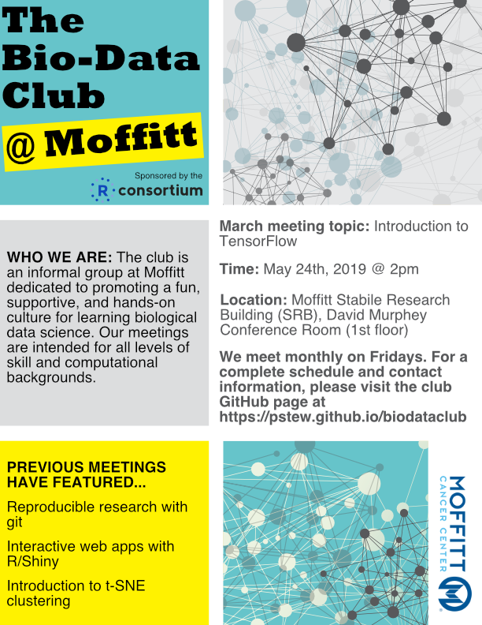
Draft flyer
Feedback welcomed.
Let Paul know if you’d like to volunteer to design a future poster.
Let Paul know if you would like to help post March flyers in your department (especially if you are not in MRC).

