Slide 1
Basic Psychometrics for Busy Statisticians
Robert Gore, ph.d.
Assistant member, biostatistics and bioinformatics
Moffitt cancer center

Slide 2
How Statisticians Get Involved
0 | 1 | 2 | 3 | 4
Not at all important | Slightly important | Somewhat important | Very important | Critically important
Ordinal Variable
A researcher develops a short measure of attitudes toward something related to cancer
The measure appears to measure what is intended
Each item is on a likert-type scale
“How important do you believe it is for you to get screened for cancer at recommended ages?”
“How important do you believe it is for you to lower your cancer risk by eating a balanced diet?”
“How important do you believe it is for you to reduce your cancer risk by not smoking or quitting smoking if you are a smoker?”
“How important do you believe it is for you to avoid excessive sun exposure in order to prevent cancer?”
The researcher then wants to create a summary measure, such as a total score or average score, and analyze these

Slide 3
Measurement Problems in Psychology
We want to measure things that cannot be directly observed (e.g., attitudes)
People may not remember the information we want
“Between the ages of 6 and 10, how many servings of fruit did you eat per day?”
People may not want to give us the information we are requesting
“How many times a month do you smoke marijuana?”
People may not want to admit the answers to our questions even to themselves
“How many times in your life have you gotten so drunk you could not remember what happened?”
People may not interpret our questions the way we intended
“Do you ever hear voices that other people cannot?”
“Yes, I have exceptional hearing”

Slide 4
Two Major Concepts in Psychological or Behavioral Measurement
Reliability
Does your measure give the same answers when it should?
Is your measure free of extraneous sources of variation, such as
Mood
How rested a person is
Which particular version of a test is given
What day of the week the test is given (e.g. Friday, Monday)
How hungry the person is
Who administers the test
Whether the test is given on a computer or with paper and pencil
Whether the test is given on an android or apple phone
Validity
Does your measure evaluate the thing you are interested in evaluating?
Content validity: did you fully test or sample randomly from a well specified domain, such as the set of all pairs of two digit numbers that could be in an addition problem
Convergent validity: does your measure correlate as expected with other measures of the same construct
Discriminant validity: does your measure fail to correlate (at near zero) with measures that it should not correlate with (e.g., a measure of ethical reasoning should not correlate with a measure of general cognitive ability)

Slide 5
Fun Example for Experimenting
Nerdy Test: 26 self-report items
Attempts to measure how much a person identifies as a “nerd”
Items were selected based on a commonsense understanding (or stereotypes) about what constitutes being a nerd or a geek
Interest in technical things
Interest in learning, reading
More introverted than extraverted
Interested in fantasy, role playing
Values intelligence and has high intellectual self esteem
Public, freely available dataset (no ethics review required for this demo)

Slide 6
My Proposed Subscale: Interest in Tech
Code
psychometrics.R
Rate how much you agree with each statement from agree to disagree
1. I am interested in science. [Q1]
7. I watch science related shows [Q7]
8. I spend recreational time researching topics others find dry or overly rigorous. [Q8]
14. I like to read technology news reports. [Q14]
https://github.com/pstew/biodataclub/tree/master/meetings/2021-09_psychometrics
1 | 2 | 3 | 4 | 5
Disagree | Somewhat Disagree | Neutral | Somewhat Agree | Agree
To Follow:
Create a folder for all files
Download all files there
Start R and run psychometrics.R

Slide 7
What psychometrics.R Does
Create Data with Known Characteristics
(Ideal Strictly Parallel Model)
Install packages
Run “hello world” example
Ensure right answer obtained
Goals of Analysis
Cronbach’s alpha > .80
For Strictly Parallel Model or Tau Equivalent Model:
RMSEA < .05 (or <.10)
TLI/CFI > .95 (or >.90)
Read in Dataset (Nerdy Test)
Do Psychometric Analyses

Slide 8
The “Reliable and Valid Test” Fallacy
“We are using the XYZ because it has been shown to be a reliable and valid test”
Reliability and validity depend critically on
Who the participants are
Why they were measured
How the researcher wants to use the measures
How the participants are actually assessed and their motives/concerns at the time of assessment
Reliability and validity are joint functions of people, tests, and situations of measurement
Example: The MMPI-2 is a “reliable and valid” test of psychopathology commonly used to screen applicants for reality TV shows. However, it has not been shown to be reliable and valid for that purpose. It has also been translated into other languages and gets used in cultural contexts for which it was not designed and has never been adequately validated (e.g., psychiatric diagnosis in China).

Slide 9
Ideal World Research Program
Reliability
Administer the measure to the same group of people at two different time points separated by a brief interval (e.g., 2 weeks) and measure agreement in results with correlation coefficient or Lin’s concordance coefficient (>.80)
Do a confirmatory factor analysis to ensure that the measure consists of strictly parallel items or tau equivalent items
Compute coefficient alpha to see if there is good internal consistency reliability
Validity
Randomly sample a large group of people similar to those to be used in the study (from the same population)
In addition to the four item measure, measure the same construct in two or three other gold standard ways. Show “high” correlations
Measure other things you don’t want to assess with the four items (the tendency to give socially desirable responses, for example).
Show near zero or non-significant correlations with things you don’t want your measure to assess
Observe real world risk taking behavior and demonstrate significant correlations between the four item attitude measure and real world risk taking
No single number can adequately summarize the reliability or validity of a test. These should be established through a process of reasoning and will differ from case to case.

Slide 10
Realistic Research Program
Reliability
Calculate Cronbach’s alpha
Perform a confirmatory factor analysis to show that these items ‘hang together’ to make a scale
Show that a parallel or tau equivalent model fits
Validity
Have the items reviewed by two or three somewhat disinterested content matter experts to ensure that they are convincing measures of the construct
If there is a specific concern (online versus phone interview) the researcher could give the test both ways to a small sample and correlate results with r or Lin’s concordance

Slide 11
Cronbach’s Alpha and KR-20
Dichotomies
Continuous or
Likert-type Items
First, consider reading:
Sijstma, K. (2009). On the use, the misuse, and the very limited usefulness of Cronbach’s alpha. Psychometrika, 74(1), pp. 107-120.
Alpha: ranges from 0 to 1 (out of bounds answers sometimes occur; figure out what is going on and fix it rather than reporting them)
Numbers above .8 are generally considered good. Numbers below .6 or .7 are generally considered inadequate
Alpha measures the internal consistency (whether items tend to correlate with one another)
It is taught as the average of all possible split-half reliabilities (e.g., correlate the even numbered with the odd numbered items and adjust for the reduction in test length)
Alpha is a lower bound estimate of reliability (Guttman, 1945) only if the items are parallel or essentially tau equivalent (Novick and Lewis, 1967)

Slide 12
Myth: An Unreliable Test Cannot Be Valid
Example:
This test was found to have low reliability because Cronbach’s Alpha = .57
Therefore the test cannot be a valid measure of anything
Why this is a myth
Some phenomena are themselves not composed of correlated parts
Example: an inventory of symptoms of a disease may not have high internal consistency especially in a clinical sample where everyone in the sample has the disease
The inventory may nevertheless validly reflect the construct being measured, especially if it has been developed using content validation or criterion keying (selecting items based on empirical correlations with the outcome of interest)

Slide 13
Classical Test Theory Basic Model
Not always what we want to measure
Equations
Q_{1i}=b_{T}T_{i} + e_{1i}
Q_{2i}=b_{T}T_{i} + e_{2i}
Q_{3i}=b_{T}T_{i} + e_{3i}
…
T_{i} is an individual’s True Score (shared source of variation) on the trait (or state) measured by the items
e_{ki} is the error in measurement of the true score associated with individual i on item k
Q_{ki} is the measured score on item (or question) k for individual i
Errors are assumed to be normally distributed and defined in the CTT as independent of one another
Graphical Depiction
T
True Score
b_{T}
b_{T}
b_{T}
Q₁
Q₂
Q₃
e₁
e₂
e₃

Slide 14
Graphical Conventions
A Constant
Indicates
A Fixed
Parameter
Letters are Parameters to Estimate
Variance of a Factor is a Double Head Curve
1
T
True Score
Ovals = Latent Variables (or Factors in CFA)
Arrows Indicate Causation or Explanation
b_{T}
b_{T}
b_{T}
Rectangles = Observed (Indicator) Variables
Q₁
Q₂
Q₃
Unexplained Variation of an Observed Indicator is a Double Headed Curve
e₁
e₂
e₃

Slide 15

What are the Data Points?
Variance-covariance matrix
Identification Constraint
 | Q₁ | Q₂ | Q₃
Q₁ | Var(Q₁)
Q₂ | Cov(Q₁Q₂) | Var(Q₂)
Q₃ | Cov(Q₁Q₃) | Cov(Q₂Q₃) | Var(Q₃)
For k variables, the variance-covariance matrix has k+_{k}C₂ unique elements =k + $\frac{\left(k\right)!}{\left(k−2\right)!(2!)}$
The maximum number of parameters to be estimated is therefore (k)(k+1)/2
Latent variables have no natural scale
Setting the variance (often to 1) puts the model in standard units (mean zero, variance 1 for latent variables)
Setting one path from each latent variable to an indicator to (often to 1) gives the scaling of that indicator to the latent variable
One of these
Is usually done

Slide 16
Test Models
PARALLEL TESTS
Tau equivalent
T
True Score
T
True Score
Unstandardized
Loadings are
Equal
b_{T}
b_{T}
b_{T}
b_{T}
b_{T}
b_{T}
Q₁
Q₂
Q₃
Q₁
Q₂
Q₃
Errors are
equal
e
e
e₃
Errors are
unequal
e
e₁
e₂
Most classical psychological test development is at least implicitly based on the parallel tests model

Slide 17
Software for Structural Equation Modeling / Confirmatory Factor Analysis
LISREL ($)
SAS PROC CALIS ($)
SPSS – AMOS module (separate add-on) ($)
R – lavaan and blaavaan (Bayesian)
Mplus ($)
Stata ($)
For cost and flexibility, R is hard to beat
For statistical sophistication, mplus is hard to beat
Also
Does
IRT

Slide 18
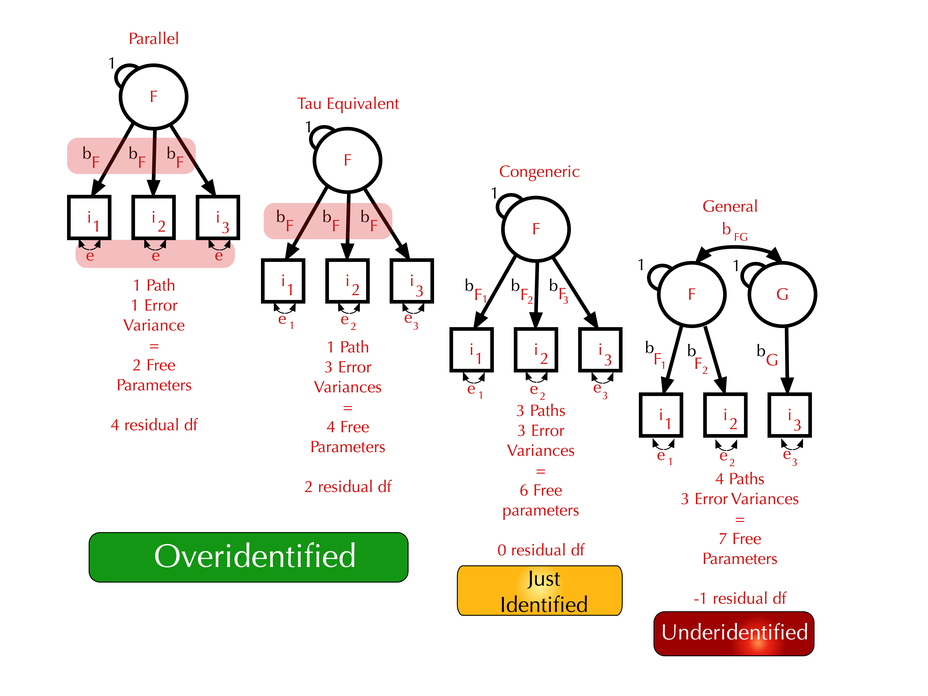
More on Identification

Slide 19
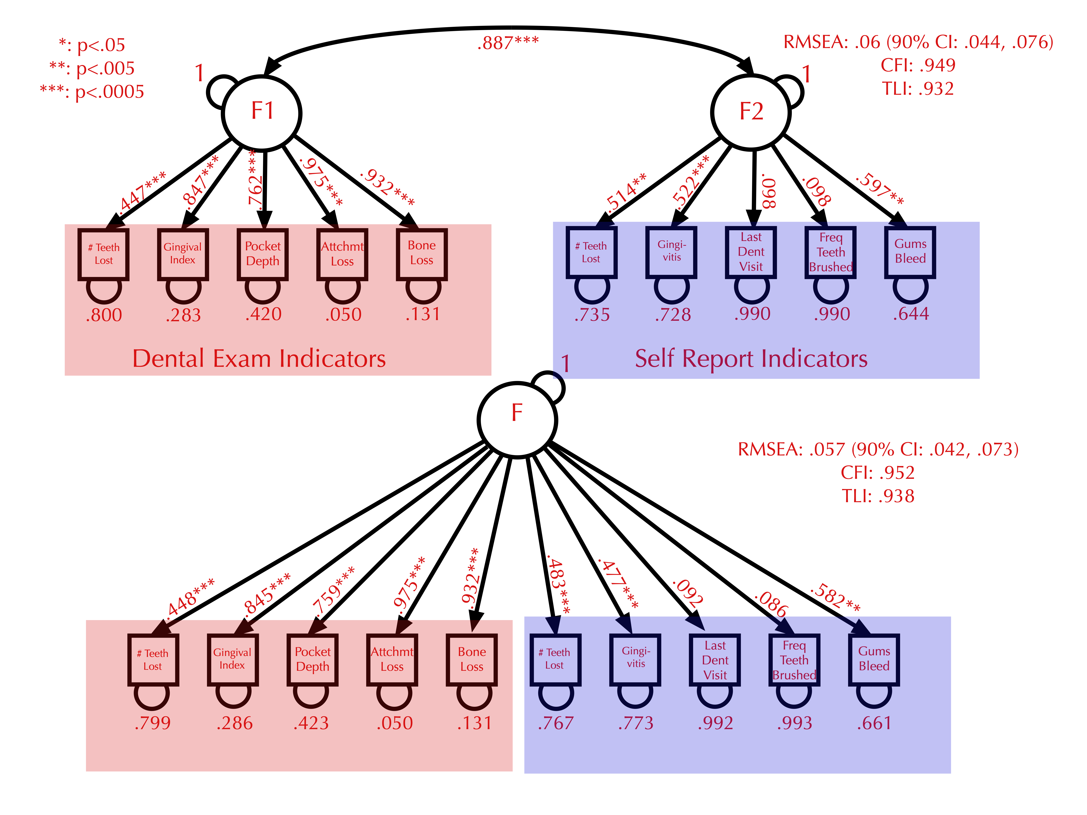
Measures of SEM Fit
RMSEA: Prefer low (<.05)
CFI: Prefer high (>.95)
TLI: Prefer high (>.95)
These were fit using mplus, FIML
No AIC/BIC because indicators are dichotomies
Is it better to delete non-significant paths?
Low Error
High Error

Slide 20
Heywood Cases
Impossible parameter estimates
Negative variances
Standardized path coefficients greater than 1 or less than -1
Causes
Model mis-specification
Lack of model identification
Outliers
Small sample sizes with only 2 indicators per factor
Poor starting values for estimation
Population correlations near -1.0 or 1.0 yielding empirical under-identification

Slide 21
Item Response Theory (IRT)
Explains a person’s test responses in terms of
The latent trait (or ability) of the person tested
The difficulty of the item
Optionally: the ability of the item to make crisp discriminations
Optionally: the ability of the person to get the item right by guessing
Commonly used in development of cognitive and knowledge tests (e.g., SAT, GRE)
Designed to allow subsets of items to be administered rather than full test (e.g., Computer Adapted Testing)

Slide 22
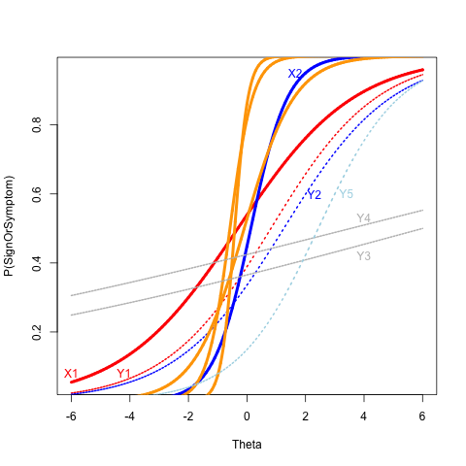
2-PL for Dental Data
X1 (high tooth loss by dental exam) and Y1 (tooth loss by self report) similar difficulty and discrimination
X2 (gingivitis by exam) much high discrimination than Y2 (gingivitis by self-report)
Y3, Y4 (low frequency of brushing and dental exams) very los discrimination
Y5 (gums bleed when brushed) still highest difficulty level

