Slide 1
conda on the cluster
Bio-Data Club/MCC Cluster Users special joint session
2020-03-25
Phillip Szepietowski, PhD
Guillermo Gonzalez, MSc, PhD

Slide 2
Outline
Conda intro (Phil)
Conda on the Cluster (Guillermo)

Slide 3
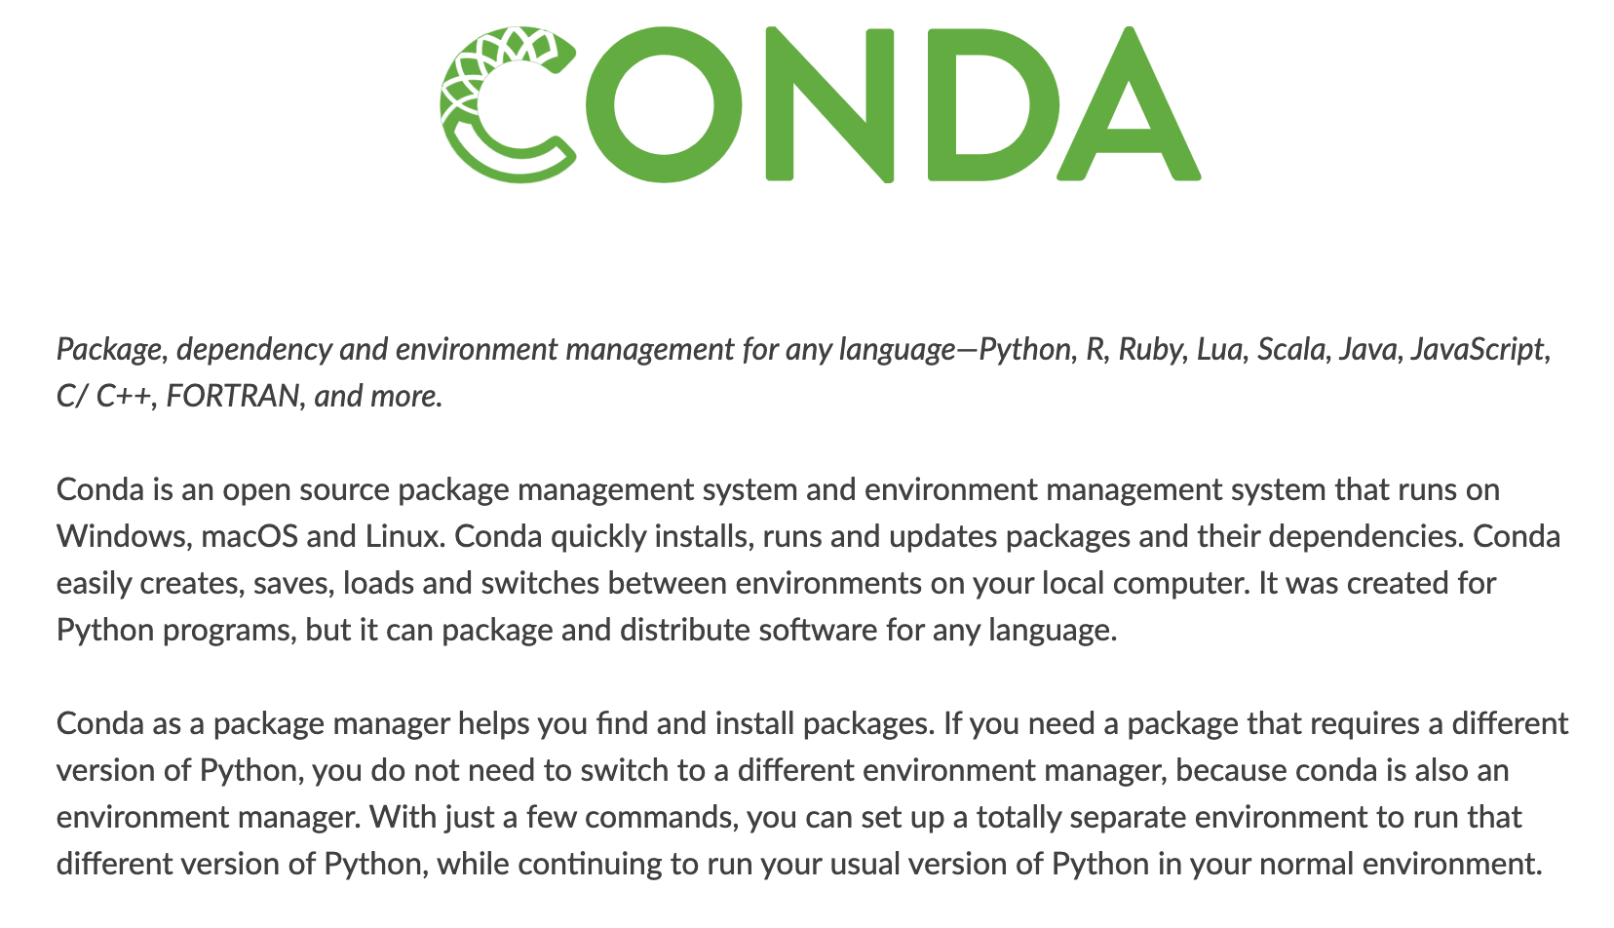
What is conda?
From: https://docs.conda.io/

Slide 4
Documentation
Conda Documentation: installation info and core documentation
https://docs.conda.io/
Anaconda Cloud: searchable package repositories/channels
https://www.anaconda.org/
Conda cheatsheet: one-stop-shop for common usage and syntax
https://docs.conda.io/projects/conda/en/latest/user-guide/cheatsheet.html
For R users:
https://docs.anaconda.com/anaconda/user-guide/tasks/using-r-language/

Slide 5
Anaconda and Miniconda
Two installation options (if installing locally)
Anaconda:
1. heavy-weight distribution (3 GB!)
2. installs conda along with ~7000 packages relevant for data analysis
Miniconda:
1. light-weight distribution (400 MB)
2. Only installs conda and its dependencies
Installing one of these will both install conda and initialize some local directories: typically ~/anaconda3 or ~/miniconda
These are where conda will store python/R as well as any installed packages and virtual environments

Slide 6

Conda uses
Package Manager:*
Install and upgrade packages
Checks for and tracks all dependencies
Can manage Python, R, C/C++
Drawback: not every package on PyPI supported (still need pip)
* What about pip!?
Stack Overflow: What is the difference between pip and conda?

Slide 7
Conda uses
Virtual Environment Manager:*
Can create isolated environments with:
Different collections of packages
Different versions of python or R
Each environment contains an individual installation of Python along with relevant packages
Useful when different projects require different versions of a packages or different versions of Python/R
These are stored in a directory structure set by conda
* virtualenv is another popular virtual environment tool which is specific to Python
Both have benefits and drawbacks:
conda can manage Python and R environments and track external dependencies, …
virtualenv stores environments in working directories, …

Slide 8
Using conda
To view installation info:
(base) $ conda info
To show a list of existing environments:
(base) $ conda env list
Show packages in current environment:
(base) $ conda list
Create a new environment:
(base) $ conda create --name biodataenv python=3.5 “scipy>0.14.0”

Slide 9
Using conda
Activate environment:
(base) $ conda activate biodataenv
Check if package installed:
(biodataenv) $ conda list pandas
Install new package:
(biodataenv) $ conda install pandas
Install specific version of package:
(biodataenv) $ conda install numpy==1.10.4
Check revisions and revert to old config:
(biodataenv) $ conda list --revisions
(biodataenv) $ conda install -n biodataenv --revision 1

Slide 10
Using conda
Some packages not supported by conda:
(biodataenv) $ conda install nlpaug
For these you might need to use pip or add new
channels to conda configuration – here we need pip:*
(biodataenv) $ pip install nlpaug
Pip installed packages are in environment but not tracked
(biodataenv) $ conda list
(biodataenv) $ conda list --revisions
*However, see: https://www.anaconda.com/using-pip-in-a-conda-environment/

Slide 11
Using conda
Documenting and saving environment info
Export to YAML file:
(biodataenv) $ conda env export --name biodataenv
--no-builds > ./biodataenv.yml
Create environment from YAML:
(biodataenv) $ conda env create --file biodataenv2.yml
Deactivate environment:
(biodataenv) $ conda deactivate
Activate new environment:
(base) $ conda activate biodataenv2

Slide 12
Additional topics/utilities
Channels
These are locations where packages are stored
Default channels: https://repo.anaconda.com/pkgs/
Other popular channel: conda-forge
Can search available channels/packages at: anaconda.org
conda-build
- Build your own conda packages
- Useful if package not currently in conda channel
- Preferred method (see here), as opposed to using pip
R environments
(base) $ conda create –n r-environment r-essentials r-base

Slide 13
Environments With R
To use R in an environment, all you need to do is install the r-base package:
(base) $ conda install r-base
Or you can do it when first creating an environment:
$ conda create -n r-env r-base

Slide 14
R Packages
Conda’s R packages are available from the R channel of Anaconda Cloud, which is included by default in Conda’s default_channels list.
All packages from the R channel are prefixed with “r-"
$ conda activate r-env
(r-env) $ conda install r-tidyverse
If you want, you can install the r-essentials bundle, which includes over 80 of the most popular scientific R packages, like tidyverse and shiny:
(r-env) $ conda install r-essentials

Slide 15
HPC Usage
Load the anaconda3 module in your scripts
Use the –-prefix (p) option when creating and activating environments
Add the following line to your script: /share/apps/anaconda3/etc/profile.d/conda.sh
Demo

Slide 16
HPC Resources
Check out the wiki – http://wiki.hpc.moffitt.org
Having problems?
Email clusterhelp@moffitt.org
Zoom channel: hpc
Slack: #hpc (Moffitt-BBSR-and-Friends)
Join the biodata club (https://www.biodataclub.org/) and the MCC Cluster Users for special seminars on issues for working remotely.

