Slide 1

An introduction to
Bio-Data Club
Fredrik Pettersson, PhD
Biostatistics and Bioinformatics Shared Resource

Slide 2
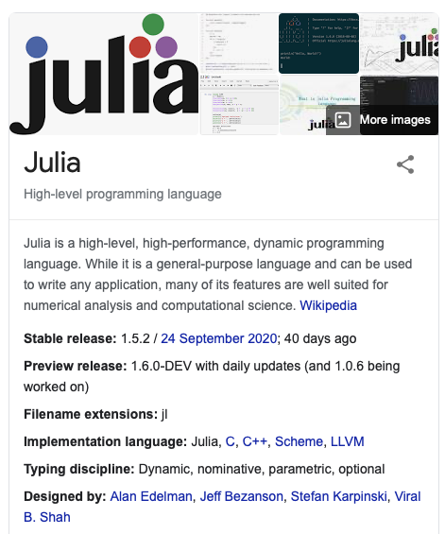
What is Julia?
Programming language
Development started 2009
First release 2012
Learnt about it at ODSC 2018

Slide 3
Why another programming language?
We already use a multitude of languages
Bioinformatics and Biostatistics: R, Python, MATLAB, SAS …
Informatics: Java, JavaScript, PHP…
My coding background
Fortran77
Perl
Java
Python
R
JavaScript
All with their advantages and domains
Could Julia work as a general-purpose programming language?

Slide 4
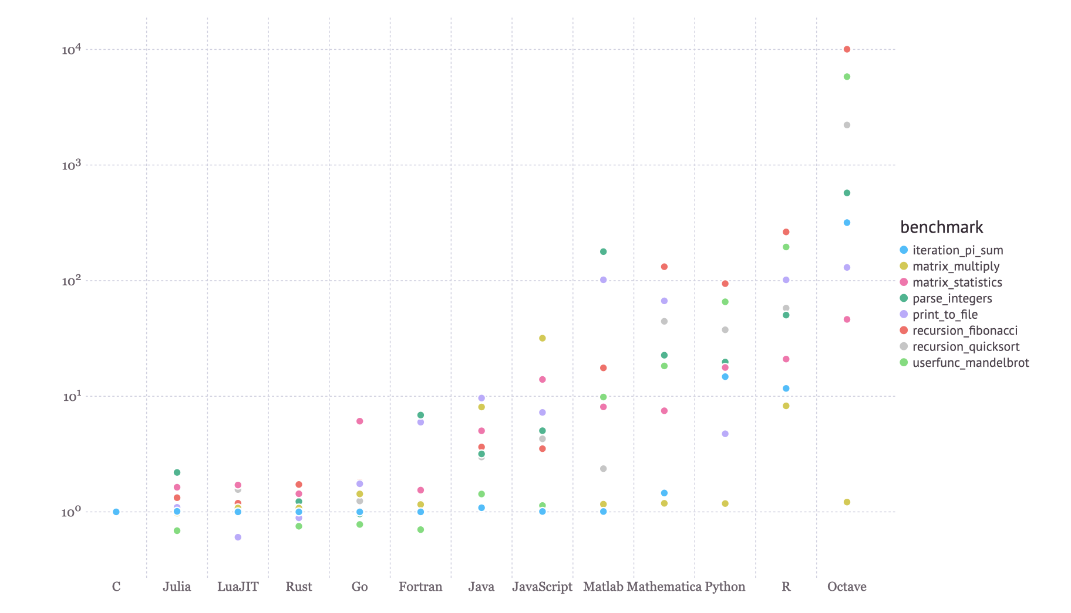
Main reasons to use Julia
You want to write code which is concise and readable
You want that same code to be fast
You prefer to write everything in one language
Calling C, Fortran, Python, R, and MATLAB libraries, likely a combination of them, is necessary for your work

Slide 5
… and reasons not to
You need low latency
Some scripting scenarios (due to pre-compilation)
Still evolving but with fewer breaking changes
Julia 1.0 is current Long-Term Support version (LTS)
Julia 1.6 will be next LTS
It is more complex than other scripting languages: there is a lot you can know
Thorough and accessible documentation

Slide 6
The Julia Community: Who is a user?
Scalable developer oriented "CS" features, all while a scripting language, has attracted a diverse audience.
ex-MATLAB users interested in using Julia for faster numerical linear algebra applications with noncommercial license?
Another significant group are the machine learning and statistics users from R/Python looking to solve the "two-language" problem.
Another group are "general-purpose" users: using Julia to develop faster web frameworks, compilers, and anything else you can think of!
Another group is from functional programming languages

Slide 7
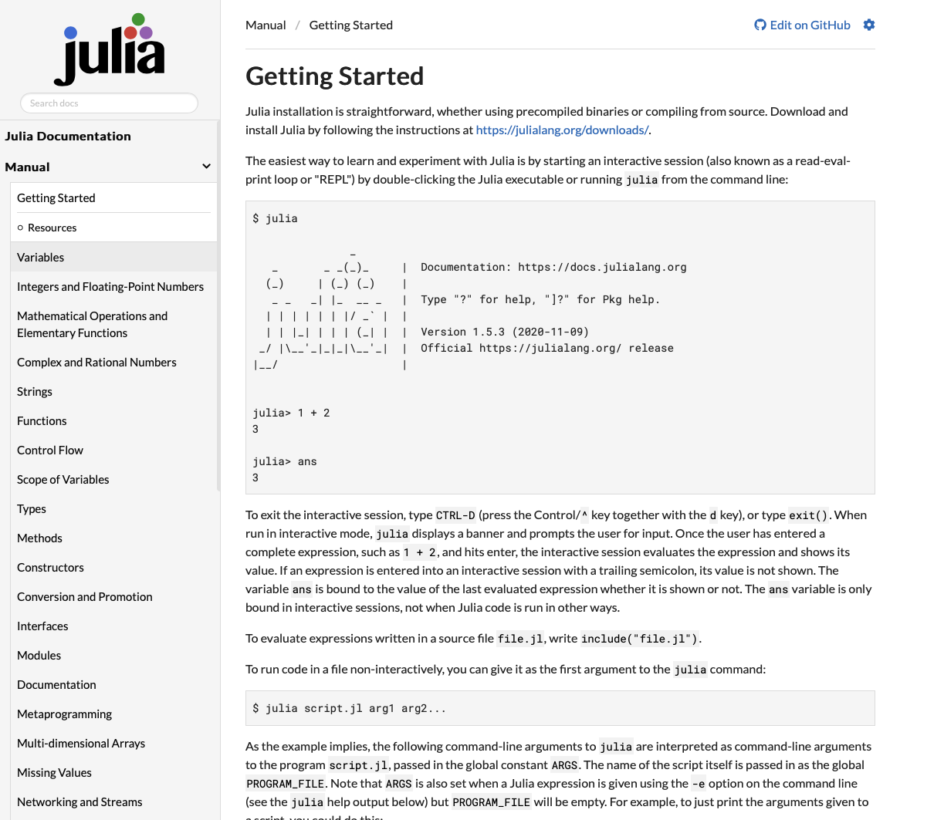
Julia has extensive and accessible documentation

Slide 8
Useful packages for data science
Similar to JavaScript, packages often have .jl in the name
Base version has limited feature set
Utility packages
CSV
Pipe (An enhancement to julia piping syntax)
DataFrames (Pandas for Julia)
DataFramesMeta (filtering and querying of DataFrames)
Statistics
Query.jl and VegaLite.jl
Mongoc (mongo client)
Diana (graphql client)
JLD2 (Julia data container)
Images.jl
OhMyREPL (formatting for REPL)
BioJulia
Comprehensive machine learning frameworks
MLJ, A Machine Learning Framework for Julia
Flux, The Julia Machine Learning Library

Slide 9
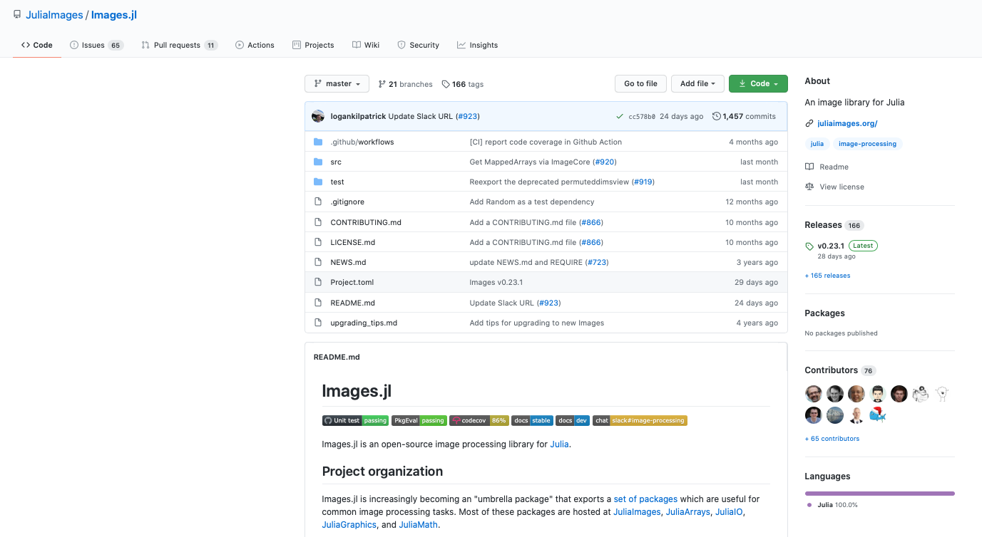
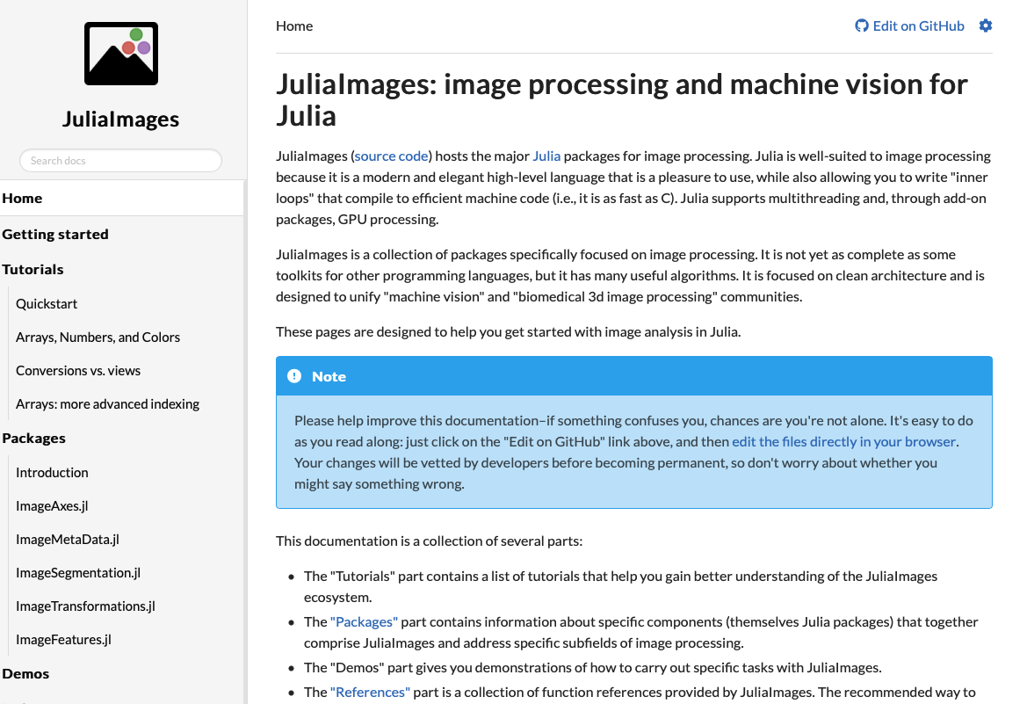
Structure of a package repo (Images.jl)
Previously tightly linked to GitHub but not so much anymore
Continuous integration/development (CI/CD)
Testing
Coverage
Documentation
Example from local GitLab
NIPALS_PCA

Slide 10
Julia's syntax is pulled from places considered "best-in-class"
The statistics looks like R.
The linear algebra looks like MATLAB.
The general-purpose parts look like Python.
The fast devectorized (for loops) code acts like C/Fortran.
Built-in support for piping and first-class functions lets some people program Julia functionally.

Slide 11
Syntax
No mandatory indentation (Python)
Unicode characters can be used for variables and functions
Indexing is 1 based
Like Matlab (can be changed, not recommended!)
Type declarations are optional but removes readability and flexibility
Datatype for missing value
Julia is very functional by design and Classes are not used as in other object-oriented languages such as C++, Java, Python and Ruby
Very nice and efficient design for piping and broadcasting
Implicit returns from functions
; to silence printout
# and #==# for commenting code
Notes:
Nordic countries example

Slide 12
The Julia REPL
Julia comes with a full-featured interactive command-line REPL (read-eval-print loop)
Four prompt modes
Julia mode
Help mode (?)
Your own functions are searchable if documented
Shell mode (;)
Can be used to run scripts, i.e. julia test.jl
Package mode (])
Managing installed packages
Managing environments (~Conda)
OhMyREPL improves the REPL
I’ve added to startup.jl
Will show IDE later

Slide 13
For developers coming from different languages
JavaScript and Python
Similarities in destructuring (compare to … and *)
Similar usage pattern for functional programming with anonymous and generic functions
Java
Although not OO, Types (structs) can be used for inheritance, generics and overloading
MATLAB
Linear algebra is equally concise

Slide 14
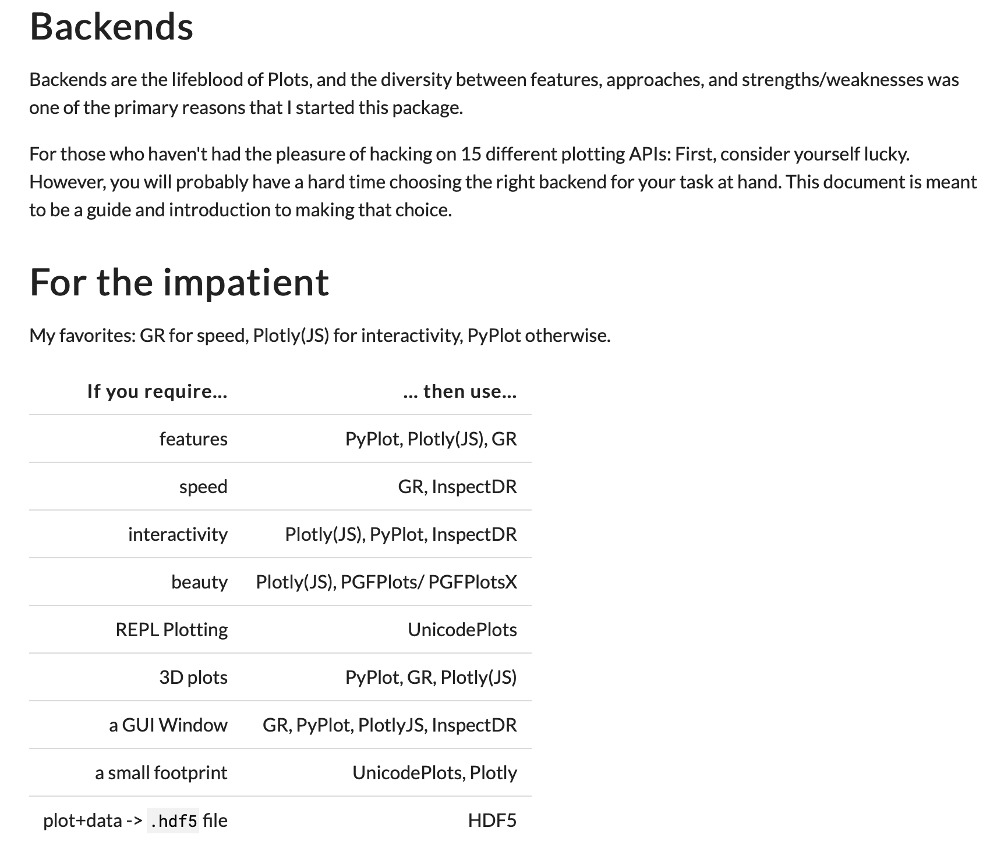
Plotting in Julia
Very powerful and flexible but somewhat complicated
Pre-compilation of Plots.jl takes time!
Vega-Lite is another popular solution that works well together with Query.jl

Slide 15
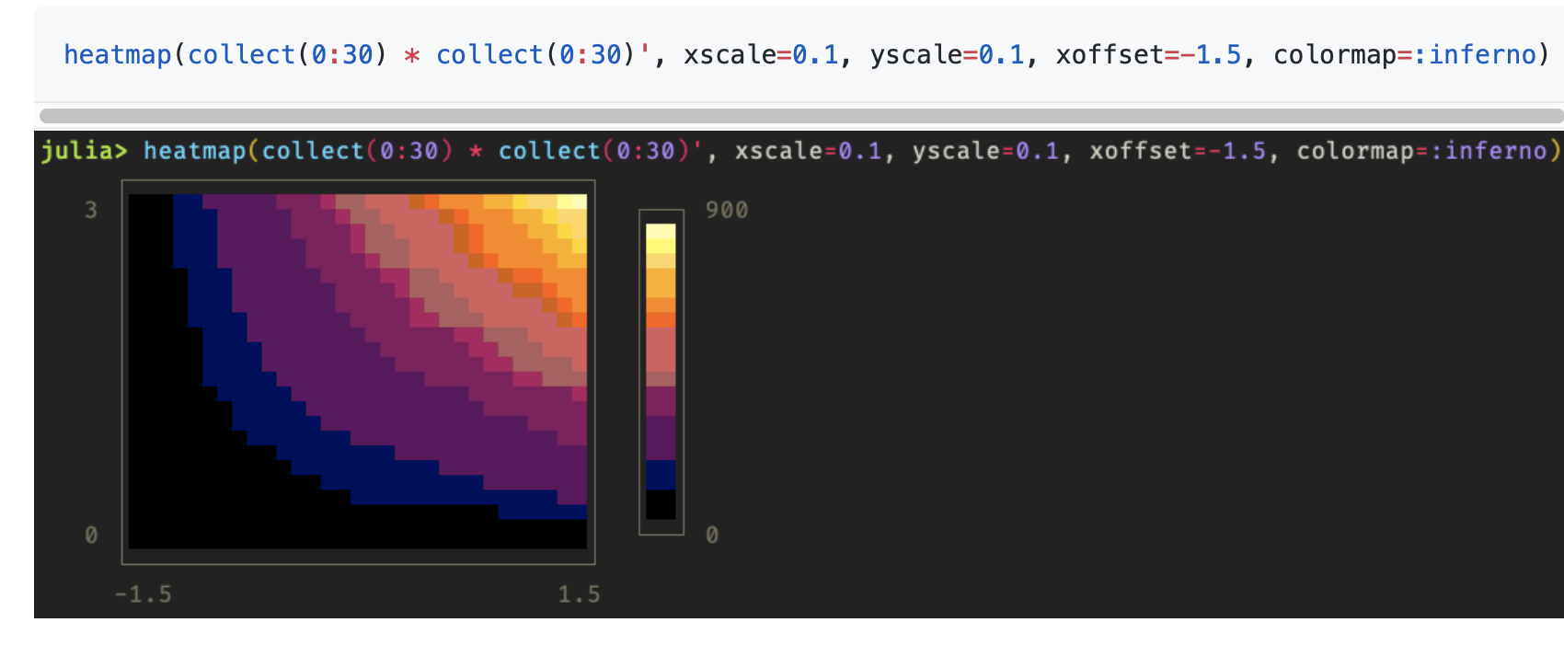
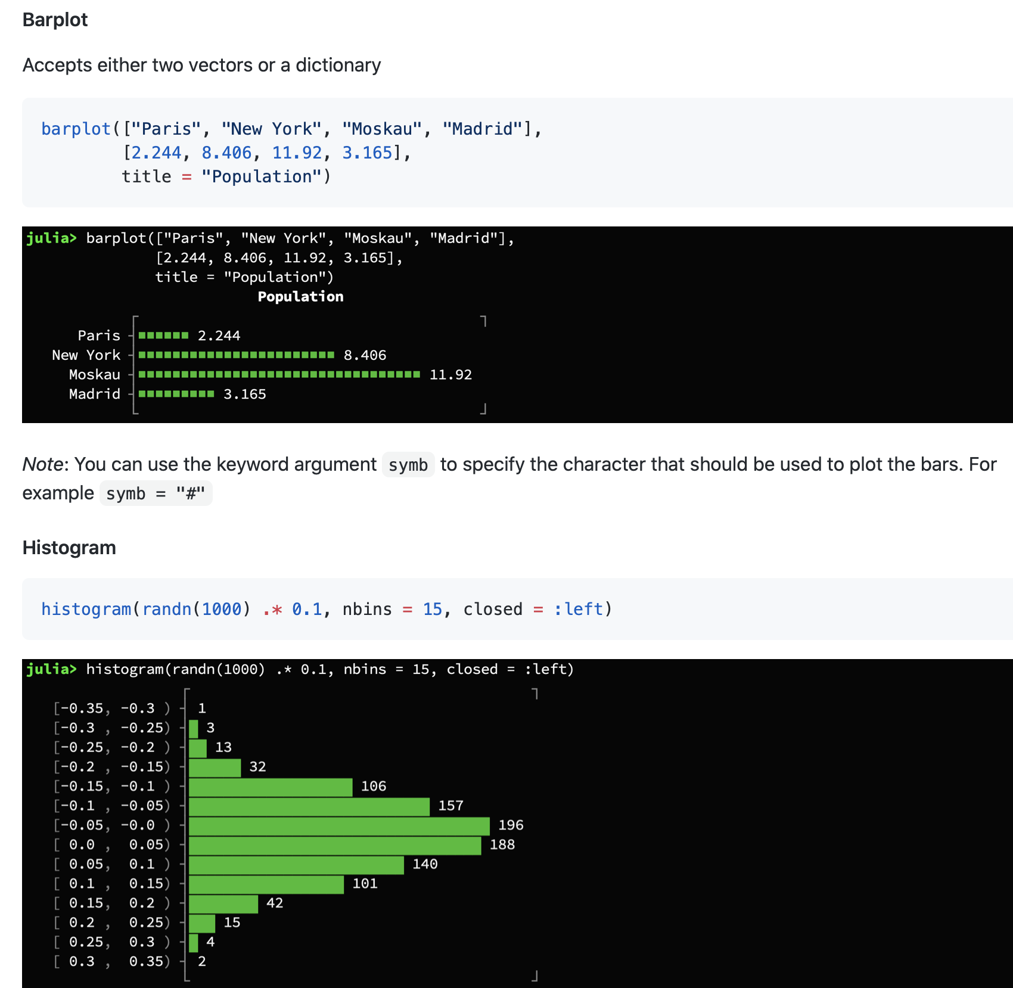
Honorable mention
UnicodePlots

Slide 16
Practical session
Emphasis on helping interested users getting started
I’m be using a Mac. Although Julia works on other platforms some necessary configurations might differ

Slide 17
Download and install Julia
https://julialang.org/downloads/
Recommended: Make symbolic link to facilitate running in terminal

Slide 18
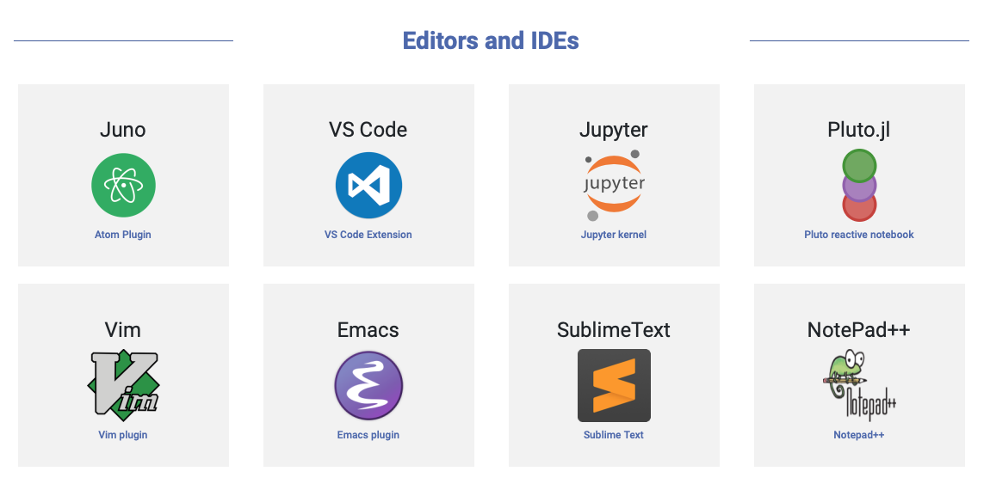

Slide 19
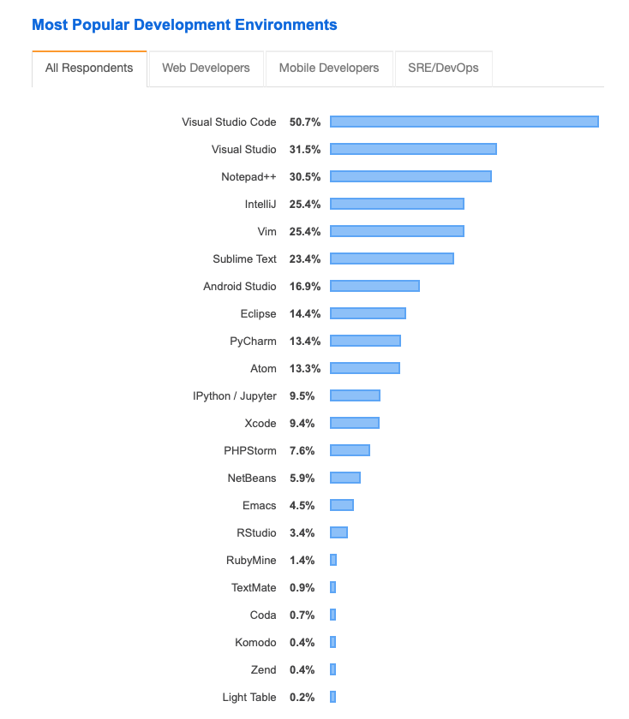
Why Visual Studio Code?
One editor for multiple languages
Simplicity
Extensions
Open-source

Slide 20
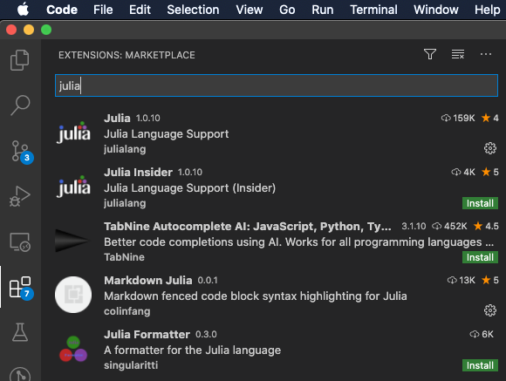
Installing Visual Studio Code
https://code.visualstudio.com/download
Install Julia extensions

Slide 21
Running Julia as a Jupyter notebook
Analysis of genotyping coverage as jupyter notebook
Jupyter extension in vscode

Slide 22
Running Julia on the cluster
An older version of Julia is installed (1.4.2 is not working)
Module load Julia 1.0.1
Steven Eschrich has kindly created singularity containers for versions 1.4.2 and 1.5.2
#!/bin/bash
SINGULARITY_IMAGE=/share/data2/applications/singularity_images/julia-v1.5.2.sif
SINGULARITY_BINDS=
if [ -f ~/.singularity_mounts ]; then
SINGULARITY_BINDS=`cat ~/.singularity_mounts | sed ':a;/$/{N;s/\n/,/g;ba}'`
fi
module load singularity/3.10
echo "Using singularity v3.1.0"
singularity run \
--bind ${SINGULARITY_BINDS} \
--home ${HOME} \
${SINGULARITY_IMAGE} $*
julia(){
~/bin/run_julia.sh $*
}

Slide 23
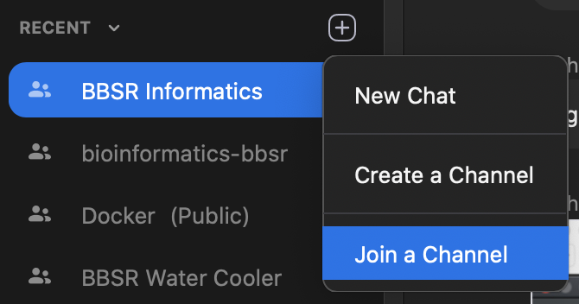

Thanks for listening!
For those interested, feel free to join the julialang Zoom channel

Slide 24
Interesting talks from JuliaCon20
Recommended sessions
Workshops
Building microservices and applications in Julia, https://live.juliacon.org/talk/Y3H7FG
MLJ: a machine learning toolbox for Julia, https://live.juliacon.org/talk/DMHZCC
Doing Scientific Machine Learning (SciML) With Julia, https://live.juliacon.org/talk/C9FGPP
Conference
Using VS Code for Julia development, https://live.juliacon.org/talk/HBTFT7
The State of Julia, https://live.juliacon.org/talk/MASLPF
Integrate Julia and Javascript using Node.js extensions, https://live.juliacon.org/talk/Q88P8U
JuliaMusic: doing cool science and becoming a better drummer, https://live.juliacon.org/talk/8RM33X
On the State of Flux, https://live.juliacon.org/talk/RRNYRW
The Julia Vega and Vega-Lite ecosystem, https://live.juliacon.org/talk/XBLMPG

