Slide 1
Normalizing omics data with IRON (Iterative Rank Order Normalization)
Eric A. Welsh

Slide 2
What do I mean by normalization?
Correct for intensity-dependent differences between samples
Relatively minimal adjustments that have a low risk of over-correction (avoid doing more harm than good)
This does *NOT* include correcting for batch effect, RNA quality, or any other source of technical artifacts
those are all true differences in the relative amounts of biomolecues within the aliquot that was assayed
I also do not mean transforming the data by mean-centering, unit variance, Z-scores, morphing the histogram distributions, etc.
Intensity-dependent differences must be corrected before other more specialized methods can correct for other sources of technical artifacts

Slide 3
How can you tell if your data needs to be normalized
Sample vs. sample log/log scatter density plots are the best and most useful way to visually identify normalization issues
Histograms and box-whisker plots are not sufficient, as they summarize the data too much
Assume that, in any given experiment, a good amount of biology is unchanged between samples
Ideal normalized data behavior:
plot should be roughly cigar-shaped
highest density and bulge either at low end or middle of the cigar
higher density ridges should lie on the sample vs. sample diagonal

Slide 4
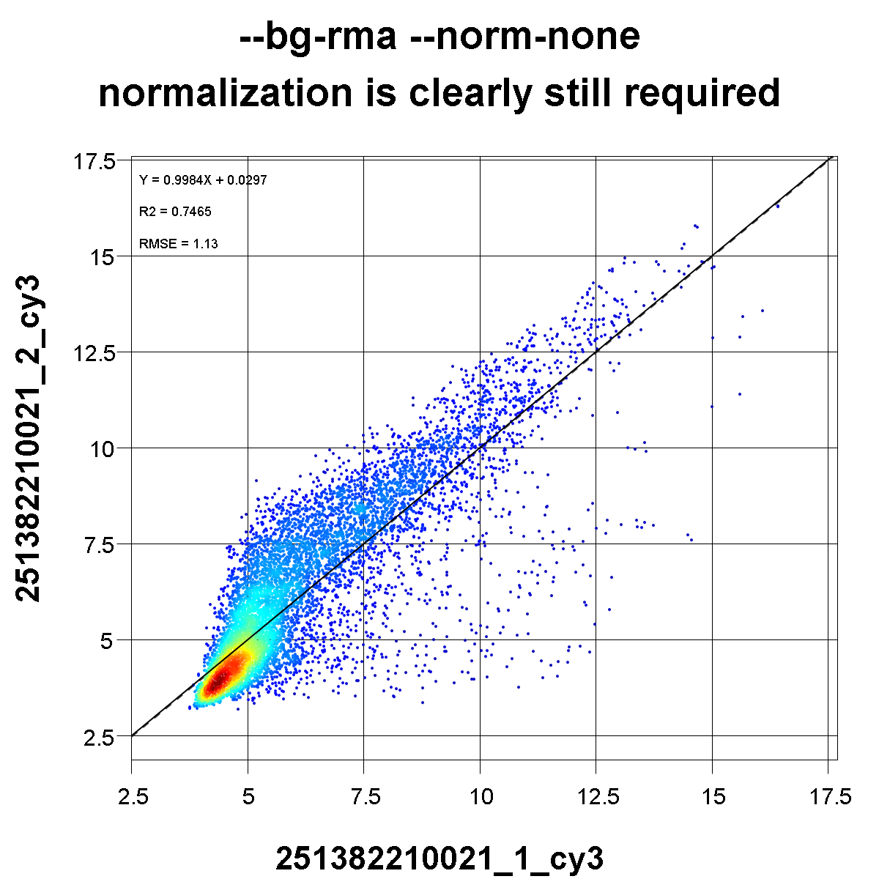
This sample needs normalization

Slide 5
Global brightness differences
Generally, only mass spectrometry omics data (proteomics, metabolomics) is this well behaved
Simplest, cleanest, and easiest normalization issue to correct
Some samples are globally brighter or darker than others
amount or quality of starting material
processing or aliquot loading variation
minor instrument variation, such as acquisition time
Scatterplot exhibits global vertical shifts
although the example on the next slide is a relatively small shift (chosen to demonstrate a slightly different issue) I often see 1.5 to 2-fold differences over an entire dataset
Correct using a global scaling factor, averaged from non-linear curve fit corrections

Slide 6
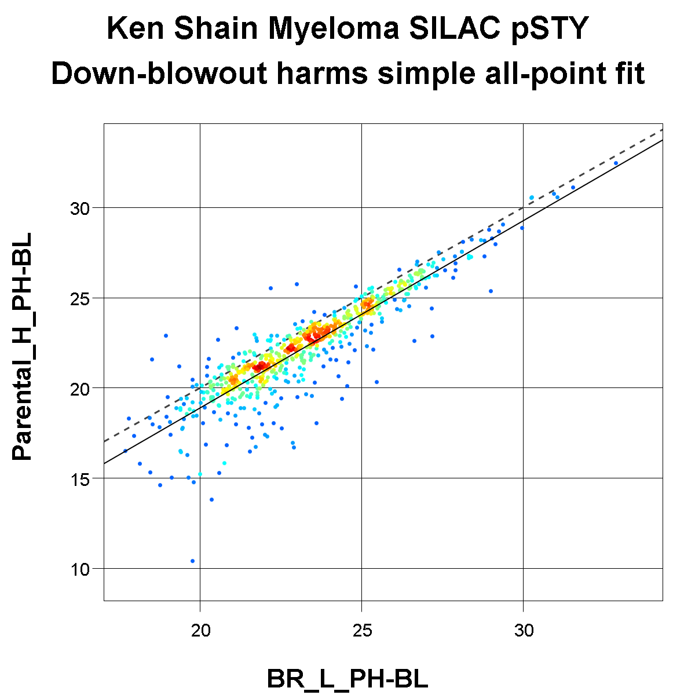

Slide 7
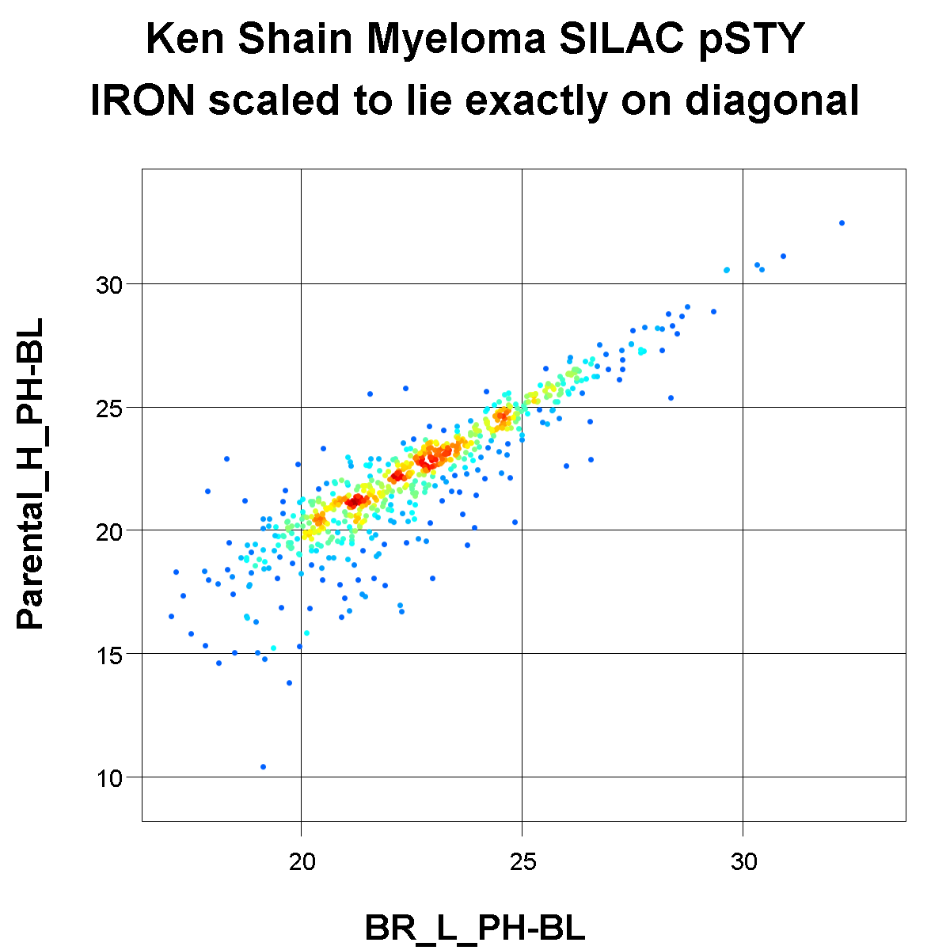

Slide 8
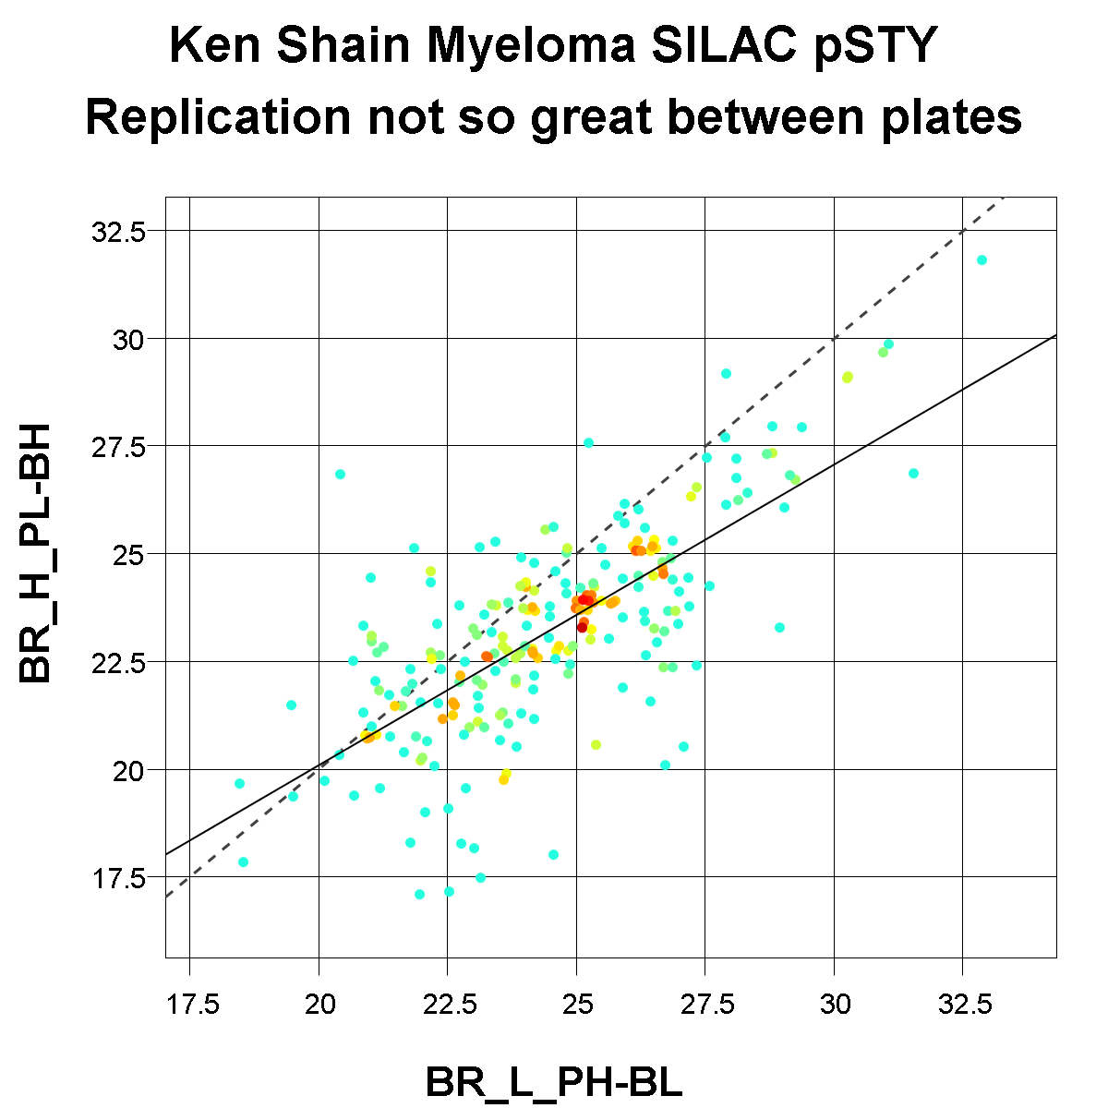
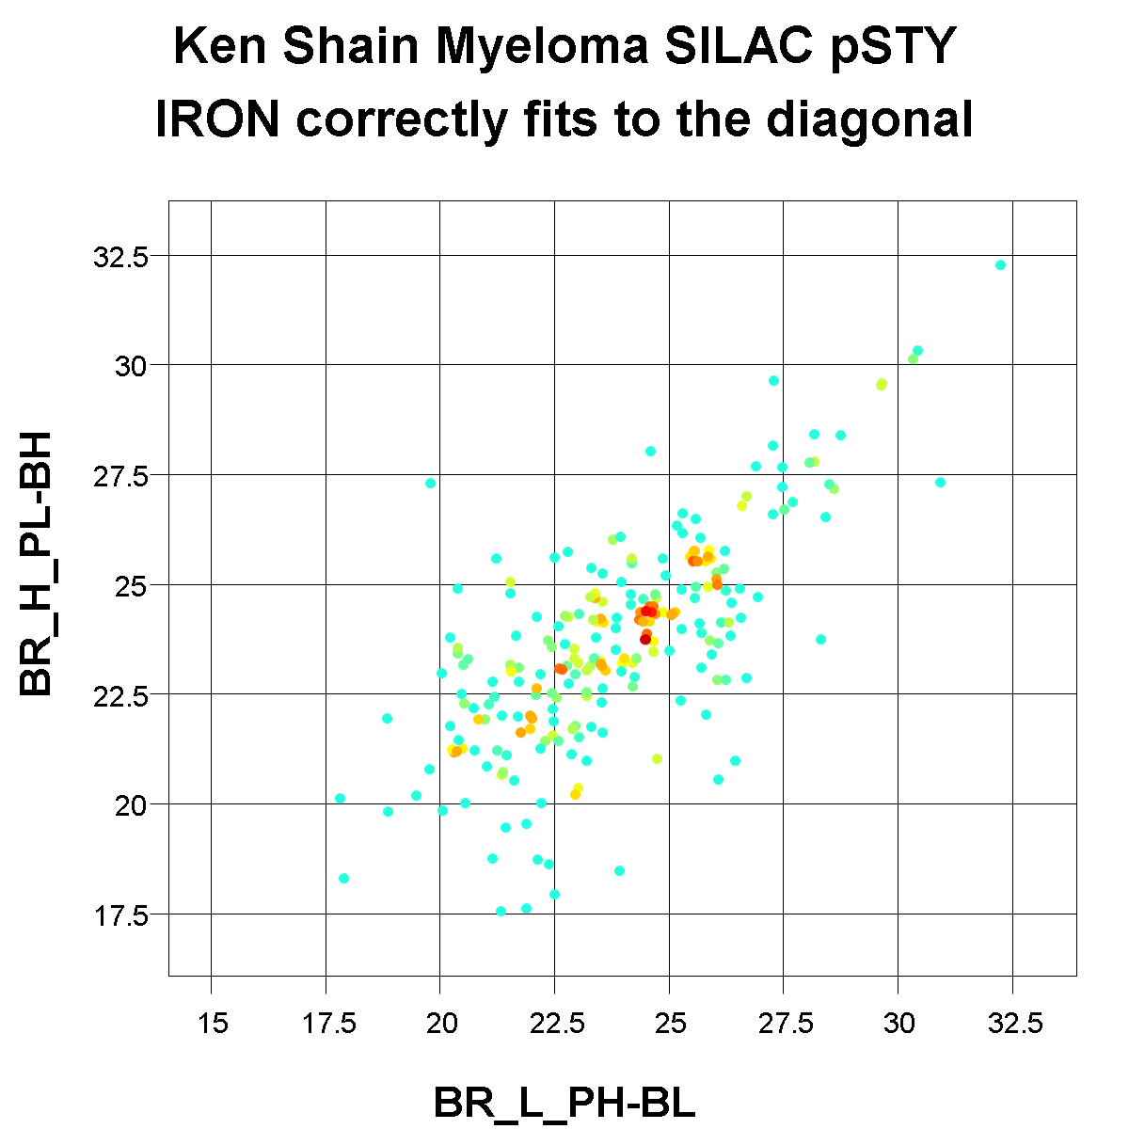

Slide 9
Linear intensity dependence
Generally only seen in some, but not all, RNA-seq data
In addition to global brightness differences, we observe a "tilt" in the scatterplot
Others have described this issue as dynamic range compression
Tilt is usually relatively minor, so be sure you've convinced yourself the data needs un-tilting before you opt to untilt rather than simply globally scaling the brightness
Correct using a linear curve fit

Slide 10
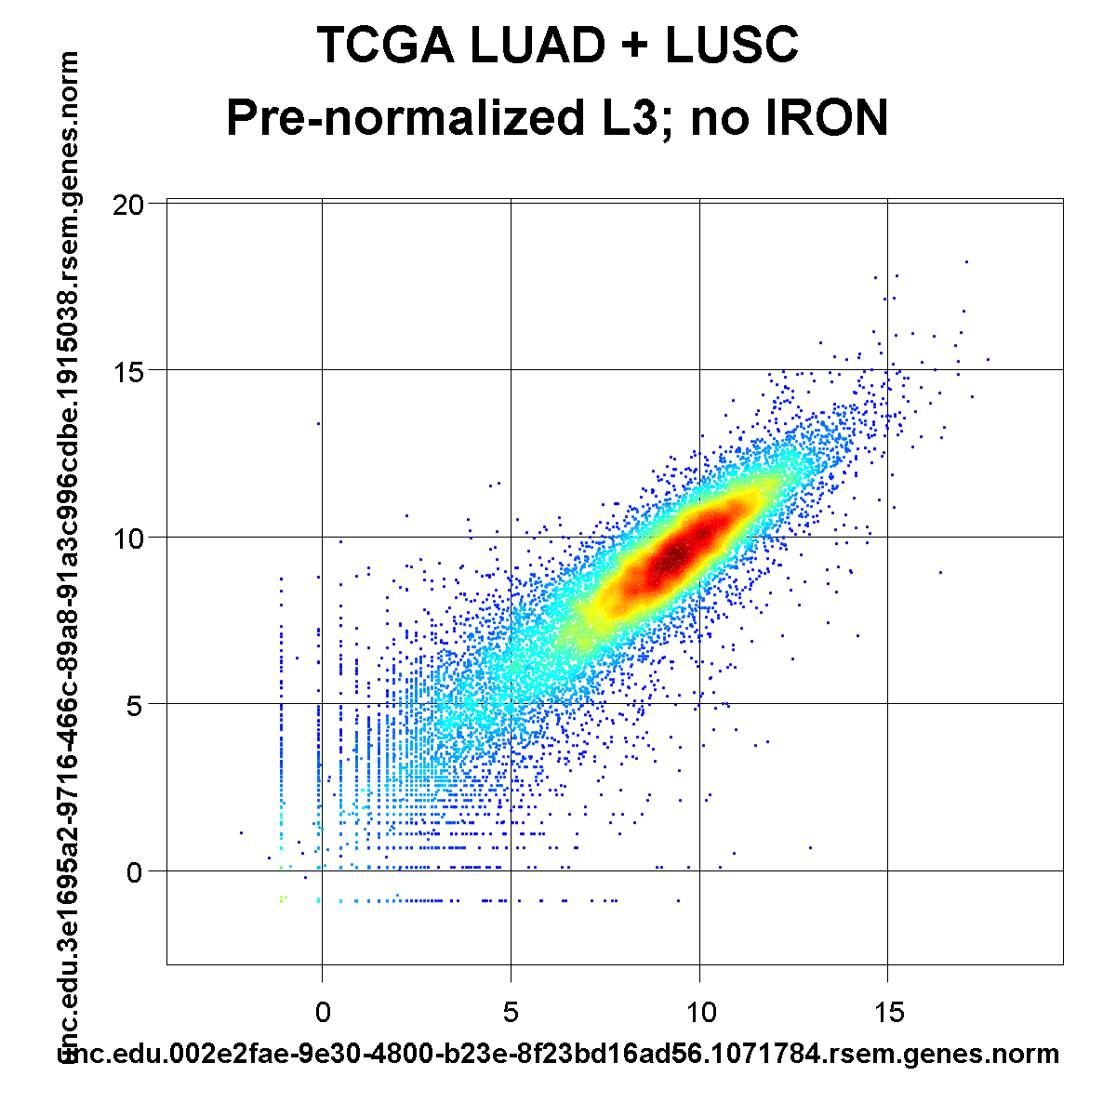

Slide 11
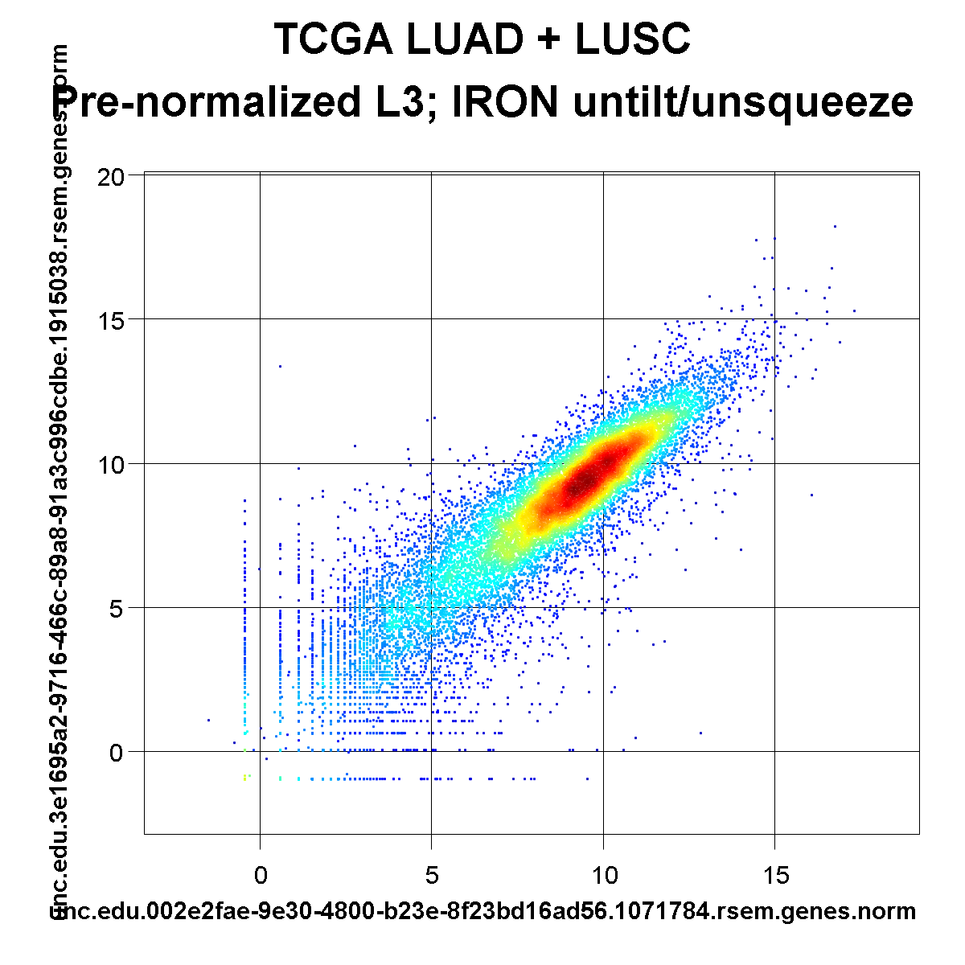
Bottom is left of center, top is right of center
Un-tilted line is better centered

Slide 12
Non-linear curvature
Banana shaped or other non-linear curvature
I can't tell you why this happens, just that it does, and it is not uncommon
Affects most microarrays
you can generally assume they will need non-linear correction
Affects some RNA-seq data sets as well
maybe it depends on the amplification or RNA isolation kit, I really don't know
Correct using a piecewise-linear curve

Slide 13
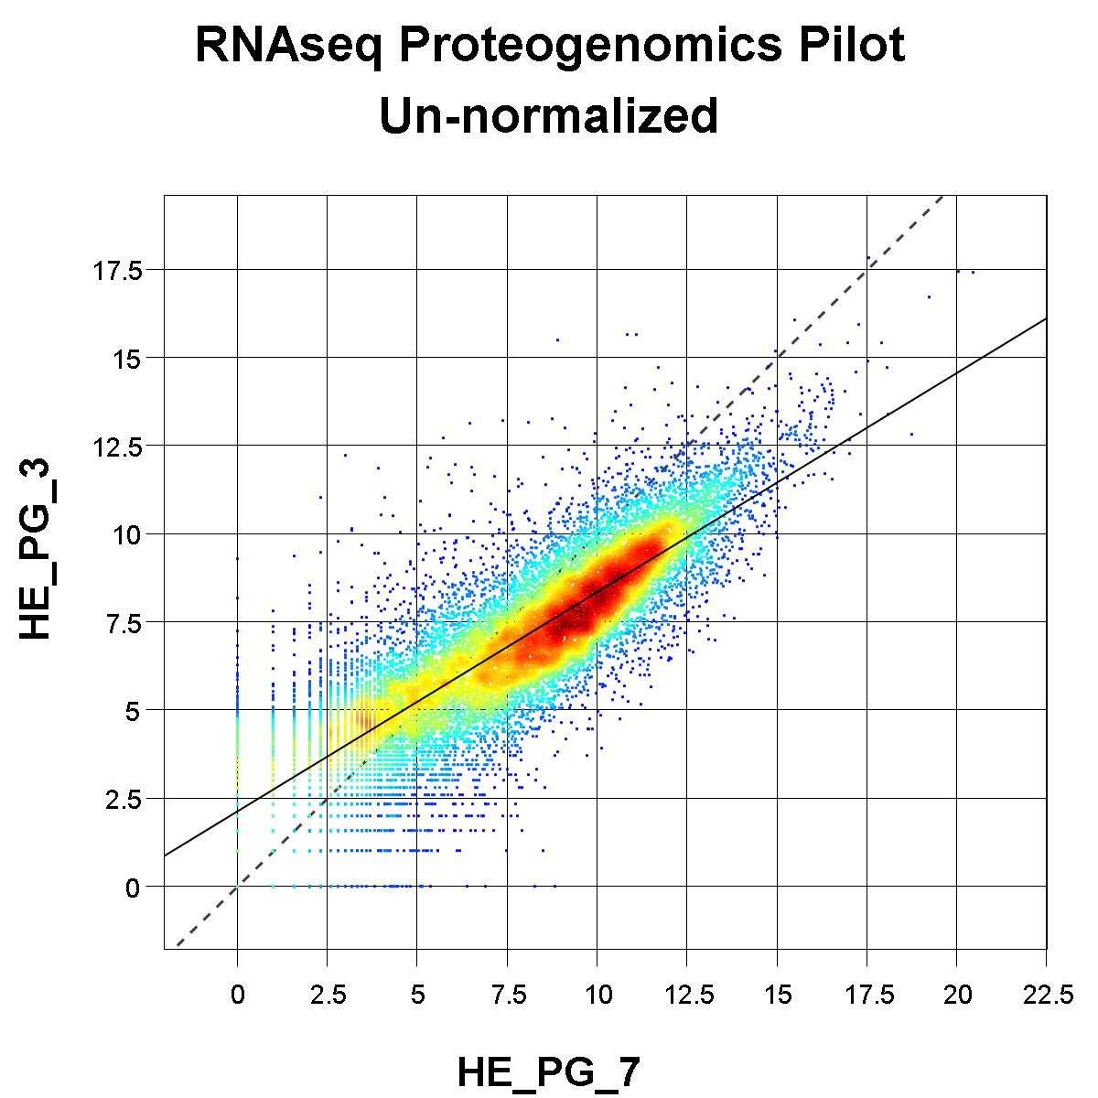

Slide 14
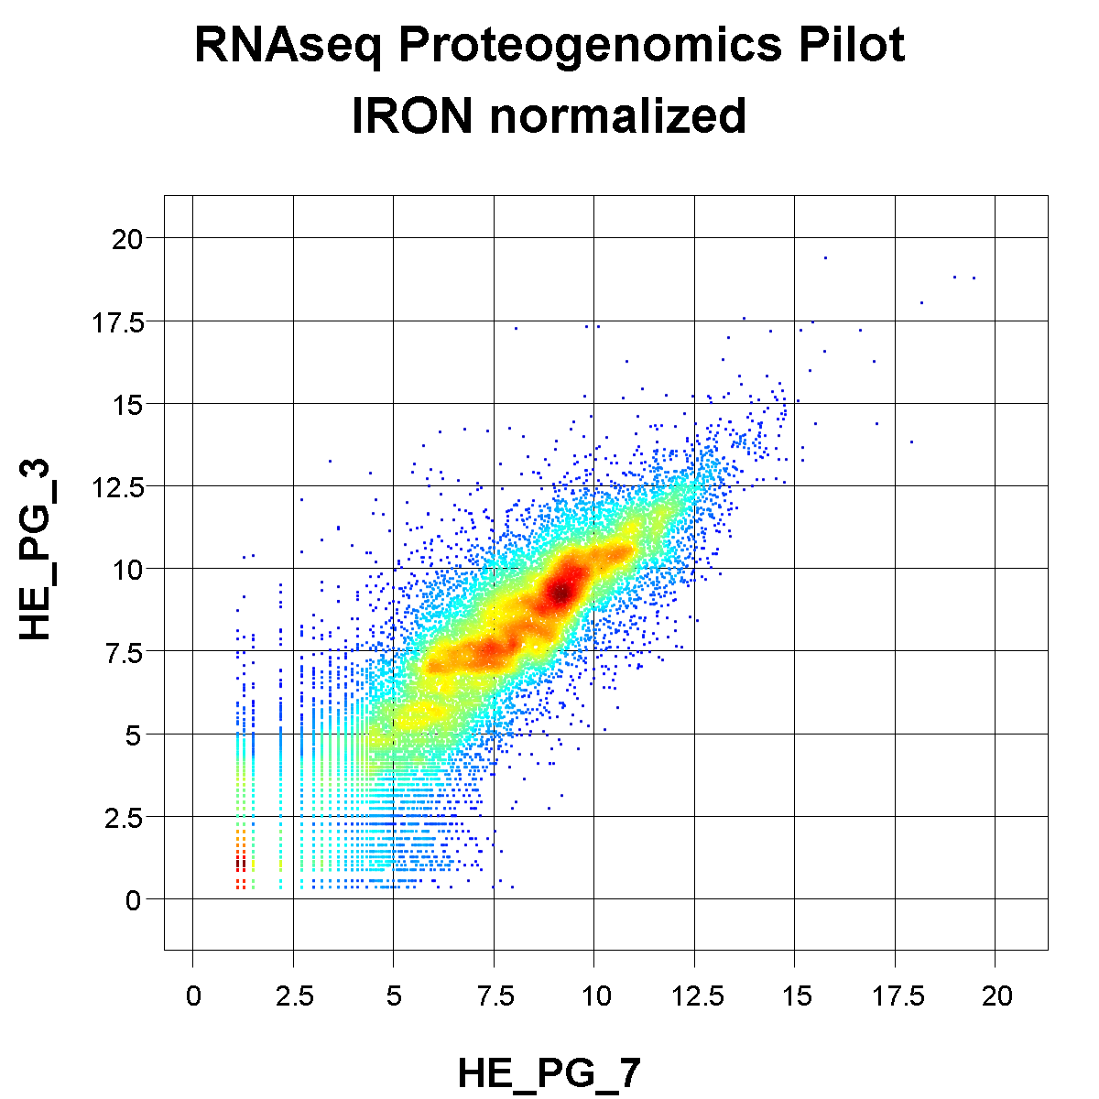

Slide 15
Agilent microarray example

Slide 16
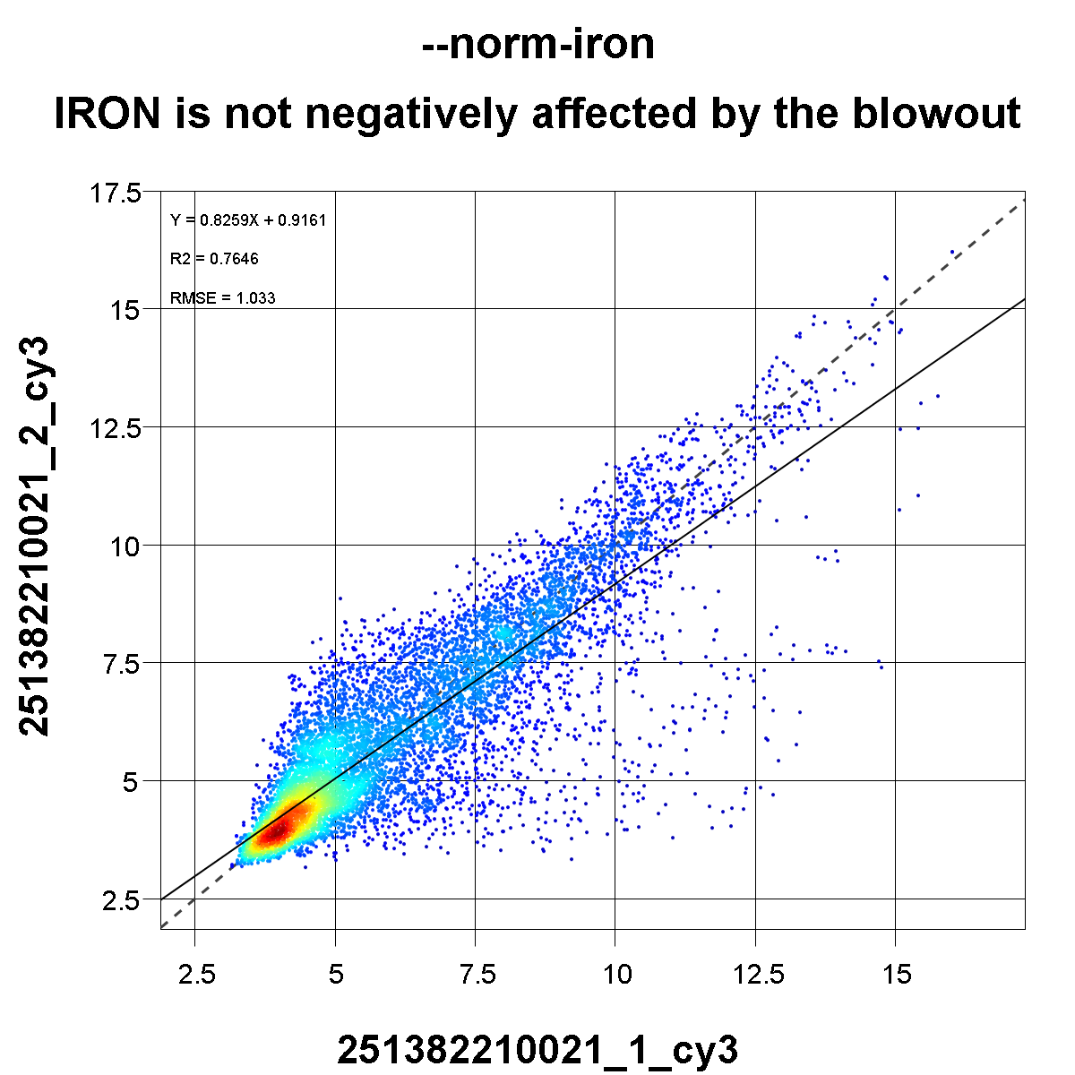

Slide 17
Summary of problematic issues
Microarray
non-linear signal curvature between samples
very little missing data
RNAseq
non-linear curvature or "tilted" range compression between samples
a good amount of low-abundance related missing data
Proteomics
global scaling differences between samples
very large amounts of missing data, cannot assume only from low abundance
Missing data may cause its own serious problems for normalization
leaving them as zeroes or imputing can lead to poor normalization
Biological experiments can exhibit "lop-sided" changes, where more genes are up-regulated than down-regulated (or vice versa)
this violates the assumption of most normalization algorithms that changes are symmetric (roughly same number and magnitude up as down)

Slide 18
How IRON works
Choose a single sample as a representative reference sample
Normalize all samples against this reference sample
ignore missing data entirely
identify a training set of relatively unchanged points
fit a linear or non-linear curve
global scaling factor, linear un-tilting, or non-linear correction
Ideally, normalizing all samples vs. the reference sample will result in all samples being normalized vs. each other
So long as you've picked a good reference sample, this assumption generally holds pretty well in practice

Slide 19
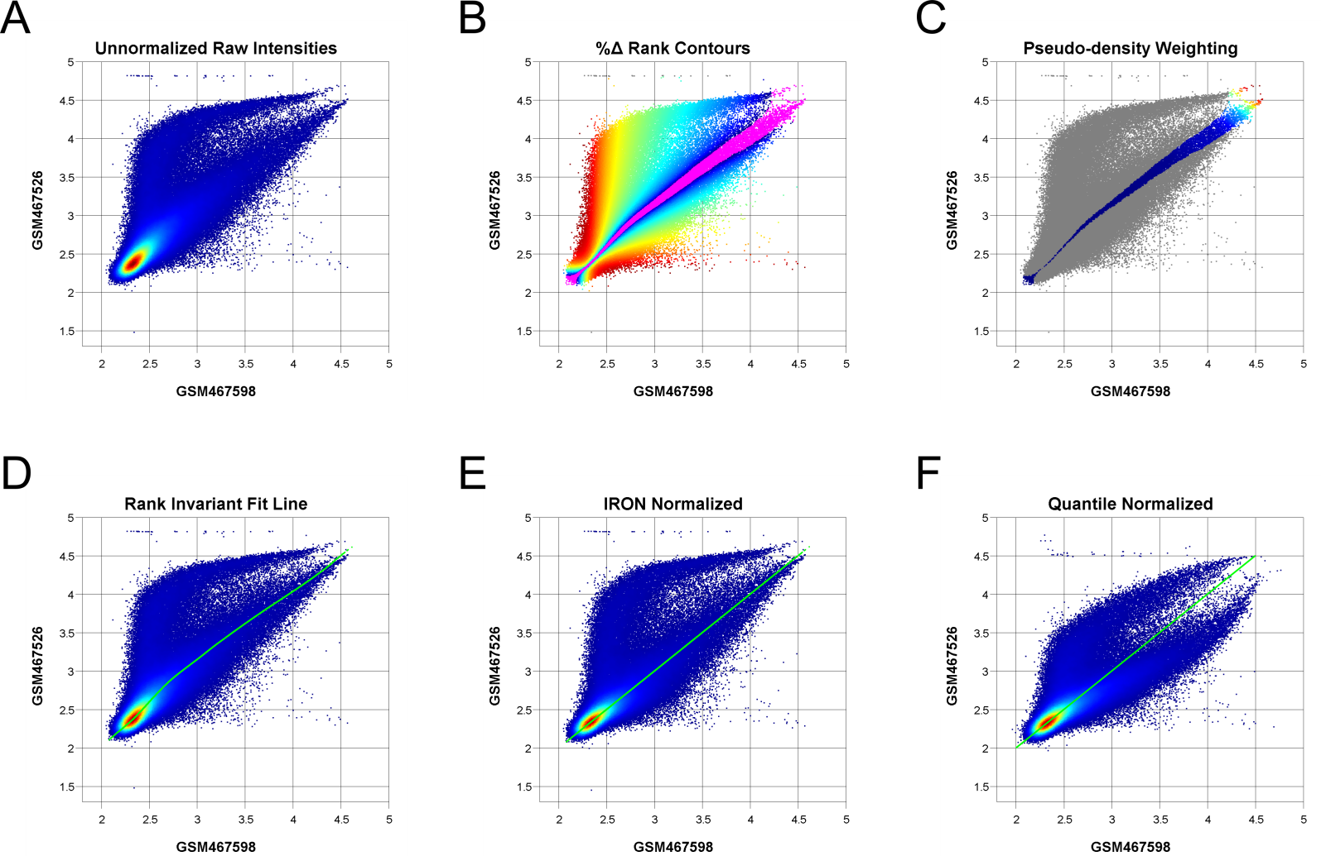
More detailed overview
Slides of each individual step to follow

Slide 20
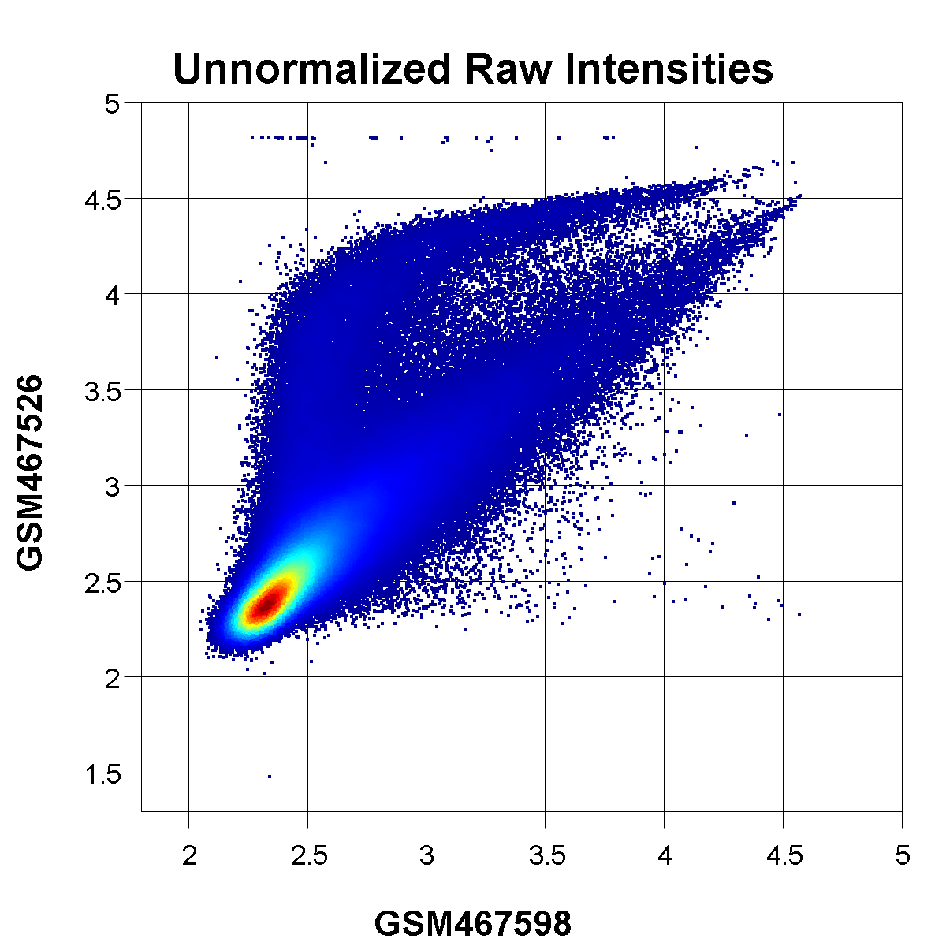
Raw, un-normalized probe intensities.
Slight upwards curvature in the main density arm
Lower density upper "problem" arm screws up most normalization methods

Slide 21
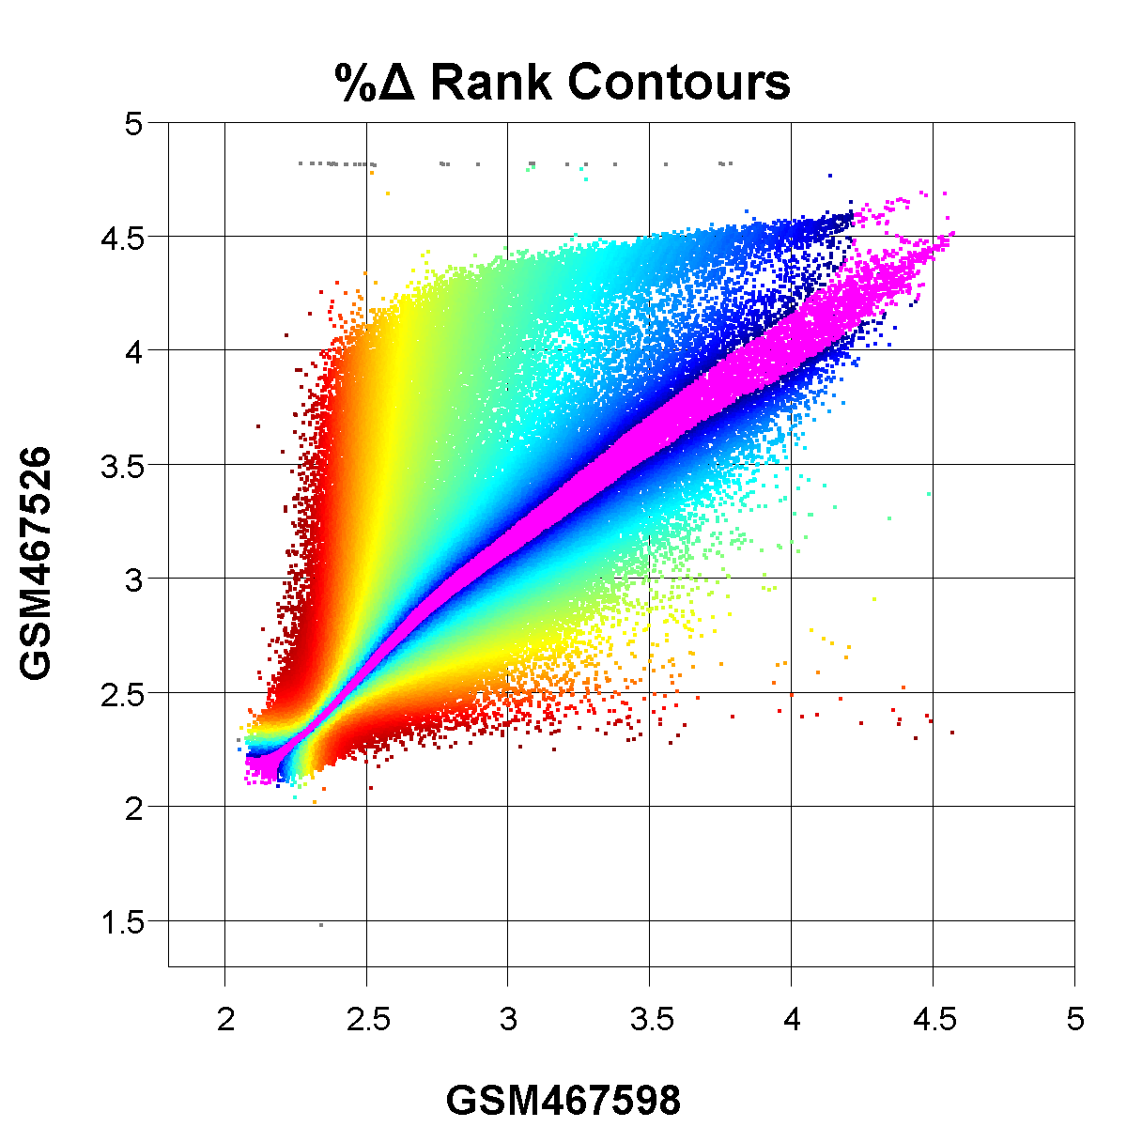
Exclude min/max probes (grey)
Colors represent outlier probes discarded at each iteration
Red = 1st iteration, Dark Blue = just prior to final iteration
The most problematic outliers are iteratively removed until the final training set roughly follows the ridge of highest density through the data

Slide 22
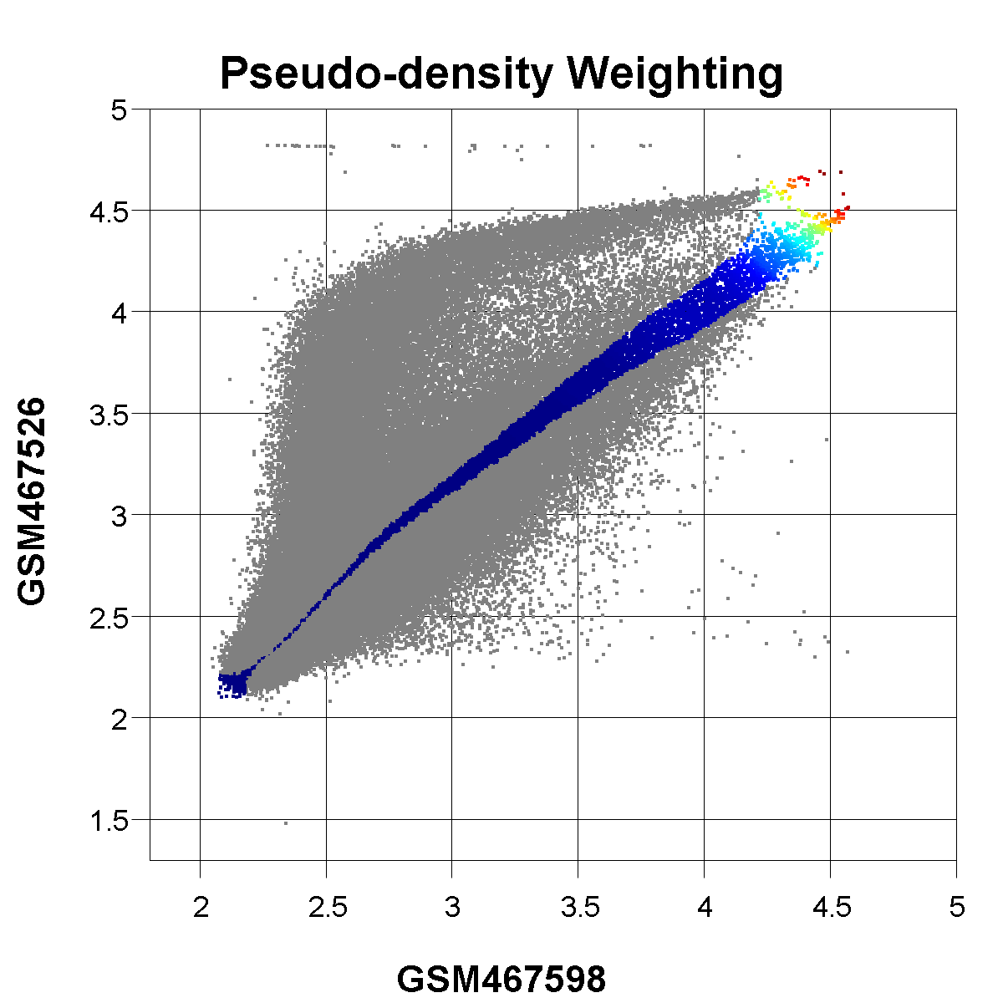
Low density regions (red) in the training set are under-sampled relative to the high density regions (blue)
Equal weights for all points would, at least for microarrays, cause the upper-right low-density tail to be poorly fit, so we must up-weight them
This is *not a problem for proteomics data*, so we use equal weights then

Slide 23
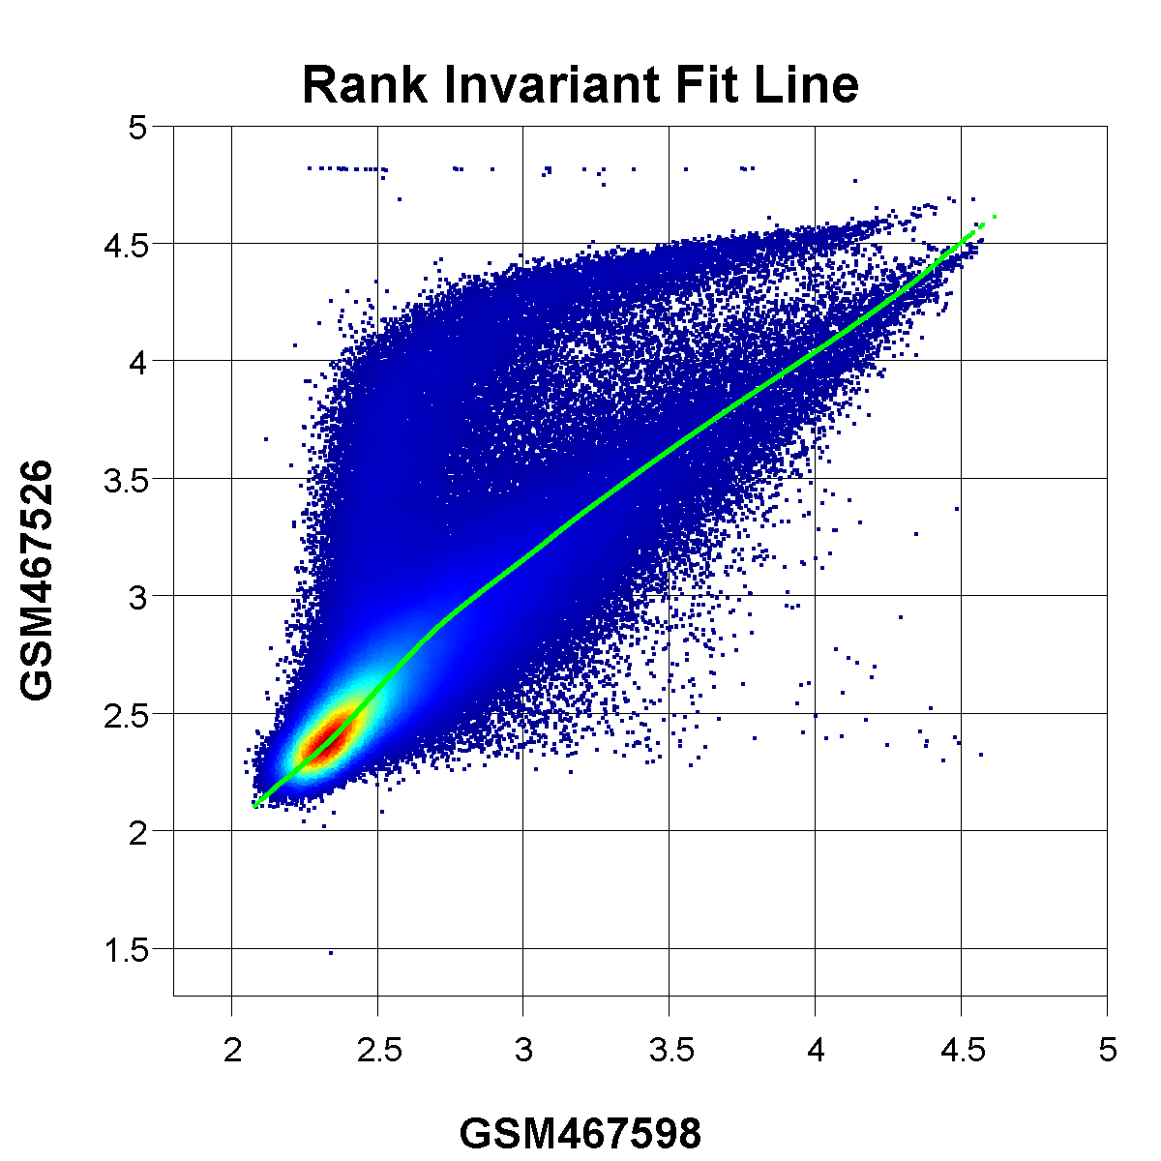
Fit a smoothed piece-wise non-linear curve through the training set, using the weights as determined in the previous step (if appropriate)
The resulting best-fit line roughly passes through the ridge of highest density from bottom-left to top-right (the ideal desired fit by eye)

Slide 24
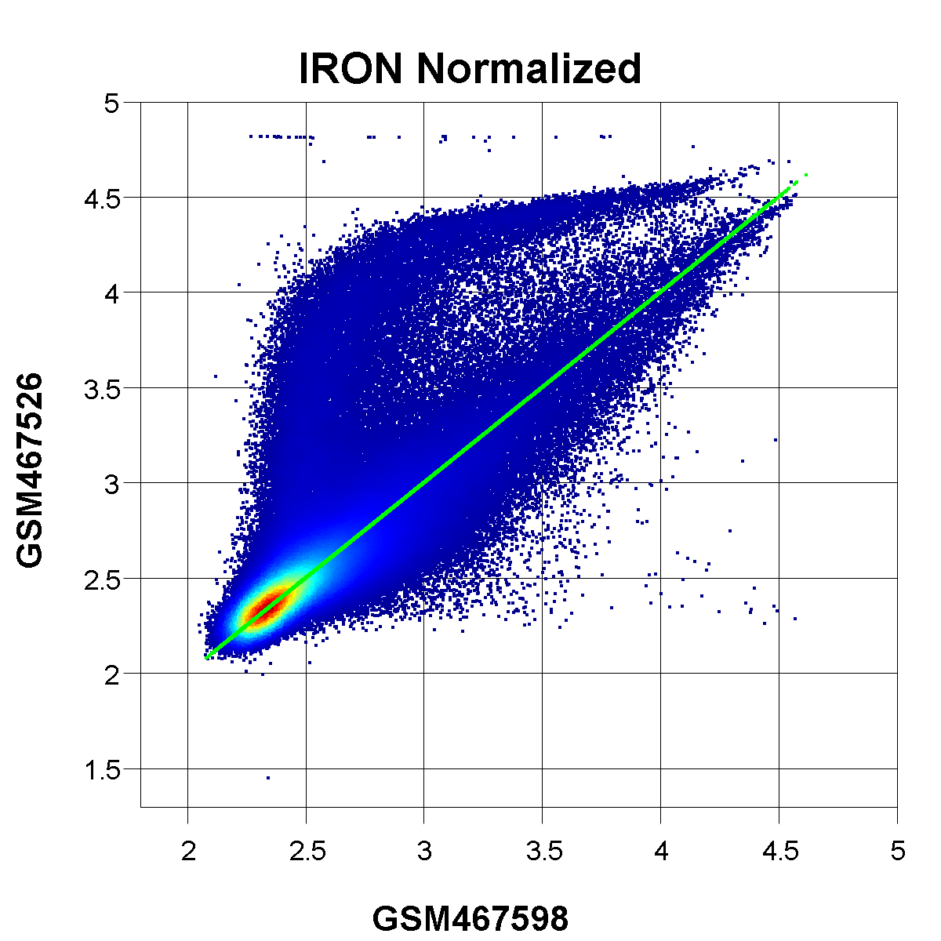
Adjust the Y (sample) values using the fit curve so that the fit curve lies on the diagonal
This normalizes the sample so that it is directly comparable to the reference sample

Slide 25
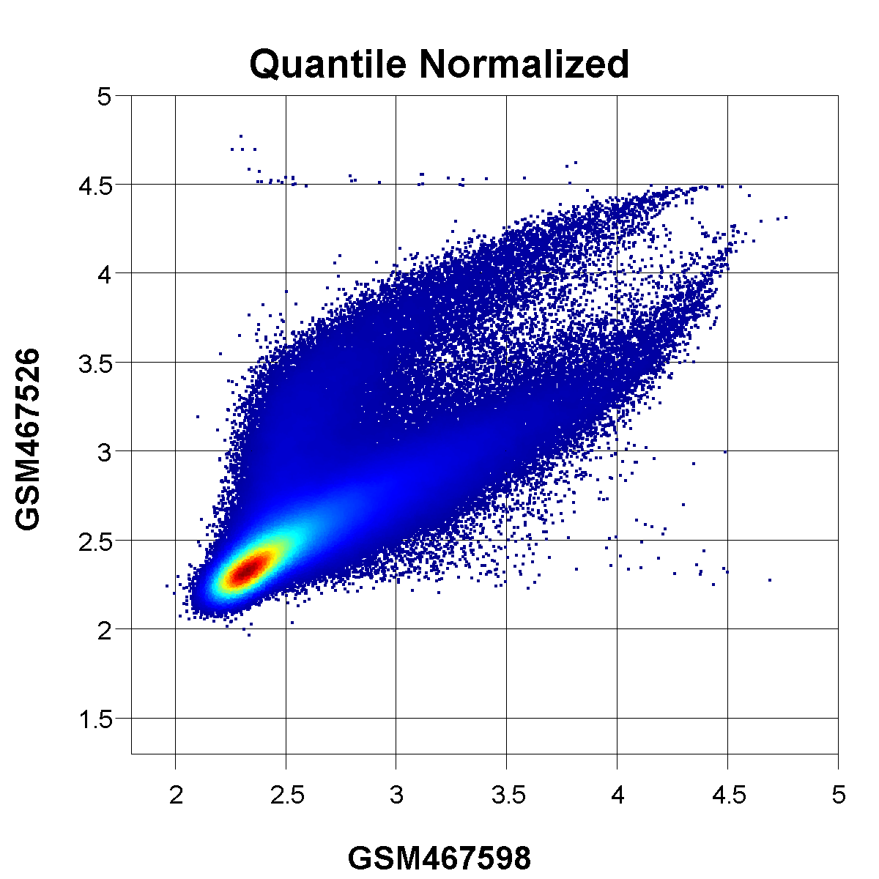
Example of the same data normalized with quantile normalization
Quantile normalization is faked out by the upper "problem" arm, effectively fitting its correction curve between the two arms
This results in a large number of probes in the main-density arm being over-corrected, appearing as down-regulated when they actually aren't

Slide 26
Advantages of IRON
The vast majority of normalization methods assume symmetric changes between samples
roughly the same number and magnitude of both up and down changes
Real biology and experiments frequently violate this assumption, often quite badly
Methods that assume symmetric changes will use the wrong set of genes to determine how to normalize the sample, resulting in incorrect normalizations
IRON, since it makes weaker assumptions than most other methods, is more robust and more able to handle the wide variety of sample behavior that we see in real data
IRON does a good job of handling missing data
so long as there is decent overlap present between samples

Slide 27
Links to IRON
Manuscript:
http://www.biomedcentral.com/1471-2105/14/153
Software:
http://gene.moffitt.org/libaffy/
Thanks to Paul Stewart, the latest release has pre-compiled OSX binaries, too!

Slide 28
Example findmedian commands used to identify the median sample
Any data in a simple spreadsheet format:
findmedian --spreadsheet rnaseq.txt > findmedian.txt
findmedian --spreadsheet --pearson proteomics.txt > findmedian.txt
Affymetrix CEL files:
findmedian -c /share/data2/mgd/CDF *.CEL > findmedian.txt
look at the 2nd to last line of findmedian.txt to identify the median sample
cat findmedian.txt | tail -2 | head -1 | cut -f 4

Slide 29
Example normalization commands
Affymetrix CEL files
iron -c /share/data2/mgd/CDF --norm-iron=abcdefg *.CEL -o iron_output.txt
Spreadsheet generated from Agilent or Illumina microarrays
iron_generic --norm-iron=abcdefg -o iron_output.txt
Proteomics
iron_generic --norm-iron=abcdefg --proteomics -o iron_output.txt
Un-tilt RNAseq
iron_generic --norm-iron=abcdefg --rnaseq –o iron_output.txt
Non-linear RNAseq
iron_generic --norm-iron=abcdefg --rnaseq --iron-non-linear --iron-weight-exponent=4 -o iron_output.txt

Slide 30
Meta-flags set most appropriate flags for different omics types
--proteomics
--bg-none --unlog --iron-global-scaling --iron-weight-exponent=0 --iron-fit-both-x-y --iron-condense-training --floor-none
--rnaseq
--bg-none --unlog --iron-untilt --iron-weight-exponent=0 --iron-fit-only-y --iron-no-condense-training --floor-none
I should probably add a --microarray flag to restore the default settings, but I haven't yet...
--bg-rma --log2 --iron-non-linear --iron-weight-exponent=4 --iron-fit-only-y --iron-no-condense-training --floor-none
If we were to log₂ (default) data containing missing data points (values of 0), we would be unable to differentiate missing from an original value of 1, since both would be zero. I should probably change its behavior to auto-convert original zeroes into blanks.

Slide 31
Tutorial example: literally my first microarray dataset
# make sure to add the libaffy binaries to your path before hand
# download the "raw" data I deposited in 2007
# they aren't actually the original Agilent files I deposited anymore...
# but the latest version of my script detects and handles that
wget https://www.ebi.ac.uk/arrayexpress/files/E-TABM-337/E-TABM-337.raw.1.zip
wget https://www.ebi.ac.uk/arrayexpress/files/E-TABM-337/E-TABM-337.raw.2.zip
# decompress the "raw" data from the zip archives
mkdir raw_arrayexpress
cd raw_arrayexpress
unzip ../E-TABM-337.raw.1.zip
unzip ../E-TABM-337.raw.2.zip
cd ..

Slide 32
Extract the sample data
# extract local background subtracted signal intensities
agilent_to_spreadsheet.pl raw_arrayexpress/US*.txt > agilent_abundances.txt
# strip out the long bits of the file names that I know to be unchanging
sed -i 's/US22502547_//g' agilent_abundances.txt
sed -i 's/_S01_GE2-SSPE_85_2x11k_1//g' agilent_abundances.txt

Slide 33
iron_generic / findmedian examples
# only do background subtraction, so you can make plots to see # how background subtraction affects the signals
iron_generic --norm-none agilent_abundances.txt -o iron_agilent_bg-only.txt
# find the median sample
findmedian --spreadsheet agilent_abundances.txt > findmedian_agilent.txt
# parse the median sample (251382210054_2_cy3) from the
# findmedian output
MEDIAN=$(tail -2 findmedian_agilent.txt | head -1 | cut -f 4)

Slide 34
Normalize the samples
# normalize against the median sample using microarray defaults (which are the default settings)
iron_generic --norm-iron="$MEDIAN" agilent_abundances.txt -o iron_agilent_normalized.txt
# use quantile normalization for comparision to IRON
iron_generic --norm-quantile agilent_abundances.txt -o iron_agilent_quantile.txt

Slide 35
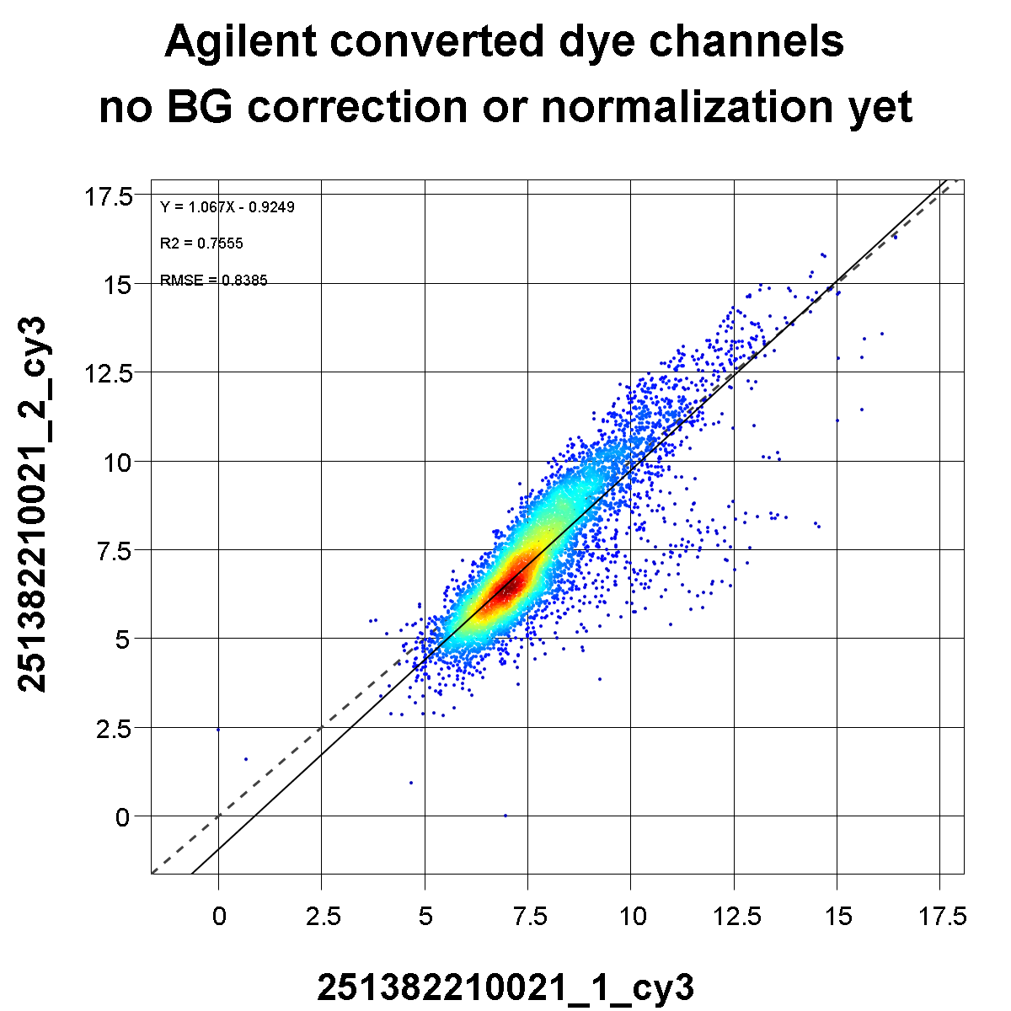

Slide 37
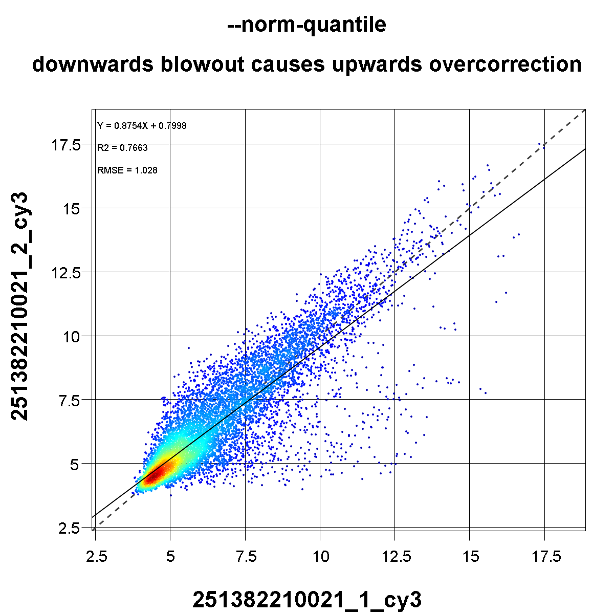

Slide 39
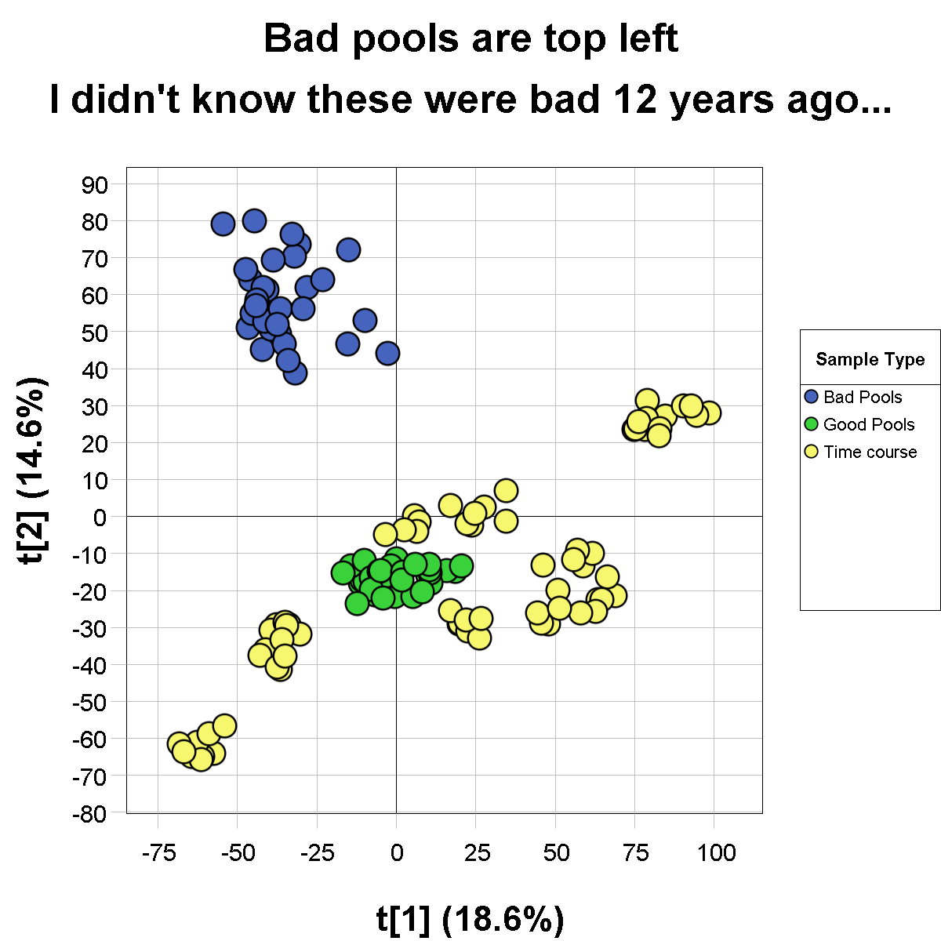

Slide 40
