Slide 1
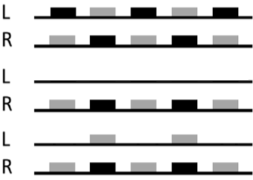
POSTER NUMBER 32
Switching attention and integration of binaural information: effects of masker types and binaural listening on the perception of alternated and interrupted speec
^{Shiran Koifman, Stuart Rosen}
Speech Hearing and Phonetic Sciences, University College London, UK
^{shiran.koifman.16@ucl.ac.uk}
Target (Tar) Distractor (Dstr)
Binaural (B) TarB+DstrB
Monaural (M) TarM+DstrM
Loosely monaural TarM+DstrB
Ear
Time →

