Slide 1
Manual comparing generated code's semantics

Slide 2
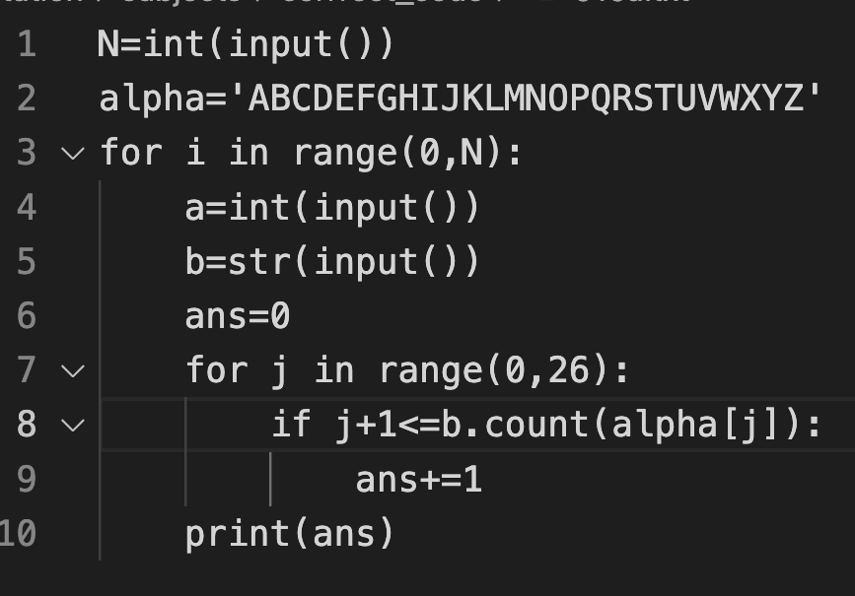
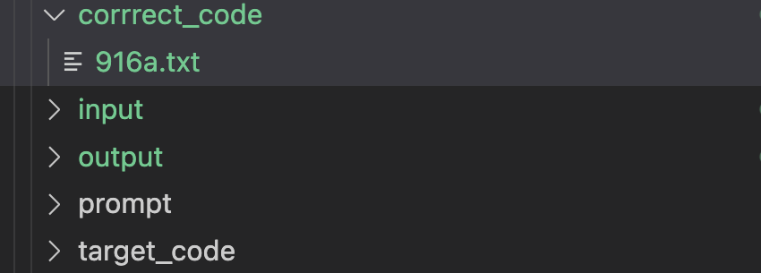
Overivew (1): input code
We only focus on correct_code/ and output/
https://codeforces.com/contest/1914/problem/A

Slide 3
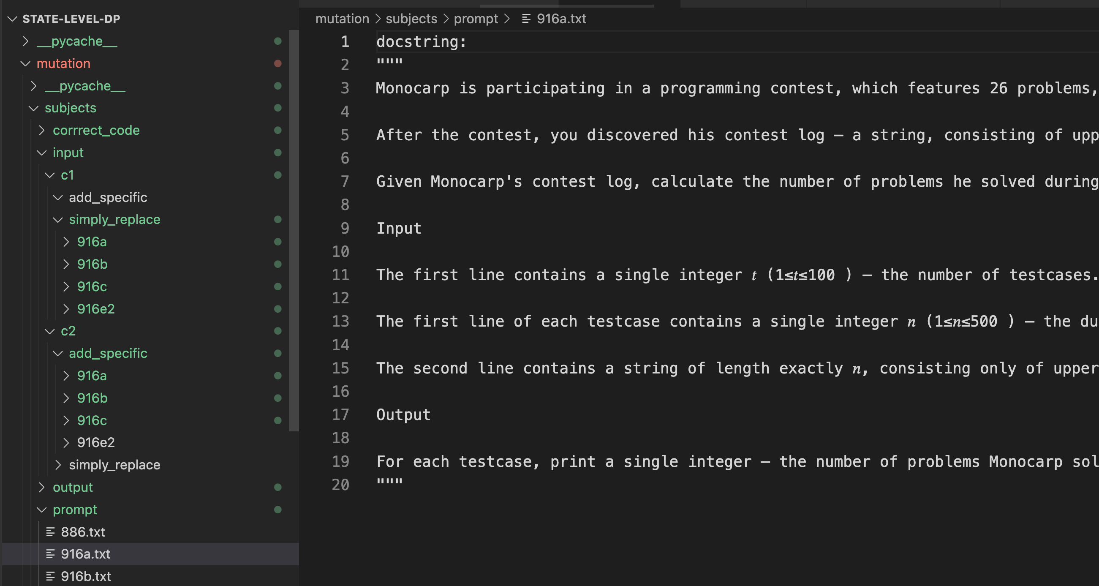
Prompt dir

Slide 4
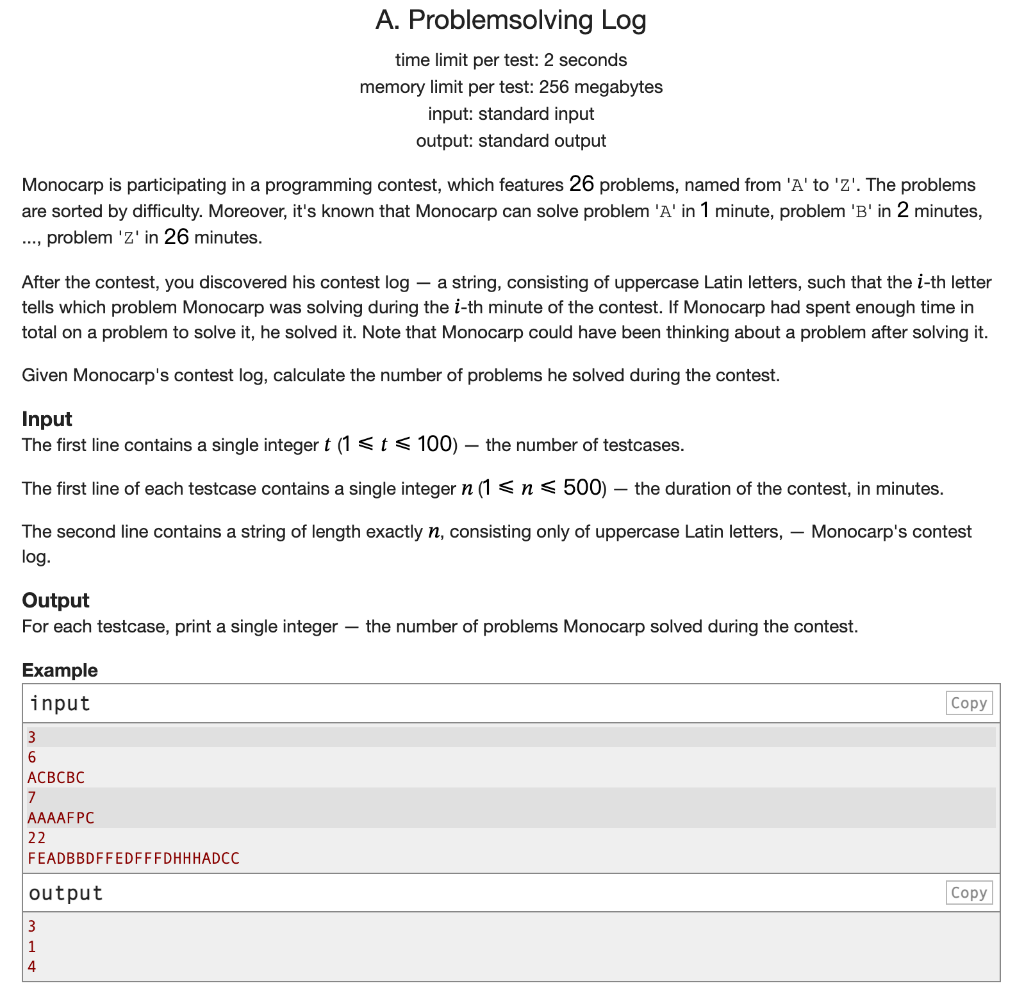
https://codeforces.com/contest/1914/problem/A

Slide 5
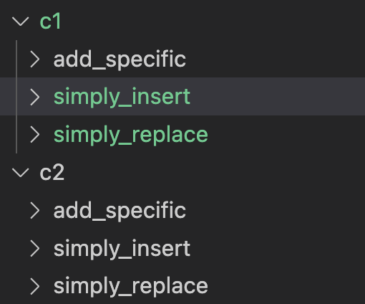
Overview
output/c1/simply_replace code is generated without mutation, output/ c2/add_specific code is generated with mutation
We compare code in c1/output/ /simply_replace and code in output/ c2 /add_specific, to see whether they have the same behavior

Slide 6
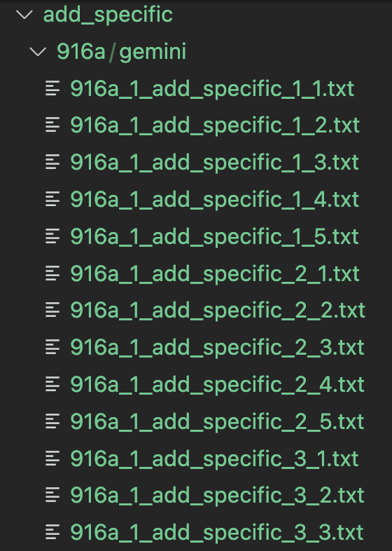
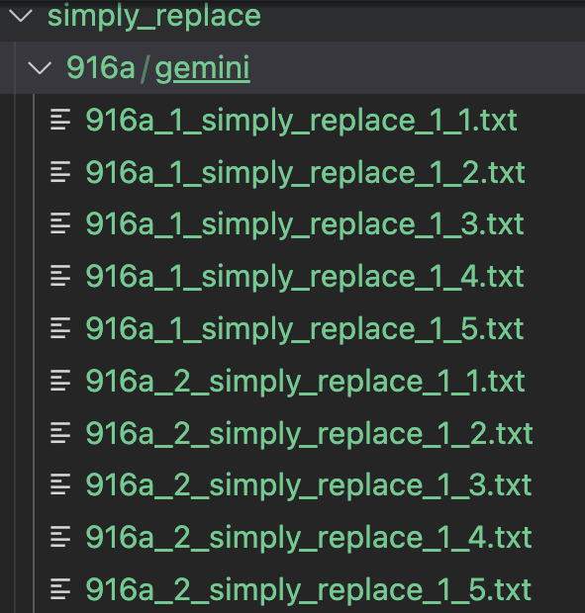
Which file to compare
c1
c2

Slide 7
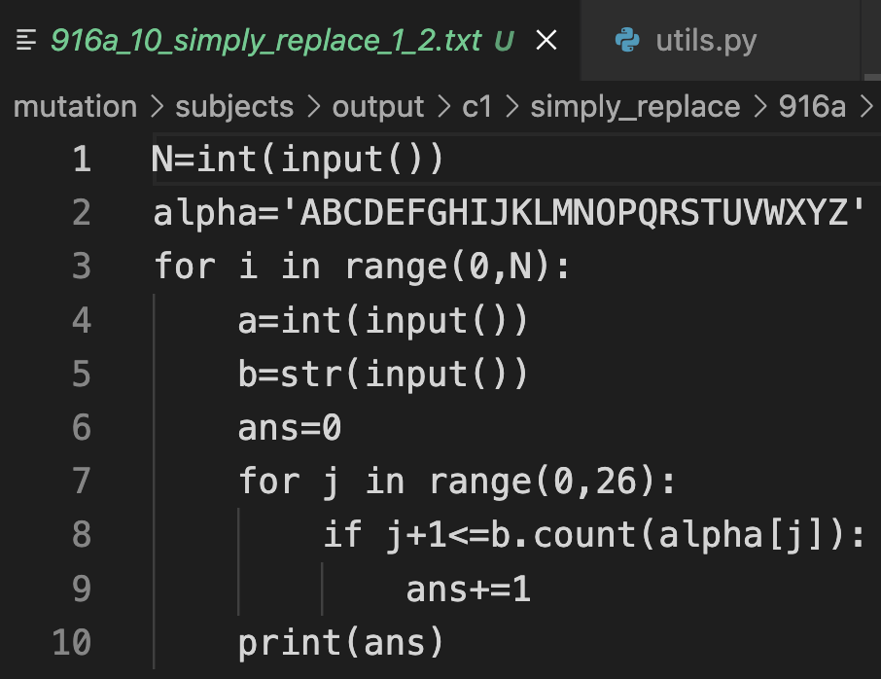
How to compare: suppose we want to generate the 10th line
10 means the 10th line is generated by replacing the 10th line of original code
correct code

Slide 8
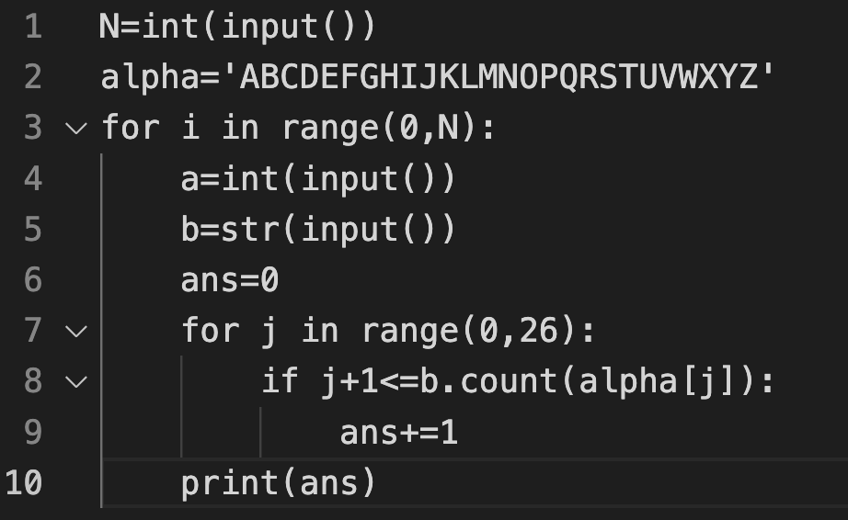
Non-generated lines
Generated lines
Input code

Slide 9
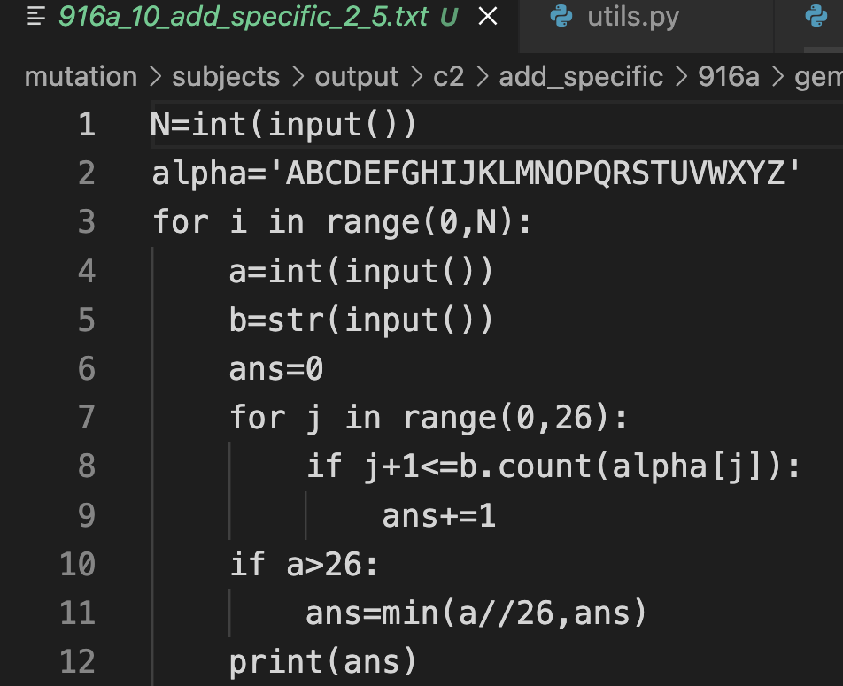
Compare only the code other than non-generated code

Slide 10
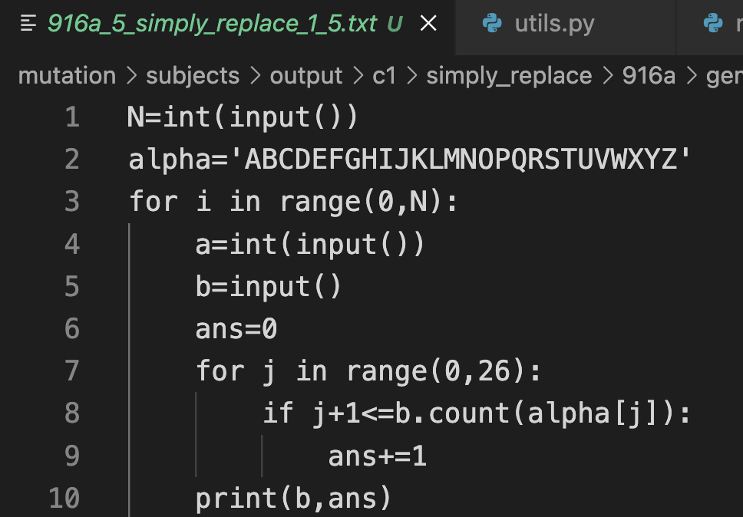
Another example
5 means the 5th line is generated by replacing the 5th line of original code
correct code

Slide 11
Non-generated lines
Generated lines
Non-generated lines
Input code

Slide 12
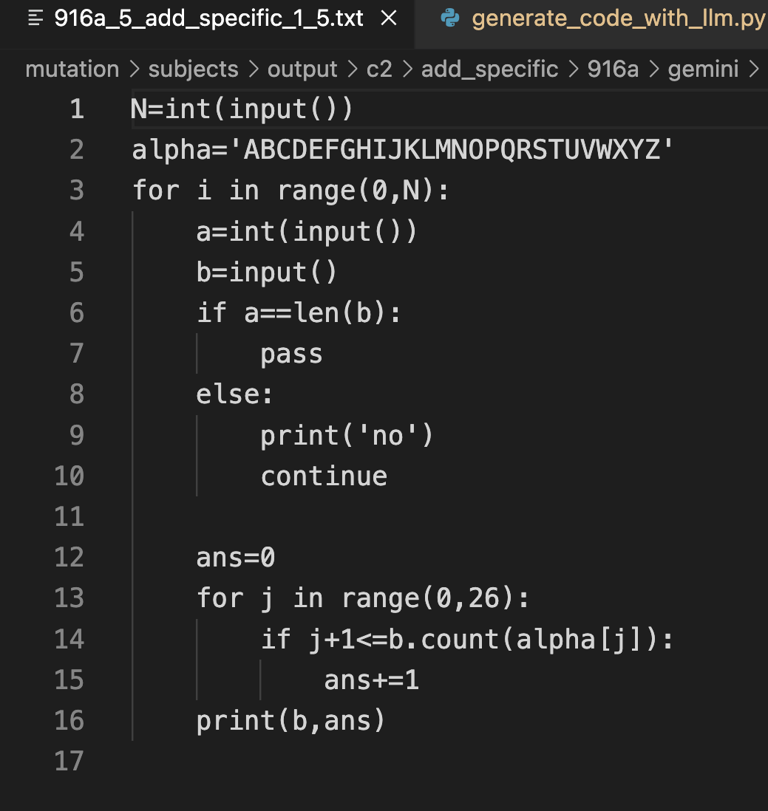
Compare only the code other than non-generated code

Slide 13
Some corner cases
Subtles spacing different does not count (unless such spacing difference leads to different code logic)
There are other corner cases such as C1 and C2 may have different variables
U may take a screenshot and discuss with me.

Slide 14
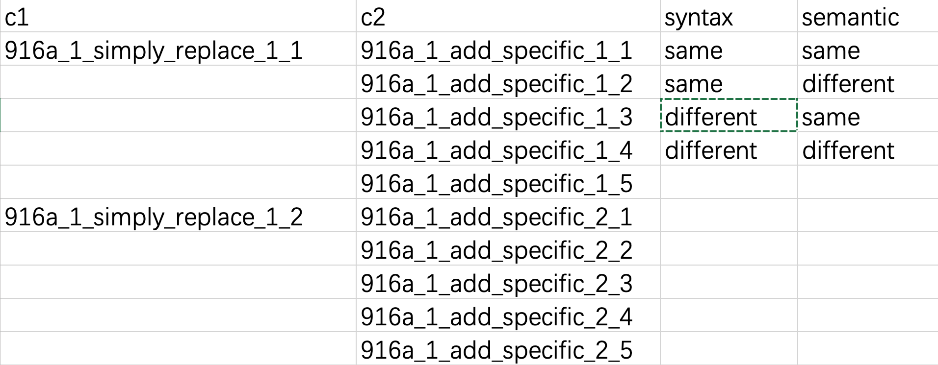
How to record data

