Slide 1

Note: The data and information in this document is reflective of a hypothetical situation and client. This document is to be used for KPMG Virtual Internship purposes only.
Sprocket Central Pty Ltd
Data analytics approach
[Division Name] - [Engagement Manager], [Senior Consultant], [Junior Consultant]

Slide 2
Note: The data and information in this document is reflective of a hypothetical situation and client. This document is to be used for KPMG Virtual Internship purposes only.
Agenda
Introduction
Data Exploration
Model Development
Interpretation

Slide 3
Note: The data and information in this document is reflective of a hypothetical situation and client. This document is to be used for KPMG Virtual Internship purposes only.
Introduction
customers analysis
Age distributions
Number of bike purchases in 3 years
Job industry category.
Wealth segments
Number of cars own on each states

Slide 4
Note: The data and information in this document is reflective of a hypothetical situation and client. This document is to be used for KPMG Virtual Internship purposes only.
Data Exploration
Customers’ age distribution
As we can see, mostly customers are between 30 to 60 years old.
Highest number in the age bracket of 50s
It gives like normal distribution pattern
Number is about same on each side

Slide 5
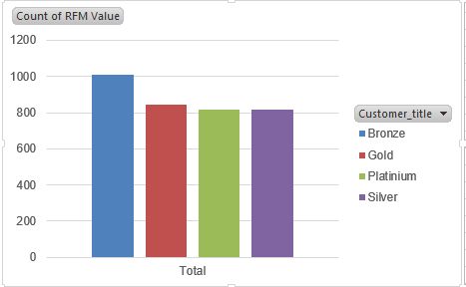
Data Exploration
Customers based on RFM
RFM value
More on Bronze category
Other are equally distributed

Slide 6
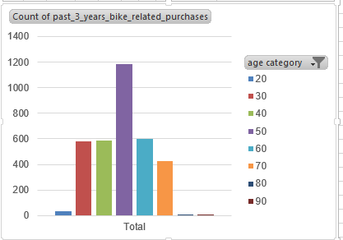
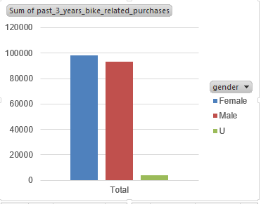
Note: The data and information in this document is reflective of a hypothetical situation and client. This document is to be used for KPMG Virtual Internship purposes only.
Model Development
Bike purchases last 3 years
As we can see, customers are mostly in the age bracket of 50s who purchased bike over last 3 years.
More Portion of female gender in purchase
So we should focus on advertises on Female customers than Male customers

Slide 7
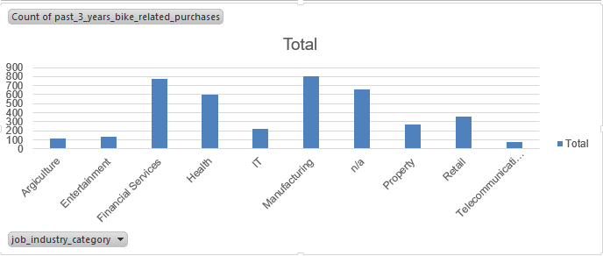
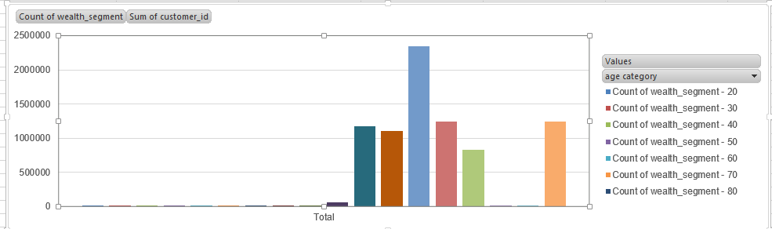
Note: The data and information in this document is reflective of a hypothetical situation and client. This document is to be used for KPMG Virtual Internship purposes only.
Interpretation
Job industry category
Mostly our new customers are on Finance industry and our Manufacturing customers are still on top 2.
The rest industries is still same
Wealth segments
Bracket of 60s more wealthy
Focus on the mid age bracket
Prepare content to their interest

Slide 8
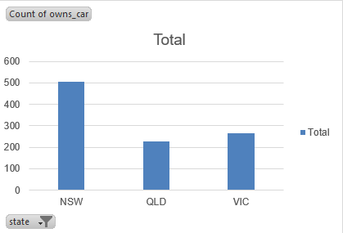
Note: The data and information in this document is reflective of a hypothetical situation and client. This document is to be used for KPMG Virtual Internship purposes only.
Interpretation
Numbers of cars owned
NSW should be considered the most since numbers of customers don’t own cars is significantly larger than that own.
VIC and QLD has more customers that own car that who don’t but we can try to have something so that those owns car will buy bikes.

Slide 9
Note: The data and information in this document is reflective of a hypothetical situation and client. This document is to be used for KPMG Virtual Internship purposes only.
Appendix

Slide 10
Note: The data and information in this document is reflective of a hypothetical situation and client. This document is to be used for KPMG Virtual Internship purposes only.
Appendix
All supporting items in that attachment.

