Slide 1
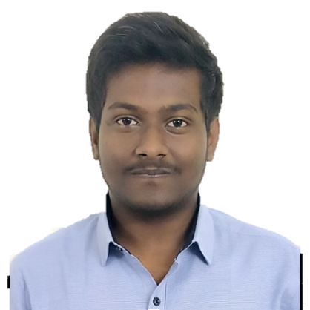


Kummarakuntla Shirdi
Analyst/Software Engineer
Bachelor of Technology : 2017 - 2021
Skills Java 8
Spring Boot
React
Angular
Bootstrap
Tailwind
Database
No SQL database – MongoDB
Web Technologies
HTML5
CSS3
JavaScript
Typescript
Add-Ons
Git & GitHub
Maven
Postman
Swagger
Additional Details
Good Communication Skills
Strong Problem-Solving Skills
Flexible
Good Leader and Mate
Optimistic and Accountable
Vijayawada
Indian
English, Hindi, Telugu
A Technical Enthusiast, Fast and Self Learner who is ready to ADAPT to any Technical Advancement.
Always ready to update, upgrade, and fit into all kinds of situations.
Very Interested in involving and solving complex problems.
Development is a very creative and challenging process which always triggers my interest.
Comfortable with Git & Github, MongoDB, Java, Spring, Angular, React, Docker, RabbitMQ Technologies.
Deals and Coupons Site
Built a Single Page Web Application from scratch that lets the user to grab best Deals and Coupons in the market at one stop. Using Spring, React, MongoDB Technologies which were learnt in the ADAPT Training.
ADAPT Assignments
Able to complete all the assignments given during the Training Successfully on Git & Github, MongoDB, Java, Spring, Angular, React, Docker, RabbitMQ Technologies.
←Check out my work on GitHub & attached Video →

