Slide 1
Project Name : Amazon clone e-commerce SITE.
Shireesh polkam (Edureka presents)

Slide 2
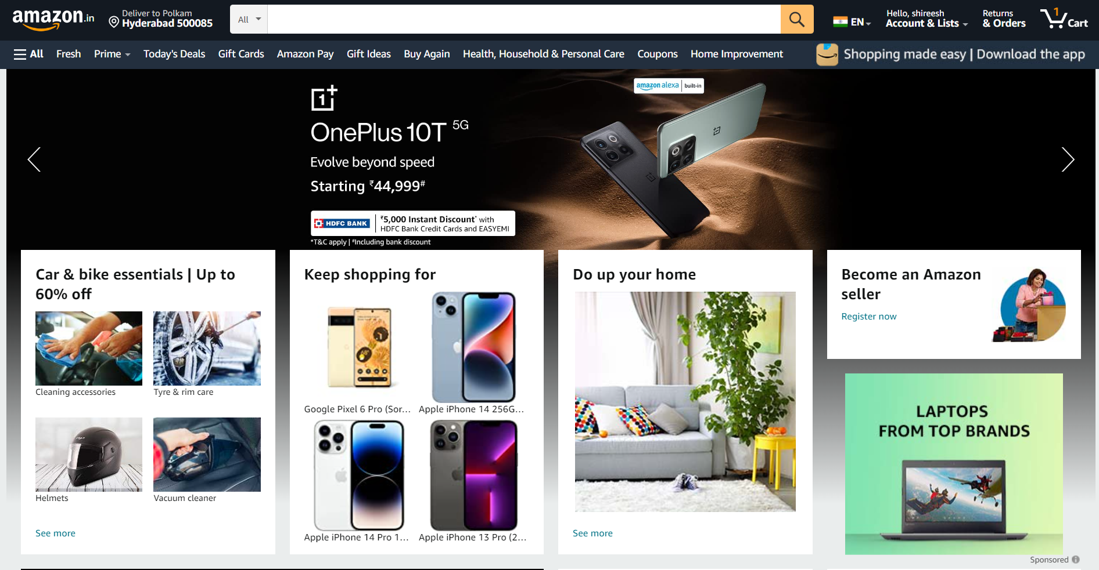
Overview
Amazon allows for individuals and business to sell and display products for sale online. It is the largest internet retailer in the world

Slide 3
Goals
Home Page
Product Page
Search and Listing Results.
Login/Create Account.
Cart Page.
Shipping
Order Confirmation
Profile/Account Settings
Payment gateway
Help/Contact Us

Slide 4
Web Technologies used in AMAZON
Front-End: | Back-End: | Database
1.HTML | 1. JavaScript | 1. Mongo DB
2. CSS | 2. Node Js | 2. AWS
3. Bootstrap | 3. Express Js
4. React

