Slide 1


ONLINE DETECTION OF DEPRESSION –RELATED POSTS IN SOCIAL MEDIA
Project Guide​
Ms. P. Priyanka​
Assistant Professor
Dept of CAI
Team Members
K. Deepthi - 193T1A0550
K. Shireesha - 193T1A0555
K. Saahithya - 193T1A0553
B. Sony - 193T1A0506
IV B.Tech. - II Semester, Project
IV B.Tech. - II Semester, Project

Slide 2
OUTLINE
Abstract
Introduction
Existing System
Disadvantages
Proposed System
Architecture
SVM
Implementation
Modules
Advantages
Results
Conclusion
References
O
Online Detection of Depression – Related Posts in Social Media

Slide 3
ABSTRACT
Depression is a critical issue that affects many people. The increasing prevalence of online communication has led researchers to explore new approaches to early detection of depression and potential healthcare solutions. Natural Language Processing (NLP) techniques and text classification methods have been applied to improve performance in this field. Furthermore, SVM algorithm to classify posts and identify depressive expressions based on the words used. The approach is innovative and addresses the growing use of online communication as a means of interaction. The application preserves user anonymity while reaching a wide audience, making it a valuable tool in the fight against mental health issues like depression.
Online Detection of Depression – Related Posts in Social Media

Slide 4
INTRODUCTION
Depression as a common mental health disorder has long been defined as a single disease with a set of diagnostic criteria. It often co-occurs with anxiety or other psychological and physical disorders and has an impact on feelings and behaviour of the affected individuals. By utilizing online user-generated content and applying Natural Language Processing techniques and text classification methods, this project provides a promising approach for detecting depression in a scalable and anonymous manner. The use of motivational messages in response to negative sentiments could potentially improve the user's mood and provide a sense of support and encouragement.
Online Detection of Depression – Related Posts in Social Media

Slide 5
EXISTING SYSTEM
Some of the currently used approaches to analysis of detection of depression posts are:
1.Logistic Regression
2.Supervised Learning
In this system the process is done manually means user has to report each and every post based on his/her personal opinion.
Online Detection of Depression – Related Posts in Social Media

Slide 6
DISADVANTAGES
Existing Machine Learning algorithms are not accurate in the detection of depressed posts.
They are poor in predicting the depression accurately.
The System does not work for huge posts.
Online Detection of Depression – Related Posts in Social Media

Slide 7
PROPOSED SYSTEM
To implement this project we are using python Speech Recognition API which will read text from audio files and then SVM will analyse that text to detect depression.
User can also upload images via post and python Tesseract OCR (Optical Character Recognition) API can read text from uploaded image and then SVM will detect depression from that text, User can upload post in text file also.
The SVM algorithm will analyze the text to detect depression. This approach will allow users who prefer to communicate through text to share their experiences and feelings .
Online Detection of Depression – Related Posts in Social Media

Slide 8
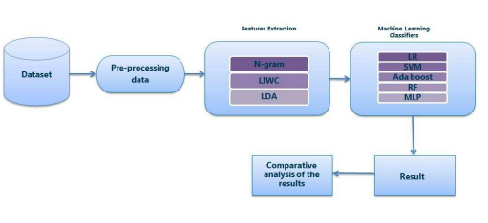
ARCHITECTURE
Online Detection of Depression – Related Posts in Social Media

Slide 9
SVM-SUPPORT VECTOR MACHINE
Support Vector Machine or SVM is one of the most popular Supervised Learning algorithms, which is used for Classification as well as Regression problems.
SVM algorithm can be used for Face detection, image classification, text categorization, etc.
The SVM algorithm can be trained on a dataset of labeled tweets, where each tweet is labeled as either related to depression or not. Once the model is trained, it can be used to classify new posts.
Online Detection of Depression – Related Posts in Social Media

Slide 10
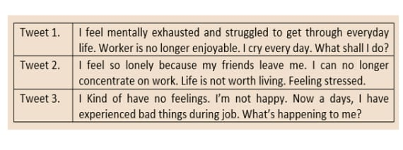
EXAMPLE
Online Detection of Depression – Related Posts in Social Media

Slide 11
IMPLEMENTATION
We use the NLP tools to pre-process the dataset before it is proceeded to the feature selection and training stage. First, we use tokenization to divide the posts into individual tokens. Next, we remove all the URLs, punctuations and stop words which could lead into erratic results if stay ignored. Then we apply stemming in order to reduce the words to their root form and group similar words together. Feature for depression detection to calculate the probability of co-occurrence of each input sentence as a unigram and bigram. To implement this project we are using python Speech Recognition API which will read text from audio files and then SVM will analyse that text to detect depression.
Online Detection of Depression – Related Posts in Social Media

Slide 12
MODULES
Admin Module:
Administrator will login to application using username as ‘admin’ and password ‘admin’. After login admin can view all registered users and all posts send by each users. Admin can send motivation messages to all depressed users. All positive and negative depression users can also be seen in the form of graph.
User Module:
Users need to register with the application and then login to application to access various sub modules such as.
Search Friends:
Using this module user can see all peoples register with the application.
Upload Posts:
Using this module user can upload post in various formats such as text file, image or audio file. This application accepts only .WAV file format.
Implementation / Simulation
Online Detection of Depression – Related Posts in Social Media

Slide 13
ADVANTAGES
Reliable in classification of use.
Easy to segregate and mark user as spam.
The SVM algorithm segregates the posts in a less time.
Online Detection of Depression – Related Posts in Social Media

Slide 14
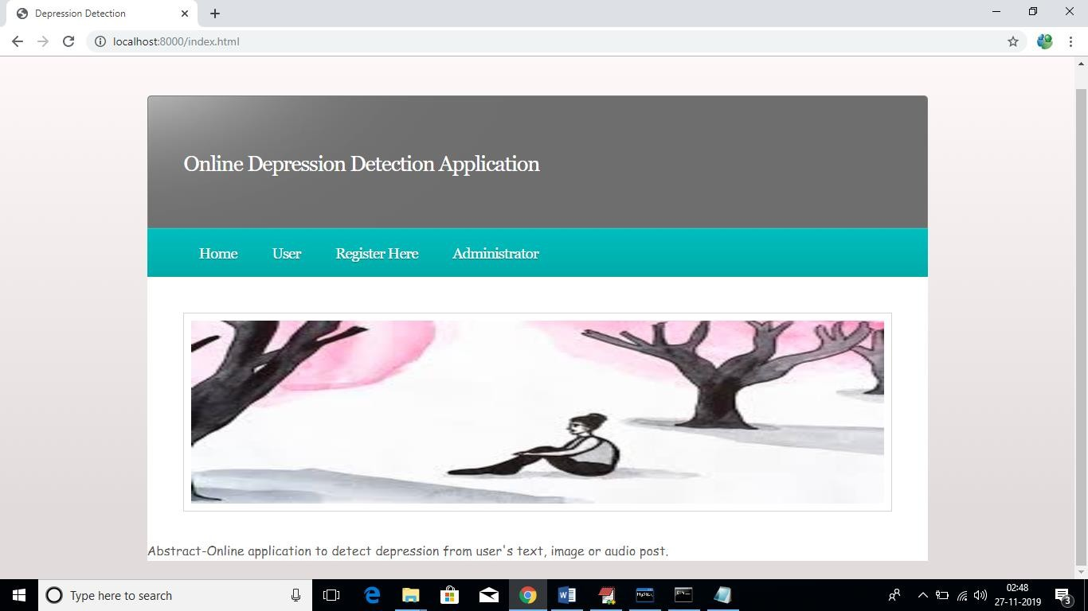
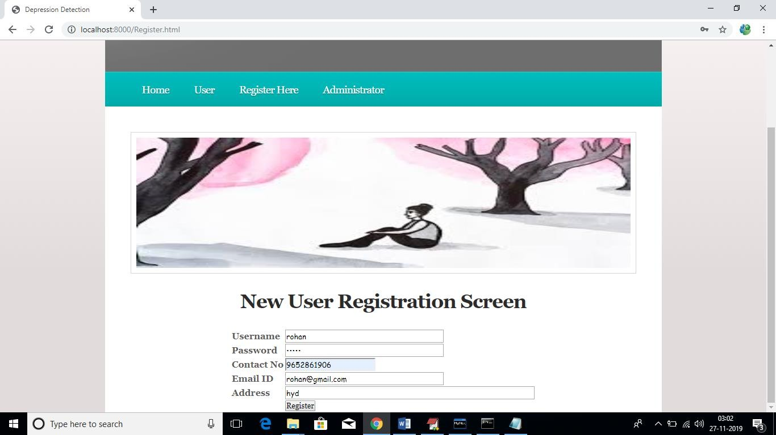
RESULTS
Online Detection of Depression – Related Posts in Social Media

Slide 15
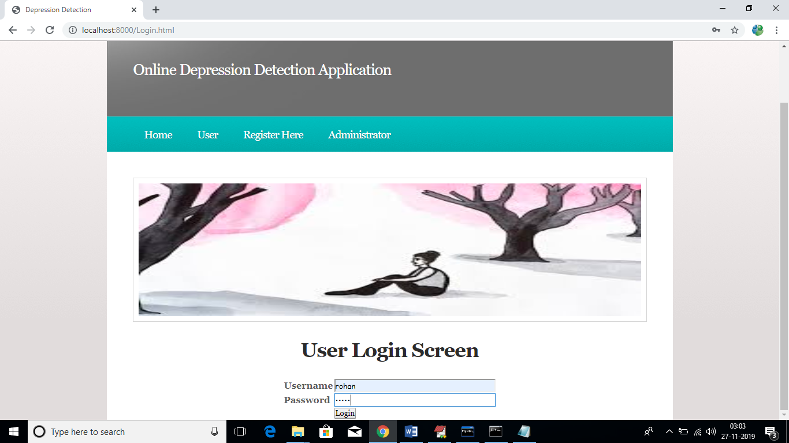
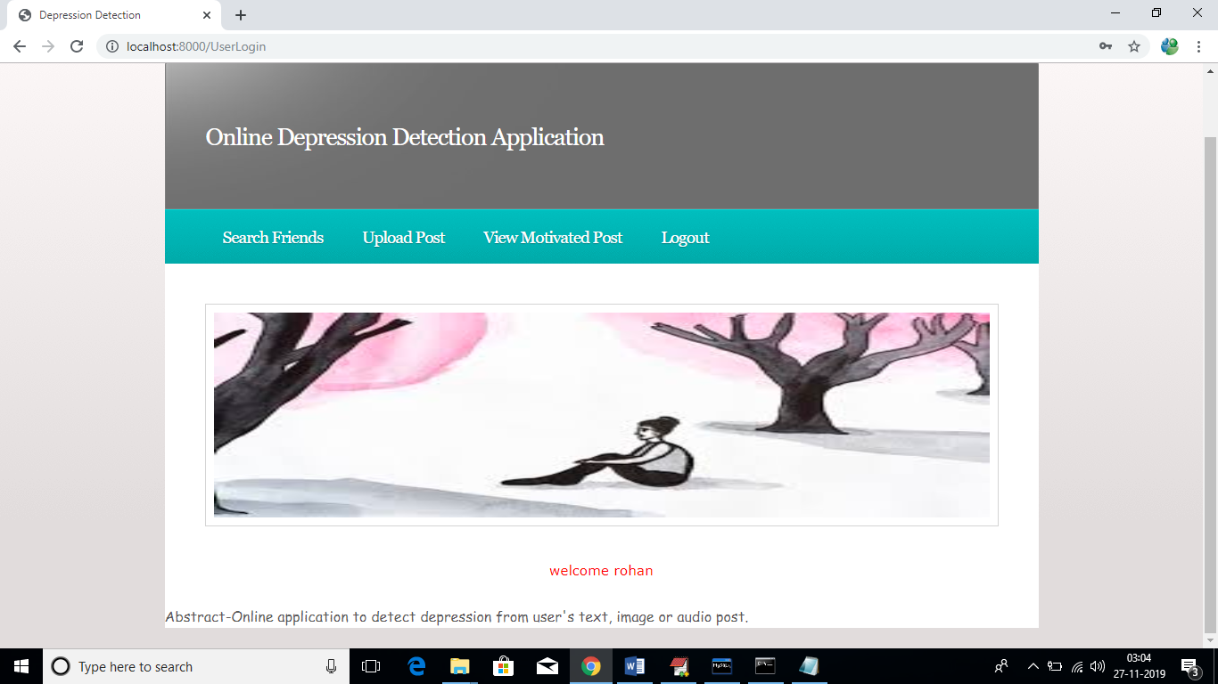
Online Detection of Depression – Related Posts in Social Media

Slide 16
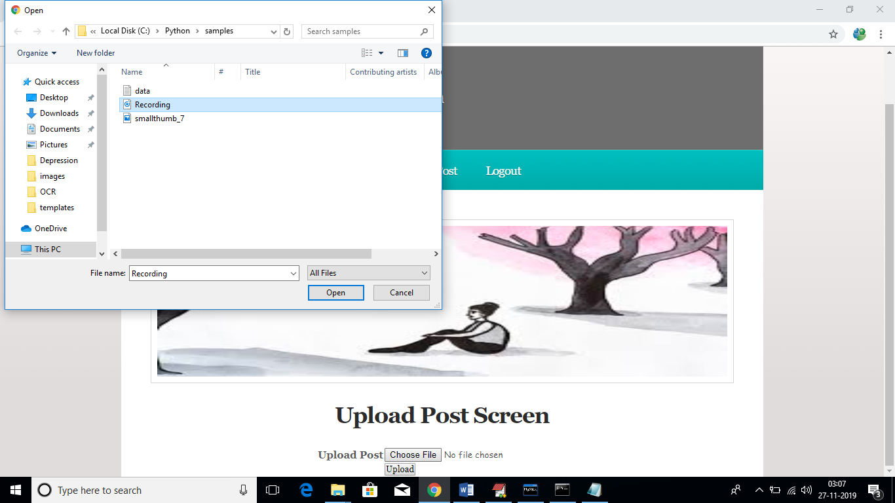

Online Detection of Depression – Related Posts in Social Media

Slide 17
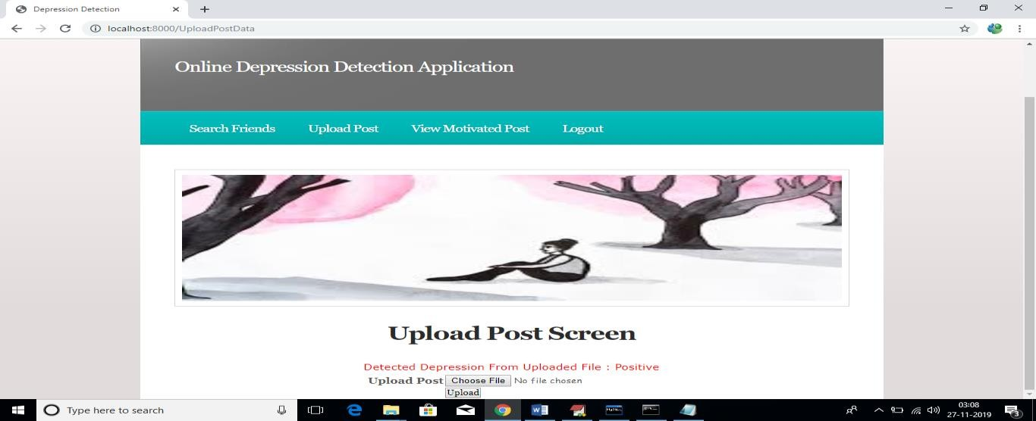
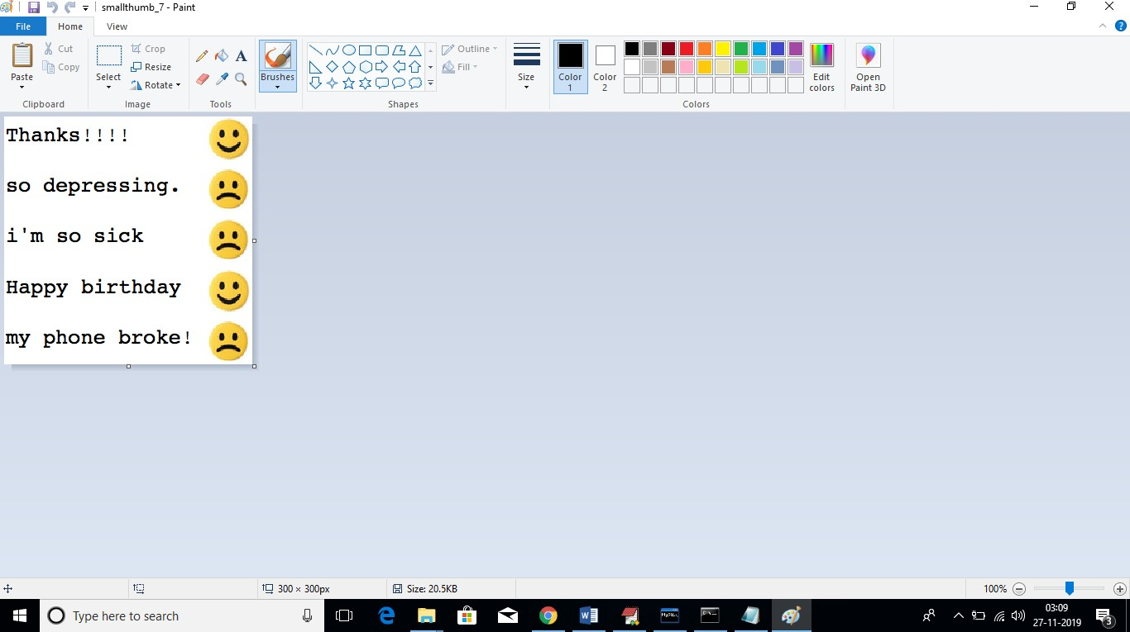
Online Detection of Depression – Related Posts in Social Media

Slide 18
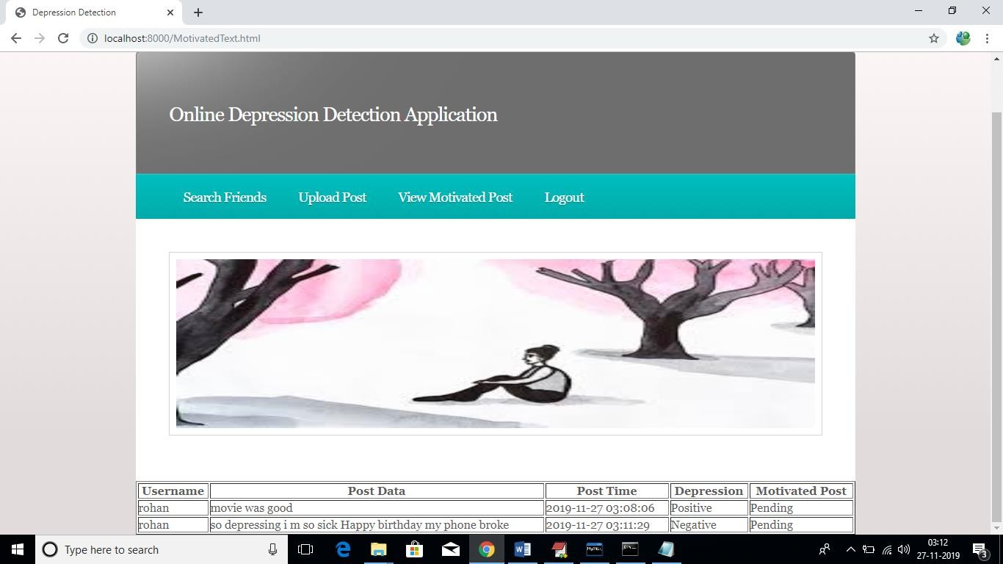
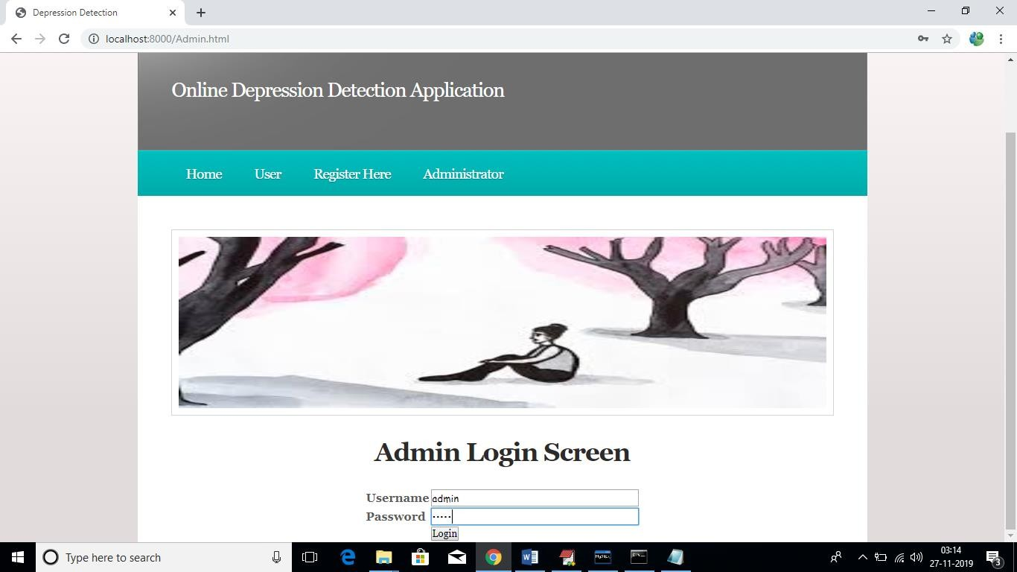
Online Detection of Depression – Related Posts in Social Media

Slide 19
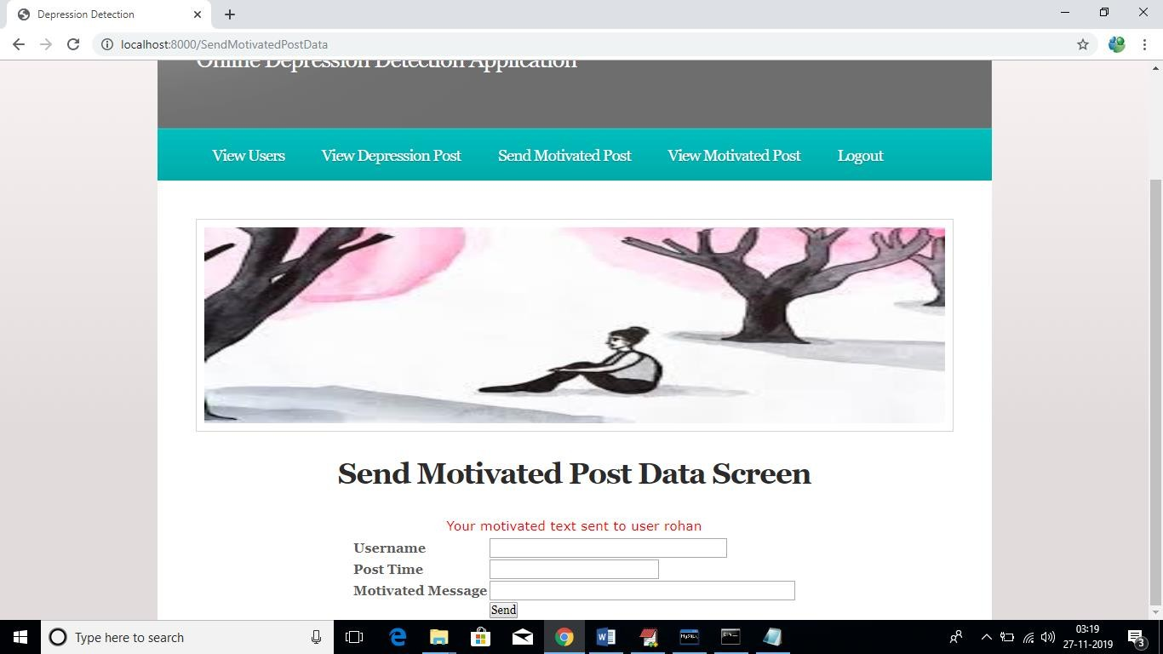
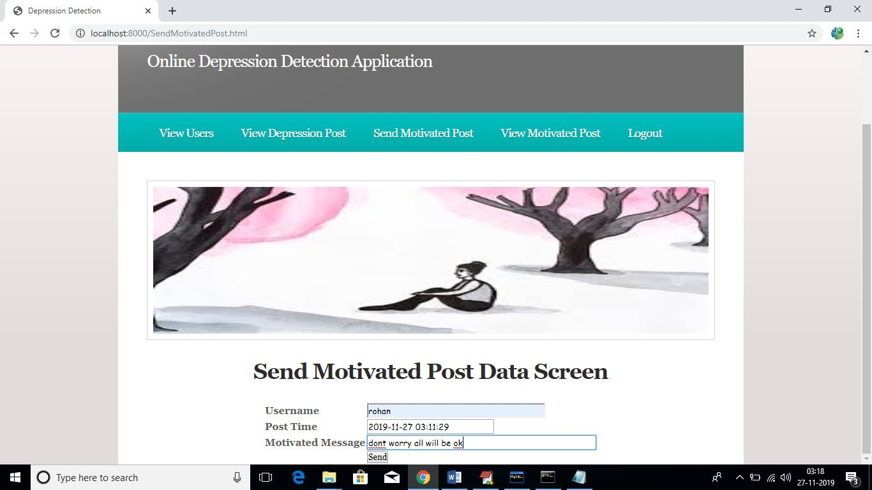
Online Detection of Depression – Related Posts in Social Media

Slide 20
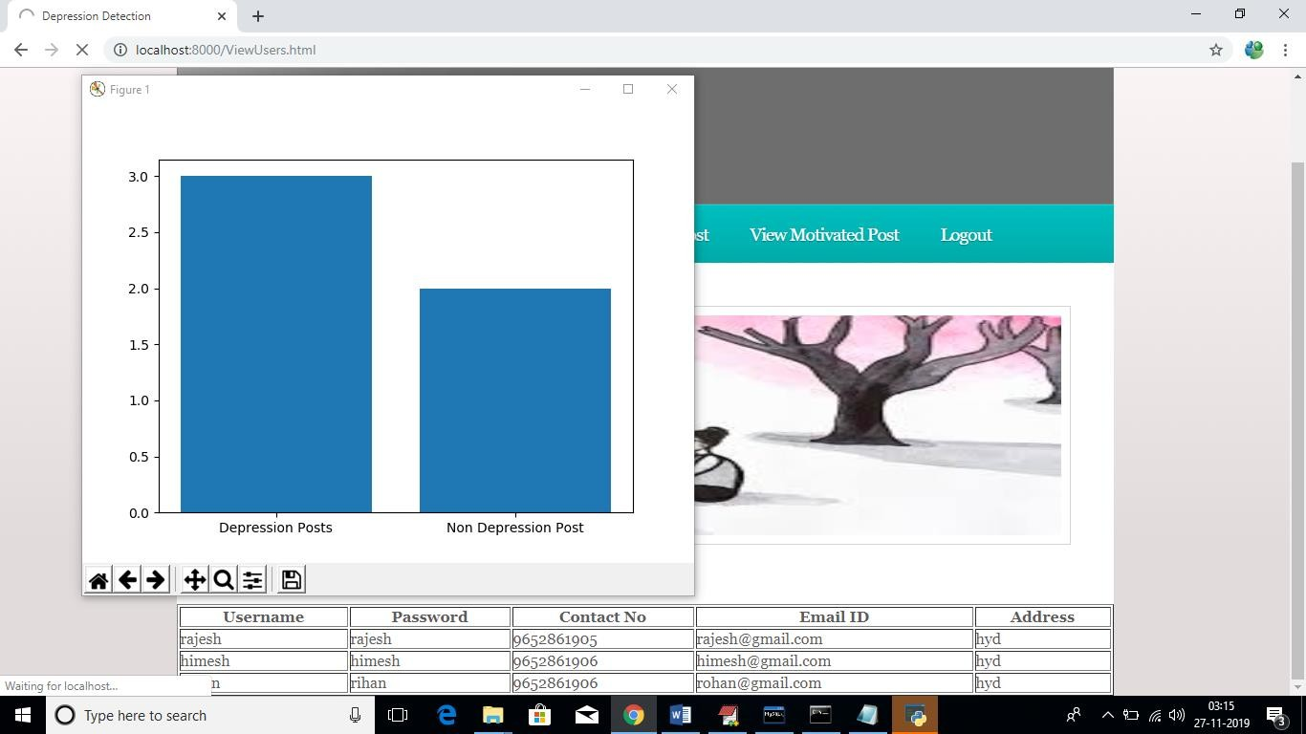
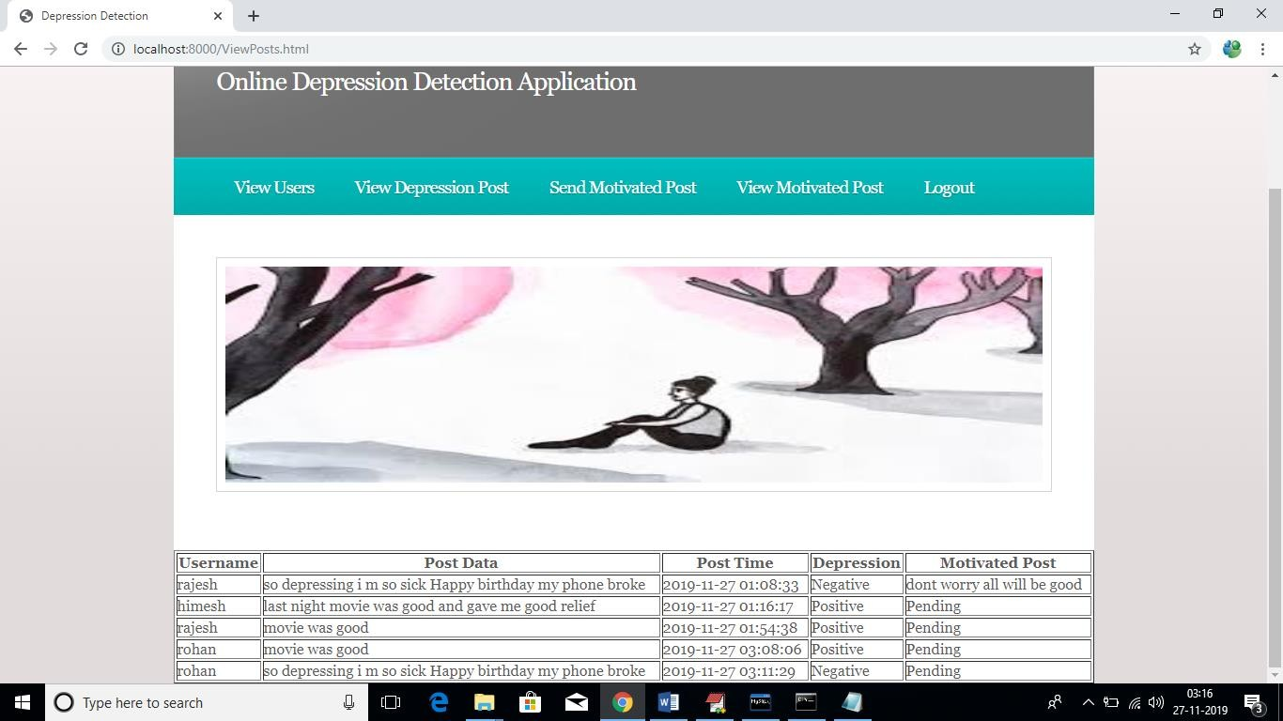
VISIBLE OUTPUT
Online Detection of Depression – Related Posts in Social Media

Slide 21
CONCLUSION
The project aimed to use NLP and text classification techniques to detect depression in social media and improve the accuracy of depression detection. Depressed language usage was identified, including self-preoccupation, feelings of sadness, anxiety, anger, hostility, or suicidal thoughts, with a focus on present and future tense. A lexicon of common depression-related words was identified. The study evaluated the performance of single and combined features using text classification methods and found that proper feature selection and combination could significantly improve performance. The SVM classifier with combined features achieved the highest performance, with 91% accuracy while the best single feature was bigram with SVM classifier, achieving 80% accuracy. This project can help people who are in depression by sending motivated message to them.
Online Detection of Depression – Related Posts in Social Media

Slide 22
REFERENCES
M. R. Islam, M. A. Kabir, A. Ahmed, A. R. M. Kamal, H. Wang, and A. Ulhaq, “Depression
detection from social network data using machine learning techniques,” Health Information Science and Systems2018
A. Kumar, A. Sharma, and A. Arora, “Anxious depression prediction in real-time Social data,” in proceeding of International Conference on Advanced Engineering, Science, Management and Technology–2019.
H. S. Alsagri and M. Ykhlef, “Machine learning-based approach for depression detection in twitter using content and activity features,” IEICE Transactions on Information and Systems, vol.
Online Detection of Depression – Related Posts in Social Media

Slide 23

Online Detection of Depression – Related Posts in Social Media Forum

Slide 24

Detection of Depression – Related Posts in Online Social Media Forum

