Slide 1


Slide 2


Slide 3



Behind the Screens: A Netflix Data Story
Shirel AMOZIEG

Slide 4
Behind the Screens: A Netflix Data Story
Project Description:
Based on Netflix data from Kaggle
Built a full pipeline: cleaning → enrichment → visualization
Designed an interactive Power BI dashboard
Problem / Need:
Netflix’s catalog is large and diverse (genres, countries, formats)
Navigating and analyzing this content at scale can be challenging without proper tools
Need for a clear, visual, and interactive overview

Slide 5
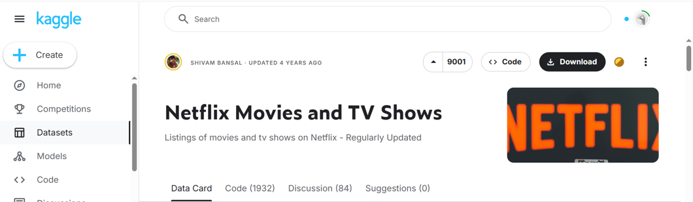
1. Data Source
Contains ~ 8700 titles (Movies + TV shows)
Features: title, cast, release_year, duration…
Updated until 2021

Slide 6


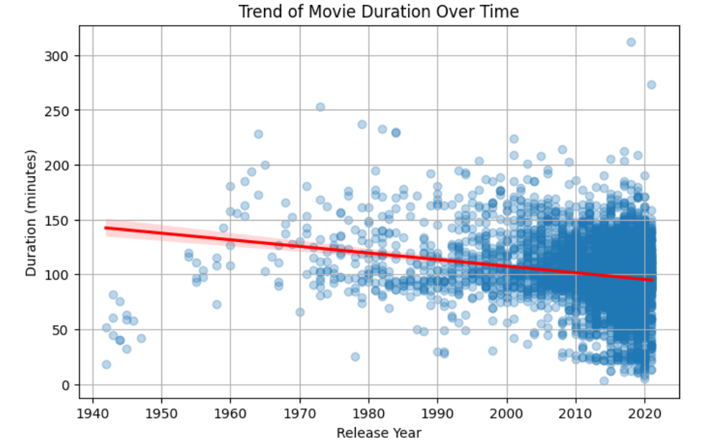
2. Data Cleaning & Preparation
Filling missing values (e.g. country, cast)
Converting data types (e.g. dates)
Dropping duplicates or irrelevant columns
Normalizing values (e.g. duration)
Handling outliers
Performing statistical analysis
Saving to a new CSV file netflix_titles_cleaned.csv
Insight:
Newer movies tend to be slightly shorter than older ones

Slide 7

3. PostgreSQL / pgAdmin Integration
Connected cleaned data to PostgreSQL database
Created main base table from final dataset 00_create_base_table.sql
Generated additional structured tables for analysis 01_create_new_tables.sql
Ran SQL queries to validate schema and content 02_check_queries.sql

Slide 8
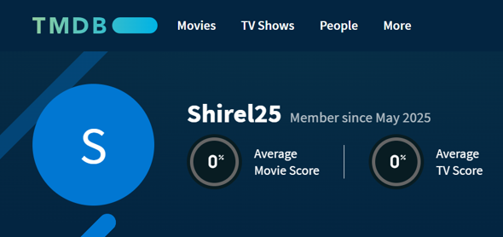

4. Movies/TV shows Posters
Used TMDB API to retrieve poster images for Netflix titles
Matched movies and shows using title + release year
Extracted and saved poster URLs into netflix_posters.csv

Slide 9
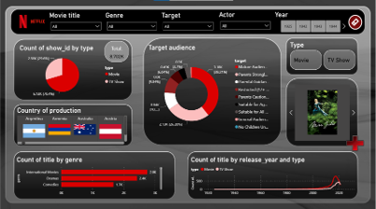
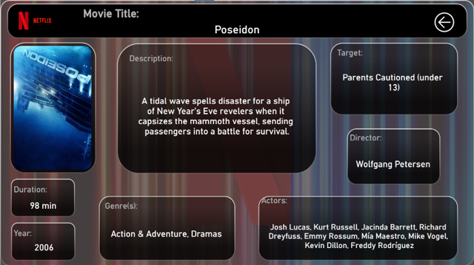

5. Dashboard - Demo
Interactive filters
Dynamic visuals
Details view for each selected title
User-friendly layout inspired by Netflix design

Slide 10
Conclusion
Achievements:
Built a full data pipeline from raw dataset to interactive dashboard
Cleaned, structured, and enriched Netflix data
Integrated country flags and movie posters dynamically
Designed a Netflix-inspired dashboard using Power BI
Enabled both exploration and detailed content view
Future Improvements:
Include available audio languages per title
Add movie recommendations using machine learning
Track content evolution over time with regular updates

Slide 11




Sources
YouTube
GitHub Project
Deployed Link
Portfolio
2mn Video
Linkedin
CV Link
Job Tracker Link

Slide 12


