Slide 1


Slide 2


Slide 3



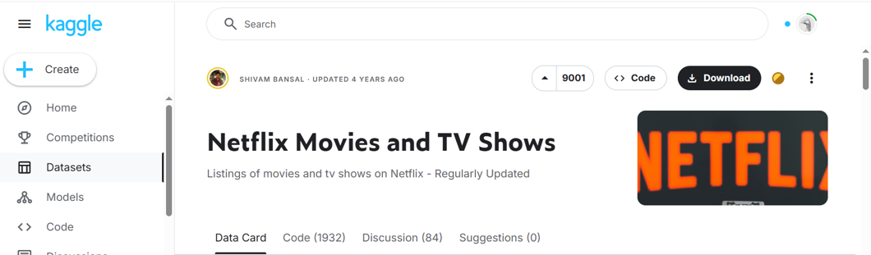
1. Data Source
Contains ~ 8000 titles (Movies + TV shows)
Features: title, cast, release_year, duration…
Updated until 2021

Slide 4


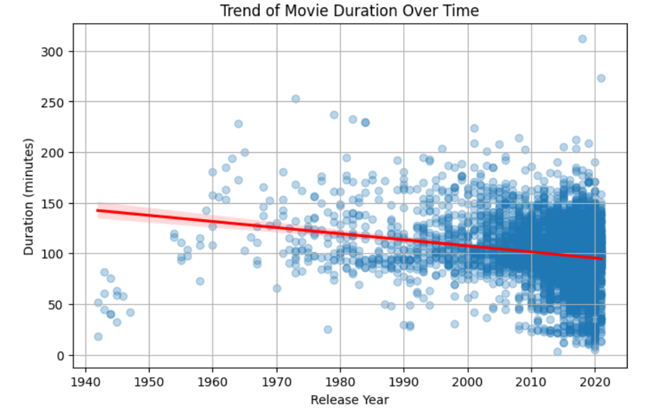
2. Data Cleaning & Preparation
Filling missing values (e.g. country, cast)
Converting data types (e.g. dates)
Dropping duplicates or irrelevant columns
Normalizing values (e.g. duration)
Handling outliers
Performing statistical analysis
Saving to a new CSV file netflix_titles_cleaned.csv
Insights:
Newer movies tend to be slightly shorter than older ones

Slide 5

3. PostgreSQL / pgAdmin Integration
Connected cleaned data to PostgreSQL database
Created main base table from final dataset 00_create_base_table.sql
Generated additional structured tables for analysis 01_create_new_tables.sql
Ran SQL queries to validate schema and content 02_check_queries.sql

Slide 6
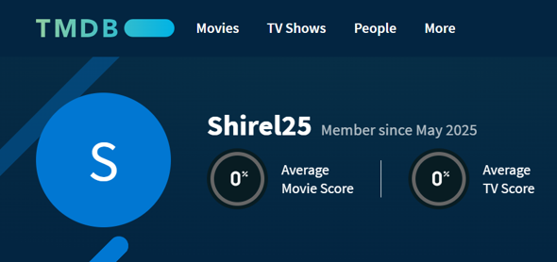

4. Movies/TV shows Posters
Used TMDB API to retrieve poster images for Netflix titles
Matched movies and shows using title + release year
Extracted and saved poster URLs into netflix_posters.csv

Slide 7
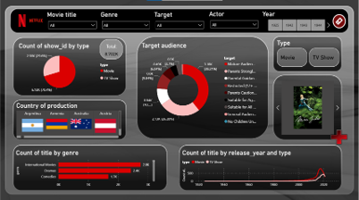
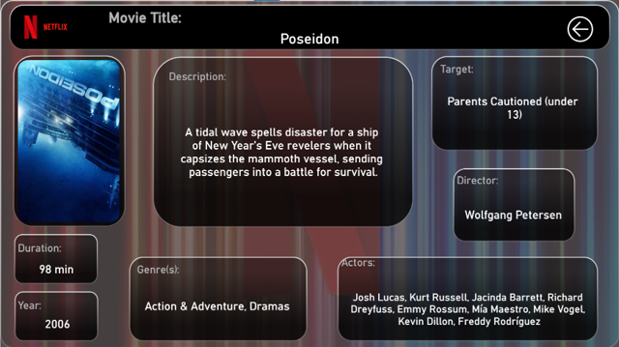

5. Dashboard - Demo
Interactive filters
Dynamic visuals
Details view for each selected title
User-friendly layout inspired by Netflix design

Slide 8
Conclusion
Achievements:
Built a full data pipeline from raw dataset to interactive dashboard
Cleaned, structured, and enriched Netflix data
Integrated country flags and movie posters dynamically
Designed a Netflix-inspired dashboard using Power BI
Enabled both exploration and detailed content view
Future Improvements:
Include available audio languages per title
Add movie recommendations using machine learning
Track content evolution over time with regular updates

Slide 9
Sources
Kaggle
ChatGPT
YouTube: https://www.youtube.com/watch?v=ZSrVOyKAC4Y&list=PLrHF9RH5-_uuWyV0Ebr7MV_9Qj_4T5t9N&index=29

Slide 10


