Slide 1

Player Churn Analysis Framework
TingtingLyu(Tangtang)

Slide 2






Data Foundations
Reference
Cabral, L. M. B., & Ross, T. W. (2008). Are Sunk Costs a Barrier to Entry?
Wei, J. T., Lin, S. Y., & Wu, H. H. (2010). A review of the application of RFM model. African journal of business management, 4(19), 4199.
Viljanen, M., Airola, A., Heikkonen, J., & Pahikkala, T. (2017). Playtime measurement with survival analysis. IEEE Transactions on Games, 10(2), 128-138.
1. Recency & Activity (The "Heartbeat")​
Sessions in the last 7 days
2. Investment & Loyalty (The "Sunk Cost")​
Total playtime​
DLC ownership​
Total lifetime playtime
3. Environmental Context (The "External Bias")
Country

Slide 3
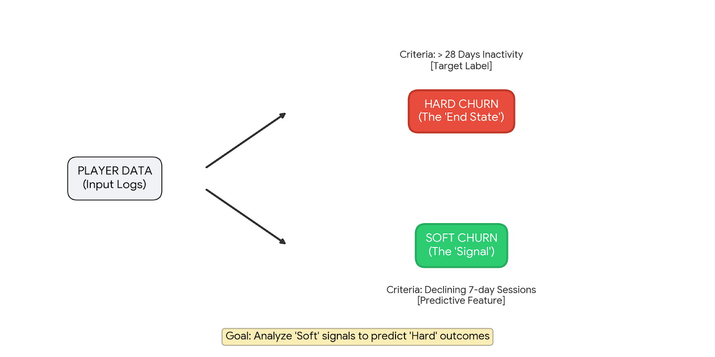
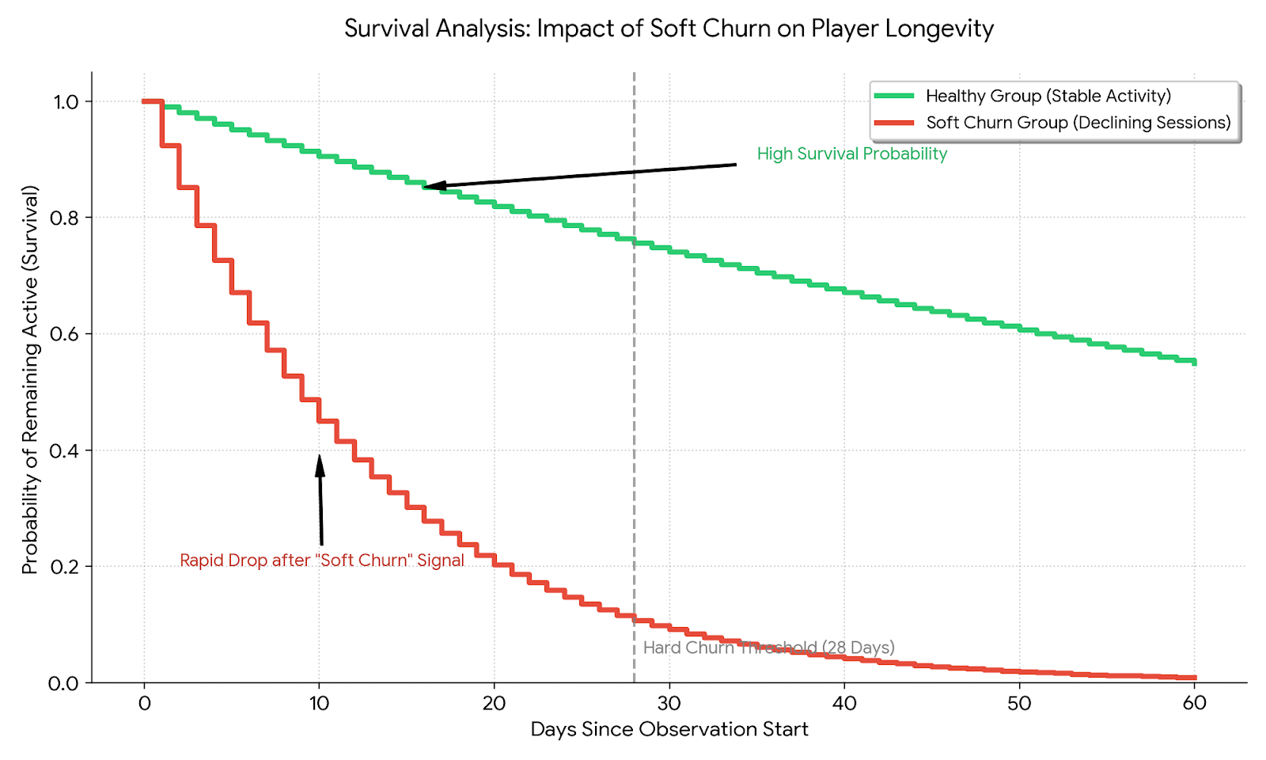
Understanding churn
Key Analysis | Visualization | Business Insight
Cohort Analysis | Survival Curves | When do players leave?
Correlation Analysis | Activity Decile | Which behaviors signal the risk?
User Segmentation | Geographical Heatmap | Where/Who is leaving?
Critical Questions for the Data
Definition Calibration : In Paradox titles, how do we distinguish between a 'natural break' after a long campaign and actual churn?
External Events : Are there specific dates for Major DLC releases or Server outages associated with these data points?

Slide 4
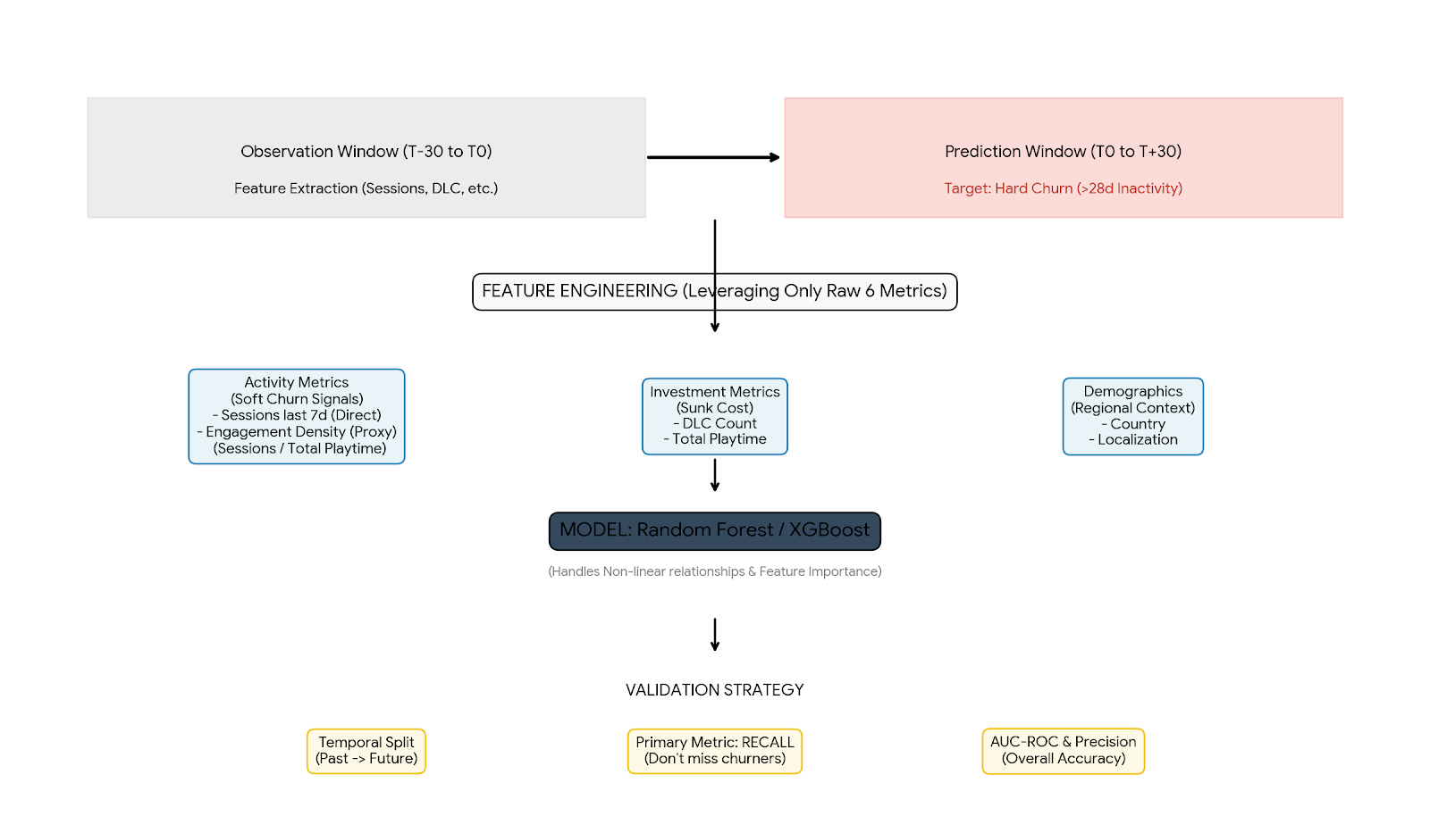
Predicting churn
Feature Engineering
Velocity: How fast players are progressing.
Value: How much players have invested in the past, and whether it's worth the effort to recover it.
Venue: Whether external factors are contributing to the situation.
Castéran, H., Meyer-Waarden, L., & Reinartz, W. (2021). Modeling customer lifetime value, retention, and churn. In Handbook of market research (pp. 1001-1033). Cham: Springer International Publishing.
Alboukaey, N., Joukhadar, A., & Ghneim, N. (2020). Dynamic behavior based churn prediction in mobile telecom. Expert Systems with Applications, 162, 113779.
Masrur, A., Yu, M., Mitra, P., Peuquet, D., & Taylor, A. (2022). Interpretable machine learning for analysing heterogeneous drivers of geographic events in space-time. International Journal of Geographical Information Science, 36(4), 692-719.
Chen, T., & Guestrin, C. (2016, August). Xgboost: A scalable tree boosting system. In Proceedings of the 22nd acm sigkdd international conference on knowledge discovery and data mining (pp. 785-794).

Slide 5
Business impact &Limitations
Business impact
Limitations
I. Business Actions (Saving the Player) | II. Limitations (Navigating the Risks)
Targeted Interventions based on Churn Signals: | Critical Awareness for Decision Making:
Veteran Loyalty Hook: Push exclusive DLC previews to high-investment players showing decay. | Survival Bias: Our model only "sees" players who made it past day 1; it misses early-exiters.
Newcomer Support: Provide guides/starter bundles to players struggling with game friction. | Correlation vs. Causality: A session drop might be due to external factors (e.g., a competitor’s release).
Proactive Feedback: Trigger micro-surveys at the "Soft Churn" point to identify bug-related exits. | Missing Signals: Lack of social data (friends' activity) and technical logs (crashes).

