Slide 1

Computer Security & Cyber Law
Compiled By: Bishwa Karn
1

Slide 2

Course Outline
Introduction to Computer Security
Cryptography and Cryptographic Algorithms
Introduction to network security
Digital Signature and Authentication Protocols
Design Principles and Common Security related programming problems
2

Slide 3
Malicious Programs and Protection
Intrusion Detection
Web Security and Email Security
Database Security 10.Policy and Procedures
11. Issues with Internet in college
3

Slide 4
Chapter 1: Introduction to Computer Security
Definition:
Computer security is the protection of computer systems from theft and damage to their hardware, software or information, as well as from disruption or misdirection of the services they provide.
4

Slide 5

Attacks, Services and Mechanisms
Security Attack: Any action that compromises the security of information.
Passive attack: unauthorized reading of a message or a file.
Active attack: modification of messages or files, and denial of service.
Security Mechanism: A mechanism that is designed to detect, prevent, or recover from a security attack.
5

Slide 6
Security Service: A service that enhances the security of data, information, systems or network.
e.g. Authentication, Authorization, confidentiality, integrity etc.
A security service makes use of one or more security mechanisms.
6

Slide 7


Basic Components & Objectives of Security
Confidentiality
Preserving authorized restrictions on information access and disclosure.
Data Confidentiality: It assures that private or secret information is not made available or disclosed to unauthorized individuals.
Privacy: What information to collect, who should collect and store the information and to whom the information may be disclosed.
7

Slide 8
2. Integrity
Guarding against improper information modification or destruction.
Data integrity: Assures that information and programs are changed only in a specified and authorized manner.
System Integrity: Assures that a system performs its intended function in appropriate manner, free from unauthorized manipulation of the
system.
8

Slide 9
3. Availability
Assures that systems work normally and service is not denied to authorized users.
Ensuring timely and reliable access to intended users.
9

Slide 10
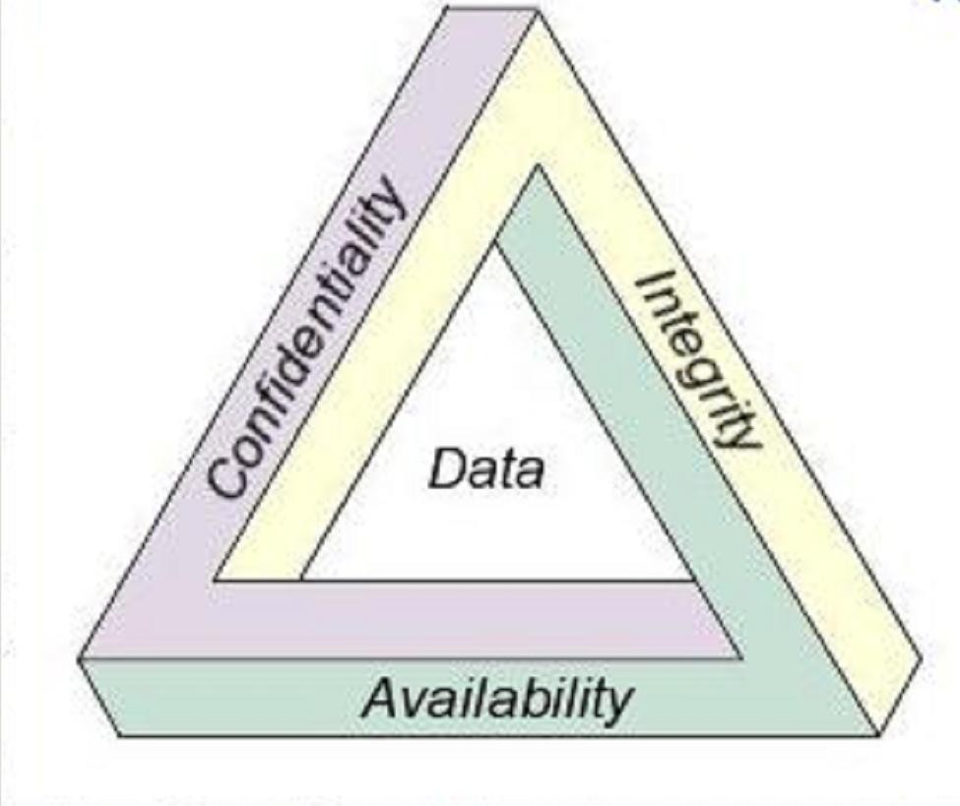
CIA Triad
Fig: The Security Requirements Triad (Security Objectives and Goals)
10

Slide 11
Other Security Services
Authenticity:
The property of being genuine and being able to be verified and trusted.
Authenticity is assurance that a message, transaction, or other exchange of information is from the source it claims to be from i.e. proof of identity.

Slide 12
Accountability:
It means that every individual who works with an information system should have specific responsibilities for information assurance.
The tasks for which a individual is responsible are part of the overall information security plan and can be readily measurable by a person who has managerial responsibility for information assurance.

Slide 13
Security Threats
A threat is a potential violation of security which might or might not occur.
Snooping
It is the unauthorized interception of information and disclosure.
Passively listening(or reading) to communications or browsing through files or system information.
e.g. passive wiretapping-a form of snooping in which a network is
monitored.

Slide 14
Modification or Alteration:
Unauthorized change of information
If modified data controls the operation of the system, threats of failure may arise
Active form of security attack
E.g. Man-in-the-middle attack in which intruder reads messages from sender and sends modified data to the receiver without knowing the changes.

Slide 15
Masquerading or Spoofing:
One entity pretends to be a different entity.
e.g. If a user tries to log into a computer across the internet but instead reaches another computer that claims to be the desired one.
Or if a user tries to read a file, but an attacker has arranged for the user to be given a different file.

Slide 16
Repudiation of origin:
A false denial that an entity sent or created something.
e.g. A customer sends a letter to a vendor agreeing to pay a large amount of money for a product. The vendor ships the product and then demands payment. The customer denies having ordered the product and by law is therefore entitled to keep the unrequested shipment without payment. If the vendor cannot prove that the letter came from the customer, the attack succeeds.

Slide 17
Denial of receipt:
A false denial that an entity received some information or message.
e.g. A customer orders an expensive product with earlier payment and the vendor ships it. If the customer has already received the product, the attacker may deny that the product is delivered. The vendor can defend against this attack only by providing that the customer did, despite his denials, receive the product.

Slide 18
Delay:
Usually delivery of a message or service requires some time t.
If an attacker can force the delivery to take more than time t, the attacker has successfully delayed delivery.
This involves manipulation of system control structures, such as network components or server components which is a form of attack.

Slide 19
Denial of service:
The attacker prevents a server from providing a service.
The denial may occur at the source (by preventing the server from obtaining the resources), at the destination (by blocking the communications from the server) or along the intermediate path (by discarding messages from either the client or the server, or both).
It poses the same threat as an infinite delay.

Slide 20
Issues and Challenges of Computer Security
Providing security is not as easy as it seems to be. The requirements for providing security (confidentiality, authentication, integrity) are quite complex, and understanding them involves complex reasoning.
In developing a particular security mechanism or algorithm, potential attacks should be considered. But unexpected
attacks may occur.

Slide 21
The procedures used to provide particular services are complex. The security mechanisms should be updated regularly to adapt to the changes.
Having designed various security mechanisms, it is necessary to decide where to use them: both in terms of physical and logical sense.
Security mechanisms typically involve more than a particular algorithm or protocol. It also requires the knowledge of system and network.
Strong security as burden to efficient and
user friendly environment and operations.
21

Slide 22
Computer and Network security is a battle between the intruder and the designer and administrator.
The users or system managers hesitate to invest on security due to little benefits until a security failure occurs.
Security requires regular and constant monitoring which is a difficult in today’s short-term and overloaded environment.
Security is implemented after the system design rather than as a part of the design process.

Slide 23
Operational Issues
1. Cost-benefit analysis
Balance between benefits of the protection and the cost of designing, implementing and using the mechanism.
If the data or resources cost less than their protection, adding security mechanisms or procedures is not cost- effective.
e.g. Database of salary information system in banks: main office and branch offices.

Slide 24
2. Risk analysis
Priority should be given to the tasks that have higher importance
Potential threats and possible effects of attack should be analyzed
e.g. network with internet and without internet
3. Laws and Customs
Any policy or mechanism for security must consider legal constraints
Restrictions affect procedural controls
24

Slide 25
Human Issues
1. Organizational Problems
Unless the loss occurs, organization believes that they are wasting effort in security
Security adds added complexity to simple operations, which may cause decrease in productivity
Comparison between loss caused due to security attack and financial loss due to added security mechanisms

Slide 26
2. People problem
Technological controls depends on human operations
Risk of human intervention
e.g. A computer system authenticates a user by asking that user for a secret code. If the correct code is supplied, the computer assumes that the user is authorized to use the system. So, unauthorized person can masquerade the system.

Slide 27
Security Policies
Security policy defines the goals and
elements of an organization’s computer systems that specifies what is allowed to do and what is not.
With respect to confidentiality, security policy identifies the leakage of information flow.
With respect to integrity, a security policy identifies authorized ways in which information may be altered and entities
authorized to alter it.
27

Slide 28
With respect to availability, a security policy describes what services must be provided.
Types of Security Policies:
1. Military Security Policy or Governmental Security Policy
Developed primarily to provide confidentiality
The name comes from military’s need to
keep information secret
28

Slide 29
Confidentiality is one of the primary concerns in governmental agencies
2. Commercial Security Policy
It is a type of security policy developed primarily to provide integrity.
The name comes from the need of commercial firms to prevent tampering with their data
If the confidentiality of a bank’s computer is compromised, a customer’s account
balance may be revealed.
29

Slide 30
But, if the integrity of the computer holding the accounts is compromised, the balances in the customers’ accounts could be altered, which has vulnerable effects.
3. Confidentiality policy:
A confidentiality policy is a security policy dealing only with confidentiality.
Both Military policies and Confidentiality policies deal with the confidentiality. However, a confidentiality policy does not deal with integrity at all whereas a
_{military policy may.}
30

Slide 31
4. Integrity Policy:
An integrity policy is a security policy dealing only with integrity.
Commercial policy may deal with confidentiality also but integrity policy does not.

Slide 32
Access Control
Access control is a security technique that can be used to regulate who or what can view or use resources in a computing environment.
Access control is a way of limiting access to a system or to physical or virtual resources. In computing, access control is a process by which users are granted access and certain privileges to systems, resources or information.

Slide 33
Types of Access Control
Mandatory Access Control (MAC)
Discretionary Access Control (DAC)
Originator Controlled Access Control
Role based Access Control

Slide 34
Mandatory Access Control
Mandatory access control (MAC) refers to a type of access control by which the operating system constrains the ability of a user to access or generally perform some sort of operation.
Each user and device on the system is assigned a similar access.
When a person or device tries to access a specific resource, the OS checks the entity's credentials to determine whether access will be granted.

Slide 35
Any operation by any subject on any object is tested against the set of authorization rules to determine if the operation is allowed.
A database management system, in its access control mechanism, can also apply mandatory access control; in this case, the objects are tables, views, procedures, etc.

Slide 36
Discretionary Access Control
Discretionary access control (DAC) is a type of security access control that grants or restricts object access via an access policy determined by an object's owner.
DAC mechanism controls are defined by user identification with supplied credentials during authentication, such as username and password.

Slide 37
DACs are discretionary because the subject (owner) can transfer authenticated objects or information access to other users.
In other words, the owner determines object access privileges or an object's access policy is determined by its owner.
A typical example of DAC is Unix file mode, which defines the read, write and execute permissions.

Slide 38
Originator Controlled Access Control
An originator controlled access control bases access on the creator of an object (or the information it contains).
Information is controlled by originator or creator of information not owner.
Sometimes creator may be owner too. In that case, it is similar to discretionary access control.

Slide 39
The goal of this control is to allow the originator of the file (or of the information it contains) to control the broadcasting of the information.
This security access control is the combination of MAC and DAC.

Slide 40
Role based Access Control
Role-based access control is a method of regulating access to computer or network resources based on the roles of individual users within an enterprise.
In this context, access is the ability of an individual user to perform a specific task, such as view, create, or modify a file.
Roles are defined according to job competency, authority, and
responsibility within the enterprise.
40

Slide 41
In RBAC, roles can be easily created, changed, or discontinued as the needs of the enterprise evolve.
The components of RBAC such as role- permissions and user-role relationships make it simple to perform user assignment.
It is used by the majority of enterprises with more than 500 employees.

Slide 42
Bell-LaPadula Model
The Bell–LaPadula Model (BLP) is a state machine model used for enforcing access control in government and military applications.
The model is a formal state transition model of computer security policy that describes a set of access control rules which use security labels on objects and clearances for subjects.

Slide 43
The Bell–LaPadula model focuses on data confidentiality and controlled access to classified information.
This module introduces the concept of state machine with a set of allowable states in security of a computer system.
The security labels are Top secret, Secret, Confidential and Unclassified.
The concept of state machine is used for the state transitions between these labels.

Slide 44
This model is the combination of Mandatory Access Control and Discretionary Access Control.
The bell-lapadula model stands on the basis of 3 properties.
Property 1: No read-up
This is a property which says an associate cannot read any documents prepared by his/her higher officials. The documents are highly confidential or may be strategic and cannot be disclosed to lower level officials.

Slide 45
Property 2: No write-down (* property)
A user is not allowed write (alter) access to object with lower security level than the current security level of subject.
Property 3: The Discretionary Security Property
This is an access control which is based on the identity of the subjects. If a subject has certain type of access on the object, he/she can transfer rights to other subject of their choice.

Slide 46
Strong Star Property:
The Strong Star Property is an alternative to the *-Property, in which subjects may write to objects with only a matching security level. Thus, the write- up operation permitted in the usual *- Property is not present, only a write-to- same operation.
Tranquility principle:
This principle states that the classification of a subject or object does not change while it is being referenced.

Slide 47
Principle of strong tranquility: This principle says that the security labels or classifications cannot change during the normal operation of the system.
Principle of weak tranquility: It states that security levels may never change in such a way as to violate a defined security policy.

Slide 48
Limitations:
Addresses confidentiality but limits integrity.
Tranquility principle limits the applicability of the model where security levels do not change dynamically.
The overall process may take more time due to the transitions between the states.

Slide 49
Biba Integrity Model
Biba Integrity Model is a formal state transition system of computer security policy that describes a set of access control rules designed to ensure data integrity.
Data and subjects are grouped into ordered levels of integrity.
The levels of integrity are Untrusted, Slightly trusted, Trusted, Highly trusted and Unimpeachable.

Slide 50
The model is designed so that subjects may not corrupt data in a level ranked higher than the subject, or be corrupted by data from a lower level than the subject.
Read up, write down (in contrast to Bell LaPadula model).
In the Biba model, users can only create content at or below their own integrity level (a monk may write a prayer book that can be read by commoners, but not one to be read by a high priest).
50

Slide 51
Conversely, users can only view content at or above their own integrity level (a monk may read a book written by the high priest, but may not read a pamphlet written by a lowly commoner).
Consider a military chain of command. A General may write orders to a Colonel, who can issue these orders to a Major.
In this fashion, the General's original orders are kept integral and the mission of the military is protected (thus, "read up" integrity).

Slide 52
Conversely, a Private can never issue orders to his Sergeant, who may never issue orders to a Lieutenant, also protecting the integrity of the mission ("write down").
In the context of a computer system, privileged processes having the highest levels of integrity are able only to read data with the highest integrity level, while being shielded from all data with a lower level of integrity.

Slide 53
The Biba model defines a set of security rules, the first two of which are similar to the Bell–LaPadula model but reverse in nature.
The Simple Integrity Property states that a subject at a given level of integrity must not read data at a lower integrity level (read up).
The * (star) Integrity Property states that a subject at a given level of integrity must not write to data at a higher level of integrity (write down).

Slide 54
3. Invocation Property states that a process from below cannot request higher access. The property whereby a subject at one integrity level is prohibited from invoking or calling up a subject at a higher level of integrity.
Limitations
Focuses only on integrity
System performance and monitoring is difficult due to the denied access to lower level information.
54

