Slide 1
Security protocols: Kerberos By Bishwa Karn

Slide 2
Needham-Schroeder protocol
N : Number used once (nonce);
||: concatenation
(1) A ! T: A || B || N_{A}
(2) T ! A: {N_{A} || B || K || {K || A}_{KB,T}}_{KA,T}
A ! B: {K || A}_{KB,T}
B ! A: N_{B}
A ! B: {N_{B}||B}_{K}
Tom (KDC)
1
2
Alice
3
Bob
4
5

Slide 3
Needham-Schroeder protocol explained
In messages 1 and 2, Alice and Tom (the Trusted Third Party (TTP)) interact:
! Tom gives Alice a session key K and authenticates himself.
In messages 3,4 and 5, the interaction is between Alice and Bob.
! Alice transfers an encrypted copy of the session key K to Bob in message 3.
! Alice is authenticated to Bob in messages 4 and 5 using the key
K that they now share.
! Actual Needham-Schroeder protocol uses a slightly different mechanism in this step.

Slide 4
Security issues
T is authenticated by A.
A is not authenticated by T, but A can only decrypt message 2 if she has the correct key K_{A,T}.
A is authenticated to B.
If key K is used for subsequent encryption or MAC-ing, then we get
implicit authentication of B to A.
! Recipient of message 3 can only obtain K if he knows the correct key K_{B,T}.
Can make authentication between A and B mutual and explicit.
! e.g. A issues a challenge to B as part of message 3 and B responds in message 4.
Session key established: chosen by T, the KDC (Key Distribution Centre).

Slide 5
Advantages
Key storage efficiency: only n keys to look after at KDC.
Only one long-term key per client (K_{A,T}) instead of n-1.
Only uses symmetric key cryptography.
Bob can be off-line in steps 1 and 2 and TTP can be off- line in steps 3,4 and 5.
It also possible for Alice to obtain K from TTP, cache it and then use it later with Bob.

Slide 6
Disadvantages
KDC is a single point of failure: security and availability.
Potential computation/communication bottleneck at KDC.
Requirement for an on-line, trusted server.
! TTP knows all session keys and all long-term keys.
How can we ensure clients look after their long-term keys properly?
! If long-term key compromised, then entities can be impersonated.
! This is an issue in non-TTP based solutions too.
Old session keys are useful to Oscar.

Slide 7
Application scenario
A corporate network, with KDC ( a server managed by IT department), and hosts being networked resources or users’ machines like: printers, storage, computational resources. The Needham-Schroeder approach simplifies key management in such a network.
KDC can also act as an access control or authorization server.
In message 1, A requests a key for communication with B (and access to) host B.
KDC can decided whether or not to provide A with access to B, by sending or withholding message 2.
KDC decision should be based on an access control policy.
B configured not to grant access to A unless A’s requests in message 3 are of the correct form.
Protocol messages can be extended to include more detailed authorizations specifying to which services at host B the requesting host should be granted access.

Slide 8
Quiz: A simple authentication dialogue
(1) C ! AS: ID_{c} || P_{c} || ID_{v}
(2)
(3)
(P_{c} is a random number generated by C)
AS ! C:
C ! V:
Ticket
ID_{c} || Ticket
Ticket = {ID_{c} || P_{c} || ID_{v}} _{Kv}

Slide 9
What must deliver a security protocol?
Key concerns are confidentiality and timeliness:
to provide confidentiality we must encrypt identification and
session key info;
! which requires the use of a previously shared private or public keys
need timeliness to prevent replay attacks
! which is provided by using sequence numbers, timestamps or
challenge/response protocols.

Slide 10

Kerberos
Kerberos is a TTP-aided authentication protocol based on Needham- Schroeder.
It’s also a software package implementing that protocol, currently
Kerberos v5 Release 1.10.
Kerberos is developed by Project Athena at MIT.
!
Kerberos v5 is specified in RFC 1510 (1992).
! Versions 1-3 unreleased, v4 obsolete but still used.
A version of Kerberos is integral to Windows BS.
Kerberos is integrated into many versions of Unix and used by
kerberized applications.

Slide 11

Why Kerberos?
Problem: Users want to access services on different servers in a network. Three threats exist:
User pretends to be another user.
User alters the network address of a workstation.
User eavesdrops on exchanges and use a replay attack to fake its true
identity.
Kerberos: In Greek mythology, a many headed dog, the guardian of the entrance of Hades (Hell) . It becomes the name of the first practical SSO (Single Sign On) protocol.

Slide 12
Kerberos solution: general idea
It provides a centralized authentication server to authenticate users to
servers and servers to users.
Relies on conventional encryption, making no use of public-key encryption.
It issues time limited tickets to authenticated users in order to use
resources in the network.

Slide 13
















Kerberos glossary

Slide 14
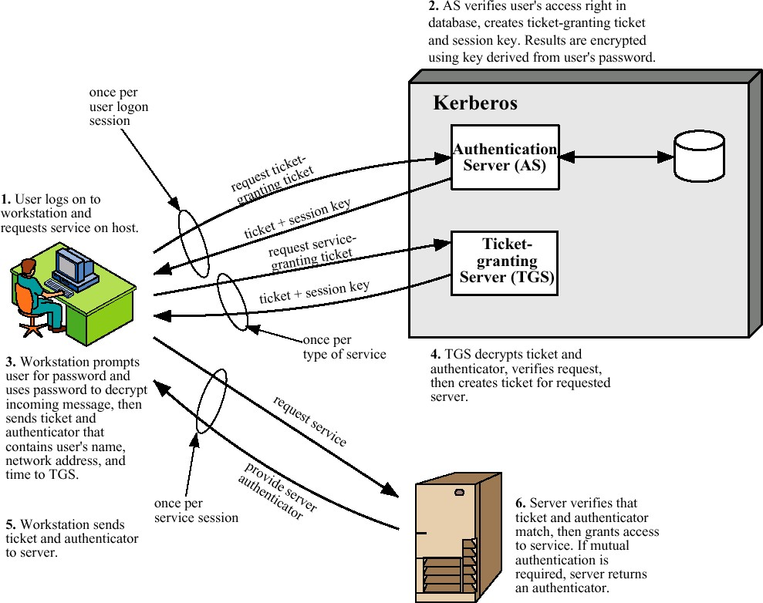
Overview of Kerberos

Slide 15























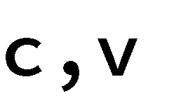
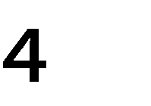








Version 4/5: Authentication dialogue
Authentication Service Exchange: To obtain Ticket-Granting Ticket
(1) → :
(2) → :
Ticket-Granting Service Exchange: To obtain Service-Granting Ticket
(3) →
(4) →
Client/Server Authentication Exchange: To obtain the service
(5) →
(6) →

Slide 16




First step: C to AS
ID_{c} || ID_{tgs} ||TS₁
K_{C}
K_{C}
AS
^{K}TGS
Kerberos authentication server

Slide 17
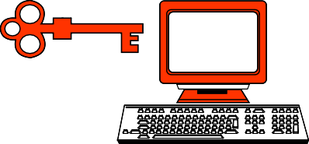




Second step: AS to C
Encrypted with key K_{C}
||ID_{TGS}||TS₂||Lifetime₂|| Ticket_{TGS}
K_{C}
K_{C}
AS
^{K}TGS
||ID_{c} ||AD_{C} || ID_{TGS}||TS₂||Lifetime₂
K _{C,TGS}: random
generated
Ticket for TGS encrypted with key K_{TGS}

Slide 18



Third step: C to TGS
Remember Ticket_{TGS} is:
||ID_{c} ||AD_{C} || ID_{TGS}||TS₂||Lifetime₂
ID_{c} ||ID_{V} || Ticket_{TGS}||Authenticator_{C,TGS}
K_{C}
^{K}TGS
TGS
Ticket granting server (TGS)
K_{V}
^{K} C,TGS
ID_{c} ||AD_{C} || TS₃
Authenticator_{C,TGS} encrypted with key K _{C,TGS}

Slide 19




Fourth step: TGS to C
Encrypted with key K_{C,TGS}
||ID_{V} ||TS₄||Ticket_{V}
K_{C}
^{K}TGS
K_{V}
^{K} C,TGS
TGS
K_{C,V} || ID_{C} || AD_{C} || ID_{V} ||TS₄||Lifetime₄
^{K}C,TGS
^{K}C,V
Encrypted with key K_{V} : Ticket_{V} for computational server

Slide 20


Fifth step: C to V
Remember Ticket_{V} :
K_{C,V} || ID_{C} || AD_{C} || ID_{V} ||TS₄||Lifetime₄
ID_{C} ||Ticket_{V}|| Authenticator_{C,V}
K
C
K_{V}
^{K}C,TGS
V
Computational server
ID_{C} || AD_{C}||TS₅
K
C,V
Authenticator_{C,V} encrypted with key K_{C,V}

Slide 21



Sixth step: V to C
Encrypted with key K_{C,V}
TS₅ + 1
K_{C}
K_{V}
^{K}C,TGS
V
Computational server
^{K}C,V
^{K}C,V

Slide 22
Difference between version 4 and 5
Encryption system dependence (v.4 DES with non standard PCBC, v.5 you can choose the encryption algorithm and use CBC)
Internet protocol dependence (v.4 only IP; v.5 any type)
Message byte ordering (v.4 arbitrary; v.5 defined by ASN1 Standard)
Ticket lifetime (v.4 21 h max; v.5 arbitrary)
Authentication forwarding to other hosts (v.4 no; v.5 yes). Example: A client issues a request to a print server that then accesses the client’s file from a file server, using the client’s credentials for access.
Inter-realm authentication: v.4 N² (!) realm to realm relationships (v5.
simpler)

Slide 23
Kerberos V. 5
Currently we have two Kerberos versions:
: better restricted to a single realm
: allows inter-realm authentication with less overhead than v. 4.
Kerberos v5 is an Internet standard specified in RFC1510, and used by many utilities.
To use Kerberos:
you need a KDC on your network;
you should have “kerberised” applications running on all participating systems.

