Slide 1

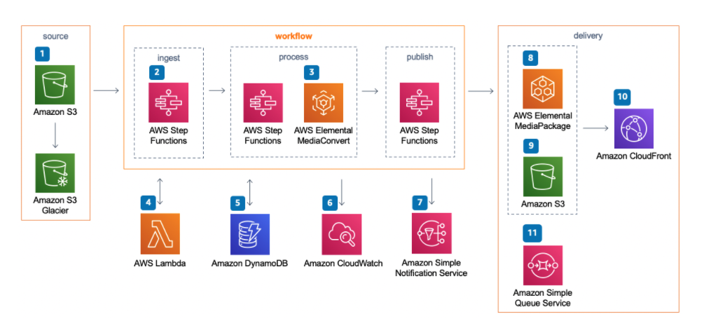
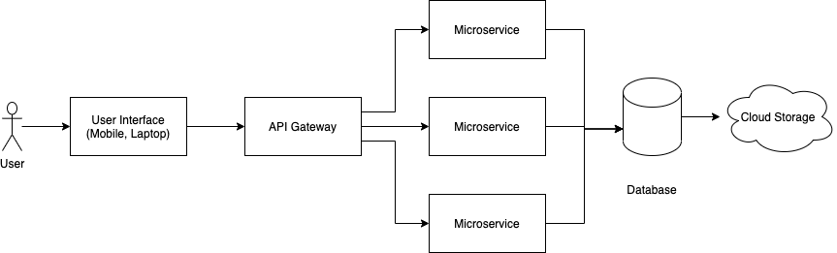

Capstone Project
Learning Management System
by
Team No. XXXX
Manidhar Kodurupaka (E18ECE057 ), Shirisha Nampally (E18CSE166)
Department of computer Science Engineering, Bennett University
Abstract
When API is called, it is first passed to the API gateway. And that gateway decides which microservice to call, where the microservice queries the database and cloud storage for data.
Bhumi LMS is a SAAS product designed for universities and schools to manage the students by providing recorded and live online courses. It also enables instructors to manage their courses and students in delivering the lectures and course work. This is a one stop solution for both offline and online organisations. LMS platform includes many new features which will help in delivering the quality education in a simple and better organised manner.
Introduction
Bhumi iTech is a cyber security-based company where you can find the optimised solutions. This company has the realistic training where it helps the people to find the outcomes of cyber actions and allows the people t to avoid and get away from the cyber-attacks. Here, each individual person or specific team can find safe area where real computers are working to get away from cyber-attacks from any kind of planning. There main Moto is to help cyber security experts to always fight with the cyber-attacks and to clear the shortage of cyber-attacks.
Learning management systems are a very common tool in the instructional designer’s toolkit. So we will be familiar with that before coming into the role it can show the hiring manager that how we can come in and hit the ground running so that we will know more about the system. From the below information we will learn about the LMS duties that we may be expected to perform what exactly and how the platform works. This is probably used from the learner’s perspective common ones and the higher industry are blackboard and canvas LMS where we are going to use talent LMS.
On knowing all the studies of learning management, we decided to built website through which the instructor uploads the lectures and can be viewed by the student. All the video lectures and discussions and if the instructor wants to give some information about the course instructor uploads documents in form of pdf or word document .etc.
Architecture
Conclusion
Proposed Method
We know that Learning management system (LMS) has been used by many of the schools, universities in order to connect with the students in absence of classroom activities. It was built in managing various resources and giving the content where the user gets good interaction with the online software. Since, we found LMS everywhere and it was made mandatory for all the organisations to upload day-to-day lectures and resources where the users that is students gives the feedback. Learning online play’s major role of freedom where we can maintain systematic life in private and professional
LMS is a website designed which contains all the recorded and live lectures which is kind of other online platforms like coursera and Udemy and so on. In this website, we have designed three dashboards which is for admin, Instructor and student. In order to check the day-to-day update of students or the users we are building website which contains attendance management. And for each lecture or according to instructor there will be option for creating the quiz and live proctoring will be there which makes the examination to be fair. In case of any detailed documents, instructor will be uploading the document and that can be downloaded by the student.
References
Ellis, Ryann K. (2009), Field Guide to Learning Management, ASTD Learning Circuits, archived from the original on 24 August 2014, retrieved 5 July 2012
^ Jump up to: ª ^{b} Davis, B., Carmean, C., & Wagner, E. (2009). "The Evolution of the LMS : From Management to Learning". The ELearning Guild Research. 24.
Experimental Results and Discussion
Alpha version of the platform is live for internal testing. Recorded (Video on demand) courses are completely ready. Currently working on Live video lecture. Redesigning the schemas for live lecture. Designing the frontend for live lecture. Testing for scalability issues.
Team No. - X

