Slide 1
A2: Liver Cancer Subgroups
Shirley Wang

Slide 2
Can you identify distinct biological “subtypes” of patients with liver cancer, using The Cancer Genome Atlas (TCGA) transcriptome sequencing data, that have different survival times?
If you are able to identify subtypes of patients then what impact does age at diagnosis, tumor stage, and sex have on the relationship between survival and subgroup?

Slide 3
Data
424 cases of liver cancer from TCGA
60483 gene features
Days_to_death and days_to_last_follow_up as measures of survival
12 without both, removed for survival analysis
Age, Gender, TumorStage (encoded into numbers)
Stage i: 1, stage iiia: 3.25, etc.
24 not reported tumor stage, removed for survival regression

Slide 4
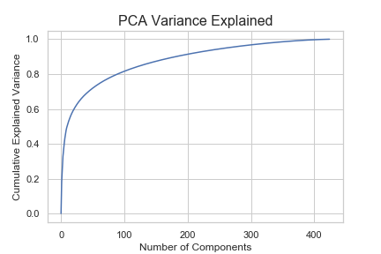
PCA for Dimensionality Reduction
50 components: 71.9%
For clustering
2 components: 25.8%
For graphing

Slide 5
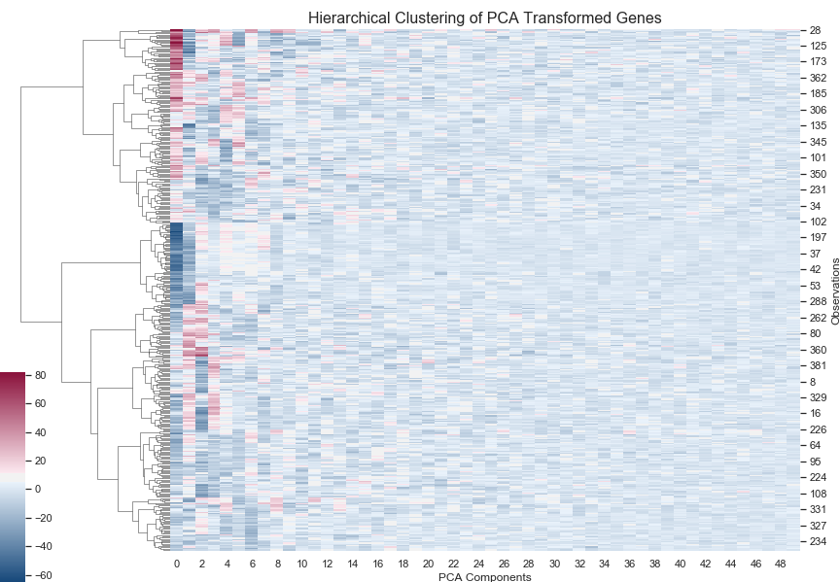

Slide 6
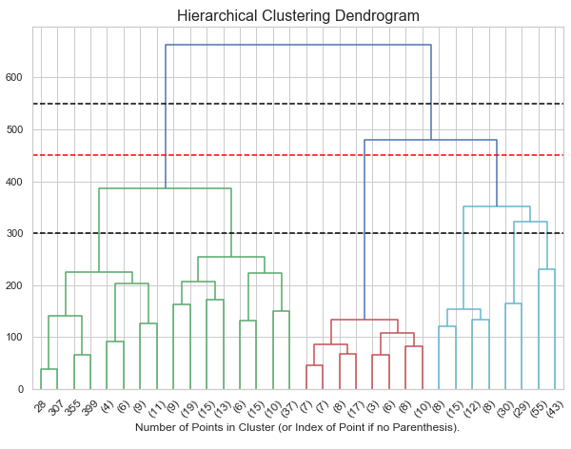
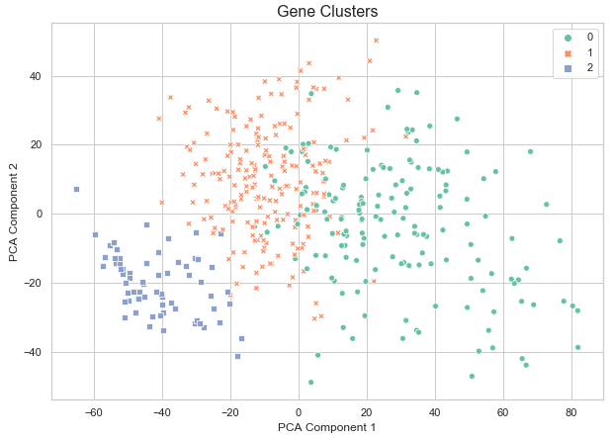
Hierarchical Clustering

Slide 7
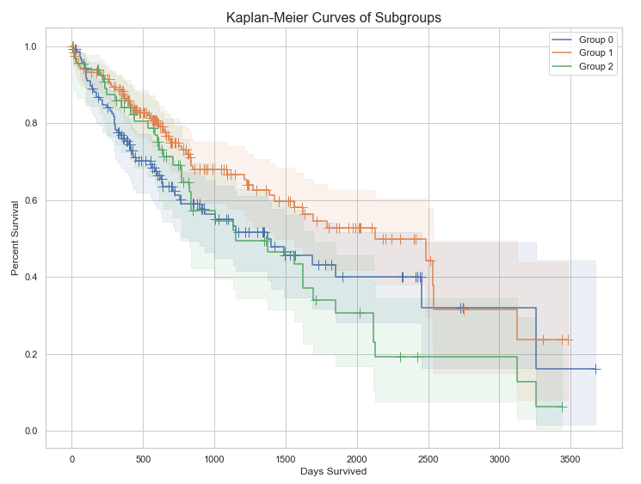
Survival Rates Between Subgroups
Group 0: 143 points
Group 1: 187 points
Group 2: 56 points
Multivariate logrank test p-value: 0.02
Somewhat different survival rates

Slide 8
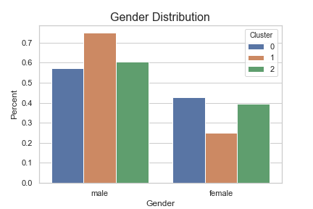
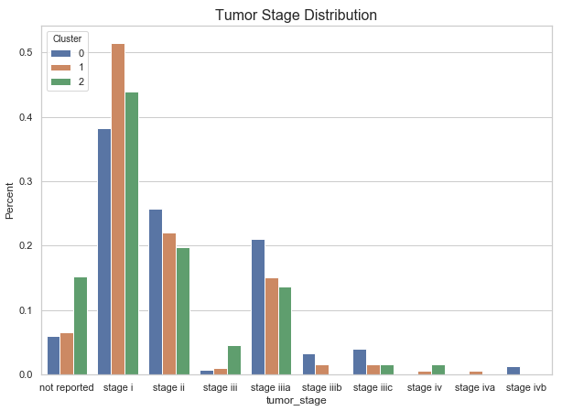
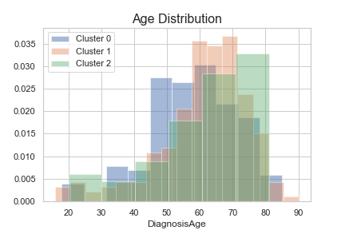
Factors Among Subgroups

Slide 9
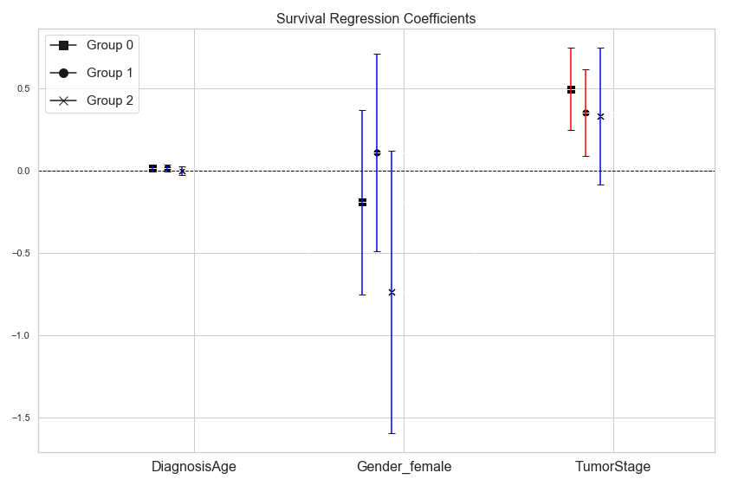

Slide 10
General Issues
Sklearn and clustering inconsistencies (sklearn giving me a bad time)
Choosing clusters based on which one resulted in a significant difference in survival time, not other measures like similarity of points in clusters (silhouette score, etc)
All other number of clusters would not give significant results
Encoding TumorStage as a numerical value instead of dummies due to linear algebra collinearity errors
TumorStage only in Group 1 violates the proportional hazards assumption of the regression with a p-value of 0.462, all others pass
Results of regression not really significant

Slide 11
Thanks For Listening
Questions Now

